Slide 1
Problem Statement: What features drive the price of houses in Ames, Iowa and where are they located?
Michael Xiao

Slide 2
Contents
Modelling and Prediction
Key Features
Conclusion and Recommendation

Slide 3
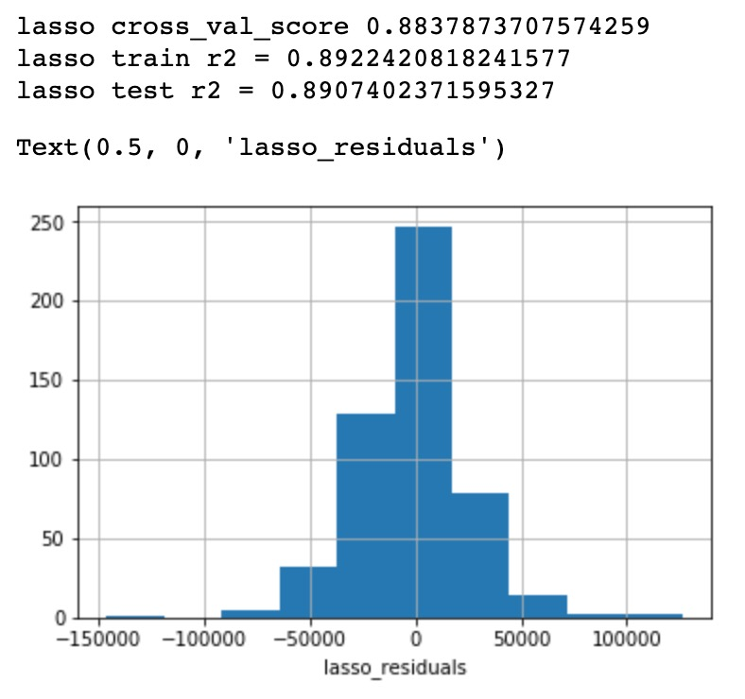
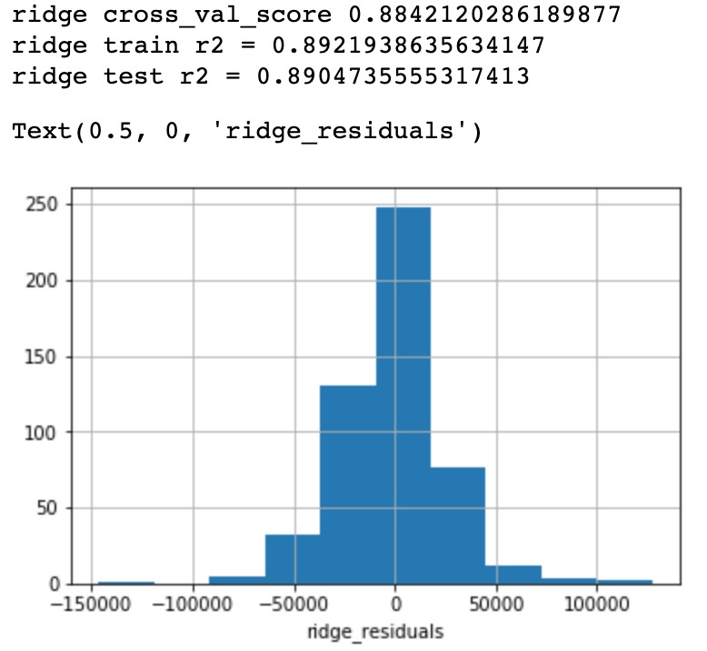
Modelling and Prediction
After comparing with our lasso and ridge model, we decide to use lasso to predict our test set.

Slide 4
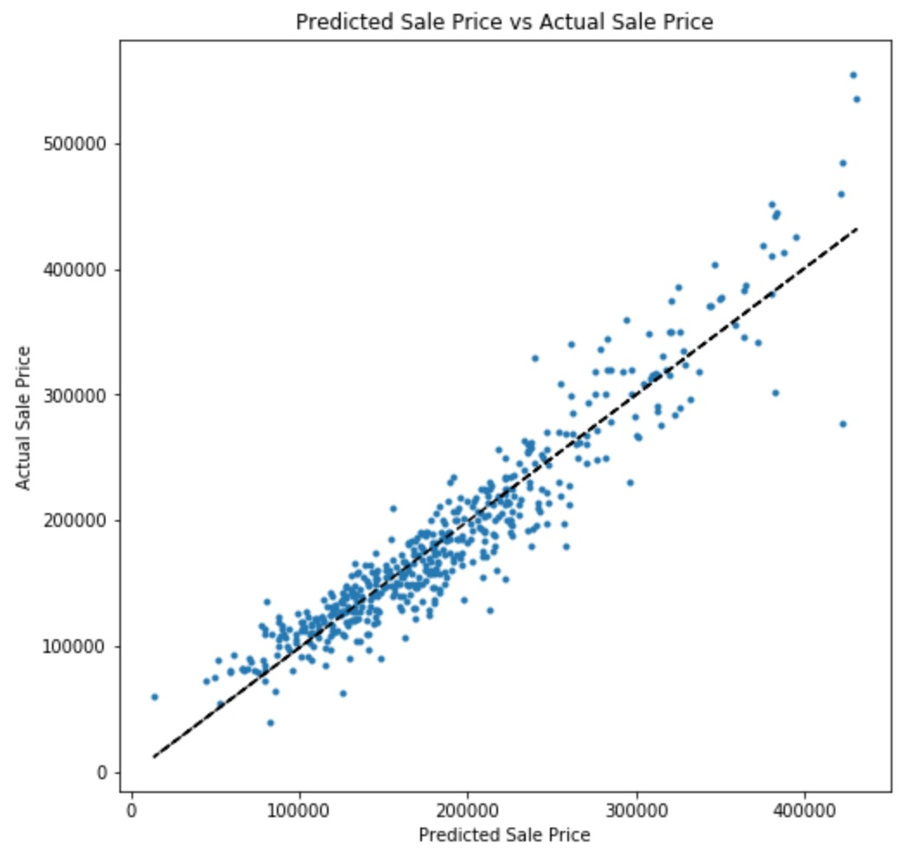
Actual vs. Predicted Sale Price
After predicting our lasso model into the test set, our model fits relatively well to predicting housing sale price

Slide 5
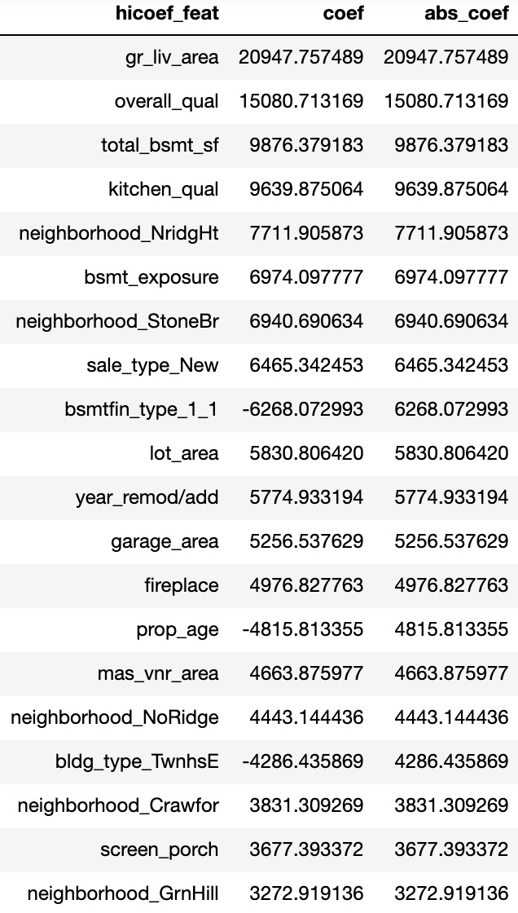
Key Features
These features are key features in our model that explains for 89% (R² = 0.89) of variance in our data

Slide 6
Conclusion and Recommendation
Most Valuable Features: ground living area, overall quality of the house, total basement square feet and kitchen quality.
Least Valuable Features: houses without a basement, townhouse end units, and older property will significantly hurt the value of a home.
Expensive Neighbourhoods: Stone Brook, Northridge Heights, Green Hills, Northridge and Crawford
Fireplaces: The more quality fireplaces a house has, the higher the value, as Ames has an average annual temperature of 49.45°F (9.69°C).

