Slide 1
Angular JS
Yaniv Arad

Slide 2
Angular JS
A Framework ( by Google) for HTML enhanced Web Applications

Slide 3
Angular JS
Modern “Mechanism” for SPA (Single Page Applications) Development.
Simplify Development and Testing by a client side MVC Architecture

Slide 4
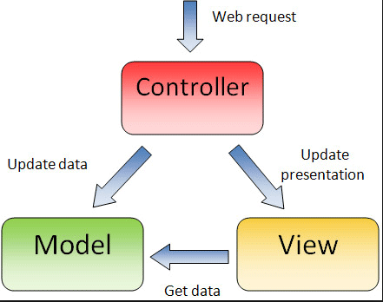
MVC (Model-View-Controller) Pattern

Slide 5
MVC Benefits
Separation of concerns:
The separation the three components, allows the re-use of the
business logic across applications.
Multiple User Interfaces can be developed without concerning the
codebase

Slide 6
MVC Benefits
Developer specialization and focus :
The developers of UI can focus exclusively on the UI screens without
bogged down with business logic.
The developer of Model / business can focus exclusively on the
business logic implementations, modifications without
concerning the look and feel and it has nothing to with business logic.

Slide 7
MVC Benefits
Parallel development by separate teams :
Business logic developers can build the classes, while the UI developers can involve in designing UI screens simultaneously, resulting the interdependency issues and time conservation.
UI updations can be made without slowing down the business logic
process
Business logic rules changes are very less that needs the revision /
updations of the UI.

Slide 8
Angular JS – Lets Begin…

Slide 9
Directives
Markers on a DOM element (such as an attribute, element name, comment or CSS class) that tell AngularJS's HTML compiler ($compile) to attach a specified behavior to that DOM element or even transform the DOM element and its children.
Directives are HTML attributes with an ng prefix.
Examples :
<div ng-controller=“My Controller”>
</div>

Slide 10
Directives : ng-app
The ng-app directive defines an AngularJS application.
The ngApp directive designates the root element of the application and is typically placed near the root element of the page - e.g. on the <body> or <html> tags.
<html ng-app>
<head>
….
….

Slide 11
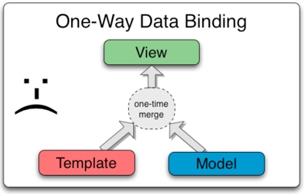
Data Bindings
Data Binding in Classical Template Systems

Slide 12
Data Bindings
Data Binding in Classical Template Systems - restrictions
changes to the model or related sections of the view are NOT automatically reflected in the view
changes that the user makes to the view are not reflected in the model.
the developer has to write code that constantly syncs the view with the model and the model with the view.

Slide 13
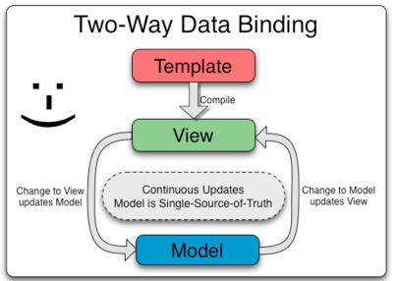
Data Bindings in AngularJS
The view is a projection of the model at all times.
When the model changes, the view reflects the change, and vice versa.

Slide 14
Controllers : ng-controller
AngularJS controllers control the data of AngularJS applications.
AngularJS controllers are regular JavaScript Objects
The ng-controller directive defines the application controller

Slide 15
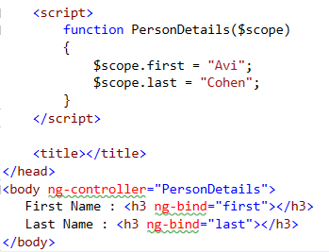
Controllers : The $scope object
In AngularJS, $scope is the application object (the owner of application variables and functions).

Slide 16
Controllers
Use controllers to:
Set up the initial state of the $scope object.
Add behavior to the $scope object.
Do not use controllers to:
Manipulate DOM — Controllers should contain only business logic. Putting any presentation logic into Controllers significantly affects its testability. Angular has databinding for most cases and directives to encapsulate manual DOM manipulation.
Format input — Use angular form controls instead.
Filter output — Use angular filters instead.
Share code or state across controllers — Use angular services instead.
Manage the life-cycle of other components (for example, to create service instances).

Slide 17
Directive: ng-bind
Replace the text content of the specified HTML element with the value of a
given expression, and updates the text content when the value of that
expression changes.
One Way Binding ($scope => View )

Slide 18
ng-bind Alternative : the {{}} Expression
Easy , Elegant but…with a Drawback !

Slide 19
Demo 1

Slide 20
Ex 1

Slide 21
Modules
A container for the different parts of your app – controllers, services, filters, directives, etc.
Angular apps don't have a main method. Instead modules declaratively specify how an application should be bootstrapped.

Slide 22
Modules - Advantages
The declarative process is easier to understand.
You can package code as reusable modules.
The modules can be loaded in any order (or even in parallel) because modules delay execution.
Unit tests only have to load relevant modules, which keeps them fast.
End-to-end tests can use modules to override configuration.

Slide 23
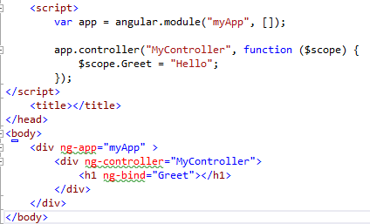
Module – How it works ?

Slide 24
Demo 2

Slide 25
Directive : ng-model
The ngModel directive binds an input,select,
textarea (or custom form control) to a property
on the scope

Slide 26
Demo 3

Slide 27
Ex 2 + 3

Slide 28
JSON - JavaScript Object Notation
-A syntax for storing and exchanging data
-an easier-to-use alternative to XML.

Slide 29
JSON Example

Slide 30
Cloning Data with JSON
$scope.originalData = {};
$scope.CopiedData = angular.copy(originalData);

Slide 31
Ex 7

Slide 32
Demo 6

Slide 33
Directive : ng-repeat
The ngRepeat directive instantiates a template once per item from a collection

Slide 34
Demo 4

Slide 35
Ex 4

Slide 36
Filters
A filter formats the value of an expression for display to the user
Built in Filters
Custom Filters

Slide 37
Filters

Slide 38
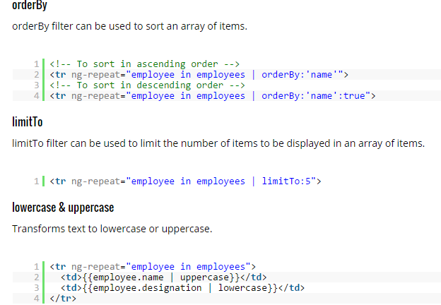
Built in Filters

Slide 39
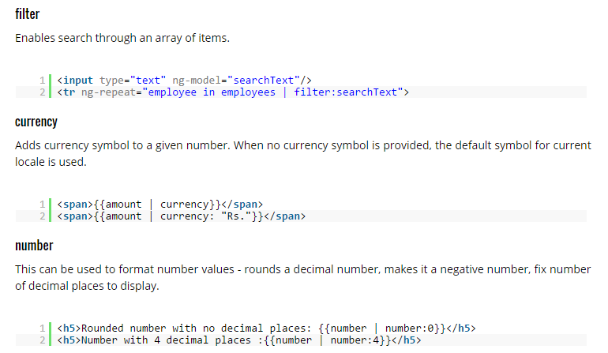
Built in Filters

Slide 40
Demo 5

Slide 41
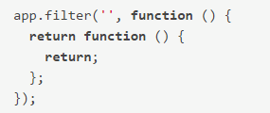
Custom Filters
Build our own custom filters by adding predefined “filter” methods to the Module

Slide 42
Demo 7

Slide 43
Ex 4 + 5 + 6

Slide 44
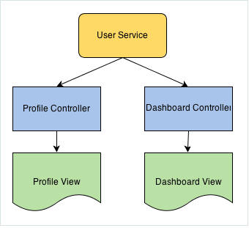
Services
singleton stateless objects or functions that carry out specific tasks

Slide 45
Services
Built in Service ( $http , $window , $q etc…)
Custom Services

Slide 46
Built in Services

Slide 47
$timeout & $interval Services
Executes client side functionality after a given time delay
$timeout – executes ONCE after X time…
$interval– executes EVERY X time…

Slide 48
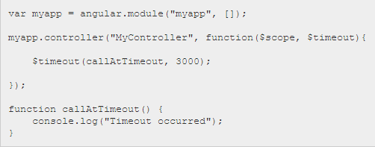
$timeout & $interval Services

Slide 49
Demo 11

Slide 50
Built in Services : The $http Service
facilitates communication with the remote HTTP servers via the browser's XMLHttpRequest object or via JSONP.
In other words : AJAX !

Slide 51
Built in Services : The $http Service
The $http service has several functions you can use to send AJAX requests.

Slide 52
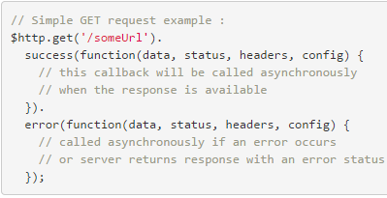
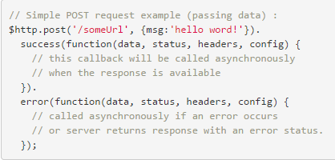
The $http Service – GET & POST

Slide 53
Demo 9

Slide 54
Also….
$q Service
$Window Service
$location Service
…
…
…

Slide 55
Ex 8

Slide 56
Custom Service
Creation of service for your own (reusable ) usage

Slide 57
Demo 10

Slide 58
Ex 9

Slide 59
Forms
Some background…

Slide 60
Forms
An AngularJS form is a collection of input controls
HTML input elements are called HTML controls:
input elements
select elements
button elements
textarea elements
provide validation services

Slide 61
Ng-submit Directive
prevents the default action (which for form means sending the request to the server and reloading the current page), but only if the form does not contain action
Submit by code :
$scope.submit();

Slide 62
Demo 12

Slide 63
Form Validation
A built-in mechanism for validating the form’s data before submitting !
NOT HTML 5 Validation !!!

Slide 64
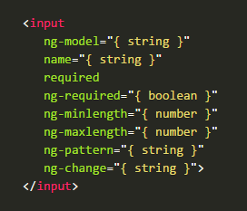
Input attributes

Slide 65
NgPattern Directive
Validates an input’s value by a Regular Expression

Slide 66
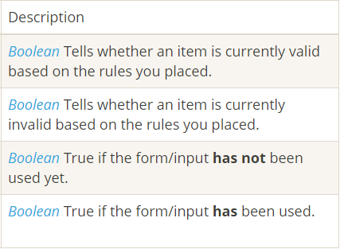
Form validation properties

Slide 67
Demo 13

Slide 68
Some more ng’s
Ng-Required
Ng-disabled
Ng-show

Slide 69
required vs. ng-required
<input …. required /> = <input … ng-required=“true” />
So…. What is the difference ???
ng-required allows set the required attribute depending on a boolean test

Slide 70
Some more ng’s
ng-disabled – Enabled\Disabled depends on…
ng-show – Visible\Hidden depends on

Slide 71
Demo 14

Slide 72
Errors Specifications
Angular provides indication of the particular invalidation cause

Slide 73
Demo 19

Slide 74
Ex 11

Slide 75
Form vs. ngForm
(Regular) Forms – can NOT be nested
ng-forms – CAN be nested !!
With ng-forms – forms can be build dynamically !!

Slide 76
Form Styling Classes
Angular already provides classes on our inputs and our forms based on if they are valid or not
Classes names :
ng-valid, ng-invalid, ng-pristine and ng-dirty

Slide 77
Ex 12

Slide 78
Form Styling Classes
Angular already provides classes on our inputs and our forms based on if they are valid or not
Classes names :
ng-valid, ng-invalid, ng-pristine and ng-dirty

Slide 79
Demo 15

Slide 80
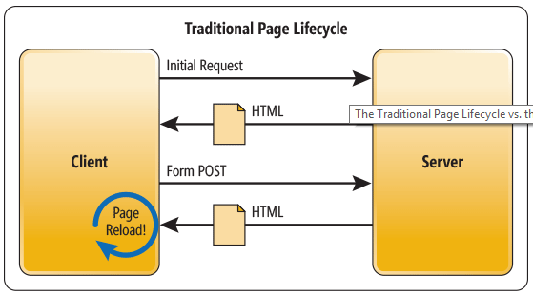
Traditional Web Applications

Slide 81
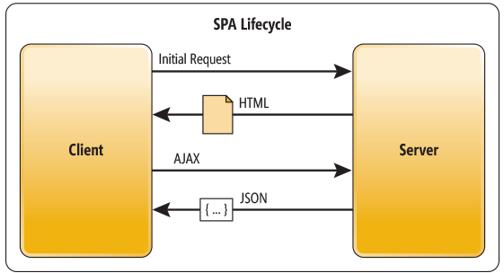
SPA Applications

Slide 82
SPA Benefits
- Applications are more fluid and responsive
(Sending the app data as JSON ) Creates a separation between the
presentation (HTML markup) and application logic
- “Mobile alike” User Experience

Slide 83
SPA with Routing
1 Application…
1 Page…
Multiple Views !
Layout Template – A template that is common to ALL views

Slide 84
SPA Key Elements
angular-route.min.js - Angular Routing Library
ngRoute – Routing Module Injection
$routeProvider - $Route Service provider
ng-view – Views Place holder Directive

Slide 85
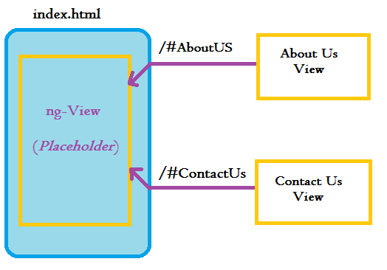
SPA with Routing

Slide 86
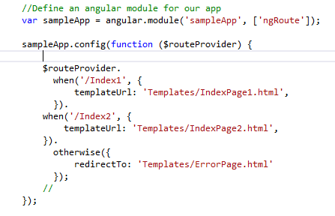
SPA Routing
Registers “Routers” with .config & $Route Service

Slide 87
Demo 16 ( No Controllers)

Slide 88
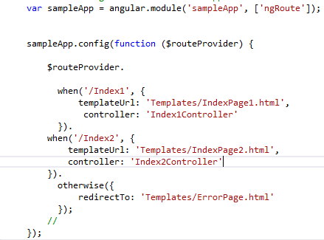
SPA Routing Controllers

Slide 89
Demo 16 ( With Controllers)

Slide 90
Ex 13

Slide 91
Routing with Parameters
Pass Parameters :

Slide 92
Routing with Parameters
Retrieve Parameters - With $routeParams Service

Slide 93
Demo 17

Slide 94
Ex 14

Slide 95
Custom Directives
AngularJS enables us to create new directives that we can encapsulate and simplify DOM manipulation.
We can create directives that modify or even create totally new behavior in HTML

Slide 96
Custom Directives

Slide 97
Restrict Options
The restrict option is used to specify how a directive can be invoked on the page.
A (Attribute) - <div my-directive></div>
E (Element) - <my-directive> </my-directive>
C (Class ) <span class=“my-directive></span>
M (Comment) <!– directive : my-directive -->
Can ne a combination : restrict : ‘AE’

Slide 98
Demo 20

Slide 99
Animation
Animating – Changing attribute(s) value during time interval
Support CSS 3
Key Elements :
- angular-animate.min.js Library
- ngAnimate Module

Slide 100
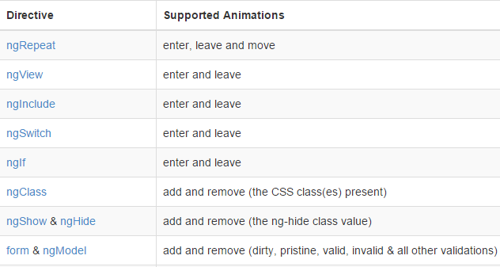
Animations

Slide 101
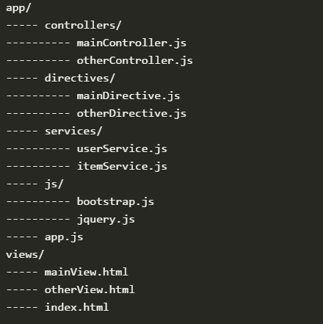
Best Practices – Directory Structure – small Apps

Slide 102
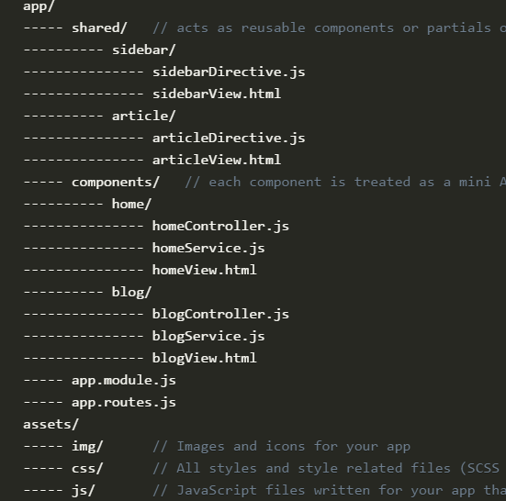
Best Practices – Directory Structure – Big Apps

Slide 103
Best Practices – Extension of HTML
DON’T manipulate DOM within controllers !!!
( It Breaks “separate of concerns” )
Create CUSTOM Directives if needed

Slide 104
Best Practices – Scope
must be write-only in the controllers
must be read-only in the templates
- do not create properties in the scope but object!

Slide 105
Best Practices – Named vs Anonymous Functions
Use named functions instead of passing an anonymous function
in as a callback.
More readable
-Easy to Debug
reduces the amount of nested callback code.

Slide 106
Best Practices – Defer Controller Logic to Services
Logic may be reused by multiple controllers when placed within a service and exposed via a function.
Logic in a service can more easily be isolated in a unit test, while the calling logic in the controller can be easily mocked.
- Removes dependencies and hides implementation details from the controller.

