Slide 1
Tracking Indexes
vs. Financials
An ETF Correlation, Risk & Portfolio Strategy Analysis
Michael Zeghibe & Connor Correnti
CSC 485 — Data Science Capstone

Slide 2
Research Question
"How do correlations between popular ETFs — VOO, QQQ, ARKK, and MAGS — shift over time, and what does this mean for portfolio diversification?"
Why It Matters
Our Approach
Policy Relevance
Static correlation snapshots miss regime shifts — correlations spike during crises, eroding diversification when it's needed most.
Time-varying analysis across 1Y, 2Y, and 3Y rolling windows using monthly log returns, Bayesian updating, and Monte Carlo portfolio simulation.
Help retail investors understand when their 'diversified' ETF portfolio actually behaves like a single concentrated bet.

Slide 3
Data Overview & Provenance
ETF | Tracks | Style | Inception
VOO | S&P 500 | Broad Market / Passive | 2010
QQQ | Nasdaq-100 | Tech-Heavy / Passive | 1999
ARKK | Disruptive Innovation | Thematic / Active | 2014
MAGS | Magnificent 7 Stocks | Concentrated / Passive | 2023
Data Sources & Processing
Tools & Libraries
Price history scraped from online financial sources as Excel files. VIX loaded as a volatility reference. All prices aligned to common overlapping dates, converted to monthly end-of-month observations, and transformed to log returns.
R (primary): readxl, dplyr, tidyr, zoo, ggplot2, lubridate, gridExtra, reshape2
Python (portfolio sim): pandas, numpy, matplotlib
Visualization: Power BI (.pbix dashboard)

Slide 4
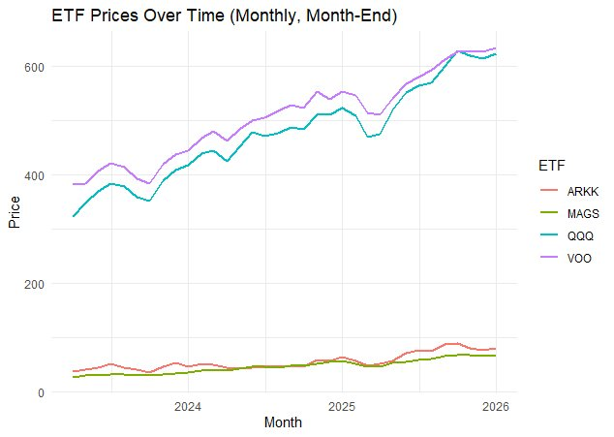
ETF Price Trends
Observations
VOO and QQQ trade at similar price levels ($400–$650), showing steady upward trends.
ARKK and MAGS trade at much lower absolute prices ($30–$80), reflecting their different fund structures.
The overlapping period (2023–2026) captures the post-pandemic recovery and AI-driven rally.
QQQ overtook VOO in price during the 2025 tech surge.

Slide 5
Exploratory Analysis & Risk Metrics
Metric | VOO | QQQ | ARKK | MAGS
Ann. Volatility | ~15% | ~20% | ~40% | ~25%
Sharpe Ratio (rf=4%) | ~0.65 | ~0.75 | ~-0.10 | ~0.90
Beta vs. VOO | 1.00 | ~1.20 | ~1.60 | ~1.30
Mean Monthly Log Ret | +0.01 | +0.013 | -0.005 | +0.02
~40%
1.60
~0.90
ARKK Ann. Volatility
ARKK Beta vs. VOO
MAGS Sharpe Ratio
Over 2x the volatility of VOO — highest risk in the group
Amplifies market moves by 60%, extreme in downturns
Best risk-adjusted returns despite concentrated holdings

Slide 6
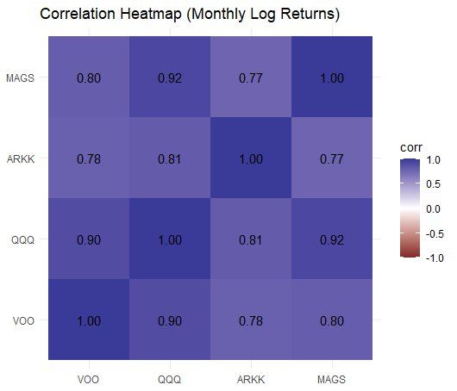
Static Correlation Analysis
Key Insights
QQQ–MAGS: 0.92
Move nearly in lockstep — holding both provides almost zero diversification.
VOO–QQQ: 0.90
High overlap due to mega-cap tech dominating both indexes.
ARKK–VOO: 0.78
Lowest correlation — ARKK offers the most decorrelation, but at extreme volatility cost.
ARKK–MAGS: 0.77
Active vs. concentrated passive strategies diverge more than expected.

Slide 7
Time-Varying Rolling Correlations
VOO Correlations
ARKK Correlations
VOO-QQQ stays tightly correlated (~0.9+). VOO-VIX is persistently negative — VIX hedges broad market risk effectively.
ARKK decorrelates sharply during the 2020 rally and 2022 crash. 1Y window shows ARKK-VOO correlation dropping below 0.5 — a regime shift.
QQQ Correlations
MAGS Correlations
QQQ maintains very high correlations with MAGS (0.90+) and VOO (0.85+) across all windows. Limited benefit from holding both.
Shorter history limits 3Y windows. Strong co-movement with QQQ and VOO. MAGS-VIX shows expected negative correlation.
Rolling window approach: 12-month (1Y), 24-month (2Y), 36-month (3Y) windows on monthly log returns using zoo::rollapply in R.

Slide 8
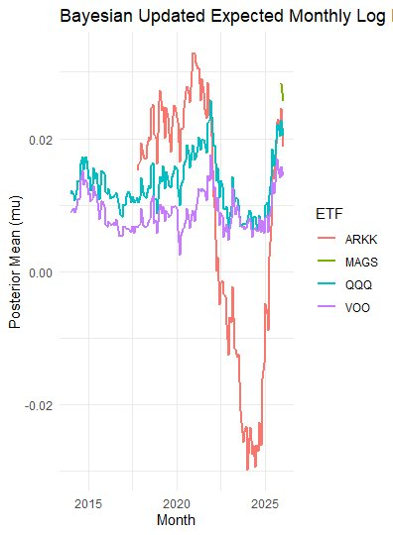
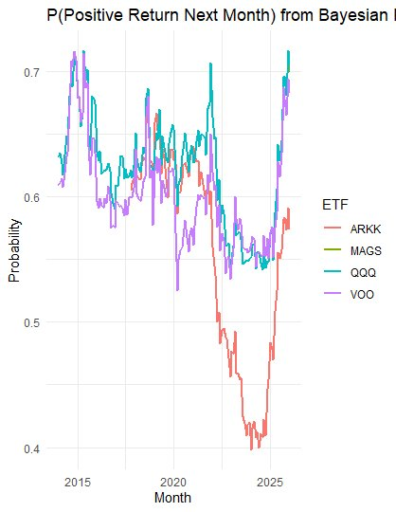
Bayesian Updating Framework
Bayesian Updated Expected Monthly Log Return
P(Positive Return Next Month) from Bayesian Model
ARKK's posterior mean plummeted to -0.03 during the 2022 drawdown, while VOO and QQQ remained positive. The Bayesian model adapts allocation weights in real-time as new return data arrives.

Slide 9
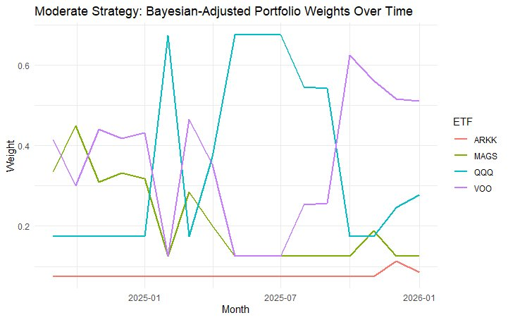

Bayesian Portfolio Adjustment
Exit & Trading Rules
Growth and exit rules compared across ETFs. VOO shows 5.38x growth; QQQ leads at 11.1x.
QQQ prob-rule growth: 7.19x over 131/145 months invested — the Bayesian signal avoided 14 months of drawdowns.
Growth Factor Output
Moderate Strategy: Bayesian-Adjusted Weights Over Time

Slide 10
Portfolio Allocation Strategies
Aggressive
Moderate
Conservative
ARKK 25% | MAGS 30%
QQQ 35% | VOO 10%
ARKK 15% | MAGS 25%
QQQ 35% | VOO 25%
ARKK 5% | MAGS 15%
QQQ 30% | VOO 50%
Maximizes growth exposure through innovation & mega-tech. High volatility tolerance required. Best during bull markets.
Balanced blend of growth and stability. QQQ as core tech exposure with meaningful VOO anchor. Suitable for most investors.
VOO-dominant for broad market safety. Minimal ARKK limits downside drag. Steady growth with lower drawdowns.
Monte Carlo Efficient Frontier: 10,000 random portfolios simulated using annualized mean returns and covariance matrix. Sharpe ratios calculated with 4% risk-free rate. Results validated that VOO-heavy allocations dominate the efficient frontier for risk-averse investors.

Slide 11
Key Findings
01
Diversification Is Time-Dependent
Correlations between QQQ, VOO, and MAGS surge during market stress. The 2020 and 2022 crises saw correlations spike above 0.95 — portfolios that looked diversified moved as one.
02
ARKK Is the Wild Card
ARKK offers genuine decorrelation but at extreme cost — 40%+ annualized volatility and a negative Sharpe ratio. Useful only in small allocations for aggressive investors.
03
QQQ and MAGS Are Nearly Identical
With a 0.95 correlation, holding both QQQ and MAGS is effectively doubling down on mega-cap tech. Investors should choose one, not both.
04
Bayesian Updating Adds Value
The Bayesian framework successfully identified regime shifts — flagging ARKK's deterioration months before the 2022 drawdown, enabling proactive weight adjustments.

Slide 12
Limitations & Future Work
Limitations
Future Directions
Short MAGS history
Only launched 2023 — limits long-term backtesting.
No transaction costs modeled
Real-world costs would reduce returns.
Static strategy weights
Fixed weights rather than dynamic rebalancing.
Survivorship & selection bias
ETFs chosen ex-post based on current popularity.
Market regime identification
Apply Hidden Markov Models to detect regimes.
Dynamic Bayesian rebalancing
Automate weight updates from posteriors.
Expand asset universe
Include bonds (BND), international (VXUS), commodities (GLD).
Real event mapping
Overlay Fed decisions and macro events on charts.

Slide 13
Conclusion
Correlations between popular tech-oriented ETFs are not constant — they shift across market regimes, often converging during the exact moments investors need diversification the most. A time-varying, Bayesian approach to portfolio construction provides a more realistic and adaptive framework than static allocation models.
4 ETFs
3 Strategies
10K Portfolios
10+ Years
Analyzed
Backtested
Simulated
Of Data
Michael Zeghibe & Connor Correnti | CSC 485 Data Science Capstone | Providence College

