Slide 1
Hungry spoon
Hengyu Guo
Jie chen
Michael dong
Minglu Liu

Slide 2
introduction
Deployment: Amazon EC2
AOP
MVC
ORM
Transactions

Slide 3
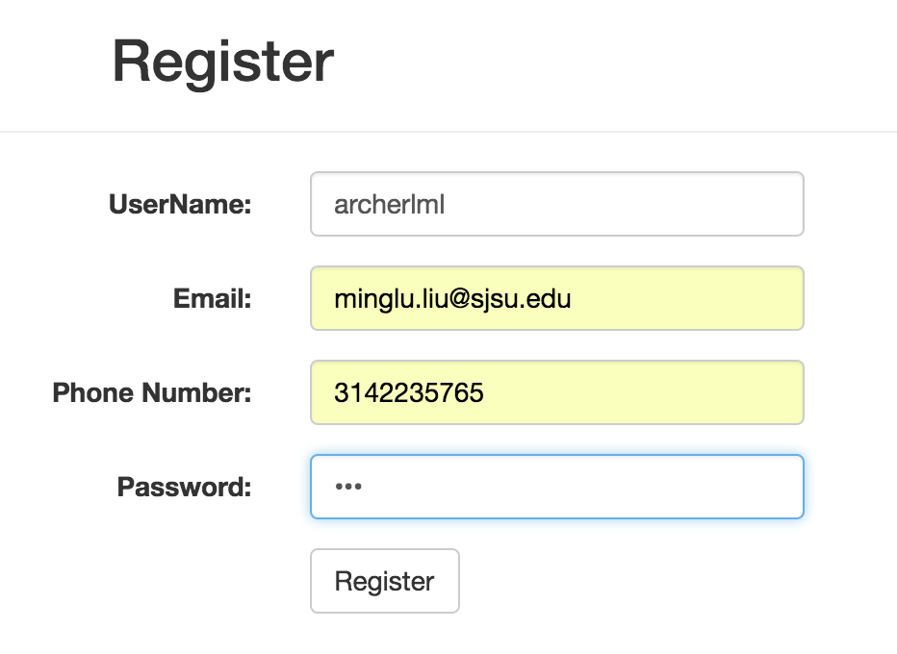
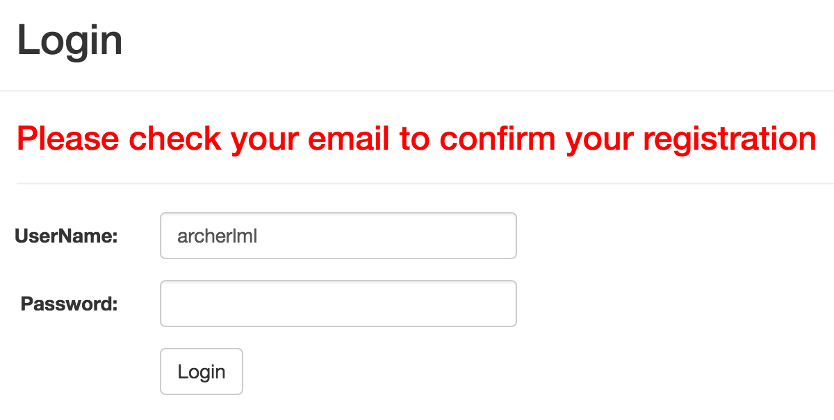
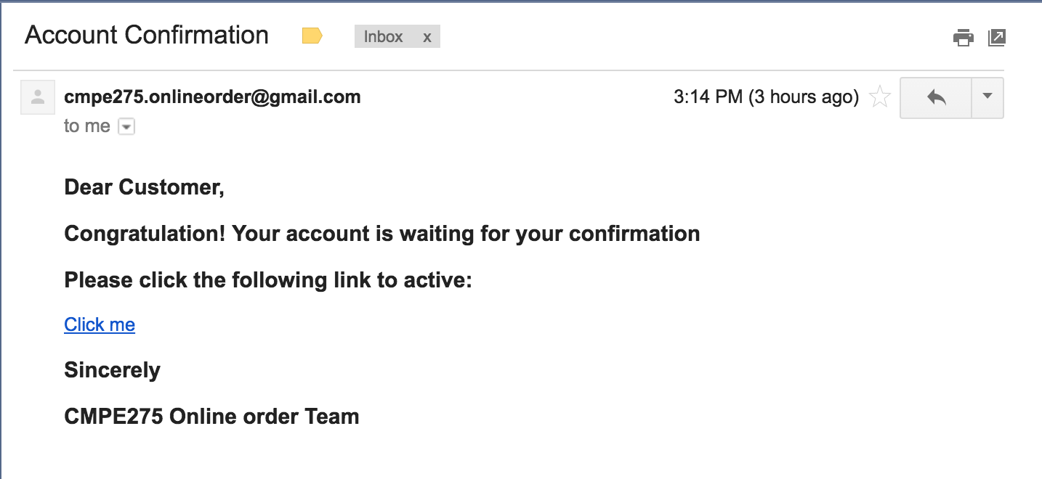
Major feature I User registration Email confirmation

Slide 4
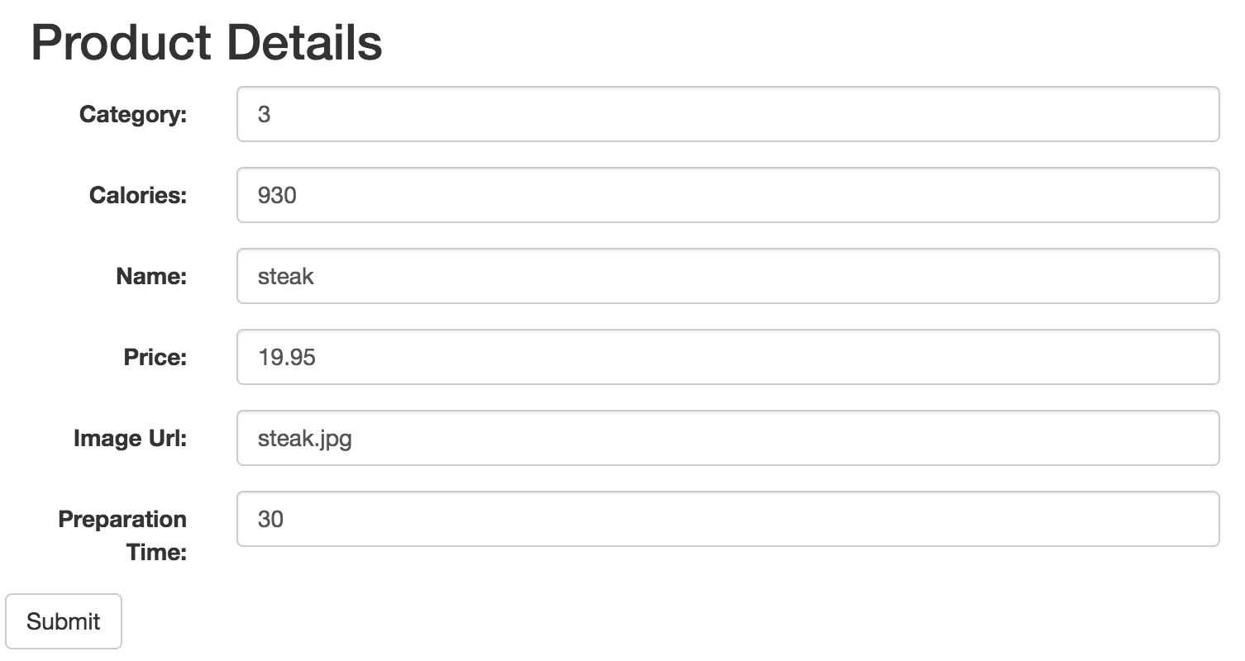
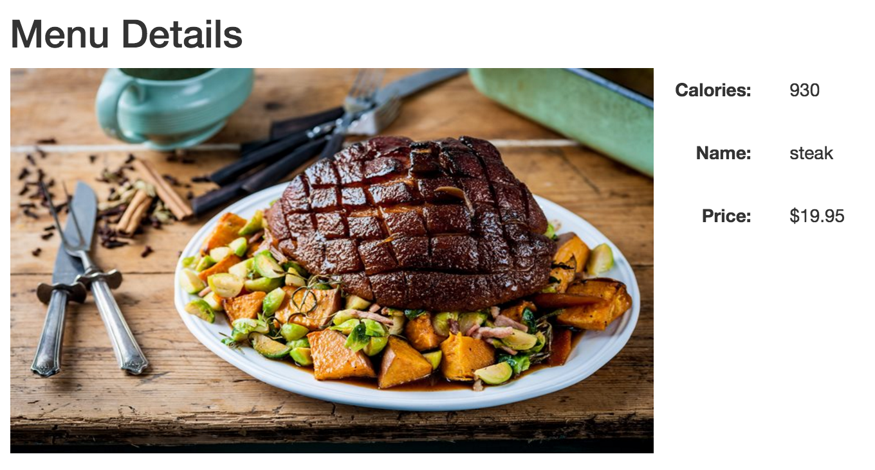
Major Feature II Menu Provisioning

Slide 5
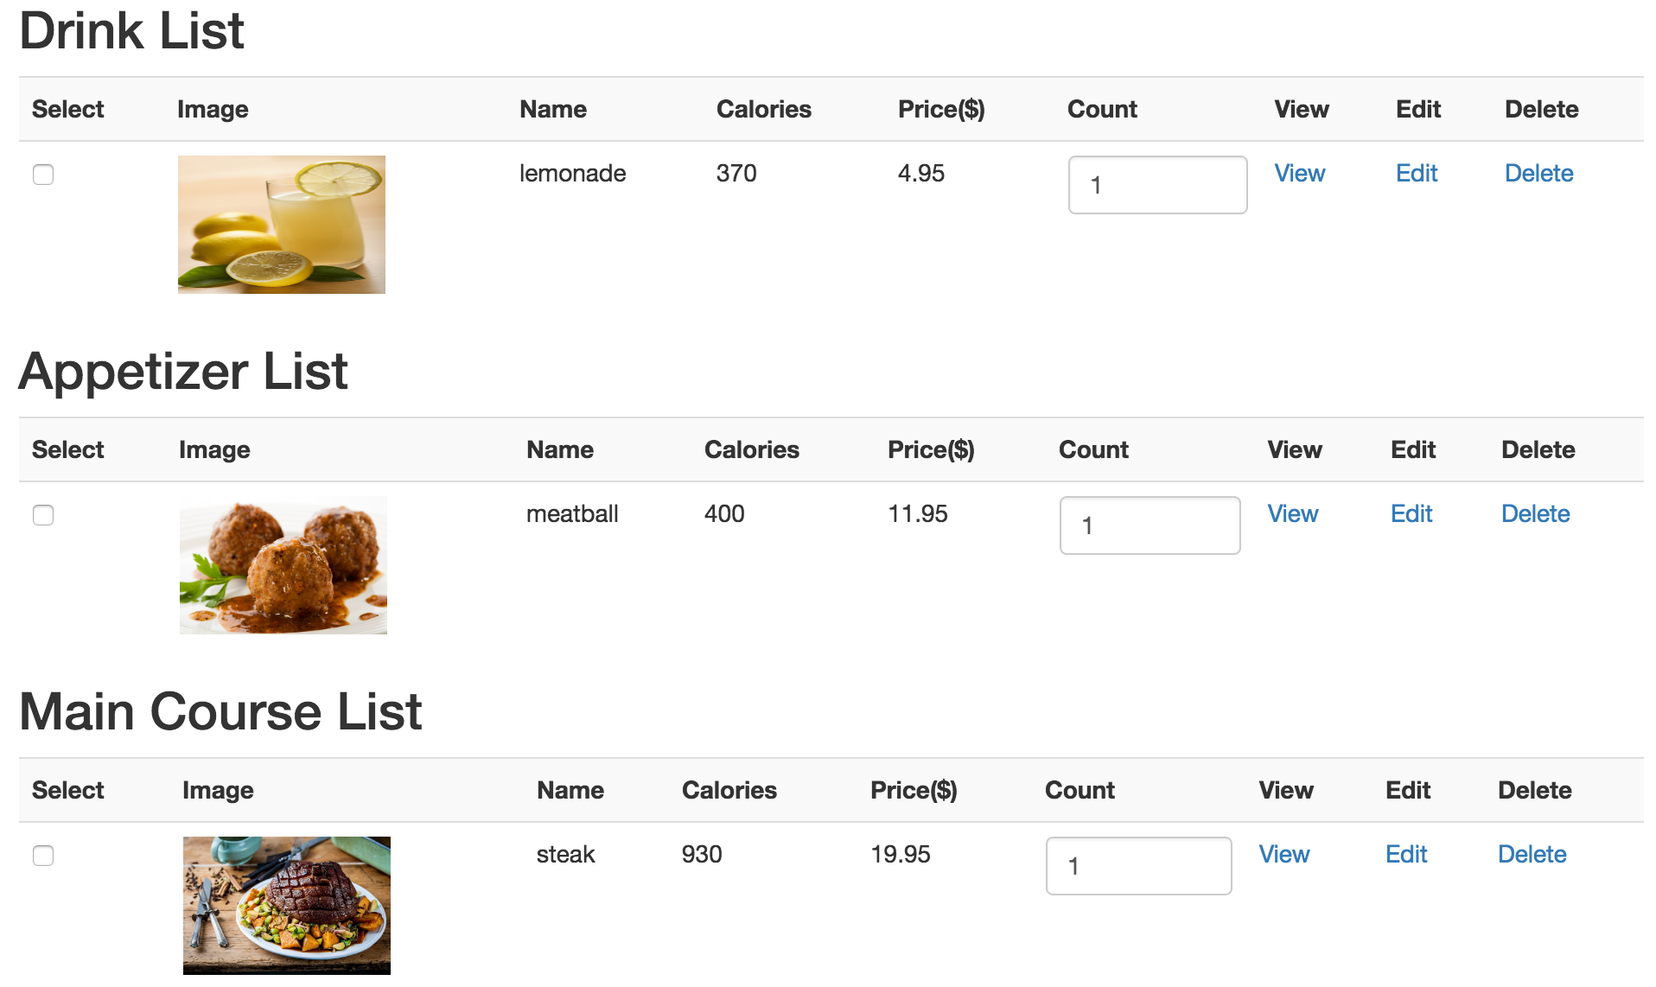
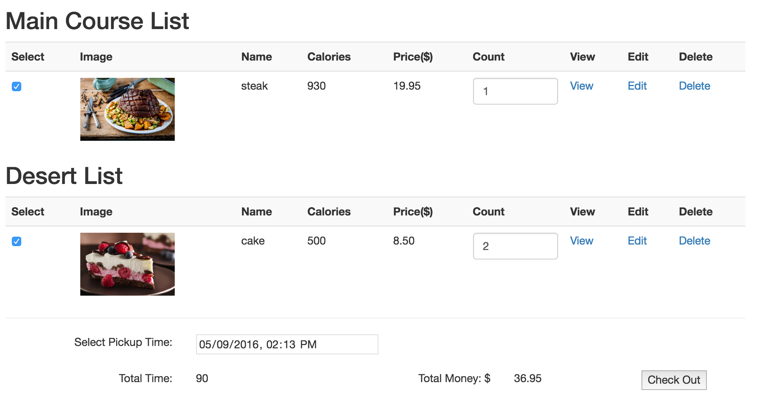
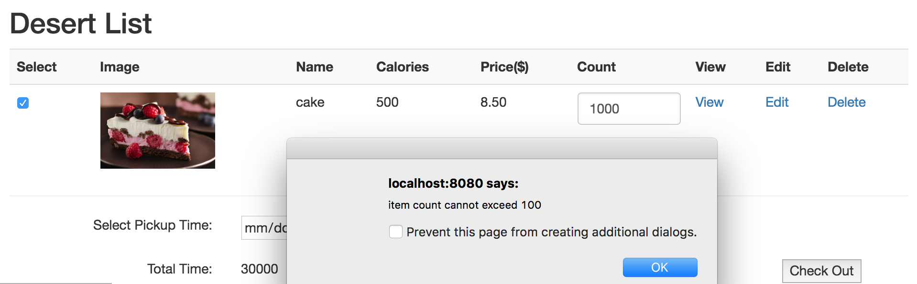
Major feature III Order food
Checkbox to select food
Add count by clicking or type
Select pickup time
Show total dynamically

Slide 6
High level design

