Slide 1
Shellshock: The Devastating Injection Hole In Linux Bash
Zhenghong Dong
12-5-2014

Slide 2
Outline
What is it?
How severe is it?
Why is it so serious?
How could it happen?
What programs/services are targeted?
How to exploit?
How to fix?

Slide 3
What is it?
A family of bugs in Bash:
CVE-2014-6271
CVE-2014-6277
CVE-2014-6278
CVE-2014-7169
CVE-2014-7186
CVE-2014-7187
Disclosed on Sept 24,2014
It has been in existence for 22 years
allowing an attacker to execute arbitrary commands remotely

Slide 4

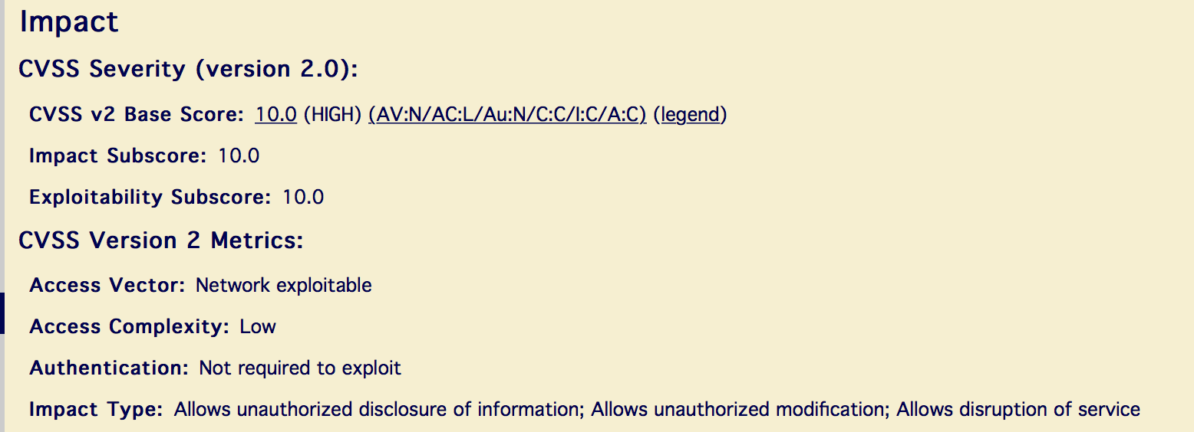
How severe is it? (1)

Slide 5
How severe is it? (2)
Striking Attack Reports:
Incapsula, in 4 days:
Attack attempts: 217,089
Affected domains: 4,115
Dell SecureWorks, in 6 days:
Scans repelled: 140,000
Cloufare, in 7 days:
Attacks blocked: 1,100,000

Slide 6
Why is it so serious? (1)
Widespread existence;
Easiness of exploitation through network;
High impact on the entire security triad.

Slide 7
Why is it so serious? (2)
Widely existed in: Bash (version 1.14 to4.3, almost full-cover
Linux, Unix
Market share in Web servers as high as:67.1%(W3Techs),71%(Netcraft),82%(Security Space) as for 2014
Mac OS X series
Desktop market share: 7.05%(Net Applications) as for 2014
Windows with Cygwin and similar products
Jail-broken iOS
Customized Android
Most routers
Linux embeded devices

Slide 8
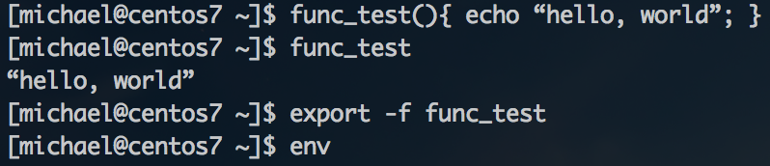
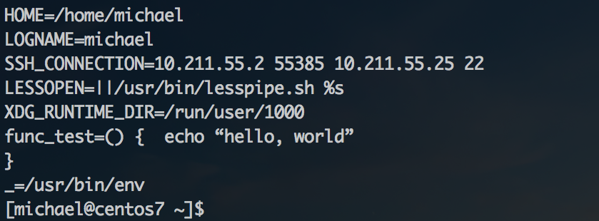

How could it happen?
In Bash,one can define a local variale or function and “export” it
as environmental variable
“env” command can show and set environmental variables
To normally add an environmental function variable:

Slide 9
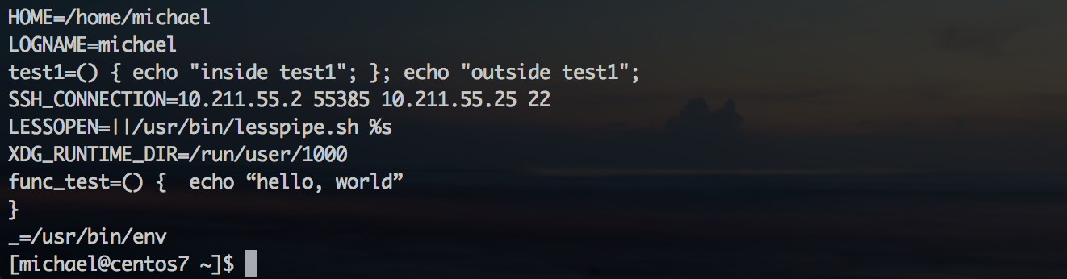
How could it happen?
Add an abnormal environmental function variable:

Slide 10
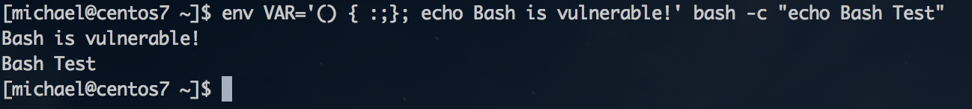
How could it happen?
The classical test command for CVE-2014-6271:
Two requirements for exploitation:
1: Accept environmental variables from remote side
2: Subshell spawn

Slide 11

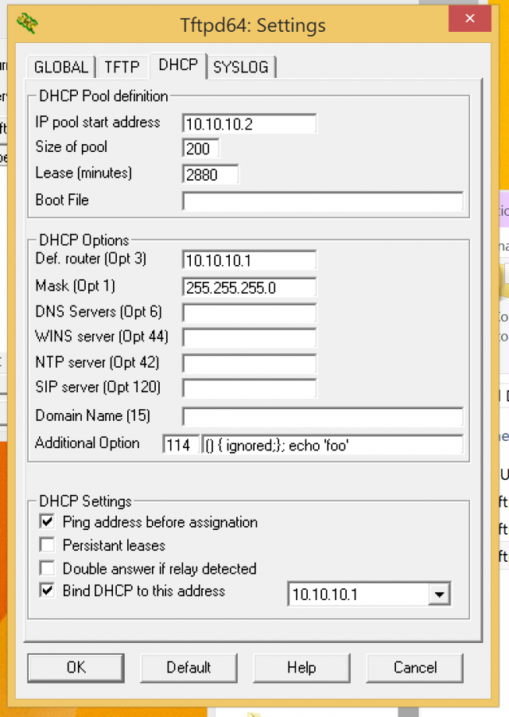
What programs/services are targeted?
Exploiting HTTP_USER_AGENT environment variables.
Exploiting OpenSSH server keys:
Exploiting DHCP server option variables

Slide 12
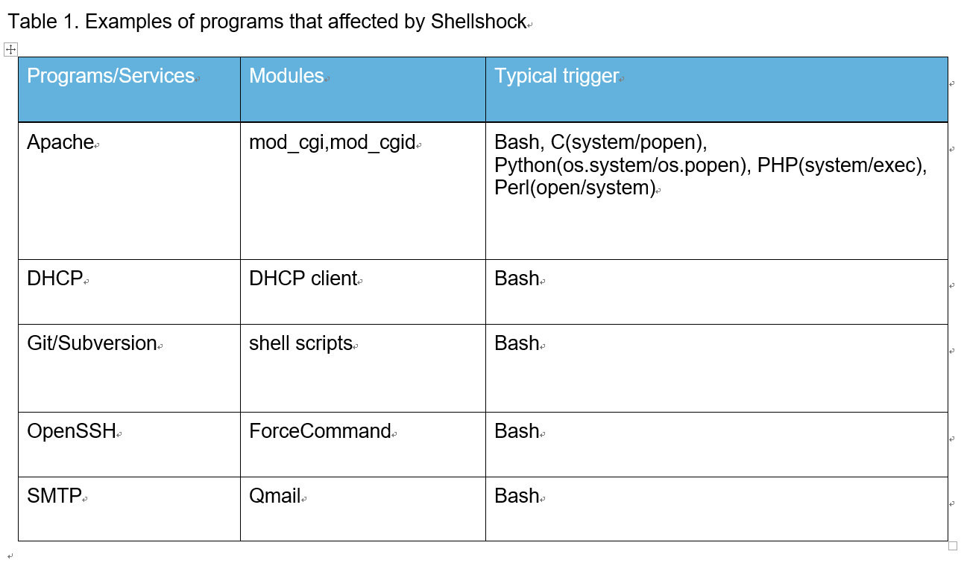
What programs/services are targeted?

Slide 13
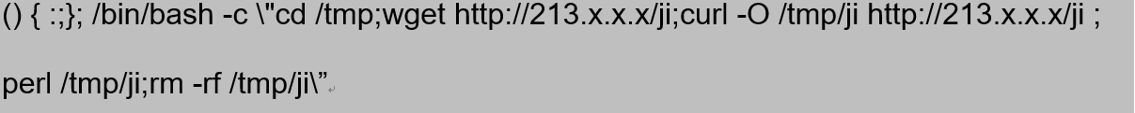
How to exploit?
Retrieving confidential information:
Reconnaissance:
Denial of Service:
Taking control of target servers:

Slide 14
How to fix?
Update Bash to latest version;
Switch to Shellshock invulnerable tsh, dash;
Install patches;
Add rules in firewalls and IDS/IPS.

Slide 15
Thanks for your time and attention!

