Slide 1
Cloud Computing Overview
Michael Zhou November 30th 2015

Slide 2
Self Introduction
Expertise: system, network and applications
Professional Experience
2013 – Present, Senior Principal Engineer @ Sensus
Hadoop-based platform management
2012 – 2013, Principal Engineer @ Extreme Networks
OpenStack
2000 – 2012, Senior Software Engineer @ Cisco
IPv6 Firewall
Unified Communication
Network Management
Education
1999, Master of Science, Massachusetts Institute of Technology
1997, Master of Engineering, Jilin University
1994, Bachelor of Science, Tsinghua University
LinkedIn Profile https://www.linkedin.com/in/michaelzhou
Notes:
Received double majors in Hydraulic Engineering and Computer Engineering from Tsinghua in 1994.
Got Master’s degree at Jilin University in 1997, majoring in Artificial Neural Networks.
Originally planning to obtain a PhD in Civil Engineering, I quit with a Master from MIT in 1999, quickly joined IT workforce and fortunately witnessed the heydays of Internet (and the ensuing bubble burst ☺).

Slide 3
Agenda
Topics
Examples of cloud computing
Milestones in cloud computing history
Key enabling technologies
Definitions and characteristics of cloud computing
Layered cloud service models
Cloud service types
Challenges and opportunities
Cloud computing trends as of this writing
Revolved around a hypothetical social application

Slide 4
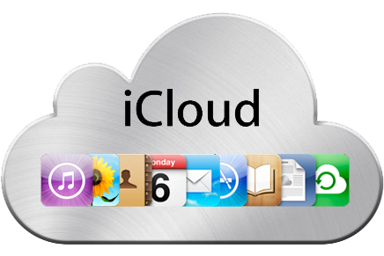
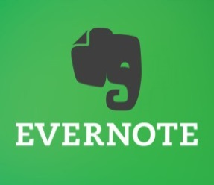

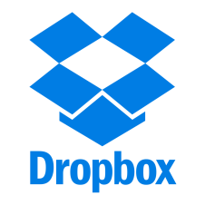

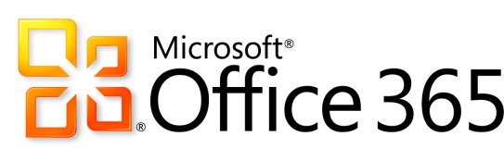









Examples of Cloud Computing
Notes:
Surveys show that 70% of American adults have used at least one cloud-based service. We now live in a “cloudy” world (sorry for the pun), constantly accessing some sorts of cloud services everyday for our communication, socializing, entertainment, or business needs.

Slide 5
Milestones in Cloud Computing
2006
Term “Cloud Computing” first used by Google CEO Eric Schmidt at SES
Amazon Web Services (AWS) EC2 and S3 launched
2006
2009
Google Apps released, first web 2.0 consumer service with much improved user experience
Salesforce.com
launched, first major web-based enterprise service
1999
OpenStack released, the open source platform
2010
Notes:
The launch of Salesforce.com and in particular, Google Apps (built with AJAX), demonstrated that cloud computing is capable of bringing near-desktop response and low latency to the web-based applications. They paved the way for many other kills apps.

Slide 6
Definitions by NIST
“ Cloud computing is a model for enabling convenient, on-demand network access to a shared pool of configurable computing resources (e.g., networks, servers, storage, applications, and services) that can be rapidly provisioned and released with minimal management effort or service provider interaction. ”
By National Institute of Standards and Technologies
Source: http://www.nist.gov/itl/cloud/

Slide 7
Characteristics of Cloud Computing
On-demand self-service
Broad network access
Resource pooling
Rapid elasticity
Measured service
Notes:
On-demand self-service: bring up or tear down virtual machines anytime as needed on control panel
Broad network access: access control panel and virtual resources (VM, storage) via network
Resource pooling: end users share hardware resources, whether it is network, compute or storage.
Rapid elasticity: add more resources to your services in a matter of minutes instead of days or weeks
Measured service: pay per use

Slide 8
Key Enabling Technologies
Software
* Virtualization
* Web services
Networking
* Fast WAN
* Network virtualization
* Security
* VPN
Hardware
* Inexpensive yet powerful commodity server computers
* SMP, Multicore processors
Notes:
The three most important contributing factors for the cloud computing popularity (IMHO) are software virtualization, inexpensive yet powerful commodity hardware, fast wide-area network (WAN). Without any of them, the idea of cloud computing probably would never fly.
Many technologies in cloud computing actually have been in existence for a long while, for instance, distributed computing, parallel computing, client-server architecture and even service-oriented architecture (SOA). It is the advances in virtualization, network and hardware that take the idea of cloud computing off ground in recent years.

Slide 9
Hypothetical Application
Assuming we were planning to build a product called GetInTouch, back to year 2005
Connect friends
Chat and share pictures and videos among friends
As a developer you have to make the following choices
Desktop/browser?
Primary programming language(s) and framework?
Java (Play and Spring)
C# (.Net)
Python (Django)
Ruby (Rails)
PHP (Zend, Symfony, CodeIgniter, or CakePHP, etc)
Where to host the application, garage or study room?
Process to deliver new features and bug fixes to minimize downtime?

Slide 10
GetInTouch’s Explosive Growth
Fast forward 10 years… GetInTouch is experiencing such explosive growth thanks to social needs and proliferation of mobile devices that the server in garage can’t handle it.
Must find service providers that can meet the following demands as needed
Rapid elasticity of computing power, storage, network bandwidth
Quick deployment
Security
…
After looking at different service options (on next slide), we settled on public cloud AWS.

Slide 11
Cloud Service Layered Models
Software as a Service
(SaaS)
Email, CRM/ERP/HR, Business Processes, Industry applications
Examples: Salesforce.com, Google Apps, Microsoft Office 365, Cisco WebEx
Platform as a Service
(PaaS)
Middleware, Databases, Runtime, Application Servers
Examples: IBM Bluemix, Heroku, AWS Elastic Beanstalk, RedHat OpenShift, Engine Yard
Infrastructure as a Service
(IaaS)
Servers, Networking, Storage, Firwalls, Load Balancers
Examples: Amazon EC2/S3, Microsoft Azure, Rackspace/OpenStack, Google Compute Engine (GCE)
Notes:
Recently we saw consolidations at IaaS and PaaS layers, with Salesforce’s strategic Heroku acquisition and IBM’s Bluemix acquisition popping right into mind. In the end, it is my estimate that only 6 or 7 major players stay in the IaaS and PaaS arena and they will command most of the market.
I shall also emphasize that many service providers offer a broad range of services that fit into different layers, allowing developers and operators to create virtual machines as well as to install middlewares, databases and application runtimes.
Take Amazon as an example, EC2 and S3 provide basic compute and storage services that shall be classified into IaaS; while its Elastic Beanstalk (EBS) service is a PaaS that facilitates deploying web apps written in Java, .Net, Node.js, Ruby, etc.
https://aws.amazon.com/ec2/
https://aws.amazon.com/s3/
https://aws.amazon.com/elasticbeanstalk/
Microsoft Azure is another great example.
https://azure.microsoft.com/en-us/services/
Virtual Machines Service allows creation of Windows or Linux machines (IaaS), whereas SQL Database and App Service install Microsoft’s flagship products SQL Server and .Net platform among others.
https://azure.microsoft.com/en-us/services/virtual-machines/
https://azure.microsoft.com/en-us/services/sql-database/
https://azure.microsoft.com/en-us/services/app-service/

Slide 12
Deploying GetInTouch
Development/Test
Deployment
Vagrant system topology
Chef/Puppet/Ansible to help deploy
Commit code changes
Build
Unit test
Regression test
Notes:
This is how the typical development cycle looks like, develop → test → deploy → develop, though a better practice would insert a “staging” step in between “test” and “deploy” where comprehensive test is conducted on production look-alike staging server(s) before actual deployment.
For those interested in automated deployment, you can look into Chef, Puppet, Ansible, etc who are the major players of the so-called field Configuration Management System (CMS). Also known as DevOps tools, they take development/testing/deployment to the next level, providing better user experience though there is still room for improvement.
Many productivity enhancement tools emerged recently to deal with blossoming of and usually incompatible virtual dev/test environments, Vagrant, Packer (from HashiCorp) and Docker being the most prominent ones.

Slide 13
Can Be Simpler!
A great IaaS and PaaS platform can make deploying SaaS much simpler!
For example, Heroku
$ heroku create get-in-touch
$ heroku git:remote -a get-in-touch
$ git commit -am ‘your latest changes’
$ git push origin master
$ git push heroku master
Notes:
The first 2 Linux commands, executed only once at initialization, create an application in Heroku and associate that application with the current code base.
The next 3 commands are all what you need to commit and push your tested code changes to remote repository. The last one will trigger Heroku to deploy latest code from master branch, automatically detecting the type of application (framework) and taking care of all dependencies along the way.

Slide 14
GetInTouch Becoming Ubiquitous
Fast forward yet another 10 years… GetInTouch is becoming such a ubiquitous app that over half of the population in the country use it everyday.
Next steps
Build own data center (see ensuing slide)
Deliver targeted ads via user interest analysis
Hadoop-based platform to host analytics applications
Open up API to integrate with other 3rd party services
…
Notes:
Assuming GetInTouch app was previously hosted in public cloud (AWS), we now are able to move it back to our own data center (private cloud)… See next slide.

Slide 15
Types of Clouds
Public Cloud
Publically shared virtualized resources
Multiple customers/tenants
Connectivity over Internet
Suited for less confidential information
Examples: Amazon Web Services (AWS), Google Compute Engine (GCE), Microsoft Azure, Rackspace
Private Cloud
Privately shared virtualized resources
Dedicated customers
Connectivity over private network or VPN
Suited for secured confidential information and core systems
Examples: data centers in large enterprises
and Hybrid Cloud…

Slide 16
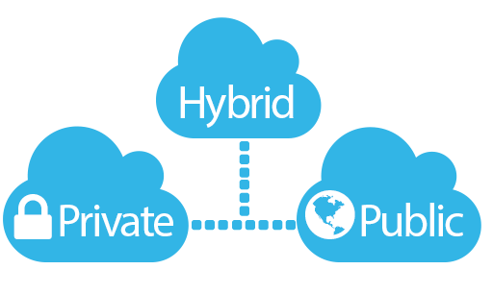
Hybrid Cloud
Combination of a public cloud provider with a private cloud platform
The public cloud and private cloud, operated independently of each other, communicate over an encrypted connection
Sensitive protected data permanently stored in private cloud
Leveraging computational power on public cloud
Benefits
Reduced access time and latency to core data
Flexibility to handle burst computation needs and failover circumstances
Notes:
Hybrid clouds are gaining more momentum going into year 2015, which seems to be the trend going forward… Quite a few industries love and embrace the idea of hybrid clouds and here are some examples.
Financial industry: trade orders are executed on private clouds whereas analytics are run in public clouds
Healthcare industry: policy restriction; amount of patient data to be moved between medical service providers and insurance companies
Law firms: use hybrid as encrypted offsite data stores to safeguard against potential for loss due to theft, natural disasters, hardware failures, etc

Slide 17
Impact to Industries
Software companies
Operating systems
Applications
DevOps tools
Hardware manufacturers
Storage
Networking
Internet service providers (ISPs)
Notes:
Revenue collected from virtual machines hosted in public clouds has been increasing for major OS providers, i.e., Ubuntu (Canonical), RedHat and to a lesser extent Windows (Microsoft). It is strategically critical for OS manufacturers/distributors that they operate compatibly with service providers like Amazon, Microsoft and Rackspace.
With the move to the cloud, it poses many challenges (and opportunities for innovations) to developers to make their applications more accessible, secure, available, and resilient to attacks and failures.
One of the key technologies that enables cloud computing is inexpensive and powerful commoditized hardware (storage and networking) and this has become a significant threat to those traditional specialized hardware manufacturers such as EMC, NetApps, Cisco and Juniper.
For example, Hadoop (HDFS/HBase) recommends commodity disks to store distributed data thanks to its excellent software architectural design.
Open Flow is poaching Cisco’s and Juniper’s low end router and switch businesses.
Amazon reported that AWS contributed 1.5 billion dollars, with net income of 267 million dollars, toward their first quarter in year 2015. Founder Jeff Bezos said AWS is quickly becoming a 5 billion dollar business, much better than expected.

Slide 18
Pros and Cons
Pros
Multiple choices
Speed
Agility
Scale
Cost
Cons
Security
Loss, corruption, and theft of critical data
Hackers infiltrate critical infrastructure
Data pipeline vulnerabilities
Lack of control
Vendor lock-up
Reliability

Slide 19
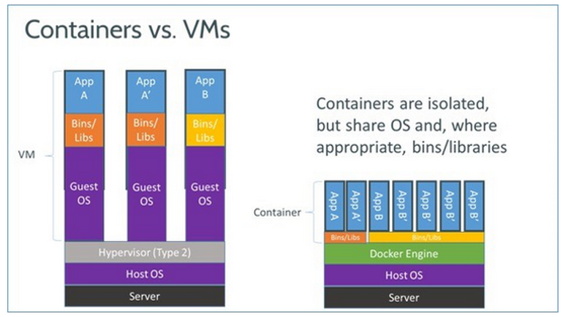
Cloud Computing Trend - Containers
Container Technology (Docker)
Source:
Lightweight compared to virtual machines
Version control
Portability
Start time
Ease-of-use
Notes:
A vanilla virtual machine with mainstream Linux OS distros (Ubuntu, CentOS or RedHat) installed could easily take 1 ~ 2 GB of disk space while a base Docker image of the same OS flavor is normally 270 ~ 400 MB. Also, if multiple containers based on the same OS are instantiated on the same VM, the disk space they take do NOT increase linearly due to the Union file system type Docker has chosen. For example, 3 CentOS containers each requiring 400MB will take much much less than 1.2GB if instantiated at the same time.
Portability: A CentOS Docker container can be instantiated on a Ubuntu machine and run without issues.
Start time: bootstrapping a virtual Linux machine on a powerful physical machine often takes 2 ~ 3 minutes, while instantiating a Docker instance takes as few as 3 seconds.
Ease-of-use: The underlying LXC (Linux Containers) technology has been in Linux kernel for a while. It is Docker that builds a good interface around it, which contributes to its popularity.

Slide 20
Cloud Computing Trend - Microservices
Microservices / Cloud APIs
Architectural style
Consists of many independent and decoupled processes which communicate via well defined APIs through encrypted channels
Similar to command line design in Linux operating system where each utility handles a simple task well but becomes super powerful if utilities are connected through pipes
REST style APIs

