Slide 1
Predicting Student Enrollment at Syracuse University
Ryan Fisher
Andrew Weiss
Joe Wilson
Michael Znidarsic

Slide 2
Data Available
Student Enrollment → Enrolled / Did Not Enroll
Location → Country, State, City (Region, Domestic / Not Domestic)
Visit Info → Date, Temperature, Presenter, Tour Guide, Visit / No Visit
Admission Decision → First Choice / Second Choice
Application Decision → Early Decision / Regular Decision
Scholarship → Offered / Not Offered
Notes:
This data was obtained via the customer relationship management system used by the Office of Admissions at Syracuse University. All of the data had been scrubbed to protect the anonymity of the students.
There was a lot of data available, but the major subjects we felt were important were student enrollment, whether the student enrolled or not, their region, information regarding their visit, as well as if they got into their first or second choice program, applied early or regular decision, and received a scholarship.

Slide 3
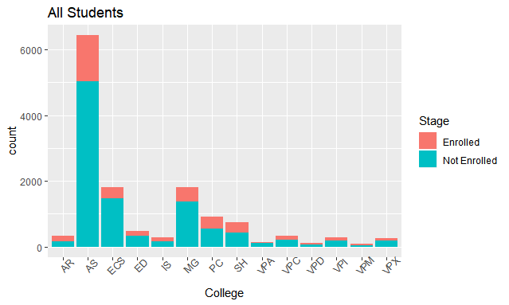
Admitted Student By College
Notes:
This first histogram shows a breakdown of all students by college, separated into enrolled and not enrolled. It is easy to see the colleges where we admit more students to enroll a large class and vice versa. This histogram also does a good job at demonstrating our overall admissions pool, which is similar to this histogram in shape at a larger scale.There are many colleges on campus, each with specific enrollment goals.

Slide 4
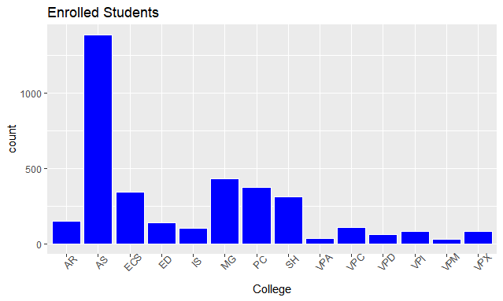
Enrolled Students by College
Notes:
This histogram demonstrates the students enrolled at Syracuse University, broken down by college. Each program has a goal for the number of students we would like to see in that program. With a goal of reaching 3600 students each year, we need to be precise on who is offered admission to ensure that we do not over enroll, but also, that each program meets their goal. Being able to predict the students that would enroll from the students that were admitted could help us meet that goal more precisely.

Slide 5
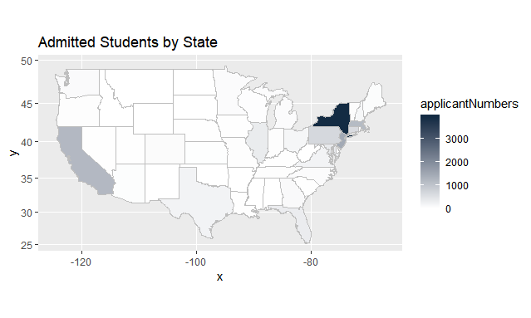
Admitted Students by State
Notes:
This map shows population by region just as a breakdown by state. We do want geographic diversity and look to get as many students to represent each of the states. Being that we are located in New York, it is easy to see that we are very skewed in our numbers with students from New York. This is not an issue at all, but, as an institution, we would like to see increase geographic diversity from states across the United States. We do very well in the corners and the coastal areas, but I can tell you for certain in 2018, we had 0 admitted students from North Dakota.

Slide 6
Prediction
Determine which students will enroll at Syracuse University depending on data available to the Office of Admissions. Determine what will be the best predictor or predictors to anticipate whether a student would attend or not to an acceptable accuracy.
Notes:
So, how do we wrap all of this together? What do we want to see from this data to help us in our decision making? We would like to predict which students will enroll based on this data. It would be nice to be able to pick each student that would attend Syracuse if admitted to make the class. This would be great for an institution because it would increase the selectivity of the university, which is something that many colleges strive for. We wanted to see, which of the data points are the best predictors to determine whether a student would attend Syracuse Unviersity or not, hopefully with some accuracy.

Slide 7
Method
Ran several different binary classification models
Determined which inputs were pertinent to each predictive model
Used different inputs in different configurations to achieve best results
Notes:
We had several methods to employ this. We ran a few different binary classification models to determine which variables were pertinent to our predictive models and those that were not. We then took those variables to determine which configurations of the data created the highest accuracy for the predictive model.

Slide 8
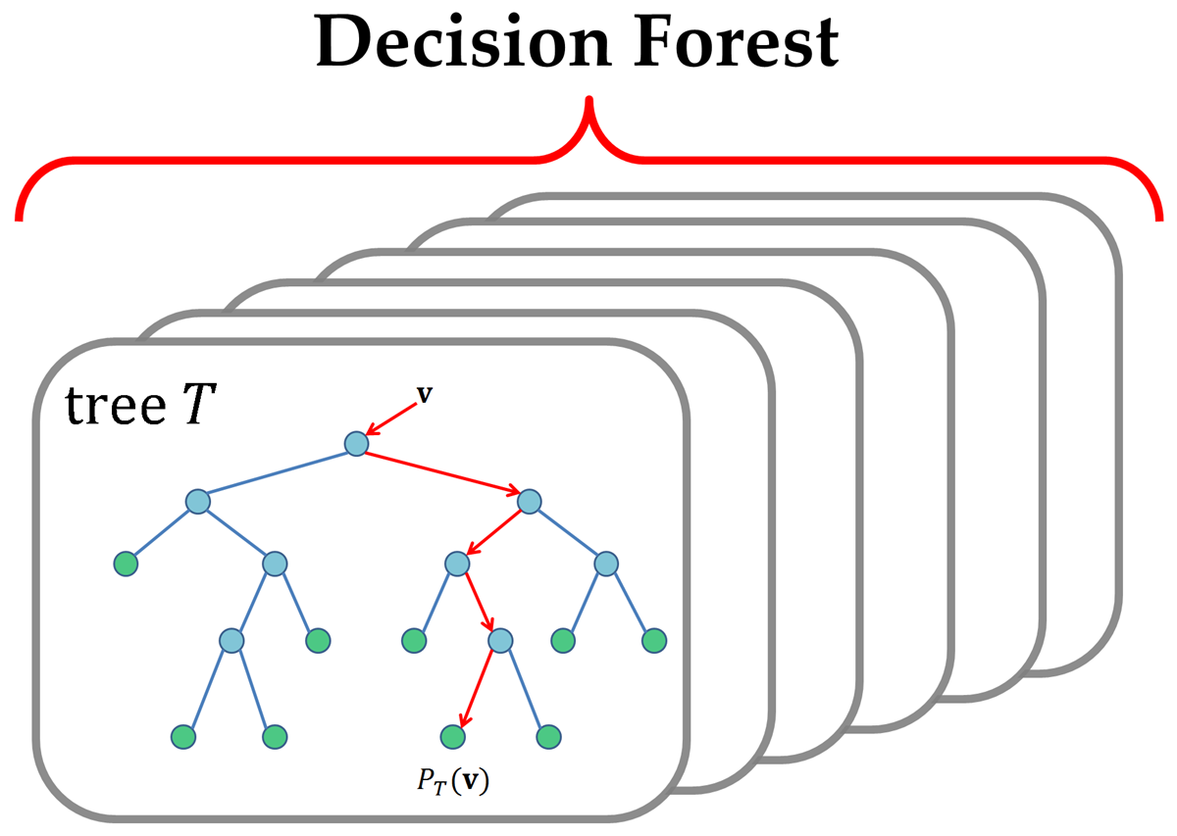
Random Forest
79.02% Tested Accuracy
Inputs:
ED, Scholarship, College, Region, Domestic, Choice
Prediction -> | Accept | Decline
Accepted | 289 | 780
Declined | 95 | 3006
Accept prediction → Low accuracy
Decline prediction → High accuracy
Notes:
The first predictive model we used was the Random Forest Model. With this model, we were able to test several students in the data and get our accuracy to about 79%. This appears to be a decent model, but there is an issue that lies in the minute details of this model. We can see that students we thought we would decline and ended up declining is the highest. We were able to predict denying enrollment to a fairly high accuracy. Looking at the accepted section shows a different story. With this model, we can see that we thought about 1000 of the students would accept their decision, where only 289 actually did. This model although, containing a fairly high accuracy, does not show us exactly what we wanted to see.

Slide 9
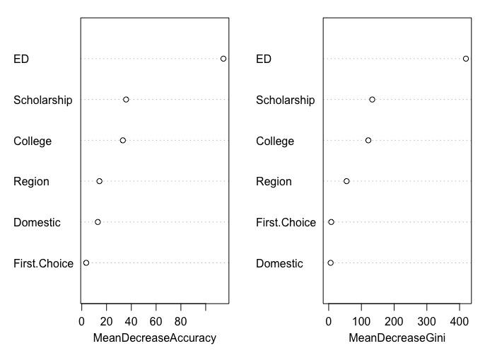
RF Variable Importance
Notes:
We then ran some code to determine the importance of each of the variables. In this, we can see that ED overwhelmingly has the highest importance. ED is whether the student applied Early Decision or Regular Decision. If a student applies early decision, they are saying they will attend their college if they are admitted. This makes sense that this is the highest variable because it is basically an early contract saying you will attend. The other variables show less importance, but are still relevant to the data.

Slide 10
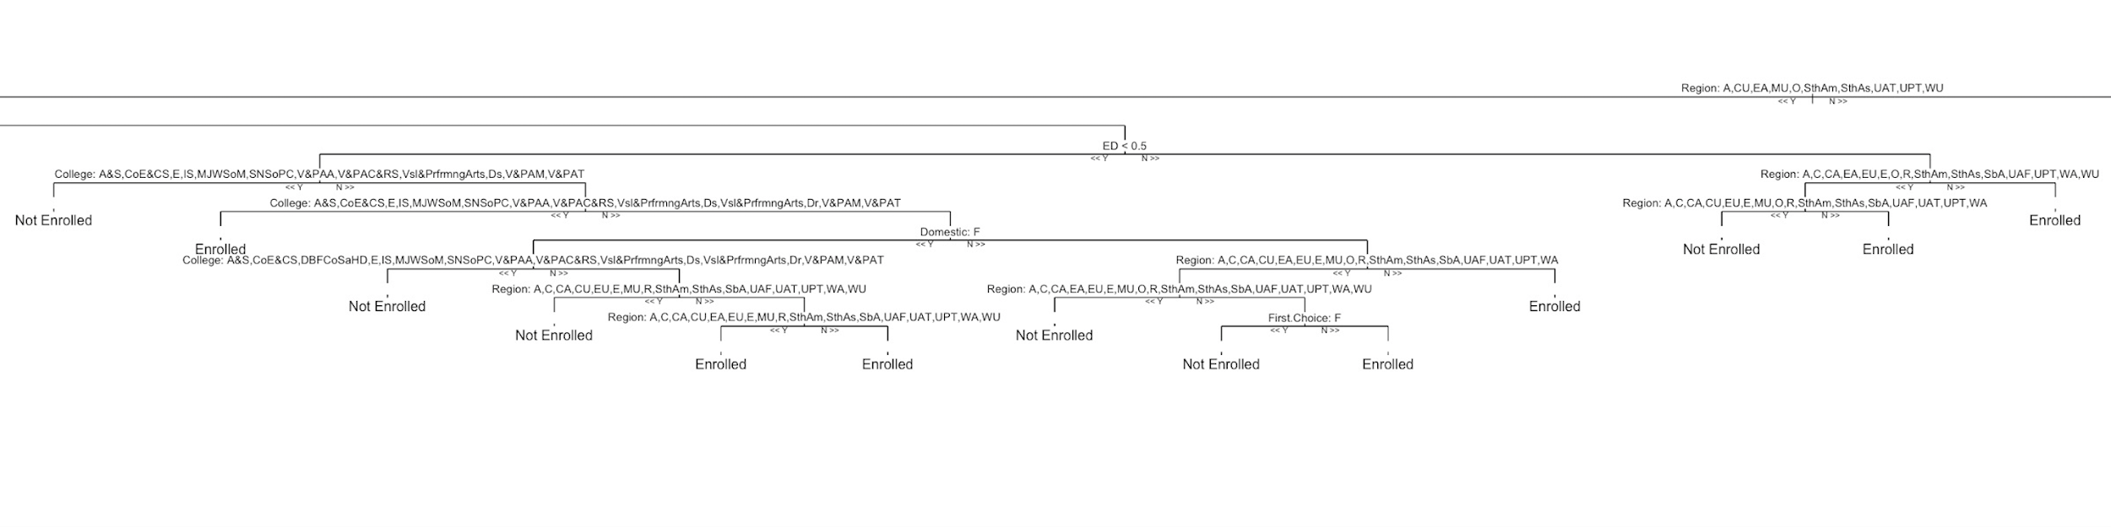
RF Decision Tree

Slide 11
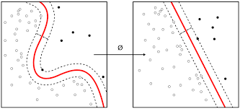
Support Vector Machine
78.05% Tested Accuracy
Inputs:
ED, Scholarship, Domestic
Prediction -> | Accept | Decline
Accepted | 229 | 936
Declined | 53 | 3287
Accept prediction → Low accuracy
Decline prediction → High accuracy
Notes:
We then ran a Neural Network test. Similarly to RandomForest, this model was able to predict students that declined very well, but was not able to predict accepting students well at all. In fact this model predicts the accept students worse than the random forest model.
The models unfortunately do not show an acceptable picture to actually use this in practice.

Slide 12
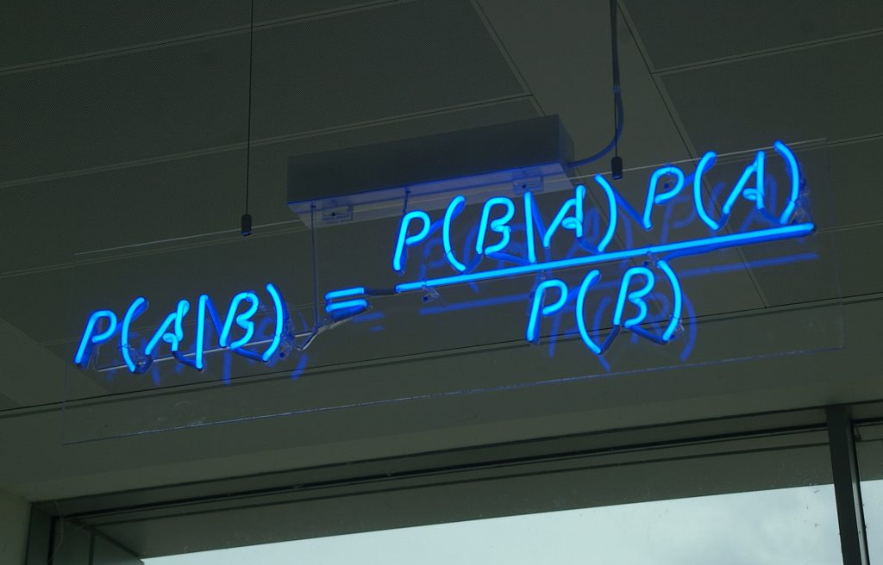
Naive Bayes Classifier
78.27% Tested Accuracy
Inputs:
College, ED, Scholarship, Domestic
Prediction -> | Accept | Decline
Accepted | 319 | 846
Declined | 133 | 3207
Accept prediction → Low accuracy
Decline prediction → High accuracy
Notes:
We then ran a Neural Network test. Similarly to RandomForest, this model was able to predict students that declined very well, but was not able to predict accepting students well at all. In fact this model predicts the accept students worse than the random forest model.
The models unfortunately do not show an acceptable picture to actually use this in practice.

Slide 13
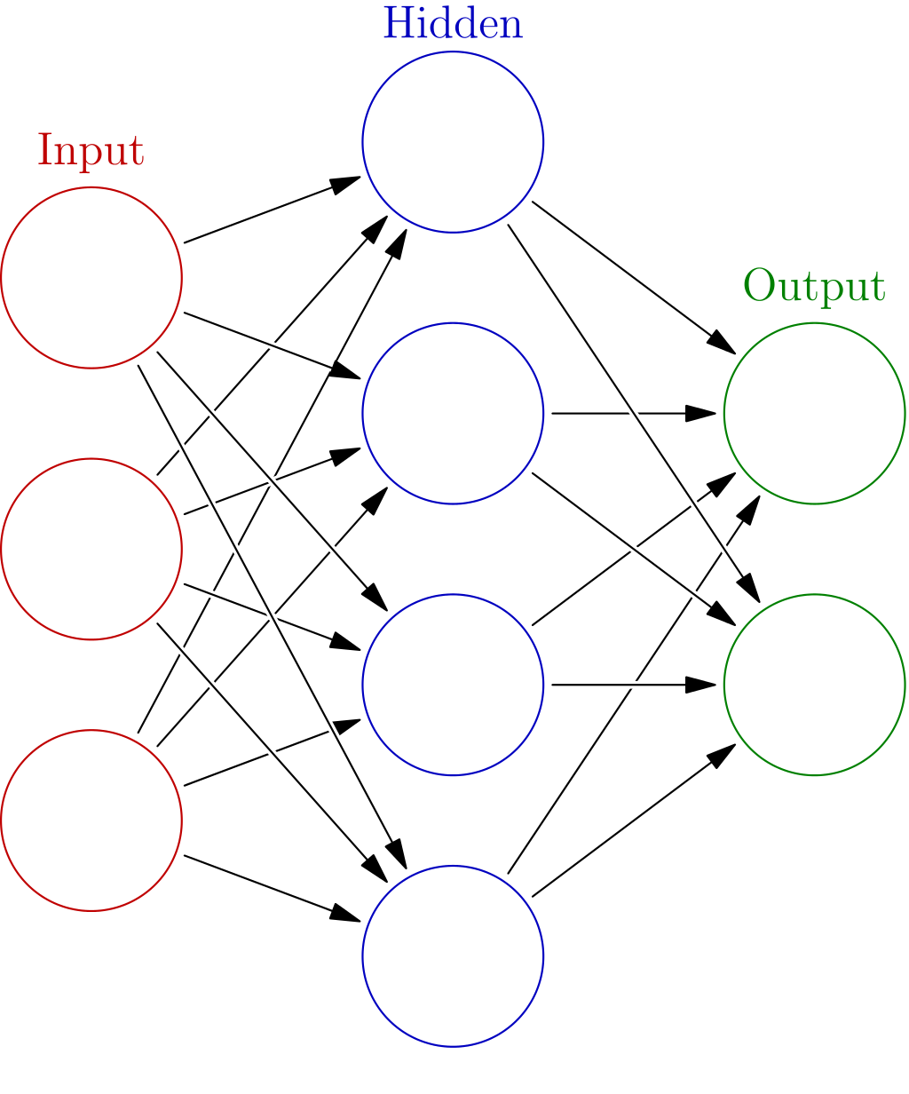
Neural Network
79.52% Tested Accuracy
Inputs:
ED, Scholarship, Choice, Domestic, GPA, Visit?, Temperature
Prediction -> | Accept | Decline
Accepted | 222 | 788
Declined | 47 | 3020
Accept prediction → Low accuracy
Decline prediction → High accuracy
Notes:
We then ran a Neural Network test. Similarly to RandomForest, this model was able to predict students that declined very well, but was not able to predict accepting students well at all. In fact this model predicts the accept students worse than the random forest model.
The models unfortunately do not show an acceptable picture to actually use this in practice.

Slide 14
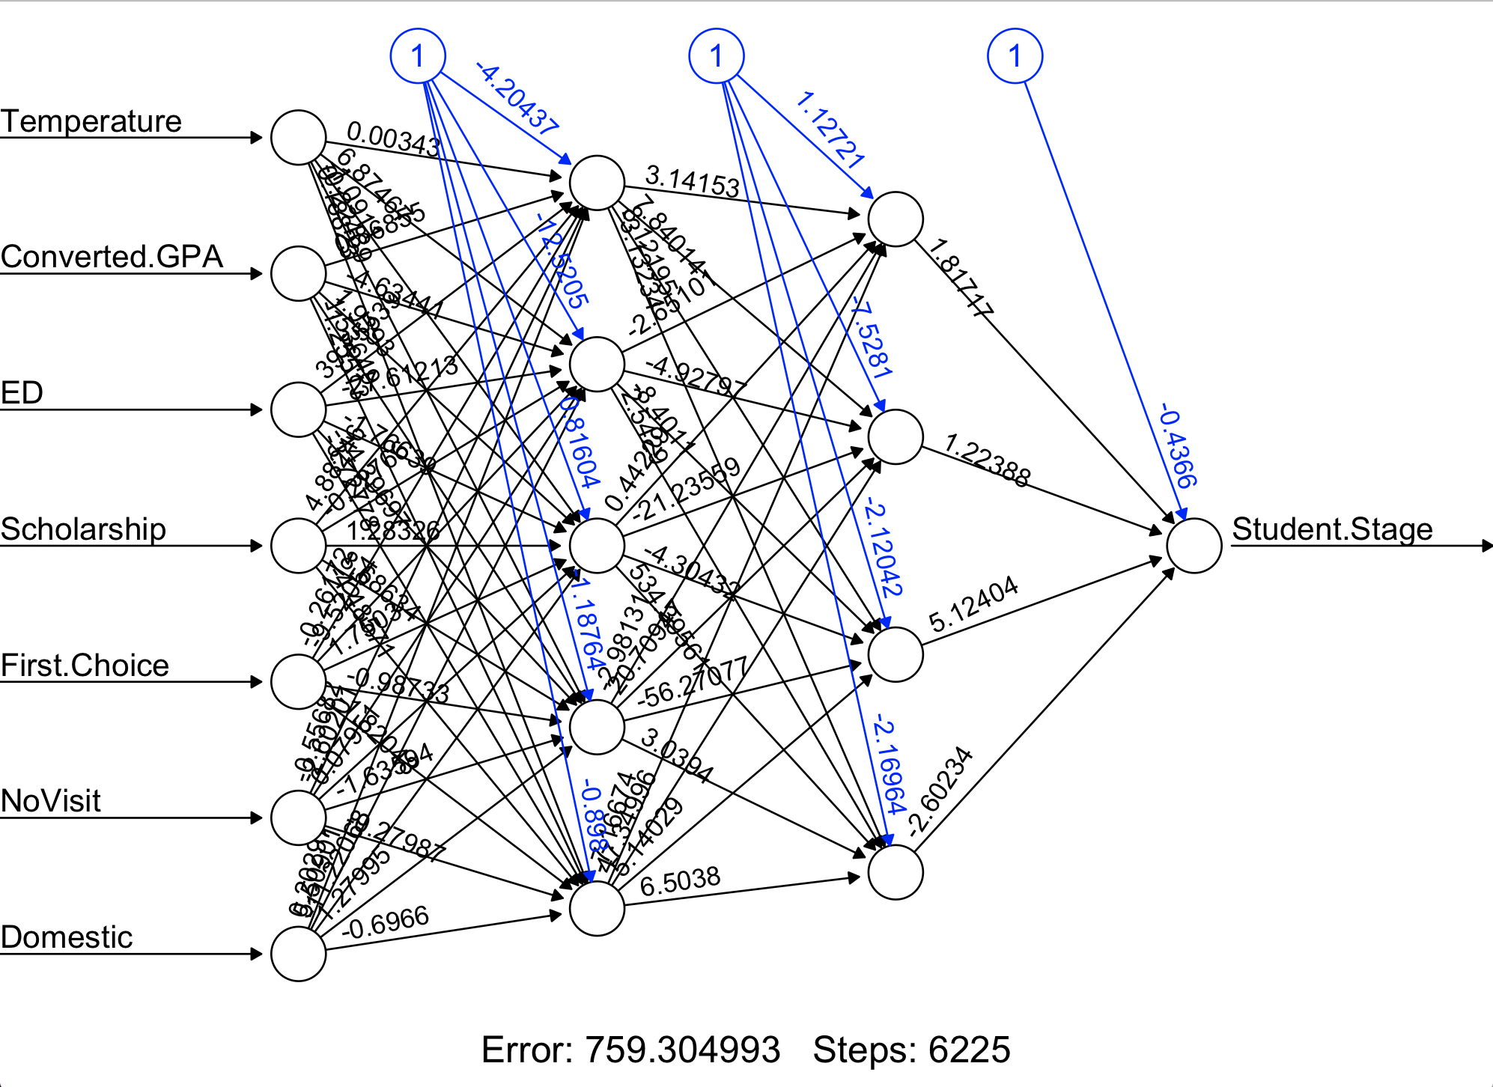
Notes:
This diagram shows our Neural Network. The number of steps indicates the number of times the algorithm self-corrected before it ceased to improve accuracy by the set threshold. The error figure is predicated on the total amount of erroneous predictions in our test data set, so it is neither a mean nor a percentage and should be ignored.

Slide 15
Model Comparison
Model | Accuracy | Accept Precision | Decline Precision
Neural Network | 79.52% | 21.98% | 98.47%
Random Forest | 79.02% | 27.03% | 96.94%
Naive Bayes | 78.27% | 27.38% | 96.02%
SVM | 78.05% | 19.66% | 98.41%

Slide 16
Model Comparison
Model | Pros | Cons
Neural Network | Accuracy | Bias, Complexity
Random Forest | Accuracy, Categoricals | Complexity
Naive Bayes | Least-Biased | Error
SVM | Parsimonious, Intuitive | Error, Bias
Notes:
Three things really impact our choice of model: Accuracy, Bias, and Parsimoniousness.
Accuracy is obviously very important, but sometimes overall accuracies can be very similar between very different models.
Bias is important, because in a hypothetical circumstance like focusing on creating a comprehensive list of students that would “accept” admission, models that are biased more towards predicting “decline” would not help us much.
Parsimoniousness becomes very important when there is limited data available to those using the model, and also if other variables, like temperature for example, are not helpful to understand because they cannot be changed.

