Slide 1
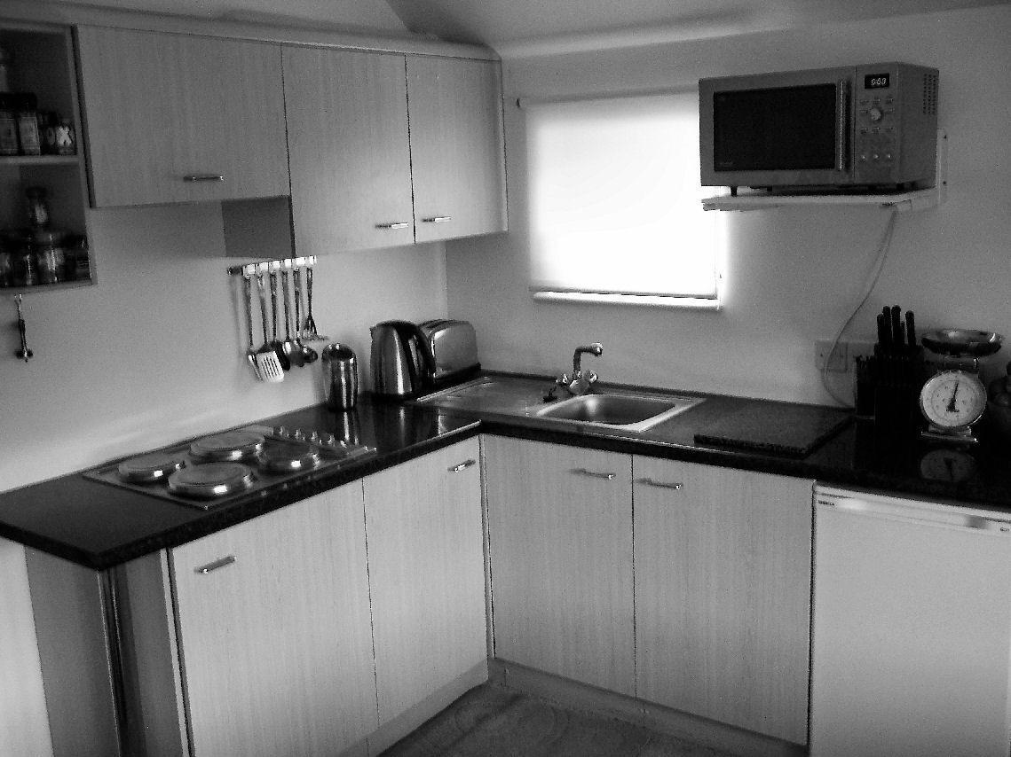
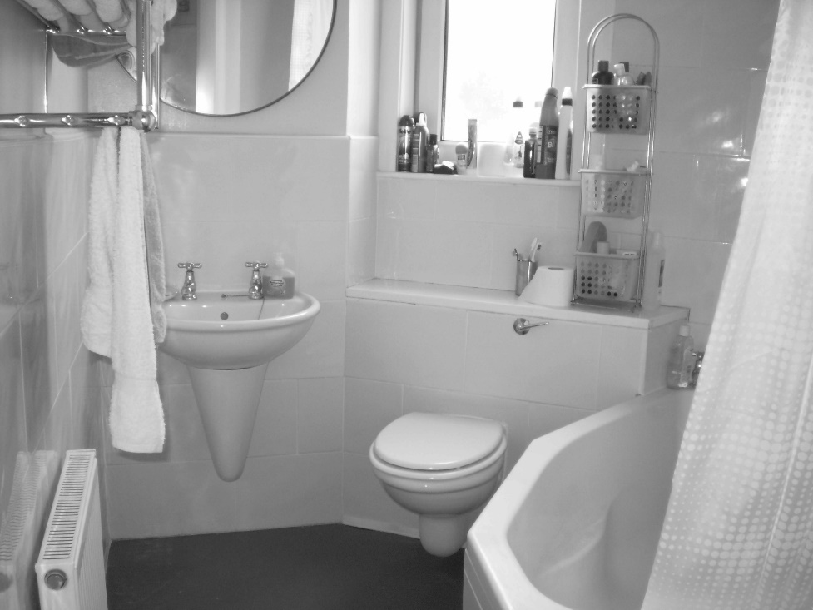
Welcome to the experiment!
In this study we will present you with images of kitchens or bathrooms. In each session you are will be instructed to do different tasks on these images.
Press the right arrow key to proceed

Slide 2

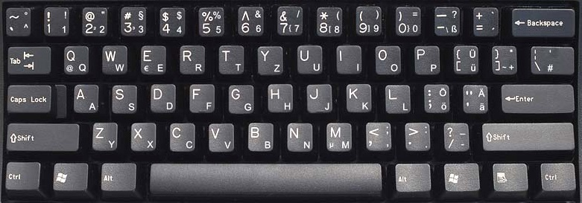

The task of the current session is a categorization task.
The images will be shown for a very brief time. Your task is to discriminate whether a presented images is a kitchen or a bathroom.
Press the ”F” button whenever you see a kitchen and the
“J” button for a bathroom. Please respond as quickly and as accurately as possible.
Press the right arrow key to proceed or the left arrow key to return to the previous slide

Slide 3
The task of the current session is a categorization task.
The images will be shown for a very brief time. Your task is to discriminate whether a presented images is a kitchen or a bathroom.
Press the ”J” button whenever you see a kitchen and the
“F” button for a bathroom. Please respond as quickly and as accurately as possible.
Press the right arrow key to proceed or the left arrow key to return to the previous slide

Slide 4
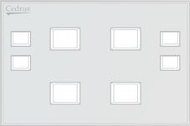
At the beginning of each sequence, we will show you two specific “target” images that you will need to remember and be on the lookout for.
Your main task will be to attentively look at each image for as long as it’s on the screen, and press the green button whenever you see a target image in any view (front or side).
Please respond as quickly and as accurately as possible.
Press the right arrow key to proceed or the left arrow key to return to the previous slide

Slide 5
At the beginning of each sequence, we will show you two specific “target” images that you will need to remember and be on the lookout for.
Your main task will be to attentively look at each image for as long as it’s on the screen, and press the little orange button whenever you see a target image in any view (front or side).
Please respond as quickly and as accurately as possible.
Press the right arrow key to proceed or the left arrow key to return to the previous slide

Slide 6
At the beginning of each sequence, we will show you two specific “target” images that you will need to remember and be on the lookout for.
Your main task will be to attentively look at each image for as long as it’s on the screen, and press the little yellow button whenever you see a target image in any view (front or side).
Please respond as quickly and as accurately as possible.
Press the right arrow key to proceed or the left arrow key to return to the previous slide

Slide 7
In addition to the visual task, there will be an auditory task as well. Therefore, a tone will occur during or shortly after the visual image.
Your task will be to discriminate “high” and “low” pitches of the tone. Use the red button to respond to high tone and the white button for low tones.
Please respond as quickly and as accurately as possible. Always respond first to the visual and then to the auditory task.
Press the right arrow key to proceed or the left arrow key to return to the previous slide

Slide 8
In addition to the visual task, there will be an auditory task as well. Therefore, a tone will occur during or shortly after the visual image.
Your task will be to discriminate “high” and “low” pitches of the tone. Use the green button to respond to high tone and the blue button for low tones.
Please respond as quickly and as accurately as possible. Always respond first to the visual and then to the auditory task.
Press the right arrow key to proceed or the left arrow key to return to the previous slide

Slide 9
Each sequence will last about 2min. You will be able to rest between sequences. The sequence will only begin after you press the right arrow key.
Please do your best to remain focused and alert, and keep your eyes fixed on the center of the screen.
If you need a break, or have any questions, do not hesitate to ask the experimenter.
We will start with a few practice trials, and you will have a chance to ask questions before starting the experiment.
Good luck!
Press the right arrow key to proceed or the left arrow key to return to the previous slide

Slide 10
In this part of the experiment, two questions will be ask after each image and tone.
Question 1: How much time did it take you to respond to the visual stimulus? i.e. what was the delay between the onset of the image and your decision to respond or not respond?
Presented as: Visual task duration?
Question 2: How much time did it take you to respond to the auditory stimulus? i.e. what was the delay between the tone and your decision how to respond?
Presented as: Auditory task duration?
Press the right arrow key to proceed or the left arrow key to return to the previous slide

Slide 11
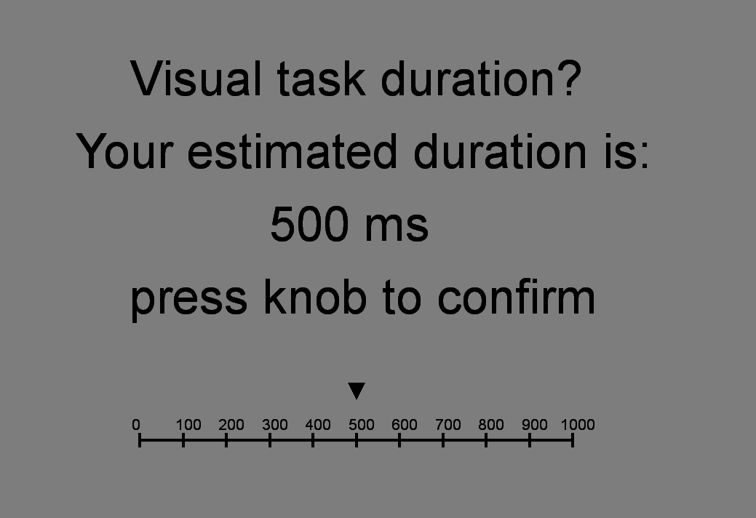
The screen for your time estimation will look like this:
By turning the knob you can change the value and move the pointer on the scale. Select your final answer by pressing the knob.
Press the right arrow key to proceed or the left arrow key to return to the previous slide

Slide 12
Each sequence will last about 3 min. You will be able to rest between sequences. The sequence will only begin after you press the space bar.
Please do your best to remain focused and alert, and keep your eyes fixed on the center of the screen. If you need a break, or have any questions, do not hesitate to ask the experimenter.
We will start with a calibration task in which you can practice time estimation, followed by a few practice trials, and you will have a chance to ask questions before starting the experiment. Good luck!
Press the right arrow key to proceed or the left arrow key to return to the previous slide

