Slide 1
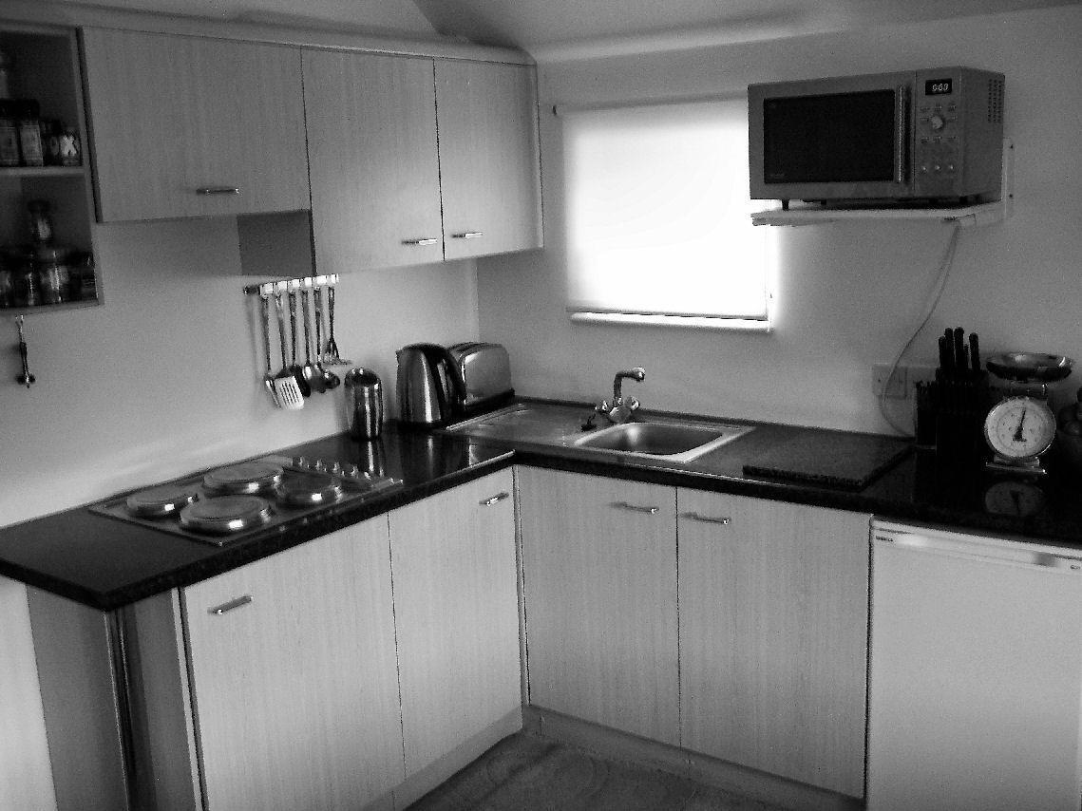
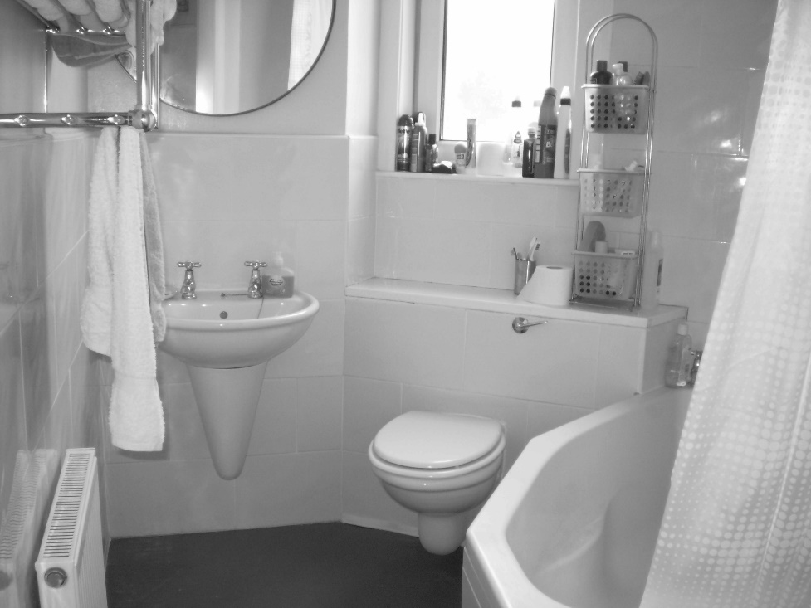
Welcome to the experiment!
You will perform a categorization task.
We will present you with images of kitchens or bathrooms. The images will be shown for a very short time. Your task is to discriminate whether a presented images is a kitchen or a bathroom.
Press the right arrow key to proceed

Slide 2

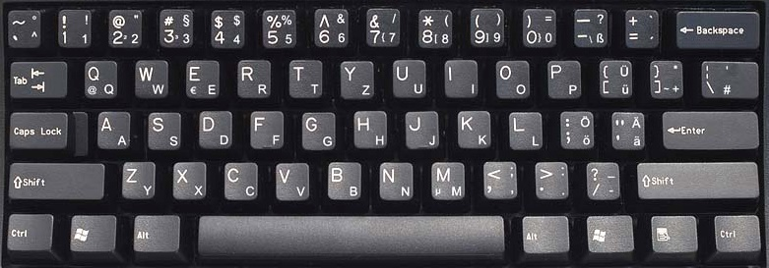

Press the ”F” button whenever you see a kitchen.
When you see a bathroom press the “J” button.
Please respond as quickly and as accurately as possible. After each block you will receive feedback on your accuracy.
Press the right arrow key to proceed or the left arrow key to return to the previous slide

Slide 3
The experiment is divided in 24 blocks. Each block will last about 2 min. You will be able to rest between blocks.
Please do your best to remain focused and alert, and keep your eyes fixed on the center of the screen.
If you need a break, or have any questions, do not hesitate to ask the experimenter.
We will start with a few practice trials, and you will have a chance to ask questions before starting the experiment.
Good luck!
Press the right arrow key to start the experiment or the left arrow key to return to the previous slide

Slide 4
Welcome to the experiment!
You will perform a rating task.
We will present you with images of kitchens. The images will be shown for 1.5 seconds. Your task is to rate your personal experience of the image on a scale from 1 to 7.
Press the right arrow key to proceed

Slide 5
Welcome to the experiment!
You will perform a rating task.
We will present you with images of bathrooms. The images will be shown for 1.5 seconds. Your task is to rate your personal experience of the image on a scale from 1 to 7.
Press the right arrow key to proceed

Slide 6
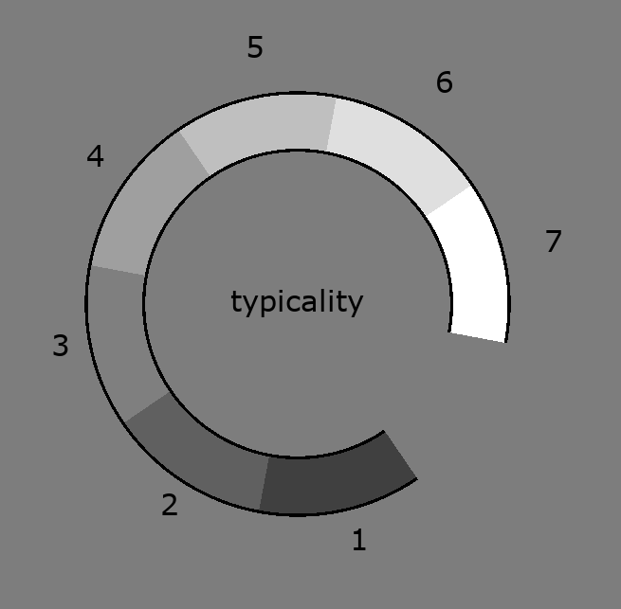
The rating task will be on typicality.
Please provide your judgment on the extent to which the presented scene is a typical version of its scene category (kitchen/bathroom).
For a very typical scene press “7” and for a totally atypical scene press “1”.
To confirm your answer press the space bar.
Take your time.
No speed pressure in this task.
Press the right arrow key to proceed or the left arrow key to return to the previous slide

Slide 7
The rating task will be on familiarity.
Please provide your judgment on the extent to which the presented scene resembles places you have lived in or where you spent a substantial amount of time during your life.
For a very familiar scene press “7” and for a totally unfamiliar scene press “1”.
To confirm your answer press the space bar.
Take your time.
No speed pressure in this task.
Press the right arrow key to proceed or the left arrow key to return to the previous slide
familiarity

Slide 8

The rating task will be on aesthetic attractiveness.
Please provide your personal judgment on the aesthetic appeal of the presented scene. In other word how beautiful the scene appears to you
For a very aesthetic scene of a press “7” and for a very unaesthetic scene press “1”.
To confirm your answer press the space bar
Take your time.
No speed pressure in this task.
Press the right arrow key to proceed or the left arrow key to return to the previous slide

Slide 9

The rating task will be on usability.
Please provide your personal judgment on the usability/practicability presented scene if you were to interact with it.
For a very practical scene of a press “7” and for a very unpractical scene press “1”.
To confirm your answer press the space bar
Take your time.
No speed pressure in this task.
Press the right arrow key to proceed or the left arrow key to return to the previous slide

Slide 10
The rating task will be on visual complexity.
Please provide your personal judgment on the complexity of the presented scene. You can think of complexity as the number of different elements appearing in a scene.
For a very complex scene of a press “7” and for a very simple scene press “1”.
To confirm your answer press the space bar
Take your time.
No speed pressure in this task.
Press the right arrow key to proceed or the left arrow key to return to the previous slide
complexity

Slide 11
The experiment is divided in 2 blocks. Each block will last about 3 min. You will be able to rest between blocks.
Please do your best to remain focused and alert, and keep your eyes fixed on the center of the screen.
If you need a break, or have any questions, do not hesitate to ask the experimenter.
We will start with a few practice trials, and you will have a chance to ask questions before starting the experiment.
Good luck!
Press the right arrow key to start the experiment or the left arrow key to return to the previous slide

