Slide 1
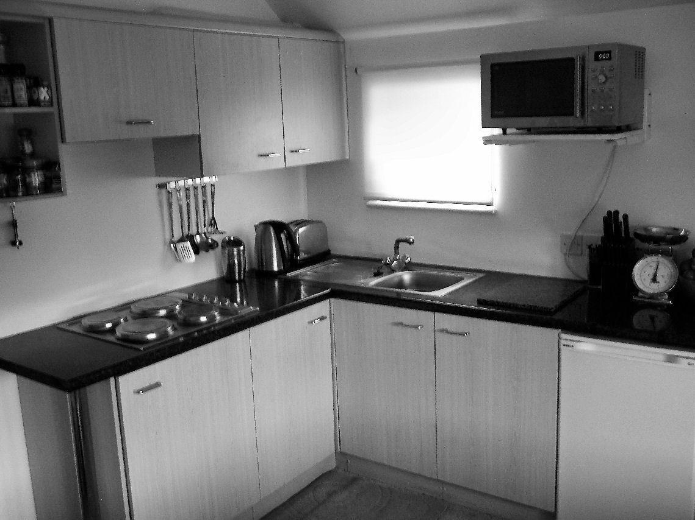
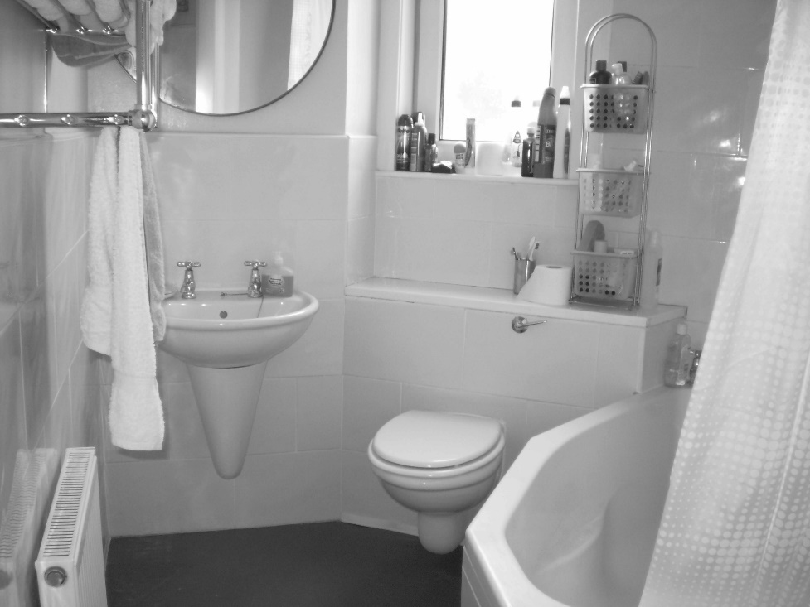
Welcome to the experiment!
In this study we will present you with images of kitchens or bathrooms. In each session you are will be instructed to do different tasks on these images.
Press the right arrow key to proceed

Slide 2

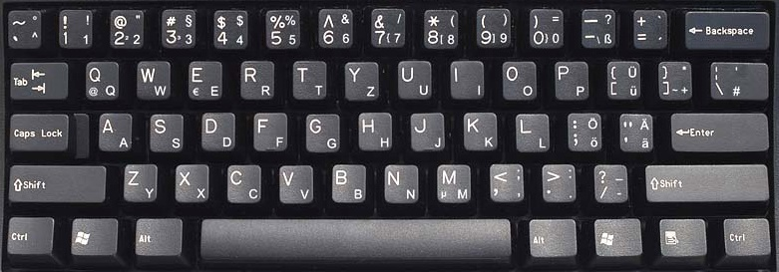

The task of the current session is a categorization task.
The images will be shown for a very brief time. Your task is to discriminate whether a presented images is a kitchen or a bathroom.
Press the ”F” button whenever you see a kitchen and the
“J” button for a bathroom. Please respond as quickly and as accurately as possible.
Press the right arrow key to proceed or the left arrow key to return to the previous slide

Slide 3
The task of the current session is a categorization task.
The images will be shown for a very brief time. Your task is to discriminate whether a presented images is a kitchen or a bathroom.
Press the ”J” button whenever you see a kitchen and the
“F” button for a bathroom. Please respond as quickly and as accurately as possible.
Press the right arrow key to proceed or the left arrow key to return to the previous slide

Slide 4
The task of the current session is a rating task.
You will see an images of a kitchen or a bathroom for 1.5 sec. Your task is to rate the image according to your personal judgment of typicality on a scale from 1 to 7.
For a very typical exemplar of a kitchen/bathroom press “7” and for a totally atypical exemplar press “1”.
Take your time. No speed pressure in this task.
Press the right arrow key to proceed or the left arrow key to return to the previous slide
very atypical
very typical

Slide 5
The task of the current session is a rating task.
You will see an images of a kitchen or a bathroom for 1.5 sec. Your task is to rate the image according to your personal judgment of aesthetic attractiveness on a scale from 1 to 7.
For a very aesthetically appealing exemplar of a kitchen/bathroom press “7” and for a totally unattractive exemplar press “1”.
Take your time. No speed pressure in this task.
Press the right arrow key to proceed or the left arrow key to return to the previous slide
very unattractive
very attractive

Slide 6
The task of the current session is a rating task.
You will see an images of a kitchen or a bathroom for 1.5 sec. Your task is to rate the image according to your personal judgment of usability on a scale from 1 to 7.
For a very practically designed/easy to use exemplar of a kitchen/bathroom press “7” and press “1” for exemplars that appears unpractical/difficult to use.
Take your time. No speed pressure in this task.
Press the right arrow key to proceed or the left arrow key to return to the previous slide
very unpractical
very practical

Slide 7
The task of the current session is a rating task.
You will see an images of a kitchen or a bathroom for 1.5 sec. Your task is to rate the image according to your personal judgment of familiarity on a scale from 1 to 7.
For an image that resembles a familiar scene very closely press “7” and for an image that is nothing alike a familiar scene press “1”.
Take your time. No speed pressure in this task.
Press the right arrow key to proceed or the left arrow key to return to the previous slide
very unfamiliar
very familiar

Slide 8
The experiment is divided in xx blocks. Each block will last about xx min. You will be able to rest between blocks.
Please do your best to remain focused and alert, and keep your eyes fixed on the center of the screen.
If you need a break, or have any questions, do not hesitate to ask the experimenter.
We will start with a few practice trials, and you will have a chance to ask questions before starting the experiment.
Good luck!
Press the right arrow key to start the experiment or the left arrow key to return to the previous slide

Slide 9
The experiment is divided in yy blocks. Each block will last about yy min. You will be able to rest between blocks.
Please do your best to remain focused and alert, and keep your eyes fixed on the center of the screen.
If you need a break, or have any questions, do not hesitate to ask the experimenter.
We will start with a few practice trials, and you will have a chance to ask questions before starting the experiment.
Good luck!
Press the right arrow key to start the experiment or the left arrow key to return to the previous slide

