Slide 1
Welcome to the experiment!
You will perform a similarity rating.
Each trial we will present you with pairs of line drawings depicting bathrooms. Your task is to rate how similar the two images are in respect to their content or their drawing style.
Press space to continue

Slide 2
Welcome to the experiment!
You will perform a similarity rating.
Each trial we will present you with pairs of line drawings depicting kitchens. Your task is to rate how similar the two images are in respect to their content or their drawing style.
Press space to continue

Slide 3
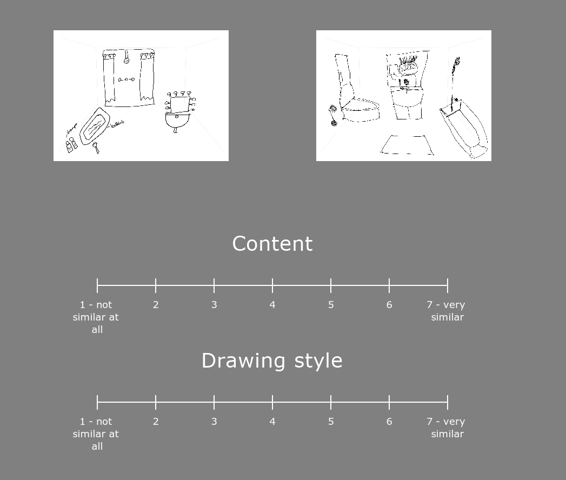
When rating the content of the two images, please judge how similar the rooms are that the drawers indented to depictIn in terms of objects and their configuration.
For this rating, try to ignore the drawing style and ability of drawer.
Please click on the number that best represents your rating on a scale like below (1 – not similar at all, 7 – very similar)
Try to use the full scale from 1 to 7 during the experiment.
Press space to continue

Slide 4
When rating the drawing style of the two images, please judge how similar the drawings are in respect to the style the drawer chose or the general drawing ability of the drawer.
For this rating, try to ignore the content of the drawing.
Please click on the number that best represents your rating on a scale like below (1 – not similar at all, 7 – very similar)
Try to use the full scale from 1 to 7 during the experiment.
Press space to continue

Slide 5
After you provided your ratings, please press space to confirm your selection.
The experiment is divided in 6 blocks. Each block will last about 7 min. You will be able to rest between blocks.
Please do your best to remain focused and alert.
If you need a break, or have any questions, do not hesitate to ask the experimenter.
We will start with a few practice trials, and you will have a chance to ask questions before starting the experiment.
Good luck!
Press space to start the practice trials

