Slide 1
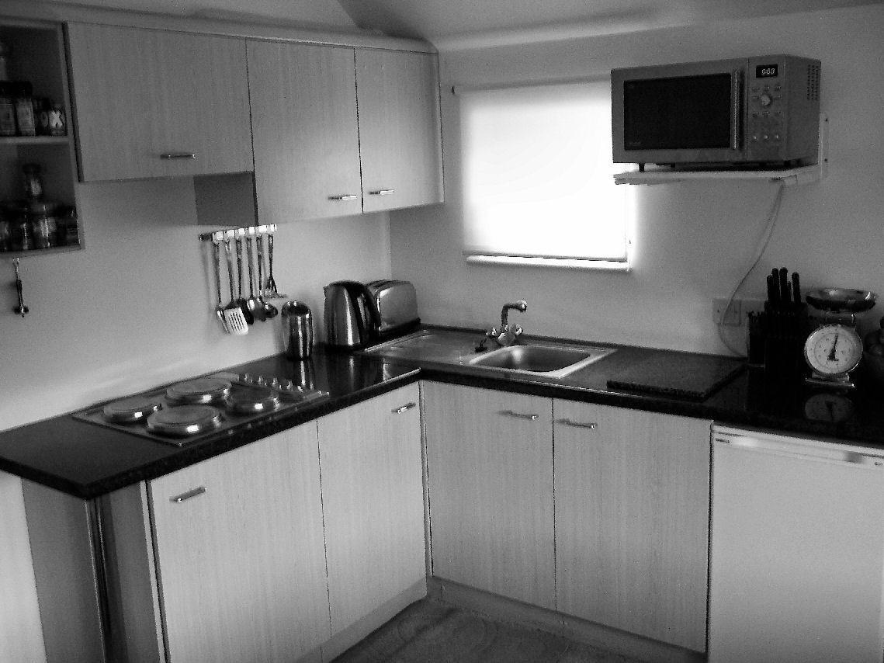
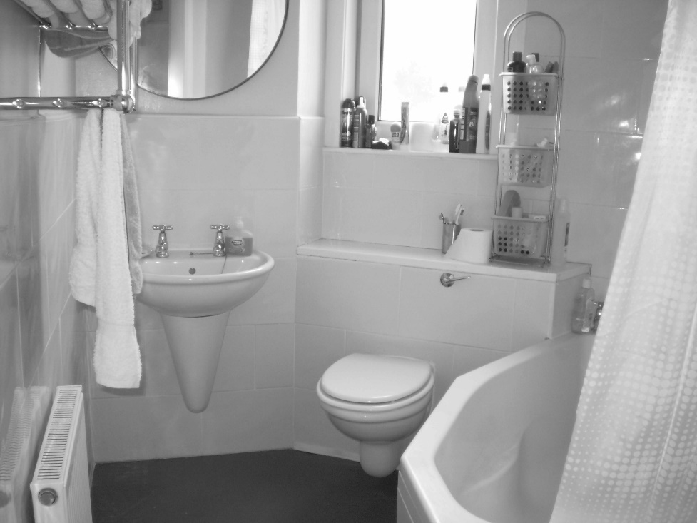
Welcome to the experiment!
You will perform a categorization task.
Will present you with images of kitchens or bathrooms. The images will be shown for a very short time. Your task is to discriminate whether a presented images is a kitchen or a bathroom.
Press the right arrow key to proceed

Slide 2

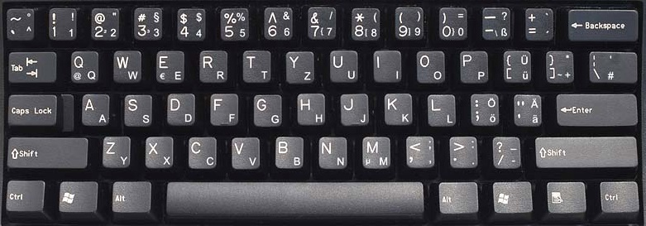

Press the ”F” button whenever you see a kitchen.
When you see a bathroom press the “J” button.
Please respond as quickly and as accurately as possible. After each block you will receive feedback about your accuracy.
Press the right arrow key to proceed or the left arrow key to return to the previous slide

Slide 3
Welcome to the experiment!
You will perform a rating task.
Will present you with images of kitchens. The images will be shown for 1.5 seconds. Your task is to rate your personal experience of the image a scale from 1 to 7.
Press the right arrow key to proceed

Slide 4
Welcome to the experiment!
You will perform a rating task.
Will present you with images of bathrooms. The images will be shown for 1.5 seconds. Your task is to rate your personal experience of the image a scale from 1 to 7.
Press the right arrow key to proceed

Slide 5
The rating task will be on typicality.
Please provide your judgment on the extent to which the presented scene is a typical representative of its scene category (kitchen/bathroom).
For a very typical exemplar of a press “7” and for a totally atypical exemplar press “1”.
Take your time. No speed pressure in this task.
Press the right arrow key to proceed or the left arrow key to return to the previous slide
very atypical
very typical

Slide 6
The rating task will be on familiarity.
Please provide your judgment on the extent to which the presented scene resembles places you have lived in or where spent a substantial amount of time during your life.
For a very familiar exemplar of a press “7” and for a totally unfamiliar exemplar press “1”.
Take your time. No speed pressure in this task.
Press the right arrow key to proceed or the left arrow key to return to the previous slide
very
unfamiliar
very familiar

Slide 7
The rating task will be on aesthetic attractiveness.
Please provide your personal judgment on the aesthetic appeal of the presented scene.
For a very aesthetic exemplar of a press “7” and for a very unaesthetic exemplar press “1”.
Take your time. No speed pressure in this task.
Press the right arrow key to proceed or the left arrow key to return to the previous slide
very
unaesthetic
very aesthetic

Slide 8
The rating task will be on usability.
Please provide your personal judgment on the usability/practicability if you were to interact with the presented scene.
For a very practical exemplar of a press “7” and for a very unpractical exemplar press “1”.
Take your time. No speed pressure in this task.
Press the right arrow key to proceed or the left arrow key to return to the previous slide
very
unpractical
very practical

Slide 9
The rating task will be on visual complexity.
Please provide your judgment on the extent to which the presented scene resembles places you have lived in or where spent a substantial amount of time during your life.
For a very familiar exemplar of a press “7” and for a totally unfamiliar exemplar press “1”.
Take your time. No speed pressure in this task.
Press the right arrow key to proceed or the left arrow key to return to the previous slide
very
unfamiliar
very familiar

Slide 10
The rating task will be on visual complexity.
Please provide your personal judgment on the complexity in the structure of the presented scene.
For a very aesthetic exemplar of a press “7” and for a very unaesthetic exemplar press “1”.
Take your time. No speed pressure in this task.
Press the right arrow key to proceed or the left arrow key to return to the previous slide
very
unaesthetic
very aesthetic

Slide 11
The experiment is divided in 24 blocks. Each block will last about 2 min. You will be able to rest between blocks.
Please do your best to remain focused and alert, and keep your eyes fixed on the center of the screen.
If you need a break, or have any questions, do not hesitate to ask the experimenter.
We will start with a few practice trials, and you will have a chance to ask questions before starting the experiment.
Good luck!
Press the right arrow key to start the experiment or the left arrow key to return to the previous slide

Slide 12
The experiment is divided in 2 blocks. Each block will last about 2 min. You will be able to rest between blocks.
Please do your best to remain focused and alert, and keep your eyes fixed on the center of the screen.
If you need a break, or have any questions, do not hesitate to ask the experimenter.
We will start with a few practice trials, and you will have a chance to ask questions before starting the experiment.
Good luck!
Press the right arrow key to start the experiment or the left arrow key to return to the previous slide

