Slide 1
BearSSL
Martin Bulák, Michal Čech, Šimon Doucha

Slide 2
About BearSSL
Implementation of the SSL/TLS (RFC 5246) protocol written in C
Currently in beta (v0.6)
Small (20KB code, 25KB RAM)
Highly portable

Slide 3
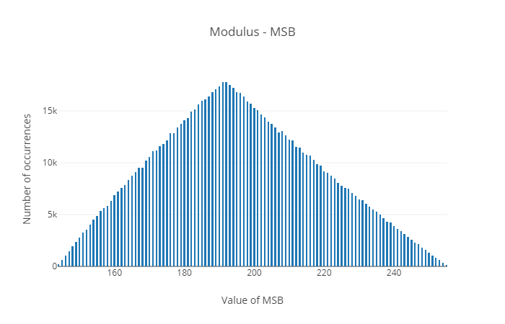
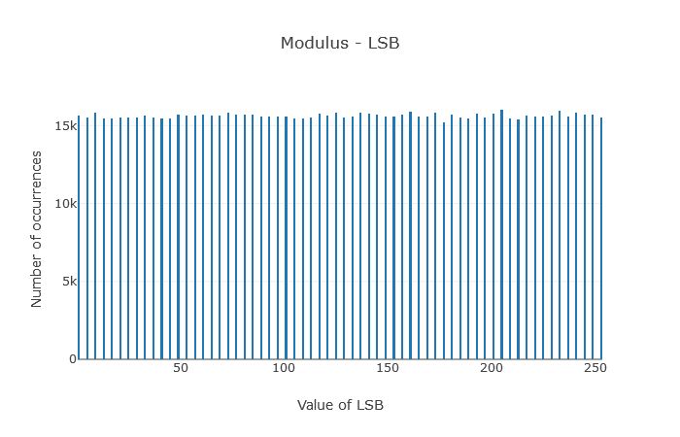
RSA-512 modulus

Slide 4
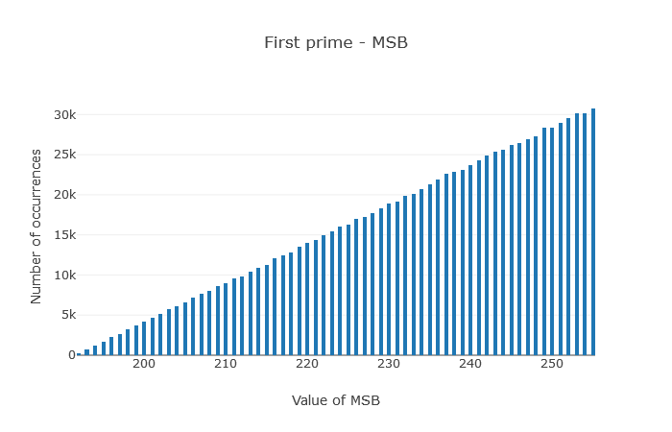
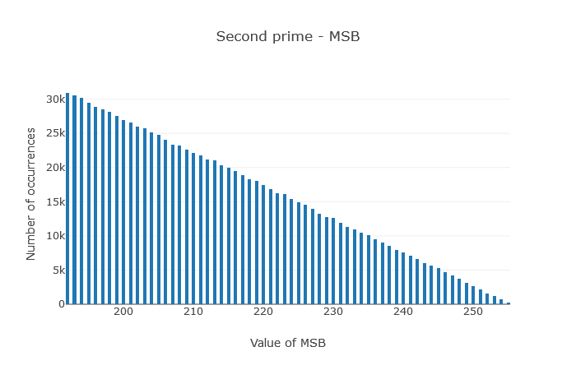
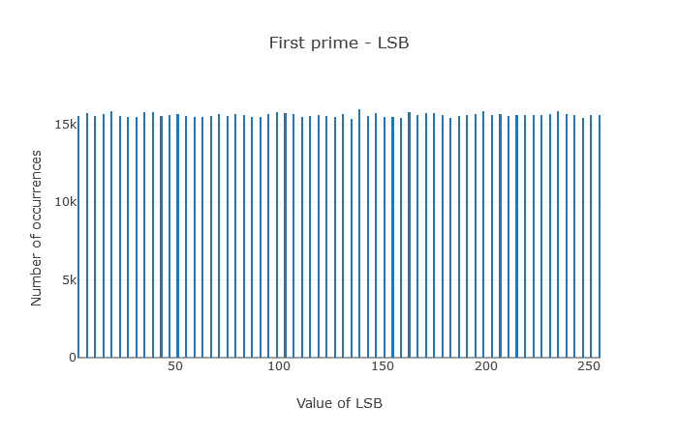
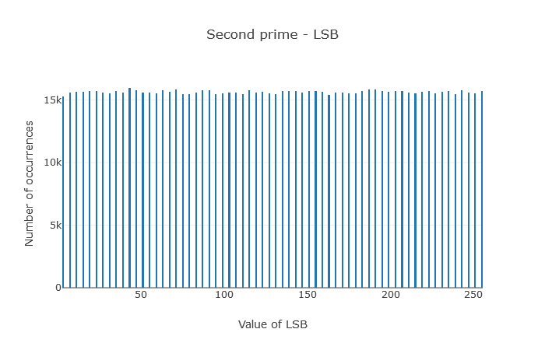
RSA-512 primes

Slide 5
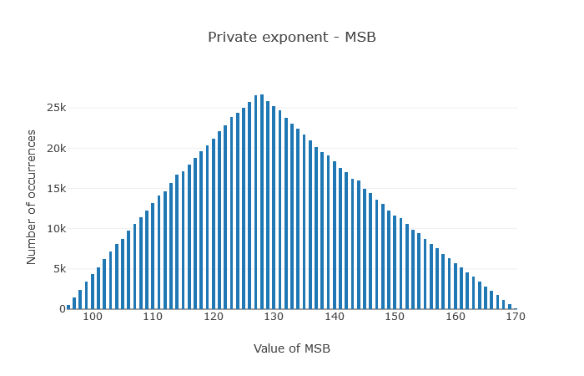
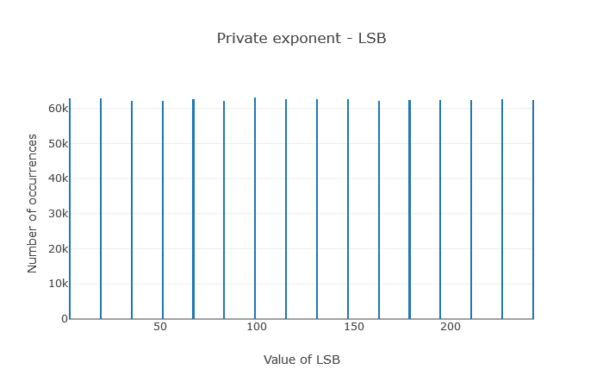
RSA-512 private exponent

Slide 6
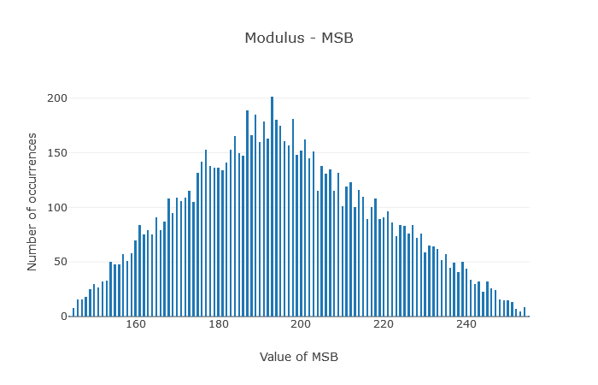
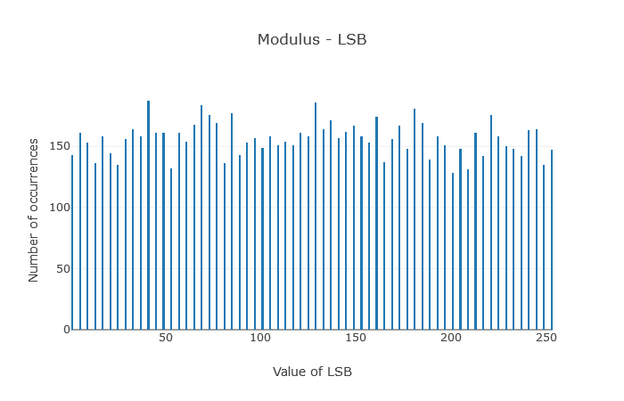
RSA-1024 modulus

Slide 7
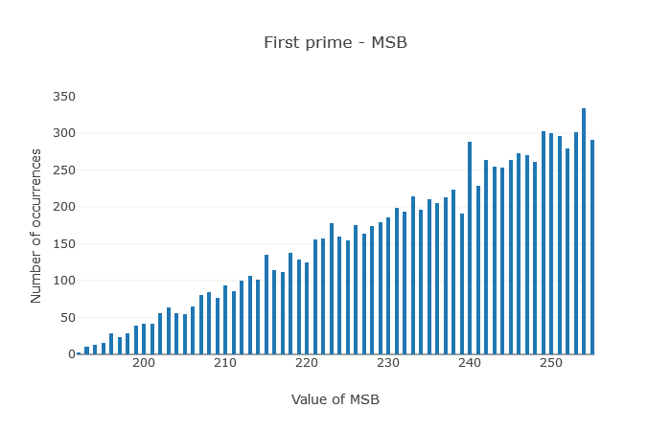
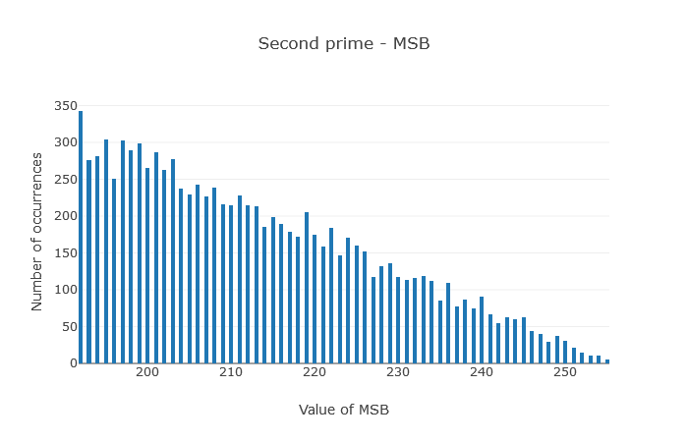
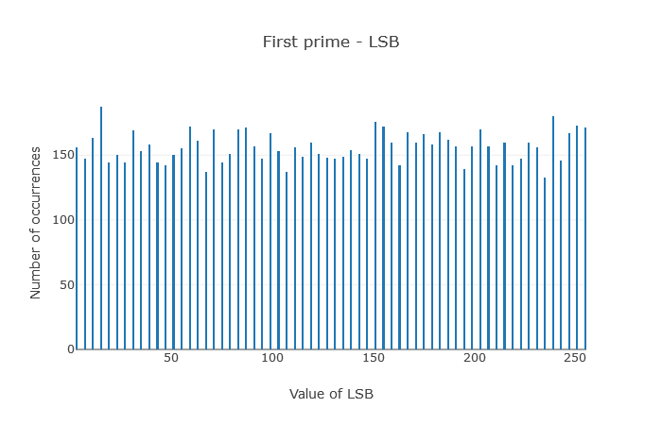
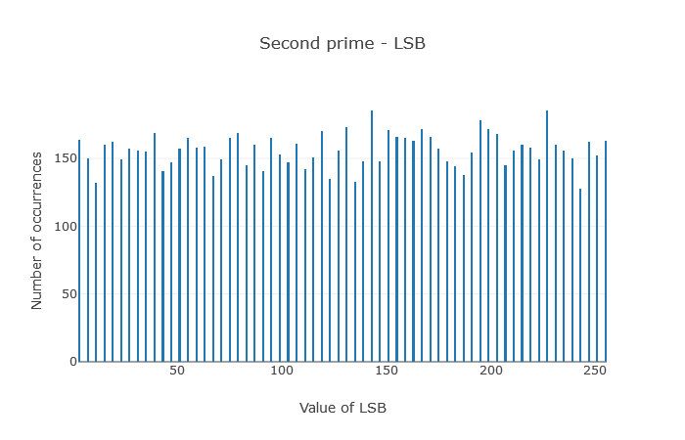
RSA-1024 primes

Slide 8

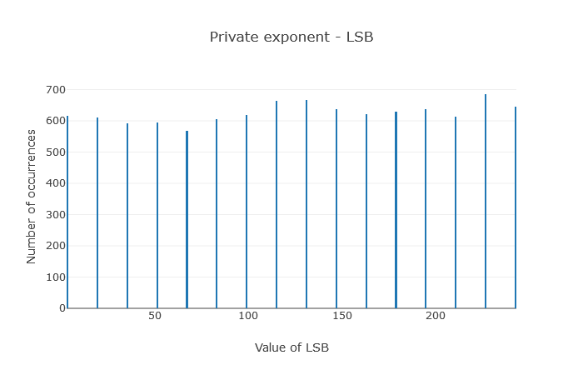
RSA-1024 private exponent

Slide 9
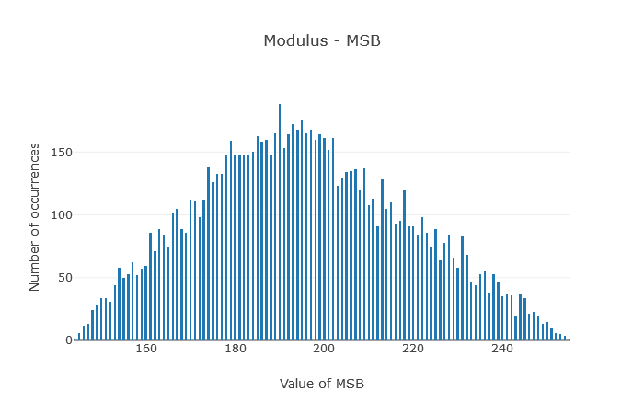
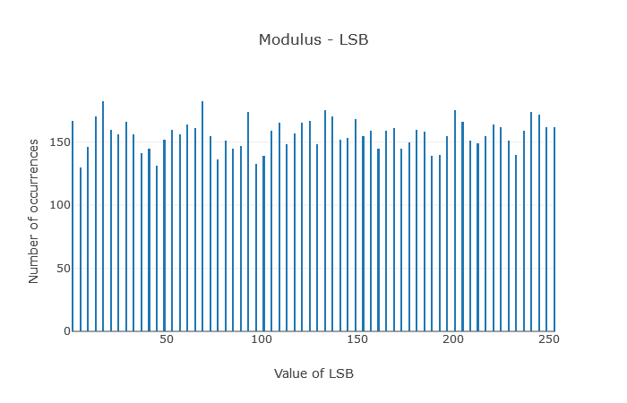
RSA-2048 modulus

Slide 10
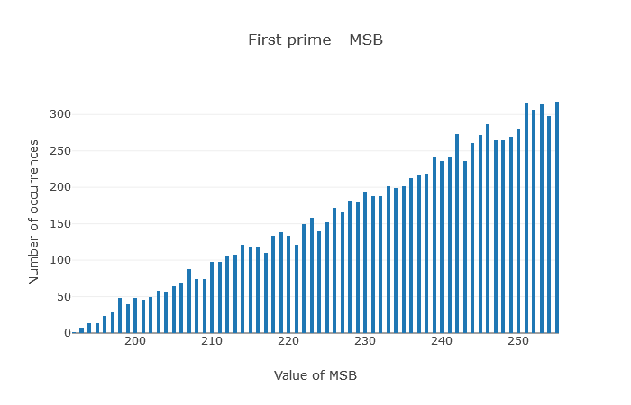
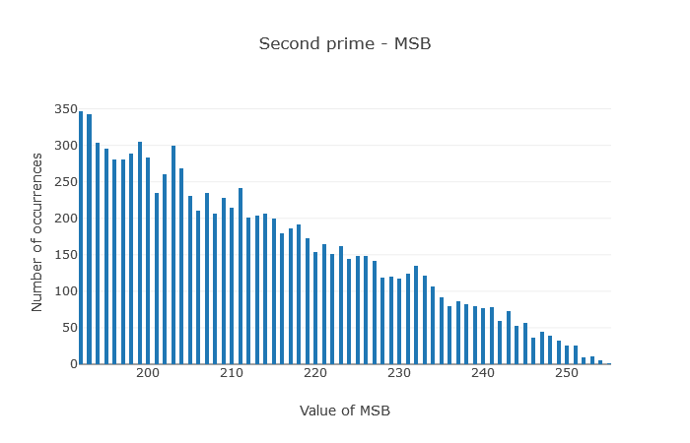
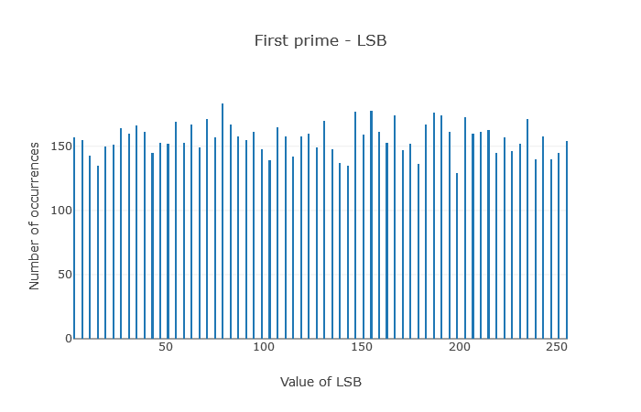
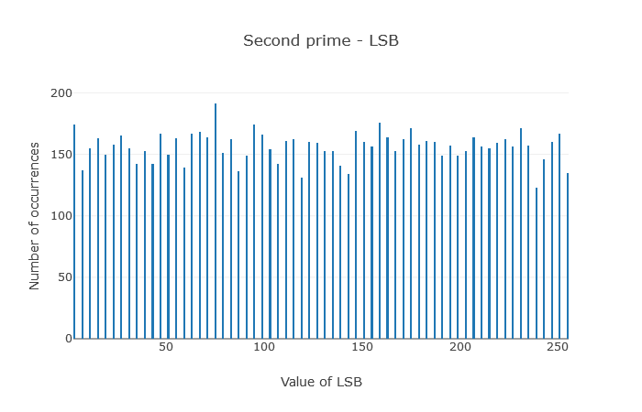
RSA-2048 primes

Slide 11
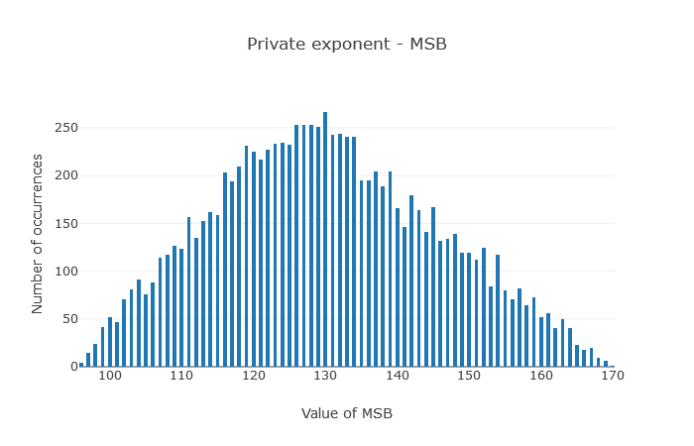
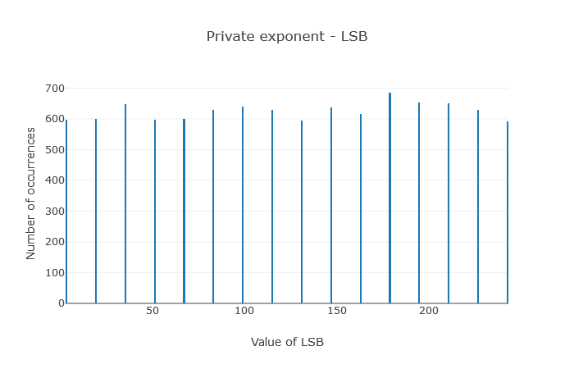
RSA-2048 private exponent

Slide 12
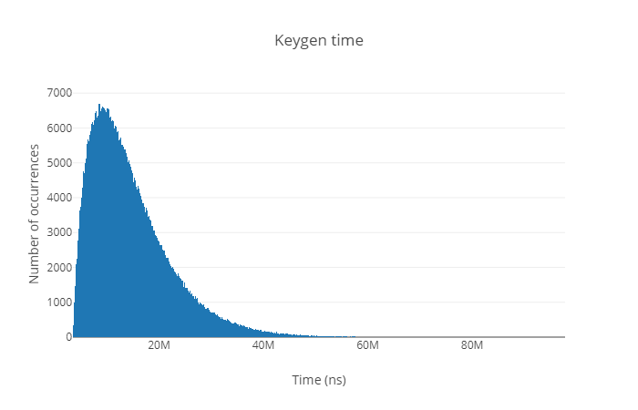
RSA-512b time

Slide 13
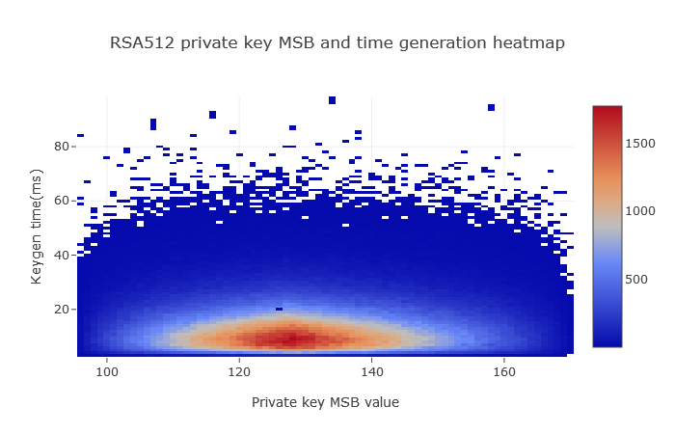
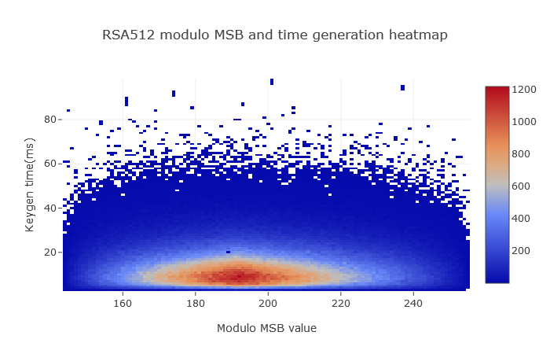
RSA-512 heatmaps

Slide 14

RSA-1024b time

Slide 15
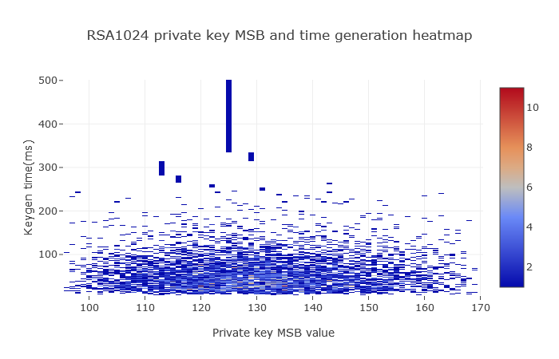
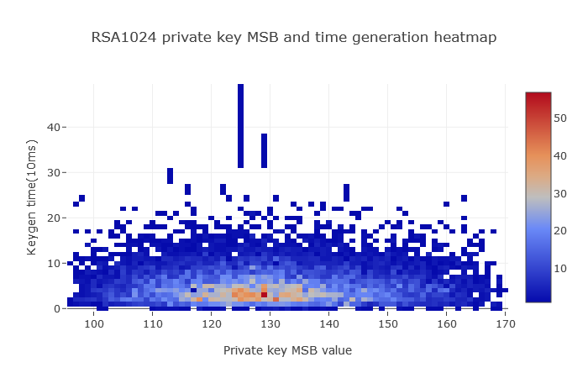
RSA-1024 heatmaps - private exponent

Slide 16
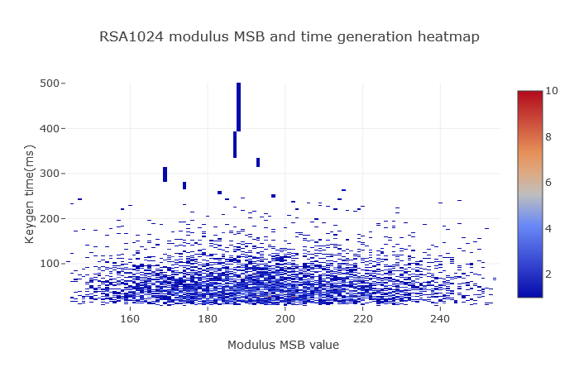
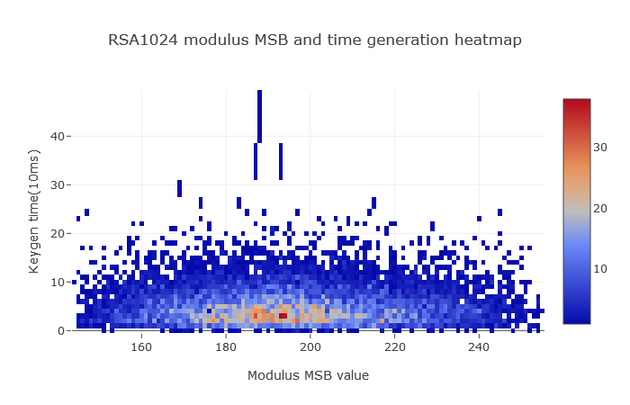
RSA-1024 heatmaps - modulus

Slide 17
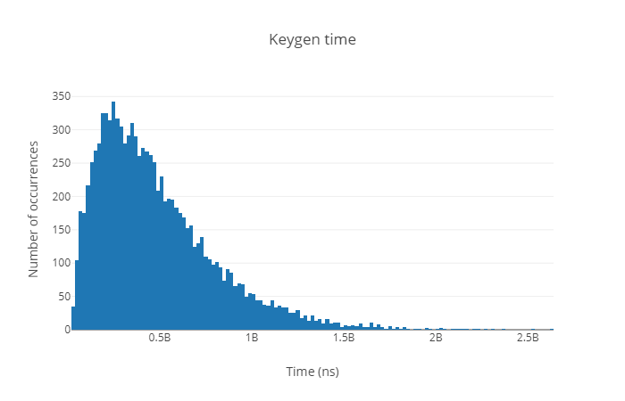
RSA-2048b time

Slide 18
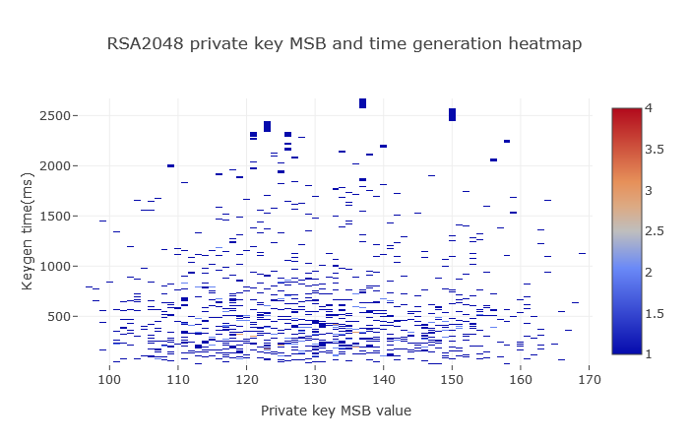
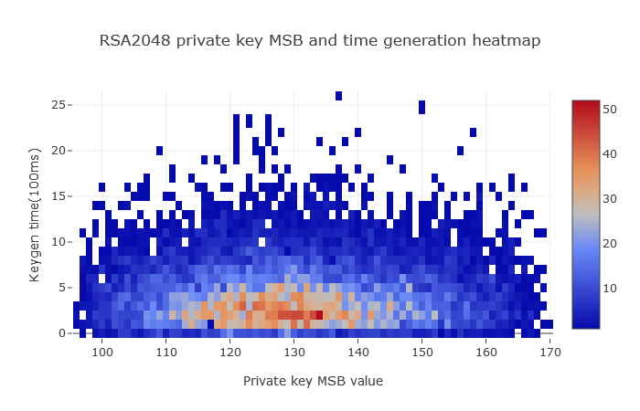
RSA-2048 heatmaps - private exponent

Slide 19
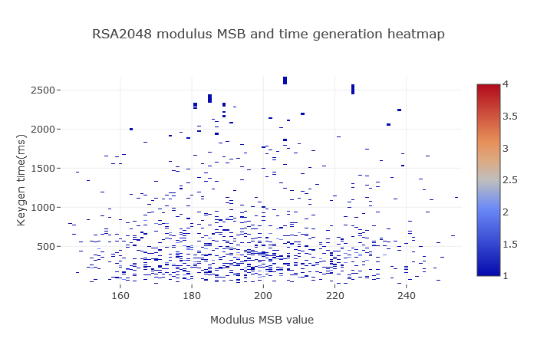
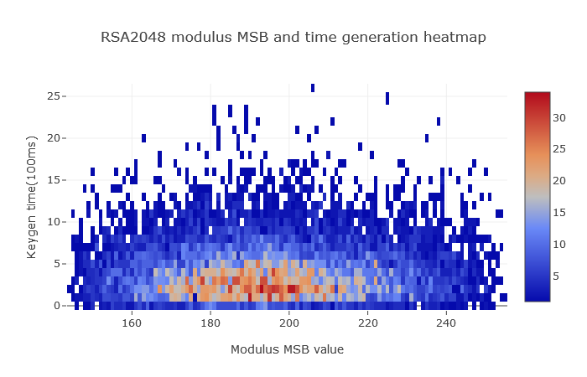
RSA-2048 heatmaps - modulus

Slide 20
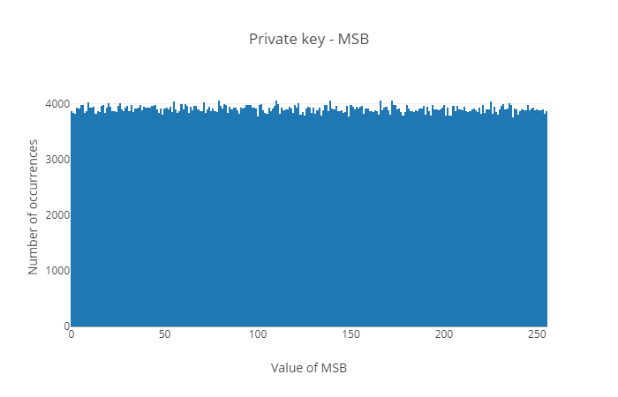
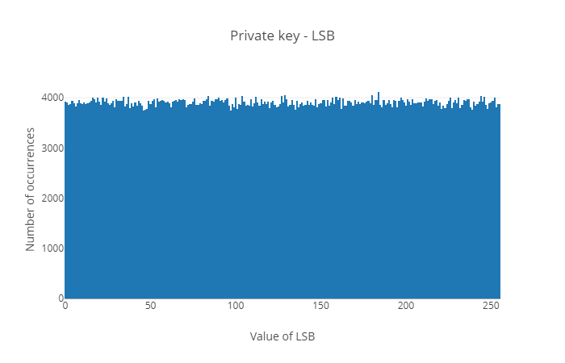
ECDSA (NIST P-256) private key

Slide 21
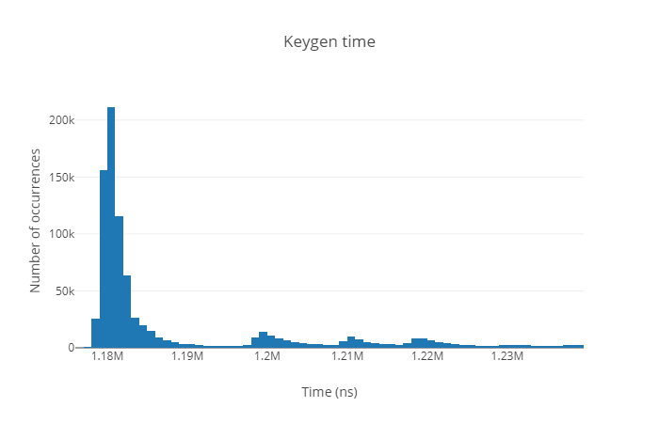
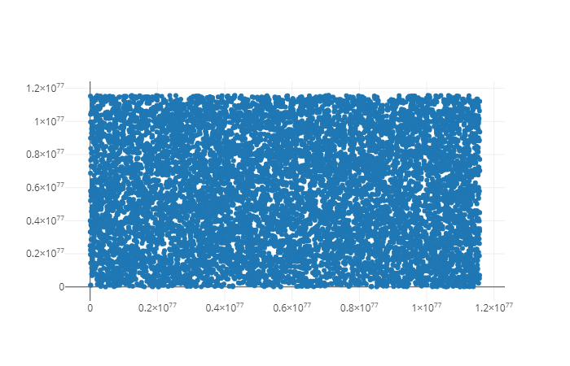
ECDSA (NIST P-256) time and public key

Slide 22
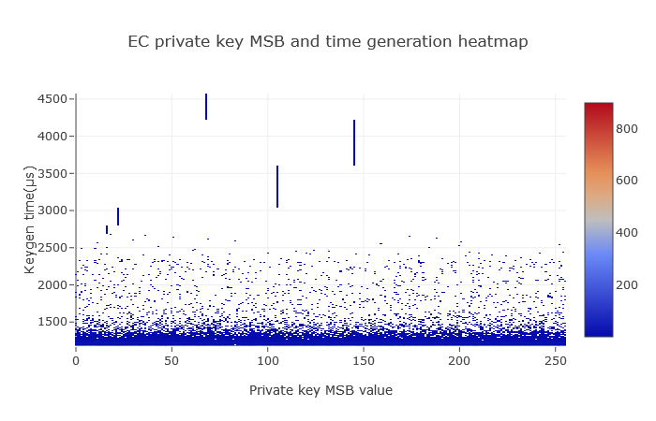
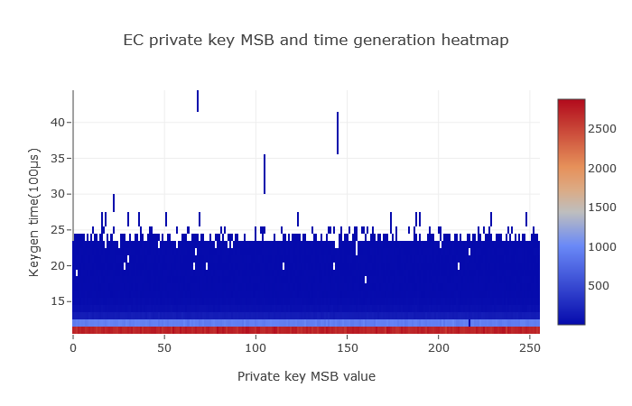
ECDSA (NIST P-256) heatmap

Slide 23
Conclusion
BearSSL is fast, easy to use and the author is willing to help
it seems that both the time of the generation and the MSB values shows no anomaly (author even claims that the implementation should run in constant time)
we are not sure about the public key of the P-256, because we expected at least some resemblance of the curve
based on this results we think that the library is well implemented without any glaring problems

