Slide 1


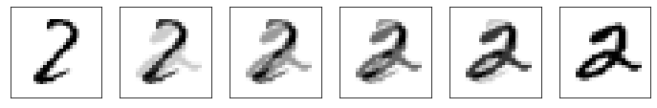

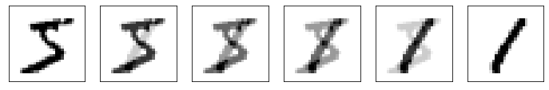
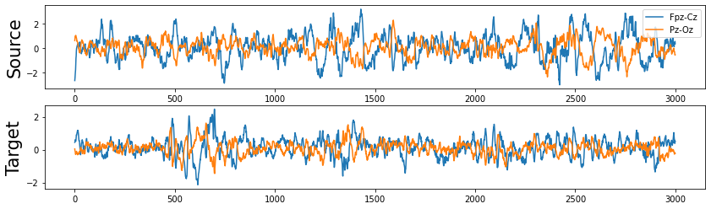
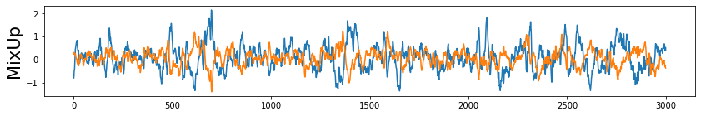
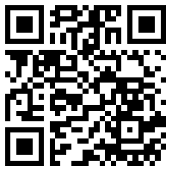
MixUp augmentation for EEG transfer learning
Michal Nahlik, nahlik.michal@seznam.cz
Introduction
EEG models could have wide applications but are often subject and experiment specific and therefore limited by the need to collect data for the target application. Collecting and labeling enough data might not be viable and tuning models on small sample can lead to overfitting and decreasing model usability, creating robust models that work well on new data thus remains challenging. MixUp augmentation can be used to introduce target features into bigger data set which reduces the risk of overfitting while allowing the model to learn required knowledge.
Multistage training
Multi-phase training provides better control over the training period and allows to simulate a real-life scenario where models would be pre-trained on an existing data source and then tuned for the target application.
Dataset split
Source data: large sample of labeled data; different subjects/datasets than test data.
Target data: small sample of labeled data related to test data; provided for transfer learning.
Test data: unlabeled data; different subjects/database than source data.
Training model in 3 stages
Stage 1 (base): train on source data only.
Stage 2 (supervised mixup): train on source data with supervised mixup augmentation using provided target data (random mixup rate from 0 to 0.6).
Stage 3 (finetuning and unsupervised mixup): train on source data with unsupervised mixup augmentation using test data (random mixup rate from 0 to 0.4) and labeled target data; using weighted sampler to focus on target data
Higher maximum mixup rate in stage 2 can be used because the label is known and only data from same class are selected. Stronger influence of target data will not have negative effect on model training by introducing features from samples belonging to different classes. In stage 3 the mixup rate is limited to 0.4 which transforms the source samples to resemble target data without overriding important information needed for correct classification.
Additional methods used during training to reduce overfitting and improve model robustness: Focal loss [2] with label smoothing, Virtual Adversarial Training [3]; Random noise augmentation.
Results on BEETL dataset
NeurIPS 2021 BEETL Competition: Benchmarks for EEG Transfer Learning (https://beetl.ai)
Task 1: sleep stage decoding on Physionet sleep data set; cross subject transfer learning; model expected to work on new subjects from different age group.
Task 2: motor imagery decoding; train on Cho 2017, BNCI 2014-001, PhysionetMI data sets, test on unpublished Cybathlon 2020 data, small number of samples from test subjects provided for transfer learning; cross dataset and cross subject transfer learning; models expected to work for different recording setups and experiment executions.
Experiment setup for both tasks
Proposed method was used in both tasks with similar setup to test its general usability for transfer learning.
AdamW optimizer; Focal loss [2] with label smoothing, Virtual Adversarial Training [3]; Random noise augmentation.
Data normalization using standard scaling (on whole dataset for task 1; on each trial for task 2).
Trained two models with different seeds, used averaged output.
Multistage training: stage 3 results used as final.
Task specific model and preprocessing (code and description: https://github.com/michal-nahlik/neurips-beetl-2021).
MixUp augmentation
Originally proposed to improve generalization and increase robustness of deep neural networks used for image classification problems [1] but can be applied to any data.
Combines two samples S1 and S2 using given mixup rate rm
Supervised MixUp: S₂ is selected to have the same label as S1.
Unsupervised MixUp: S2 is selected randomly, resulting label can be either calculated the same way as mixup data or based on the dominant sample.
Samples from different distributions should be normalize before mixup.
$f\left(S_{1},S_{2},r_{m}\right)=\left(1−r_{m}\right)∗S_{1}+r_{m}∗S_{2}$
Task | Stage 1 (base) | Stage 2 (mixup) | Stage 3 (finetuned)
Sleep stages | 60.05 | 69.32 | 66.78
Motor imagery | 39.87 | 59.87 | 56.47
Figure 4: Accuracy in BEETL competition for each task and model output after each training stage
Stage 1
Training data: source data
Motivation: learn general knowledge
Stage 3 results were submitted to NeurIPS 2021 BEETL competition and ranked 3rd in Task 1 and 5th in Task 2 resulting in 5th overall place.
Figure 1: Example of supervised and unsupervised MixUp on MNIST dataset
with increasing mixup rate: 0, 0.2, 0.4, 0.6, 0.8, 1.
Conclusion
Results in both BEETL tasks suggest that MixUp is a viable option for EEG transfer learning and could be an alternative to tuning models directly on target data. Stage 3 did overfit and reduce the final score slightly but that might be result of non-optimal training setup. It would be interesting to explore how number of samples used for transfer learning affect the model performance while using mixup compared to currently used methods. Another thing to explore could be the influence of unsupervised mixup on model robustness.
Stage 2
Training data: Supervised MixUp(Source data, Target data)
mixup rate = Random(0, 0.6)
Motivation: introduce target specific features
Stage 3
Training data: target data; unsupervised MixUp(Source data, Test data)
mixup rate = Random(0, 0.4)
Weighted sampler: target 0.75, source 0.25
Motivation: finetune on target data, introduce features from test dataset
References
Hongyi Zhang, Moustapha Cisse, Yann N. Dauphin, & David Lopez-Paz. (2018). mixup: Beyond Empirical Risk Minimization.
Takeru Miyato, Shin-ichi Maeda, Masanori Koyama, Ken Nakae, & Shin Ishii. (2016). Distributional Smoothing with Virtual Adversarial Training.
Tsung-Yi Lin, Priya Goyal, Ross Girshick, Kaiming He, & Piotr Dollár. (2018). Focal Loss for Dense Object Detection.
Figure 2: Example of MixUp augmentation using source and target EEG data with mixup rate 0.6.
Figure 3: Training pipeline visualization.

