Slide 1
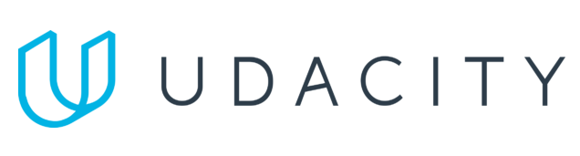
Data Lake Value Proposition
Medical Data Processing Company
Michał Jańczyk
Udacity IPS Version 1.0

Slide 2
Agenda
What is a Data Lake
Components of a Data Lake
Data Lake vs Data Warehouse
Business Value of Data Lake Solution
Proposed Data Lake Architecture for Medical Data Processing system
Udacity IPS Ver. 1 2/2020

Slide 3
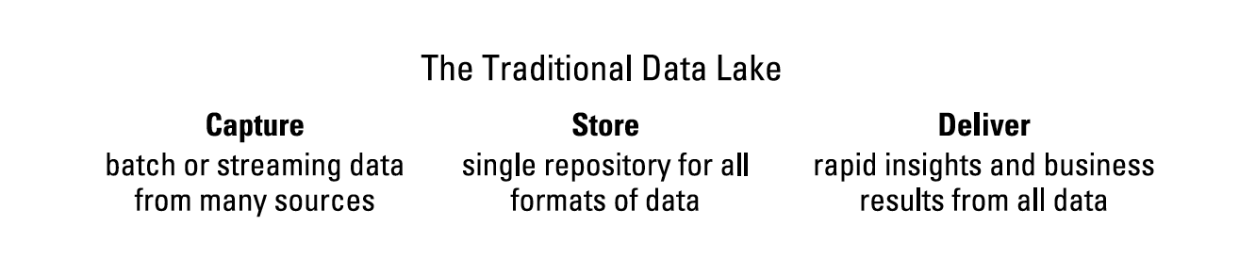
What is a Data Lake
Executive summary
The most important thing to understand about a data lake is not how it is constructed, but what it enables. It’s a comprehensive way to explore, refine, and analyze petabytes of information constantly arriving from multiple data sources. The original promise of the data lake remains: a way for organizations to collect, store, and analyze all of their data in one place.

Slide 4
Components of Data Lake
How to avoid data swamps?
Build data lake based on data quality and data governance
The ability to store unlimited amounts of diverse data makes the cloud data lake particularly well-suited for Medical Data Processing Company
All data and compute resources are internal to the modern data lake platform, and can be accessed, analytics and executed quickly and efficiently
Well architected data lakes does not have problems include lackluster performance, difficulty managing and scaling the environment, and high license costs for hardware and software.

Slide 5
Data Warehouse
Data Lake
DW stores all incoming data in quantitative metrics with schemas
DW is a mix of variety of technologies and component which allows the strategic use of data
DW defines the schema before the data is stored
DL stores all incoming data irrespective of the source and its structure
DL is using as a storage repository that stores all type of data
DL defines the schema after the data is stored
Udacity IPS Ver. 1 2/2020

Slide 6
Business Value of Data Lake
Modern data lake technologies have emerged, enabling organizations to easily share slices of their data, and receive shared data, in a secure and governed way.
Ultimately, a data lake should democratize access to the data.
Modern cloud data lakes allow them to capture, store, and facilitate analysis to discover trends and patterns - with the majority of data in the cloud.
Executives and professionally trained analysts thrive on data exploration and data-driven decision-making.

Slide 7
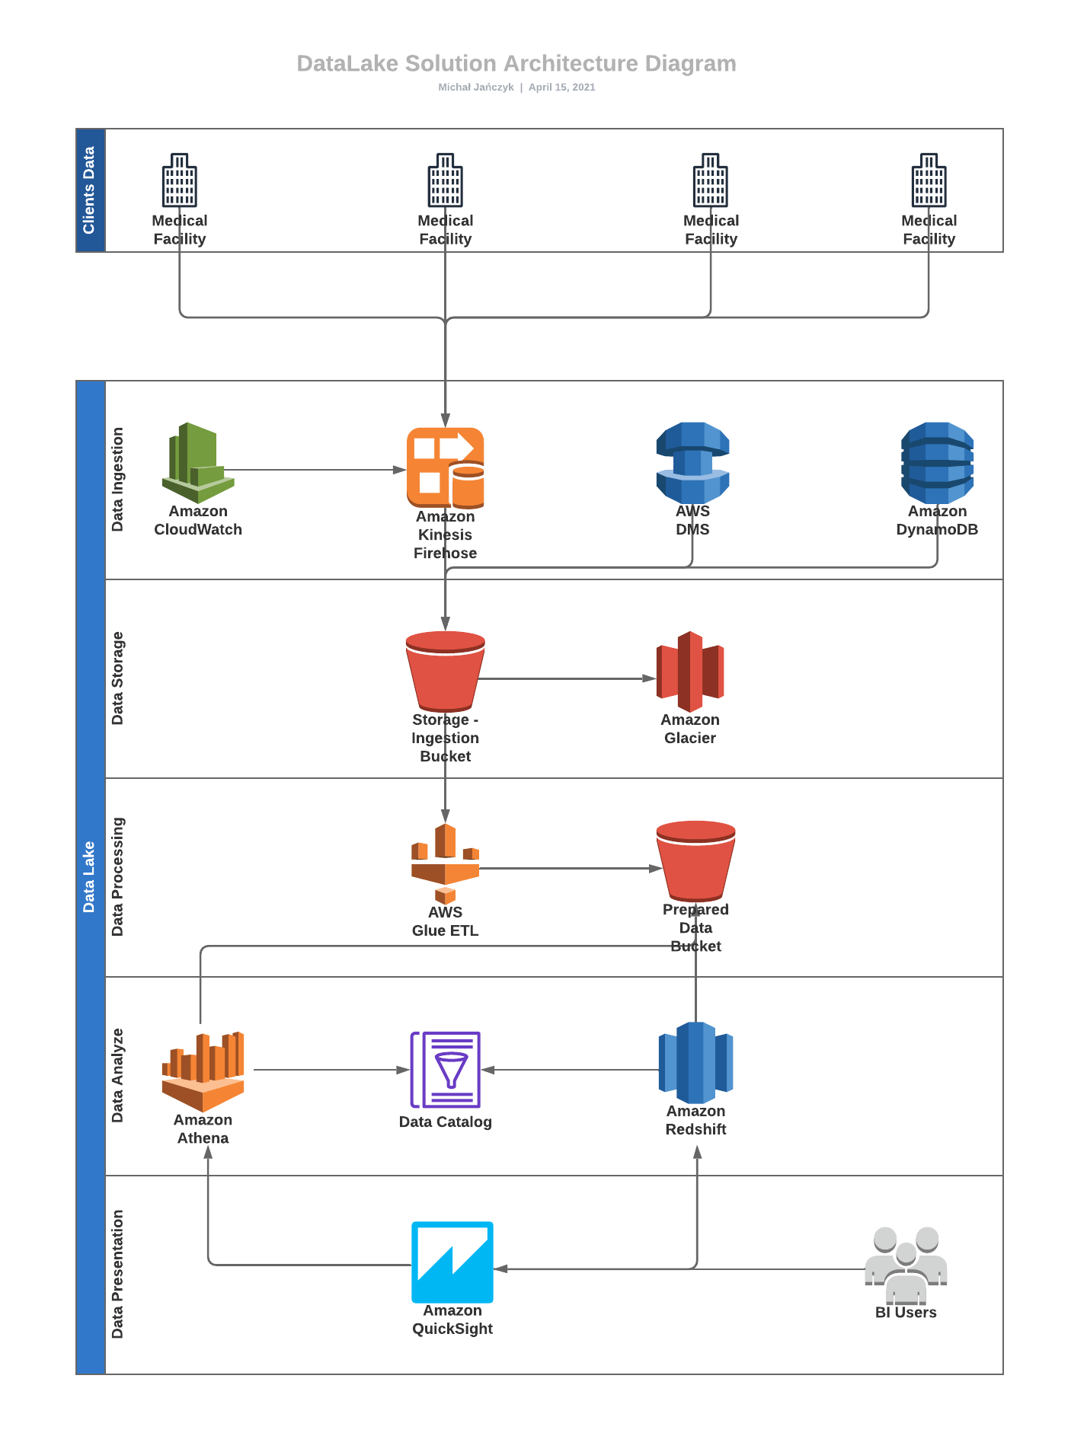
Data Lake Architecture
Serverless AWS Cloud Data Lake
Why Serverless
Simple to manage
No cost for IDLE
Best for Agile methodology

Slide 8
THANK YOU
Udacity IPS Version 1.0

