Slide 1
Checkers game
logic + image recognition
Michał Czupryniak, Bartosz Kaczorowski, Michał Werda

Slide 2
Architecture
Image recognition
Checkers logic
Status view

Slide 3
Structure
[EMPTY,
WHITE_PAWNS,
BLACK_PAWNS,
WHITE_PAWNS_PROMOTED,
BLACK_PAWNS_PROMOTED]
[0,
1,
2,
3,
4]

Slide 4
Structure
BOARD_ARRAY = [[PIECE.EMPTY.value for x in range(8)] for x in range(8)]
[[0, 0, 0, 0, 0, 0, 0, 0],
[0, 0, 0, 0, 0, 0, 0, 0],
[0, 0, 0, 0, 0, 0, 0, 0],
[0, 0, 0, 0, 0, 0, 0, 0],
[0, 0, 0, 0, 0, 0, 0, 0],
[0, 0, 0, 0, 0, 0, 0, 0],
[0, 0, 0, 0, 0, 0, 0, 0],
[0, 0, 0, 0, 0, 0, 0, 0]]

Slide 5
Structure
START_BOARD_ARRAY = [[1, 0, 1, 0, 1, 0, 1, 0],
[0, 1, 0, 1, 0, 1, 0, 1],
[1, 0, 1, 0, 1, 0, 1, 0],
[0, 0, 0, 0, 0, 0, 0, 0],
[0, 0, 0, 0, 0, 0, 0, 0],
[0, 2, 0, 2, 0, 2, 0, 2],
[2, 0, 2, 0, 2, 0, 2, 0],
[0, 2, 0, 2, 0, 2, 0, 2]]

Slide 6
Rules
def move_white_paws(type, fromWhere, toWhere)
return <ACTUAL_BOARD_ARRAY>
def move_black_paws(type, fromWhere, toWhere)
return <ACTUAL_BOARD_ARRAY>
def function_find_all_legal_moves(BOARD_ARRAY)
return <array>

Slide 7






Tiles used to create the visual representation of the state of game

Slide 8


Using PIL to create an array

Slide 9
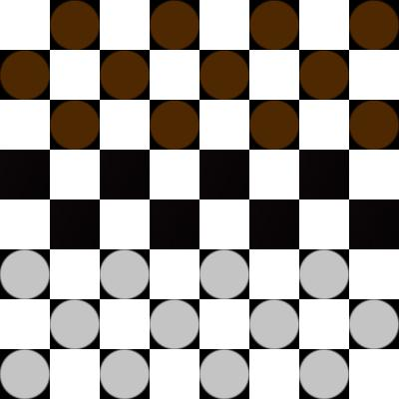
Example of a processed state

Slide 10
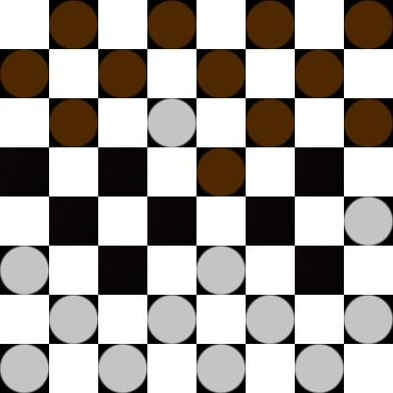
Another example of state

Slide 11
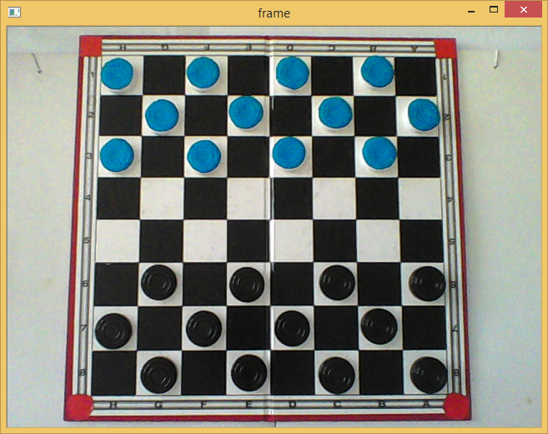
Original image

Slide 12
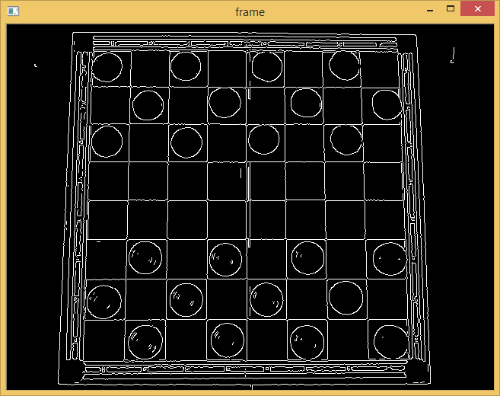
Gradients detection

Slide 13
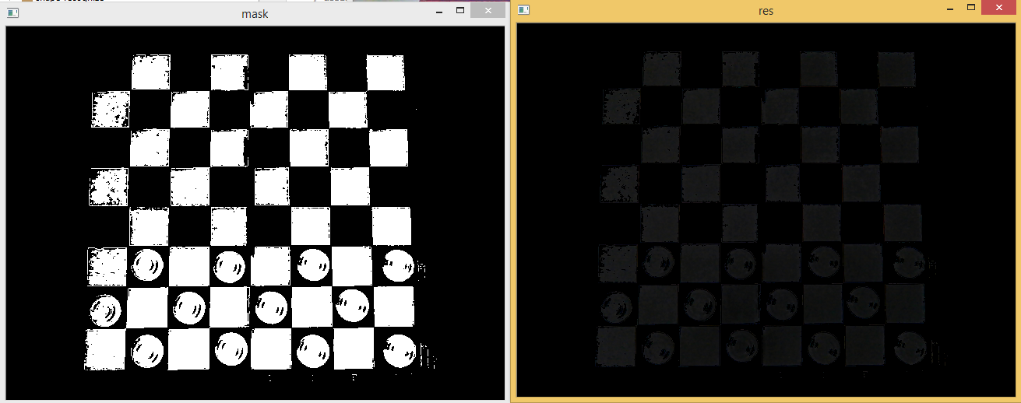
Black detection

Slide 14
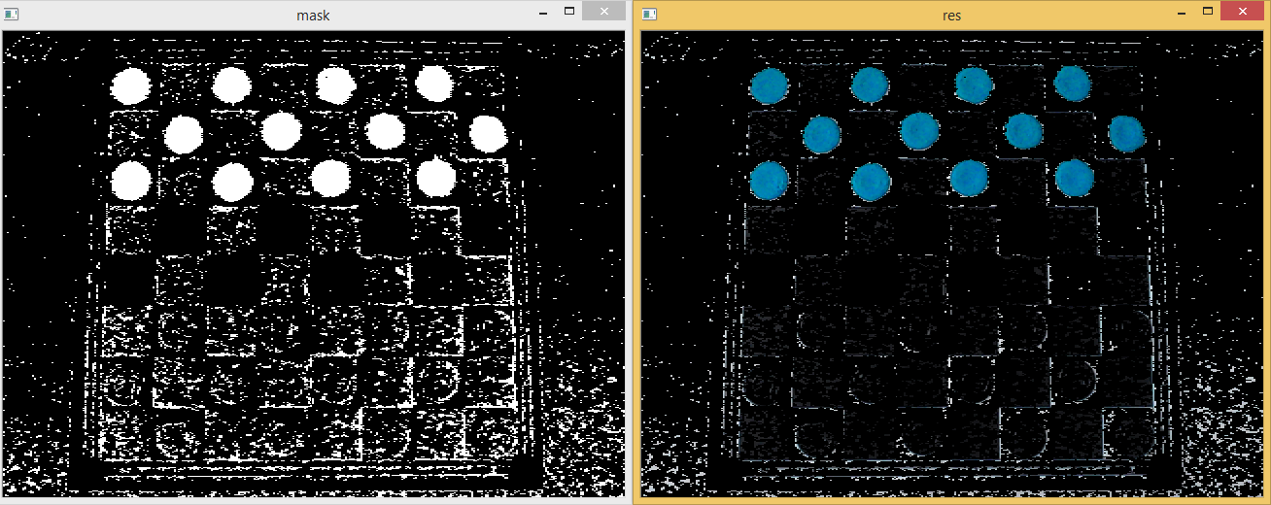
Blue detection

Slide 15
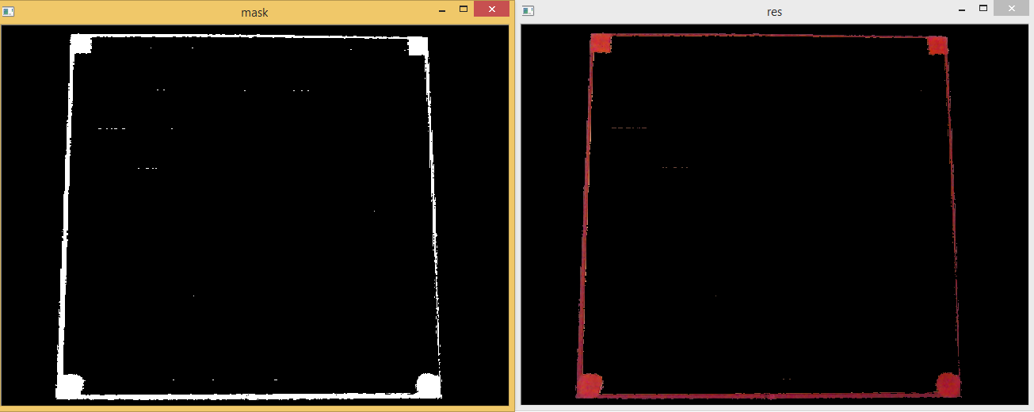
Red detection

