Slide 1

Short Interactions Workshop –
Value Based Selling
Global Marketing and Sales Capabilities
Notes View Only
Hide this slide for presenting
Company Confidential
2010© Eli Lilly and Company
Notes:
Short Interactions Workshop –
Value Based Selling
Copyright © 2010 Eli Lilly and Company
CONFIDENTIAL. FOR TRAINING PURPOSES ONLY. NOT FOR USE IN DETAILING.
Facilitator’s Guide
BET #366155; BET Abbreviation GSSRSIVBS

Slide 2

Short Interactions Workshop –
Value Based Selling
Global Marketing and Sales Capabilities
Notes View Only
Hide this slide for presenting
Notes View Only
Hide this slide for presenting
Company Confidential
2010© Eli Lilly and Company
Notes:
About This Workshop
LEARNING OBJECTIVES
By the end of this workshop, you will be able to:
Recognize the Top 4 mistakes Sales Representatives (SRs) make during Short Interactions (SI)
Identify the fundamentals of Short Interactions
Recognize the importance of Planning, Gaining Incremental Commitment, and Evaluating for Short Interactions
Demonstrate multiple Short Interaction dialogues
CONFIDENTIAL. FOR TRAINING PURPOSES ONLY. NOT FOR USE IN DETAILING.
MATERIALS CHECKLIST
ROOM SET-UP
The room set-up plays a critical role in the success of this workshop and helps to create a beneficial learning environment for the participants. Set up your room keeping the following in mind:
If using rectangular tables, position tables in a “U” shape so that participants can see the front of the room without obstructions. Position the appropriate number of chairs around the U-shaped table set-up.
If using round tables, position tables so that there is enough room at the front of the room for the “Gone in 60 Seconds” Activity.
Position screen, computer station, computer, and LCD projector in the center of the room.
BET #366155; BET Abbreviation GSSRSIVBS

Slide 3



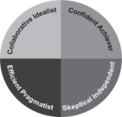



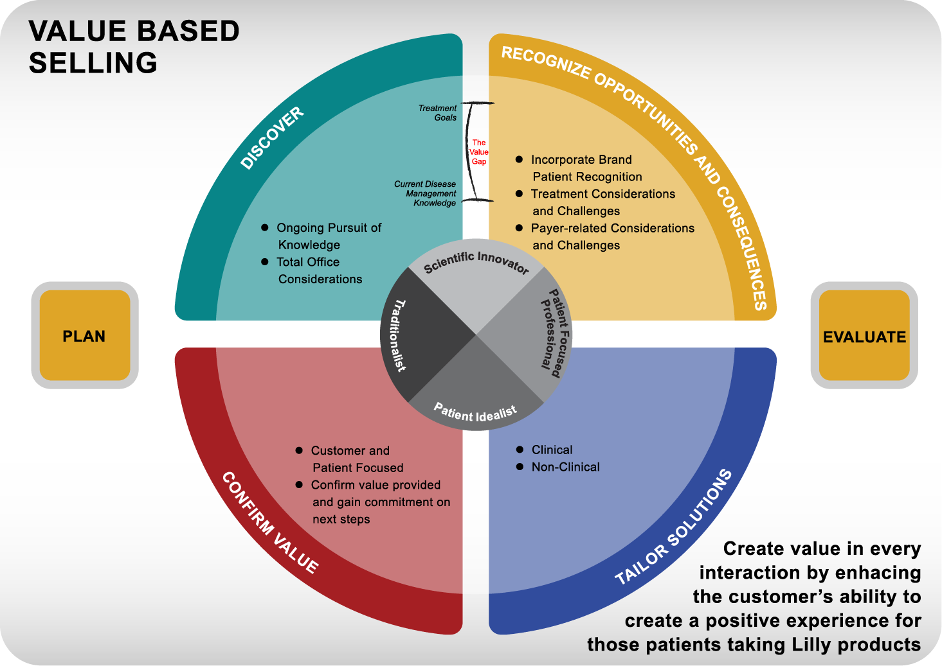

Short Interactions Workshop
Value Based Selling
Patient
Notes:
Display slide when participants are entering the room.
Next slide…
Short Interactions Workshop - VBS
Total Workshop Time:
1 hour 45 minutes
BET #366155; BET Abbreviation GSSRSIVBS

Slide 4
Workshop Agenda
10 min Welcome & Introduction
30 min Short Interaction Fundamentals
60 min “Gone in 60 Seconds” Activity
5 min Wrap-up
Total Time = 1 hour 45 minutes
Notes:
Welcome participants to the workshop.
Review the workshop agenda with participants.
Next slide…
Workshop Agenda
Welcome & Introduction –
Total Time: 10 minutes
6 Slides (1 of 6)
Welcome participants
Review the agenda
BET #366155; BET Abbreviation GSSRSIVBS

Slide 5
Learning Objectives
By the end of this workshop, you will be able to:
Recognize the Top 4 mistakes SRs make during short interactions
Identify the fundamentals of Short Interactions
Recognize the importance of Planning, Gaining Incremental Commitment and Evaluating for short interactions
Demonstrate multiple short interaction dialogues
Notes:
Review the Learning Objectives for the workshop.
Transition Statement: Let’s begin today by looking at the Top 4 mistakes that Sales Representatives make when faced with a short interaction.
Next slide…
Welcome & Introductions –
Learning Objectives
6 Slides (2 of 6)
Review the learning objectives with the participants.
BET #366155; BET Abbreviation GSSRSIVBS

Slide 6
Short Interactions – Top 4 Mistakes SRs Make
Failure to plan for shorter-than-expected sales interactions.
Question:
Do you think you need to spend as much time planning for a short interaction vs. a longer interaction with the customer? Why?
What do you think you need to do differently (if anything) to plan for a short vs. a longer interaction with the customer? Why?
Notes:
Say: The failure to plan for short interactions is one of most common mistakes Sales Representatives make.
Ask: Do you think you need to spend as much time planning for a short interaction vs. a longer interaction with the customer and why?
Possible answers include: No, because what can you really discuss with a customer in 60 seconds. Yes, but getting the customer to actually give you additional time is rare.
Ask: What do you think you need to do differently to plan for a short interaction vs. a longer interaction with the customer and why?
Possible answers include: Start planning for shorter interactions (the Sales Representatives may admit that they do not currently do this), create a more focused call objective to fit a shorter amount of time, prepare the appropriate information or sales materials (e.g. reprints, patient education, etc.) ahead of time.
Remind Sales Representatives that is important to invest as much time planning for short interactions as they do for longer customer interactions. In many ways, a short interaction is more difficult to plan for than a long interaction.
Say: We will take a close look at the best way to plan for short interactions later in the workshop.
Transition Statement: Let’s take a look at the second common mistake that Sales Representatives make.
Ask (for fun): Any guesses what mistake #2 might be?
Short Interactions –
Top 4 Mistakes SRs Make
6 Slides (3 of 6)
Mistake #1: SRs fail to plan for shorter-then-expected sales interactions.
BET #366155; BET Abbreviation GSSRSIVBS

Slide 7
Short Interactions – Top 4 Mistakes SRs Make (continued…)
2. Failure to quickly frame the purpose of the meeting with the customer.
Question: Which framing statement is stronger and why?
  It’s great to see you, Doctor X. I was just stopping by to check on your supply of patient education materials. Do you have a minute?
  It’s great to see you, Doctor X. I wanted to take this quick opportunity to find out how your patients have been responding to the new patient education materials that we discussed last week/month.
Notes:
Say: The second most common mistake made by a Sales Representative in a short interaction is the failure to quickly frame the purpose of the meeting with the customer. Let’s take a look at two example framing statements to better understand this mistake.
Ask: On the slide, there are two framing statements. Which framing statement is stronger and why?
Read A & B on the slide to the participants…
It’s great to see you, Doctor X. I was just stopping by to check on your supply of patient education materials. Do you have a minute?
It’s great to see you, Doctor X. I wanted to take this quick opportunity to find out how your patients have been responding to the new patient education materials that we discussed last week/month.
Answer: The correct answer is B. You can see in this example that the Sales Representative immediately takes the opportunity to frame the purpose of the meeting because time is limited. As a result, the customer is more likely to provide the information requested vs. telling the Sales Representative, “No, I do not have a minute. I’m running late to an appointment.”
Say: In addition, Option B allows the Sales Representative to gain incremental commitment (action) from the customer.
For example:
On my next visit we can discuss the new patient education materials in more detail and I can answer any questions that you may have (incremental commitment in 60 seconds or less!!).
I will make sure I follow up with your Diabetes educator while I am here to see if he/she has any questions on the new materials and then follow-up with you at our next visit (incremental commitment in 60 seconds or less!!).
Transition Statement: The third mistake that Sales Representatives often make is… next slide.
Short Interactions –
Top 4 Mistakes SRs Make
6 Slides (4 of 6)
Mistake #2: SRs fail to quickly frame the purpose of the meeting with the customer.
BET #366155; BET Abbreviation GSSRSIVBS

Slide 8

Short Interactions – Top 4 Mistakes SRs Make (continued…)
Sales Representatives share more information in short interactions than they should.
Sharing too much information;
one-way communication;
“tell-selling”
Sales
Representative
Limited Time
With Customer
Notes:
Say: Mistake #3 happens when a Sales Representative gets distracted, knowing that they have limited time with the customer, and begin to “share” more information than they should.
Say: In addition, this is where Sales Representatives tend to revert back to old behavior (the Lilly Selling Model); they become less customer-centric, and begin “tell-selling”. In addition, the communication becomes one-way vs. a dialogue.
Say: The best way to overcome this mistake is to:
Be aware of this common reaction to limited time with the customer,
Plan effectively for short interactions, and
Practice, practice, practice (which we will do shortly).
Remind the Sales Representatives that they more prepared they are for a short interaction (plan), the less likely that this will happen to them.
Transition Statement: The fourth mistake that Sales Representatives tend to make during short interactions is…
Next slide…
Short Interactions –
Top 4 Mistakes SRs Make
6 Slides (5 of 6)
Mistake #3: SRs share more information in short interactions than they should.
BET #366155; BET Abbreviation GSSRSIVBS

Slide 9

Short Interactions – Top 4 Mistakes SRs Make (continued…)
Begin to speak more quickly during the customer interaction.
Question: What might happen if you begin to speak more quickly during a short interaction with the customer?
Do you feel like you truly know what to do in short interactions to create customer value?
Notes:
Say: …they begin to speak more quickly!
Ask: What might happen if you begin to speak more quickly (or even begin to share more information than you should) during a short interaction with the customer?
Possible answers include: lose credibility with the customer, the customer stops paying attention, you lose the opportunity to negotiate for more time, etc.
Click to bring up the question on this slide.
Ask: How many people truly feel like you know what to do in short interaction to create customer value?
Note to facilitator: Participants may, or may not, feel comfortable admitting their level of comfort with creating customer value in short interactions (which is OK – remember, this is a safe learning environment)! Reassure them that it is OK (that is why time is being dedicated to the skills in this workshop).
Transition Statement: Whether you feel like an “expert” in short interactions or a “beginner,” we will spend the rest of our time in this workshop discussing the Fundamentals of Short Interactions and Practicing multiple short interactions in a highly interactive activity. Let’s get started…
Short Interactions –
Top 4 Mistakes SRs Make
6 Slides (6 of 6)
Mistake #4: SRs begin to speak more quickly during the customer interaction.
BET #366155; BET Abbreviation GSSRSIVBS

Slide 10
Workshop Agenda
10 min Welcome & Introduction
30 min Short Interaction Fundamentals
60 min “Gone in 60 Seconds” Activity
5 min Wrap-up
Total time = 1hour 45 minutes
Notes:
Review the workshop agenda with participants.
Next slide…
Short Interaction Fundamentals
Total Time: 30 minutes
9 Slides (1 of 9)
Set up the next section on Short Interaction Fundamentals.
BET #366155; BET Abbreviation GSSRSIVBS

Slide 11
Short Interaction Fundamentals
What do you think are the fundamentals of an effective interaction within Value Based Selling when time is limited with a customer?
  Plan
  Gain Incremental Commitment
  Evaluate
Notes:
Ask: the question on the slide, and allow time for people to respond.
Click to reveal the answers on the slide (Plan, Gain Incremental Commitment, and Evaluate).
Say: These fundamental components should look familiar to you.
Ask: Where else are these fundamental components found?
Answer: Right, each one is a included in the Value Based Selling Model (VBSM).
Next slide…
Short Interaction Fundamentals
9 Slides (2 of 9)
The fundamentals of a short interaction include:
Plan
Gain Incremental Commitment
Evaluate
BET #366155; BET Abbreviation GSSRSIVBS

Slide 12

The Value Based Selling Model (VBSM)
The Value Based Selling Model is a flexible framework
that allows Sales Representatives to…
A flexible framework that allows you to create value in every interaction by enhancing the customer’s ability to create a positive experience for those patients taking Lilly Brands.
Create value in every interaction by enhancing the customer’s ability to create a positive experience for those patients taking Lilly Brands.
Notes:
The Value Based Selling Model is a flexible framework, not a linear process.
It may take multiple customer interactions before a commitment is made by the customer.
Say: The Value Based Selling Model provides you with a flexible framework to tailor both your short, and long interactions, using an incremental and progressive approach.
Remind the SRs that not every interaction ends in a “sale”. It may take multiple visits/interactions to move a customer from their current behavior to new behavior.
Remind the SRs that the VBSM is not a linear process – SRs progress through the components in different ways based on the needs of the customer. Each customer interaction is unique.
Transition Statement: Let’s take a closer look at how each of the Short Interaction fundamentals (Plan, Gain Incremental Commitment, and Evaluate) can be used to create an effective customer interaction when time is limited.
Next slide…
Short Interaction Fundamentals – The Value Based Selling Model (VBSM)
9 slides (3 of 9)
BET #366155; BET Abbreviation GSSRSIVBS

Slide 13
Short Interaction Fundamentals
  Plan – what are the key components of planning?
    Customer Knowledge
        What do I already know about my customer?
        Where am I in the Value Based Selling Model with this customer?
    Selling Situation
        How often do I see the customer?
        How much time do I anticipate having with the customer, and what setting will I be in for this visit/call?
Notes:
Say: As we’ve discussed, planning is critical to our success for short interactions as well as longer interactions with customers.
Say: the key aspects of planning include:
Customer Knowledge:
What do I already know about my customer?
Possible answers include: target patient treatment goals, customer needs, customer priorities, etc.
Where am I in the Value Based Selling Model with this customer?
Possible answers include: Discover, Tailor Solutions, etc.
Selling Situation
How often do I see the customer?
Possible answers: once per week, once per month, once per quarter, once per year, etc.
How much time do I anticipate having with the customer, and what setting will I be in for this call/visit?
Possible answers: 60 seconds in the hallway of the hospital, 60 seconds in the hallway at the doctor’s office between patients, etc.
Say: How much time you will have, and how often you can see the customer, are important considerations as you plan to engage the customer.
For example:
If you see the customer once per week, you may decide to dedicate time to the Discover component of VBS to strengthen your understanding of their disease management approach on a call on a Thursday, because you believe this knowledge will help you for a lunch meeting/program you have on Thursday of the following week.
If you see the customer once per quarter, you may decide not to dedicate any additional time to the Discover component of VBS because you believe that you already have enough knowledge to engage them in a meaningful dialogue to address the patient treatment goals they have discussed with you on previous calls/visits.
Short Interaction Fundamentals – Plan
9 slides (4 of 9)
The key components of planning include:
Customer knowledge
Selling situation
Short interaction call objective
BET #366155; BET Abbreviation GSSRSIVBS

Slide 14
Short Interaction Fundamentals
  Gain Incremental Commitment
    How will I engage this customer for a short interaction?
    What incremental commitment will I ask for during the interaction to move me forward with the longer term objective with this customer?
Don’t forget to frame the purpose of the meeting quickly
during a short interaction with the customer!
Notes:
Say: While it may seem nearly impossible to gain incremental commitment in 60 seconds during a customer interaction, if you effectively plan and scale back the “scope” (or expectation) of what you might gain commitment on in 60 seconds, you can achieve your goal!
Say: It is also important to consider how you will engage the customer for a short interaction.
Ask: Does anyone remember what one of the Top 4 mistakes that SRs make during a short interaction is when engaging the customer?
Answer: Mistake #2 - Failure to quickly frame the purpose of the meeting with the customer.
Remind SRs that it is important to adjust how they engage their customers when planning for a short interaction.
Next slide…
Short Interaction Fundamentals – Gain Incremental Commitment
9 slides (5 of 9)
Frame the purpose of the meeting quickly when engaging the customer.
Gaining incremental commitment is possible if you plan effectively.
BET #366155; BET Abbreviation GSSRSIVBS

Slide 15
Short Interaction Fundamentals –
Writing a Short Interaction Call Objective
  Short interaction call objectives need to be:
    Realistic – an achievable goal – what is a realistic action or commitment to ask for in 60 seconds?
      Question: Is this a realistic short interaction call objective? Why?
        Dr. Harris recognizes the appropriate brand patient for Product X and is confident in using Product X with that patient.
Specific – focused and clear
    Question: Why is being specific important?
Notes:
Say: Once you have thought through the planning questions, it is time to write a pre-call objective for your short interaction.
Say: Short call objective should be realistic.; an achievable goal for 60 seconds that allow you (the SR) to ask for a realistic commitment or action from the customer.
Click to reveal the question.
Read the example short interaction objective to the participants.
Ask: Is this a realistic short interaction call objective? Why?
Answer: This objective is not realistic for a short interaction. The objective is too broad, asks a closed ended question, and focuses the customer on the negative of the Product X.
Click to reveal the next short call interaction component.
Say: Short call objectives should also be specific.
Click to reveal the question.
Ask the question from the slide: Why do you think it is important to be specific, especially in a short interaction?
Possible answers: during a longer interaction, there may be time to dialogue with the customer and ask additional clarifying questions; if you can’t quickly frame the purpose of the meeting with the customer, they may not understand the value which results in lost credibility with the customer.
Transition statement: Let’s take a look at a few more examples of short interaction objectives.
Next slide…
Short Interaction Fundamentals – Writing a Short Interaction Call Objective
9 slides (6 of 9)
BET #366155; BET Abbreviation GSSRSIVBS

Slide 16
Short Interaction Fundamentals –
Writing a Short Interaction Call Objective (continued)…
Short Interaction Objective | Effective or Ineffective? Why?
Confirm that Dr. Harris understands the dosing profile for Product X.
Ask Dr. Harris if he has had any issues with Product X since your last visit.
Confirm that Dr. Harris had a chance to review the patient education materials from the last call, and ask Dr. Harris if you may follow-up to see if his Diabetes Nurse Educator has any questions about the materials.
Effective
Ineffective
Effective
Notes:
Say: Let’s take a look at three examples of short interaction call objectives. As I read each one, the group will determine if the objective is effective or ineffective for a short interaction and why.
Read the 1st objective to the group.
Ask: Is this an effective or ineffective call objective for a short interaction and why?
Reveal the answer by clicking once.
Say: The first objective is effective. Why? The objective is both realistic and attainable for a short interaction. It is also specific.
Read the 2nd objective to the group.
Ask: Is this an effective or ineffective call objective for a short interaction and why?
Reveal the answer by clicking once.
Say: The second objective is ineffective. Why? While this objective may be more appropriate for a long interaction, there is too much information to try and discuss for a short interaction. In addition, the objective focuses the customer on a negative of Product X (had Dr. Harris had any issues with Product X since your last visit).
Read the 3rd objective to the group.
Ask: Is this an effective or ineffective call objective for a short interaction and why?
Reveal the answer by clicking once.
Say: The third objective is effective. Why? The objective is both realistic and attainable for a short interaction. It is also specific.
Next slide…
Short Interaction Fundamentals – Writing a Short Interaction Call Objective
9 slides (6 of 9)
BET #366155; BET Abbreviation GSSRSIVBS

Slide 17
Short Interaction Fundamentals
  Evaluate
    Did I tailor my approach based on the customers time?
    Who got more value from the interaction; me or the customer?
    What value did I provide?
    Did I achieve the call objective for this short interaction?
Getting better at short interactions requires
reflection on what worked and what did not work!
Notes:
Say: Following the call/visit with the customer, it is important to evaluate the short interaction.
Did I tailor my approach based on the customers time?
Remind the SRs that they need to be aware of the non-verbal body language of the customer: do they look like they are in a hurry? do they turn their back to you when they see you coming down the hall of the hospital? do they keep looking at their watch? Ignoring these non-verbal signs, can damage the long term relationship with the customer (and make the SR look insensitive).
Who got more value from the interaction; me or the customer?
Remind the SRs that it takes good pre-call planning discipline, and practice, to get good at short interactions with customers.
What value did I provide?
This is a great question to reflect on following a short interaction. If a SR can become skilled in providing value in 60 seconds, think about how much value they can provide in 20 minutes!!
Remind the SRs to think about if they made any of the Top 4 Mistakes (sharing too much information, talking to fast, etc.)
Did I achieve the call objective for this short interaction?
Remind SRs to go back to their short interaction call objective and reflect on whether they achieved their goal. If not, ask them to revise the objective to reflect a more realistic call objective for a short interaction. The more practice a SR gets at writing realistic short interaction objectives, the better!
Say: Getting better at short interactions requires reflection on what worked ,and what did not work.
Next slide…
Short Interaction Fundamentals – Evaluate
9 slides (7 of 9)
Getting better at short interactions requires reflection on what worked well and what did not work during the interaction.
BET #366155; BET Abbreviation GSSRSIVBS

Slide 18
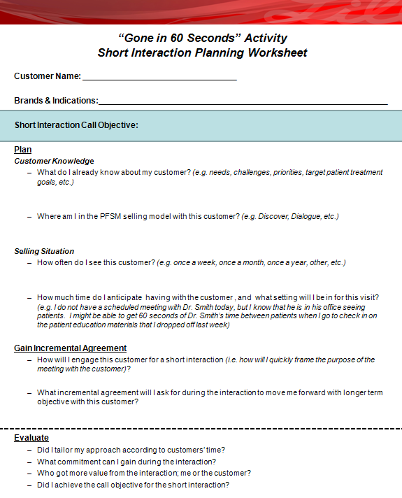
Short Interaction Planning Worksheet
Use this worksheet
to help you plan for
short interactions with
your customers!
Notes:
Say: To help you with your short interaction planning, I’m going to hand out a Short Interaction Planning Worksheet. Please take 2 per person. We will use these in the next section of this workshop; “Gone in 60 Seconds Activity”.
Note to Facilitator: This worksheet is located in the Appendix on the last page of this slide deck (Slide #27). Print the worksheet in Notes View (2 per person) plus extra copies.
Review the worksheet as with the participants.
Ask: Are there any questions?
Transition Statement: Before we move into the skill practice section of the workshop, let’s review the Keys to Successful Short Interactions.
Next slide…
Short Interaction Fundamentals – Short Interaction Worksheet
9 slides (8 of 9)
Review the three sections on the Short Interaction Planning Worksheet (Plan, Gain Incremental Commitment, and Evaluate)
BET #366155; BET Abbreviation GSSRSIVBS

Slide 19
Keys to Successful Short Interactions
Be flexible and prepared for multiple situations. Expect the unexpected.
Quickly frame the purpose of the interaction to help the customer see its value.
Understand that there is value in an incremental commitment toward the longer term objective.
Keep questions short enough for a brief interaction with the customer, but stimulating enough to prompt customers to stop and think.
Ask rather than tell…
    How would you compare…?, How do you feel about…?, What would happen if…?
Notes:
Review the five points on the slide
Ask: Are there any additional items that you would add based on your experience with short interactions?
Possible answers will vary.
Next slide…
Short Interaction Fundamentals – How do successful SRs manage short interactions?
9 Slides (9 of 9)
Successful short interactions require being flexible, quickly framing the purpose of the meeting, keeping questions short but stimulating, and asking rather than telling.
BET #366155; BET Abbreviation GSSRSIVBS

Slide 20
Workshop Agenda
10 min Welcome & Introduction
30 min Short Interaction Fundamentals
60 min “Gone in 60 Seconds” Activity
5 min Wrap-up
Total time = 1 hour 45 minutes
Notes:
Review the workshop agenda
Next slide…
“Gone in 60 Seconds” Activity
Total Time: 60 minutes
4 Slides (1 of 4)
Set-up the “Gone in 60 Seconds Activity”
BET #366155; BET Abbreviation GSSRSIVBS

Slide 21
“Gone in 60 Seconds” Activity – Part 1 - Planning
The only way to get good at Short Interactions is to practice, practice, practice!
Using your “Gone in 60 Seconds” Activity Short Interaction Planning Worksheets, take 10 minutes to fill in the information on two of your current customers.
You will be able to use this worksheet as a reference in Part 2 of the “Think Fast” Activity.
Notes:
Note to Facilitator: Before beginning this activity, ensure that the participations have two copies of the Short Interaction Planning Worksheet.
Say: To begin this activity, you will need to select two of your current customers. For the next 10 minutes, you will work independently completing one Short Interactions Planning Worksheet per customer. Once you have completed a planning worksheet for each customer, we begin the “Gone in 60 Seconds Activity”. The activity will provide you with the opportunity to practice multiple short interactions with these customers.
Next slide…
“Gone in 60 Seconds” Activity
4 Slides (2 of 4)
Each participant should complete the Short Interactions Planning Worksheet for two of their current customers .
BET #366155; BET Abbreviation GSSRSIVBS

Slide 22
“Gone in 60 Seconds” Activity –
Part 2 – Skill Practice
Divide participants into 2 groups.
Group #1 (the customer) form a single line in the middle of the room.
Group #2 (the sales representative) form a single line facing Group #1.
Group #1 = Customer
CUST #1
CUST #2
CUST #3
CUST #4
CUST #5
CUST #6
Facilitator
SR #7
SR #8
SR #9
SR #10
SR #11
SR #12
Group #2 = Sales Representatives (SR)
Notes:
Say: Now that you have completed your Short Interaction Planning Worksheets for two of your customers, I’m going to break you up into two groups.
Note to facilitators: Ask the participants to count off by 1, 2, 1, 2 until everyone is assigned a number.
Say: I would like those of you in Group #1 to line up in the center of the room. Bring your worksheets with you. Group #1 will be the Sales Representatives.
Say: I would like those of your in Group #2 to line up in the center of the room facing Group #1. You should also bring your worksheets with you. Group #2 will be Customers.
Next slide…
“Gone in 60 Seconds” Activity
4 Slides (3 of 4)
Participants will create 2 lines facing each other.
Group #1 = customer
Group #2 = sales representative
BET #366155; BET Abbreviation GSSRSIVBS

Slide 23
“Gone in 60 Seconds” Activity –
Part 2 - Skill Practice… (continued)
When the facilitator says START, he/she will start the stop watch. The Sales Representatives will have 60 seconds to detail the customer using the short interaction planning worksheet.
When the facilitator says STOP, the customer will have 30 seconds to provide feedback to the sales representative.
When the facilitator calls NEXT ROUND, everyone will step to his/her left and assume the role of the appropriate audience (SR or customer).
Repeat steps 4-6 until everyone is back in their original starting position.
Group #1 = Customer
CUST #1
CUST #2
CUST #3
CUST #4
CUST #5
CUST #6
Facilitator
SR #7
SR #8
SR #9
SR #10
SR #11
SR #12
Group #2 = Sales Representatives (SR)
Notes:
Say: Here’s how the activity works. I have a stop watch that will be used to time a 60 second interaction with the customers you planned an interaction with using the worksheets.
Say: When I say START, Group #1 (the Sales Representatives) will begin their first interaction with the customer (Group #2). You may select either of the customer profiles that you outlined on the Short Interaction Planning Worksheet. You may also refer to the Short Interaction Planning Worksheet during the 60 seconds if it will help you remember your call objective and key points.
Say: When I say STOP, Group #1 (the Sales Representatives) will stop talking and Group #2 (the customer) will have 30 seconds to provide feedback on the interaction.
Say: After 30 seconds, everyone will step to their left. The people on the ends will move into their new role as either as a customer or SR.
Say: Once everyone has moved into place, I will START the next round of short interactions.
Say: We will continue with this process until everyone is back in their original positions. Begin the activity.
Activity Debrief: Ask the participants:
What observations did you have during the activity?
How did it feel when you were in the SR role?
How did it feel when you were the customer role?
Did you catch yourself making any of the common mistakes that we discussed earlier in the workshop?
What did you learn in this experience?
“Gone in 60 Seconds” Activity
4 Slides (4 of 4)
60 seconds to detail the customer
30 seconds to provide feedback
Everyone moves to their left for the next round.
BET #366155; BET Abbreviation GSSRSIVBS

Slide 24
Agenda
10 min Welcome and Overview
30 min Short Interaction Fundamentals
60 min “Gone in 60 Seconds” Activity
5 min Wrap-up
Total time = 1 hour 45 minutes
Notes:
Wrap-Up
Total Time: 5 minutes
2 Slides (1 of 2)
Wrap-Up
Review the workshop agenda with participants.
Next slide…
BET #366155; BET Abbreviation GSSRSIVBS

Slide 25
Based on the short interaction fundamentals that we reviewed, the most common mistakes SRs make during short interactions, and the skill practice from the “Gone in 60 Seconds” activity, what are you going to do differently as a result?
Wrap-Up
Notes:
Wrap-up
2 Slides (2 of 2)
What has the group learned from this workshop and skill practice that will help them engage the customer in more effective short interactions?
Ask the participants to continue standing (following the “Gone In 60 Seconds” Activity) for the Wrap-Up.
Note to facilitators: As a wrap-up activity for the workshop, read the question on the slide and go around the circle asking each participant to answer.
BET #366155; BET Abbreviation GSSRSIVBS

Slide 26
Short Interactions Workshop –
Value Based Selling
Global Marketing and Sales Capabilities
Notes View Only
Hide this slide for presenting
Notes View Only
Hide this slide for presenting
Company Confidential
2010© Eli Lilly and Company
Notes:
APPENDIX
CONFIDENTIAL. FOR TRAINING PURPOSES ONLY. NOT FOR USE IN DETAILING.
BET #366155; BET Abbreviation GSSRSIVBS

Slide 27
Short Interactions Workshop –
Value Based Selling
Global Marketing and Sales Capabilities
Notes View Only
Hide this slide for presenting
Notes View Only
Hide this slide for presenting
Company Confidential
2010© Eli Lilly and Company
Notes:
“Gone in 60 Seconds” Activity
Short Interaction Planning Worksheet
Customer Name: __________________________________
Brands & Indications:________________________________________________________________
Short Interaction Call Objective:
Plan
Customer Knowledge
What do I already know about my customer? (e.g. needs, challenges, priorities, target patient treatment goals, etc.)
Where am I in the Value Based Selling Model with this customer? (e.g. Discover, Tailor Solutions, etc.)
Selling Situation
How often do I see this customer? (e.g. once a week, once a month, once a year, other, etc.)
How much time do I anticipate having with the customer, and what setting will I be in for this visit/call? (e.g. I do not have a scheduled meeting with Dr. Smith today, but I know that he is in his office seeing patients. I might be able to get 60 seconds of Dr. Smith’s time between patients when I go to check in on the patient education materials that I dropped off last week)
Gain Incremental Commitment
How will I engage this customer for a short interaction (i.e. how will I quickly frame the purpose of the meeting with the customer)?
What incremental commitment will I ask for during the interaction to move me forward with the longer term objective with this customer?
Evaluate
Did I tailor my approach based on the customers time?
Who got more value from the interaction; me or the customer?
What value did I provide?
Did I achieve the call objective for this short interaction?
CONFIDENTIAL. FOR TRAINING PURPOSES ONLY. NOT FOR USE IN DETAILING.
BET #366155; BET Abbreviation GSSRSIVBS

