Slide 1
Node.js – like development in Java
30. 6. 2016 @ Mimacom SK

Slide 2
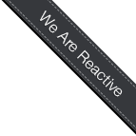



+

Slide 3
Vert.x
Asynchronous event-driven model (similar to node.js)
Easy to build heavily concurrent applications thanks to simple Actor-like concurrency model
Supports many languages (Java, Javascript, Ruby, Groovy, …) basically anything that can run on JVM
Fully multithreaded (thanks to JVM)
Event handlers (async) can use synchronous code as well (so the traditional Java APIs can be used)

Slide 4
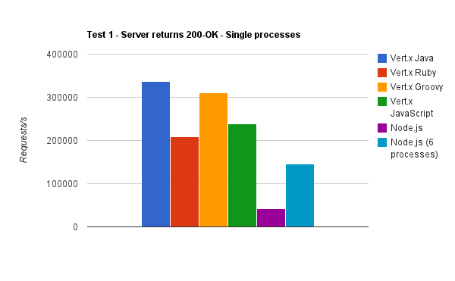
Vert.x performance
Source: http://vertxproject.wordpress.com/2012/05/09/vert-x-vs-node-js-simple-http-benchmarks/

Slide 5



Architecture
Vert.x module 1
Verticle instance 1
Verticle instance 2
Verticle instance 3
Vert.x event bus

Slide 6
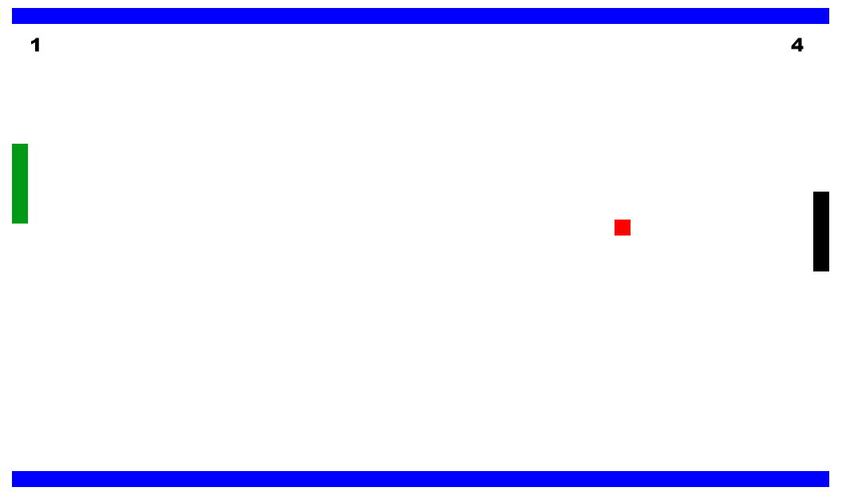
Pong

Slide 7
Pong messaging
Lobby verticle
Game verticle
Reply queue
Game state topic

Slide 8
Pong messaging
Message access boundary
Private queue for each instance
Game verticle
Game Lobby verticle
Game verticle
Game verticle instances
Public queue
Game lobby private queue
Input queue
State topic
Event bus client-side bridge

Slide 9
Communication: The event bus
EventBus eb = vertx.eventBus();
MessageConsumer<String> consumer;
Consumer = eb.consumer(“sk.mimacom.hello",
message -> {
System.out.println(“Message: " + message.body());
});
consumer.unregister();

Slide 10
Communication: The event bus
EventBus eb = vertx.eventBus();
eb.send(“sk.mimacom.hello”, “Hello,world!”);
eb.publish(“sk.mimacom.hello”, “Hello,world!”);
eb.send(“sk.mimacom.hello”, “Hello,world!”, reply -> { //AsyncResult<Message<String>>
ar.result.reply(“...”);
ar.result.fail (“...”);
});

Slide 11
Eventbus: Service proxies
JsonObject message = new JsonObject();
message.put("collection", "mycollection")
.put("document", new JsonObject().put("name", "tim"));
vertx.eventBus().send("database-service-address", message, options, res2 -> {
if (res2.succeeded()) {
// done
} else {
// failure
}
});
☹

Slide 12
Eventbus: Service proxies
@ProxyGen
public interface SomeDatabaseService {
// A couple of factory methods to create an instance and a proxy
static SomeDatabaseService create(Vertx vertx) {
return new SomeDatabaseServiceImpl(vertx);
}
static SomeDatabaseService createProxy(Vertx vertx,
String address) {
return new SomeDatabaseServiceVertxEBProxy(vertx, address);
}
// Actual service operations here...
void save(String collection, JsonObject document,
Handler<AsyncResult<Void>> resultHandler);
}

Slide 13
Eventbus: Service proxies
SomeDatabaseService service = SomeDatabaseService.createProxy(vertx,
"database-service-address");
// Save some data in the database - this time using the proxy
service.save("mycollection", new JsonObject().put("name", "tim"), res2 -> {
if (res2.succeeded()) {
// done
}
});
😐

Slide 14
Eventbus: Service proxies
Future<...> future = ...;
service.save(“...”, new JsonObject(...), future.toHandler());
future.subscribe(value -> {
//replied message
}, throwable -> {
//error occured
}, () -> {
//completed
});
☺

Slide 15
<*)))>{
To start coding, clone this repository: https://github.com/michalboska/vertx3-techsession
(branch: assignment)
To see the complete code, see https://github.com/michalboska/vertx3-techsession
(branch: master)

Slide 16


Enjoy!
Please fill out the feedback form at https://goo.gl/7m55Ii

