Slide 1
Node.js – like development in Java
30. 6. 2016 @ Mimacom SK

Slide 3
Vert.x
Asynchronous event-driven model (similar to node.js)
Easy to build heavily concurrent applications thanks to simple Actor-like concurrency model
Supports many languages (Java, Javascript, Ruby, Groovy, …) basically anything that can run on JVM
Fully multithreaded (thanks to JVM)
Event handlers (async) can use synchronous code as well (so the traditional Java APIs can be used)

Slide 4
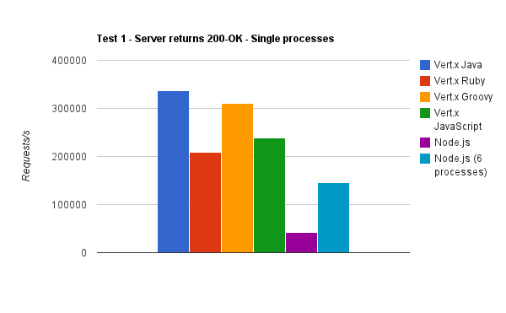
Vert.x performance
Source: http://vertxproject.wordpress.com/2012/05/09/vert-x-vs-node-js-simple-http-benchmarks/

Slide 5



Architecture
Vert.x module 1
Verticle instance 1
Verticle instance 2
Verticle instance 3
Vert.x event bus

Slide 6
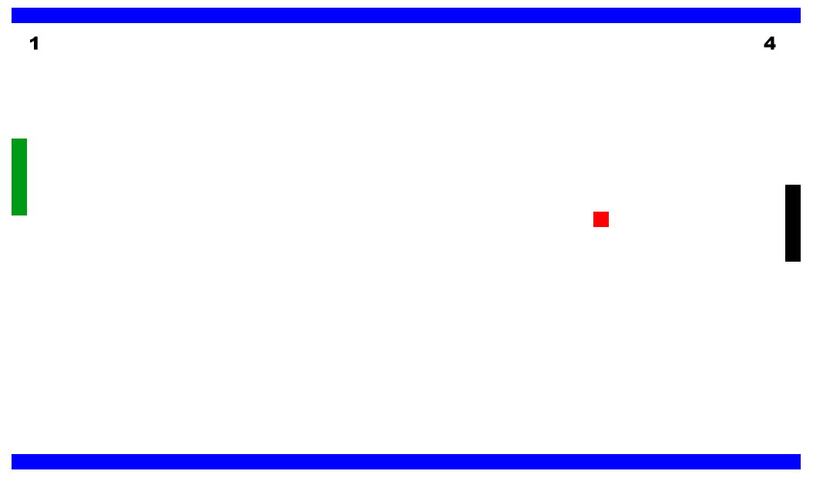
Pong

Slide 7
Pong messaging
Lobby verticle
Game verticle
Reply queue
Game state topic

Slide 8
Pong messaging
Message access boundary
Private queue for each instance
Game verticle
Game Lobby verticle
Game verticle
Game verticle instances
Public queue
Game lobby private queue
Input queue
State topic
Event bus client-side bridge

Slide 9
<*)))>{
To start coding, clone this repository: https://github.com/michalboska/codingbeer-vertx-template
To see the complete code, see https://github.com/michalboska/codingbeer-vertx
(don’t cheat :P )

Slide 10


Enjoy!

