Slide 1
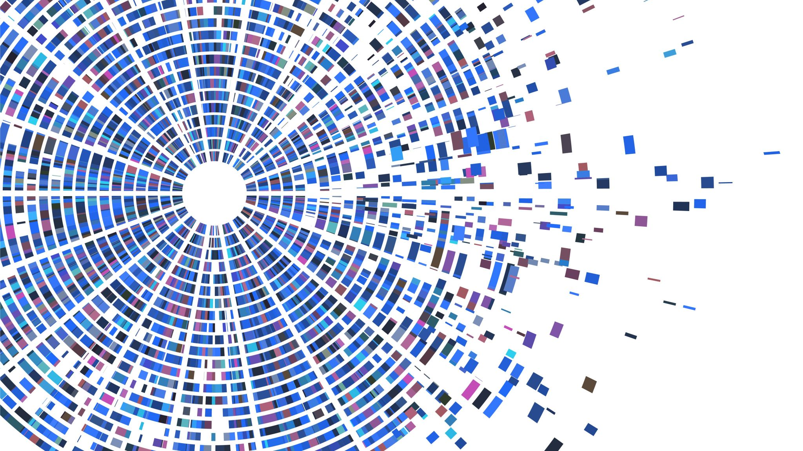
Predicting severity level of collisions in Seattle

Slide 2
Predicting severity level of collision in Seattle is valuable for citizens and local government
Predictive model which will provide reasonable prediction if under certain conditions is higher probability of collision with a given severity
Citizens of Seattle should be interested in this problem because knowing the relationships between conditions and likelihood of collision can save their money and life
Goal is to provide them information about current situation on a roads and possible dangers – so it will be possible to avoid them

Slide 3
Data acquisition and cleaning
Dataset Collisions—All Years provided by SPD and recorded by Traffic Records is available here and metadata about the dataset can be found here
Dataset includes all types of collisions. Collisions will display at the intersection or mid-block of a segment. Timeframe: 2004 to Present.
In the raw dataset were 194 673 rows and 38 columns
Duplicate, highly similar or highly correlated features were dropped.

Slide 4
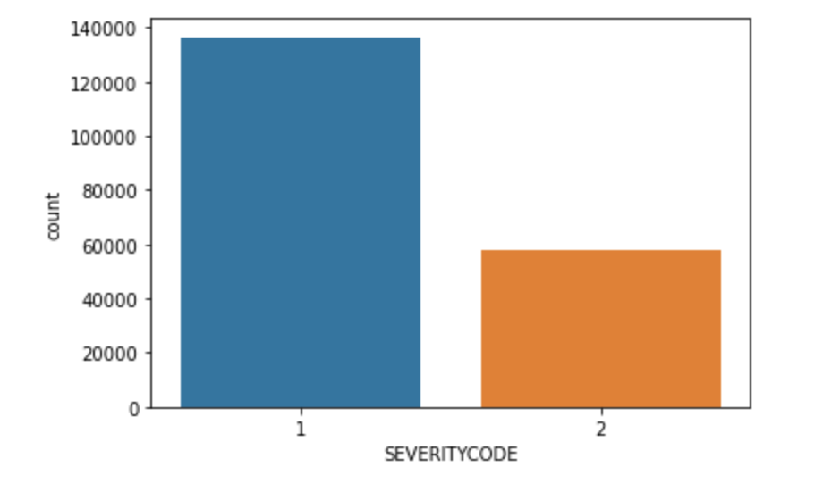
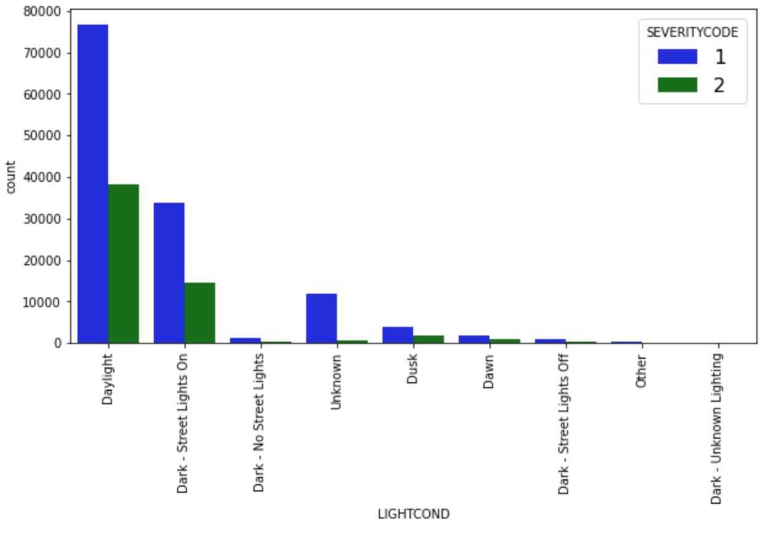
Compare counts of SEVERITYCODE 1 and 2 in the dataset

Slide 5
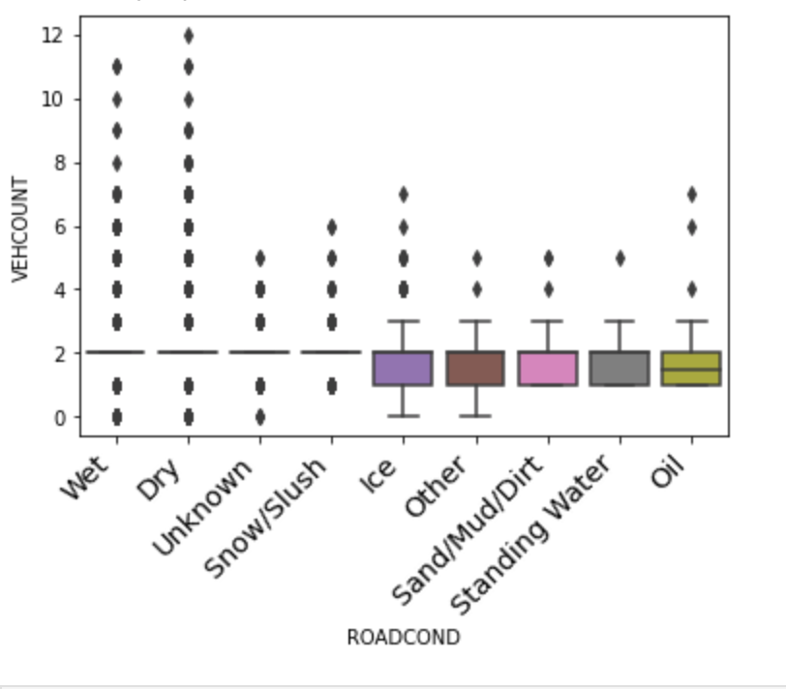
Collisions which happen on a wet or dry road has more outliers and collisions on ice, oil or standing water have similarly average 2 vehicle involved

Slide 6
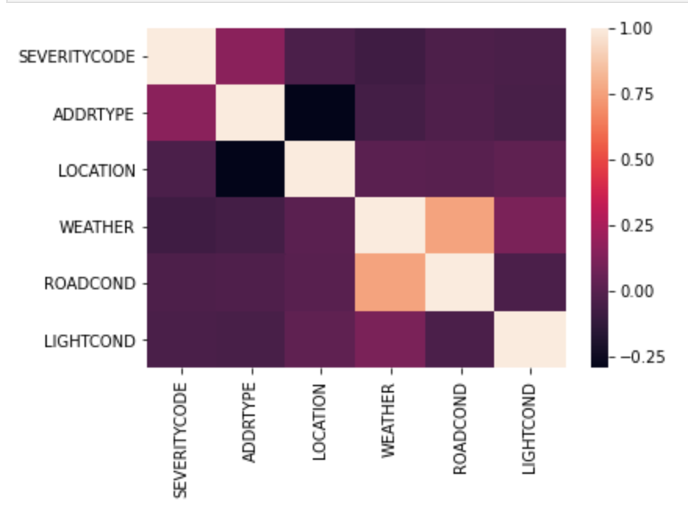
ADDRTYPE, LOCATION and ROADCONDITION have the biggest impact on SEVERITYCODE according to the matrix

Slide 7
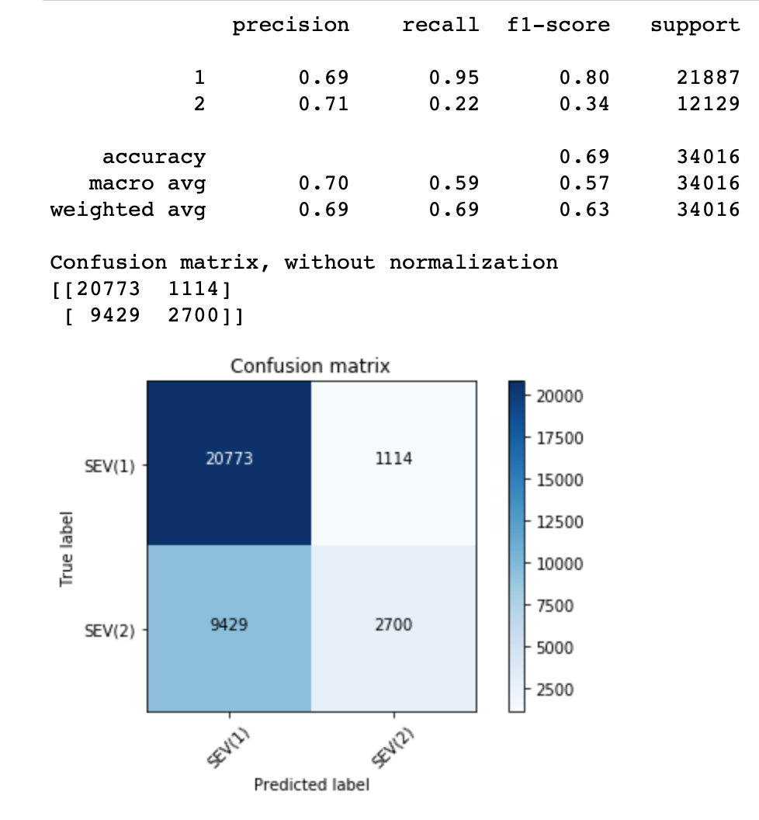
Decision tree classifier model performance

Slide 8
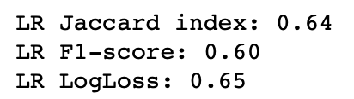
Logistics regression model performance

Slide 9
Conclusion and future directions
Built useful models to predict severity code according to a given conditions
Accuracy of the models has room for improvement
Capture more data about binary conditions, traffic (number of vehicles) and hour of an accident

