Slide 1
What will we cover today?
Mininet
OpenvSwitch
Open Flow
Ryu SDN
Tools:
  Tcpdump
  Nano

Slide 2
Mininet
network emulator
creates a network of virtual hosts, switches, controllers, and links
a network testbed for developing OpenFlow applications
Enables complex topology testing, without the need to wire up a physical network
usable out of the box without programming
Provides a straightforward and extensible Python API

Slide 3
Mininet
Try it!
Create a basic 1 switch topology
  sudo mn
  Commands: net, nodes, pingall
  h1 ping h2
  h1 ping -c1 h2
sudo mn --topo single,3 --mac
sudo mn --topo linear,2,2 --switch ovsk
sudo mn --topo linear,2,2 --switch ovsk --controller remote

Slide 4
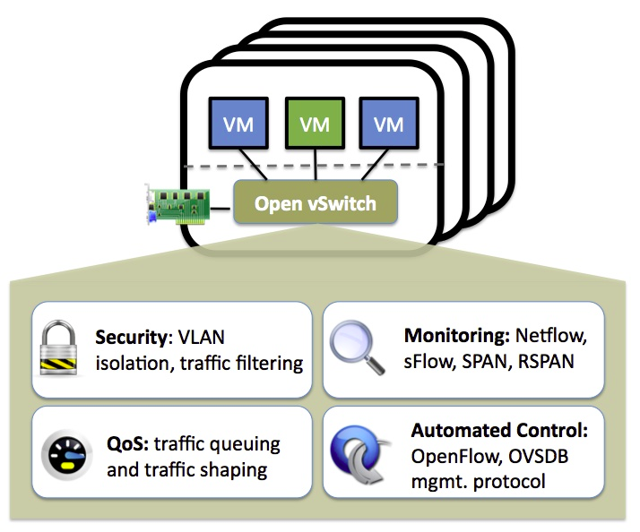
Open vSwitch

Slide 5
Open vSwitch
Why Open vSwitch?
  The mobility of state
    Examples of state: entry in L2 forwarding table, L3 forwarding state, policy routing state, ACLs, QoS policy, monitoring configuration
  Responding to network dynamics
    a network state database (OVSDB) supports remote triggers

Slide 6
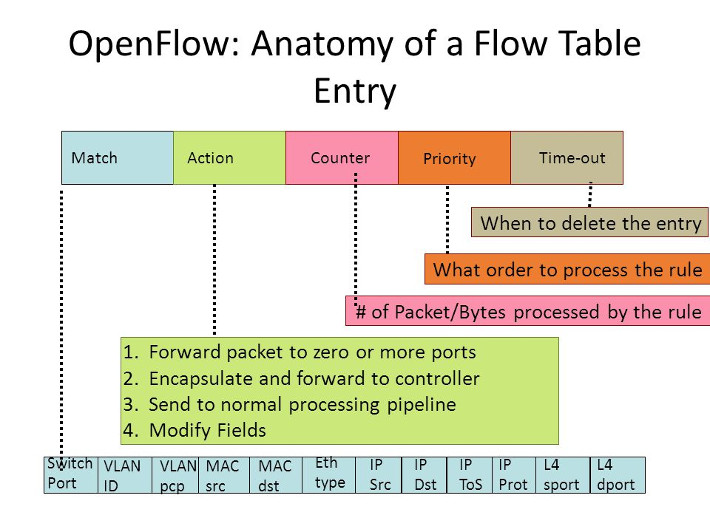
Open Flow
0

Slide 7
Hands on time!
Let's try to install some rules to SDN switch in our topology
Start mininet
sudo mn --topo single,3 --mac --arp --switch ovsk --controller none
Try: h1 ping h2
  Does it work?

Slide 8
Hands on time!
Check scripts in 'scripts' folder
Configure switch to OpenFlow 1.3
  sudo ovs-vsctl set bridge s1 protocols=OpenFlow13
Add a simple flow to switch s1:
  sudo ovs-ofctl add-flow s1 -O OpenFlow13 priority=1,in_port=1,dl_dst=00:00:00:00:00:02,actions=output:2
Delete flows from switch s1:
  sudo ovs-ofctl -OOpenFlow13 del-flows s$i

Slide 9
Exercise
Make ping between h1 and h2 work
Take a look at installFlows1.sh script
  cat installFlows1.sh
What about larger topology?
For connectivity between all node pairs
  For n nodes and k switchs: k*2^n flows
  Exponential growth of flows
Solution: SDN controller + software

Slide 10

Ryu
流 (ryu) – “flow”
龍 (ryu) – Japanese dragon
manages “flow” control to enable intelligent networking

Slide 11
Ryu
SDN Framework
  A platform for building SDN applications
  Provides useful libraries and well-defined API
Open source software (Apache v2)
  Fully written in Python
  Project site: http://osrg.github.com/ryu/

Slide 12
Ryu application step 1
Ryu Hello World
  l2_step1.py
Run:
  ryu-manager l2_step1.py
from ryu.base import app_manager
from ryu.ofproto import ofproto_v1_3
class L2Switch(app_manager.RyuApp):
OFP_VERSIONS = [ofproto_v1_3.OFP_VERSION]
def __init__(self, *args, **kwargs):
super(L2Switch, self).__init__(*args, **kwargs)
print "Hello Ryu"

Slide 13
Creating a Ryu application
a subclass of ryu.base.app_manager.RyuApp
A Ryu application can
  Observe events
  Generate events
from ryu.base import app_manager
from ryu.ofproto import ofproto_v1_3
class L2Switch(app_manager.RyuApp):
OFP_VERSIONS = [ofproto_v1_3.OFP_VERSION]
def __init__(self, *args, **kwargs):
super(L2Switch, self).__init__(*args, **kwargs)
print "Hello Ryu"

Slide 14
OpenFlow event classes
describes a Ryu event generated in the system
A Ryu application can register its interest for a specific type of event
  It is done by using set_ev_cls (“observe_event”) decorator
Event class attributes:
  msg - An object which describes the corresponding OpenFlow message.
  msg.datapath - A ryu.controller.controller.Datapath instance which describes an OpenFlow switch from which we received this OpenFlow message.

Slide 15
ryu.controller.controller.Datapath
describes an OpenFlow switch connected to this controller
Attributes:

Slide 16
ofproto_v1_3_parser
Controller-to-Switch Messages
  Handshake
  Switch Configuration
  Flow Table Configuration
  Modify State Messages
  Multipart Messages
  Packet-Out Message
  Barrier Message
  Role Request Message
  Set Asynchronous Configuration Message

Slide 17
ofproto_v1_3_parser
Asynchronous Messages
  Packet-In Message
  Flow Removed Message
  Port Status Message
  Error Message
Symmetric Messages
  Hello
  Echo Request
  Echo Reply
  Experimenter

Slide 18
ofproto_v1_3_parser
Port Structures
  ryu.ofproto.ofproto_v1_3_parser.OFPPort
Flow Match Structure
  ryu.ofproto.ofproto_v1_3_parser.OFPMatch
Flow Instruction Structures
Action Structures

Slide 19
Updating the MAC Address Table
Get the receive port (in_port)
Get destination and sender MAC address
Update MAC address table
def _packet_in_handler(self, ev):
# …
in_port = msg.match['in_port']
pkt = packet.Packet(msg.data)
eth = pkt.get_protocols(ethernet.ethernet)[0]
dst = eth.dst
src = eth.src
dpid = datapath.id
self.mac_to_port.setdefault(dpid, {})
self.logger.info("packet in %s %s %s %s", dpid, src, dst, in_port)
# learn a mac address to avoid FLOOD next time.
self.mac_to_port[dpid][src] = in_port
# ...

Slide 20
Choose the transfer destination port
Get the destination port from MAC address table (if exists)
If destination MAC not found in MAC address table, flood the packet (OFPP_FLOOD)
If destination MAC is found add entry to the flow table of the switch
def _packet_in_handler(self, ev):
# ...
if dst in self.mac_to_port[dpid]:
out_port = self.mac_to_port[dpid][dst]
else:
out_port = ofproto.OFPP_FLOOD
actions = [parser.OFPActionOutput(out_port)]
# install a flow to avoid packet_in next time
if out_port != ofproto.OFPP_FLOOD:
match = parser.OFPMatch(in_port=in_port, eth_dst=dst)
self.add_flow(datapath, 1, match, actions)
# ...

Slide 21
Packet transfer
Get the destination port from MAC address table (if exists)
If destination MAC not found in MAC address table, flood the packet (OFPP_FLOOD)
If destination MAC is found add entry to the flow table of the switch
def _packet_in_handler(self, ev):
# ...
data = None
if msg.buffer_id == ofproto.OFP_NO_BUFFER:
data = msg.data
out = parser.OFPPacketOut(datapath=datapath, buffer_id=msg.buffer_id,
in_port=in_port, actions=actions, data=data)
datapath.send_msg(out)

Slide 22
ofproto_v1_3_parser.OFPMatch
This class is implementation of the flow match structure having compose/query API.
Arguments: in_port, eth_dst, eth_src, eth_type, vlan_vid, vlan_pcp, ipv4_src, ipv4_dst etc.
Example:
>>> # compose
>>> match = parser.OFPMatch(
... in_port=1,
... eth_type=0x86dd,
... ipv6_src=('2001:db8:bd05:1d2:288a:1fc0:1:10ee',
... 'ffff:ffff:ffff:ffff::'),
... ipv6_dst='2001:db8:bd05:1d2:288a:1fc0:1:10ee')

