Slide 1
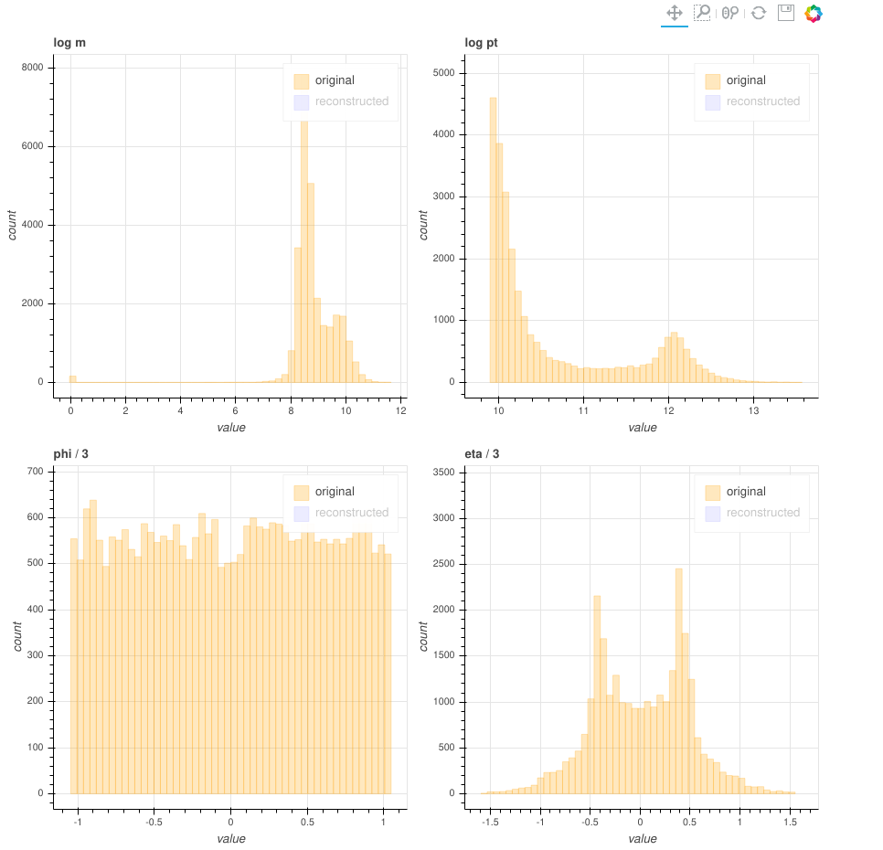
Original data
111778 data points for training, 27945 for validation
Each point representing 4 variables
Data was processed so that all variables are approximately with the same ranges
Goal: use neural networks (autoencoders) to compress the 4 variables into 3 latent ones

Slide 2
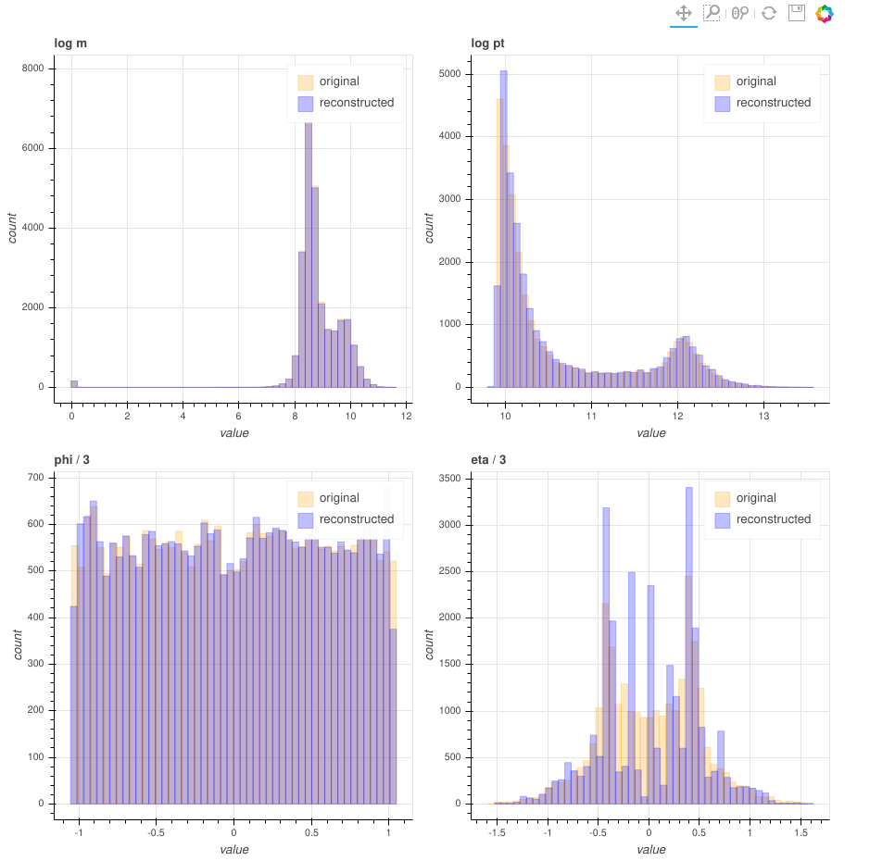
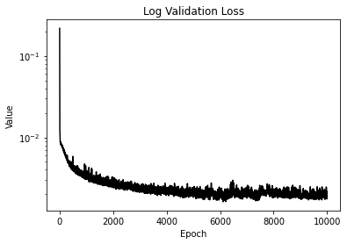
Reconstructed data
Captured well the bimodality of `pt` and the uniformity of `phi`
Failed to capture the distribution of `eta`
Not/very slightly overfitting after 10000 epochs
  Larger network could be used
  Final training MSE loss: 0.001898
  Final validation MSE loss: 0.001919

Slide 3
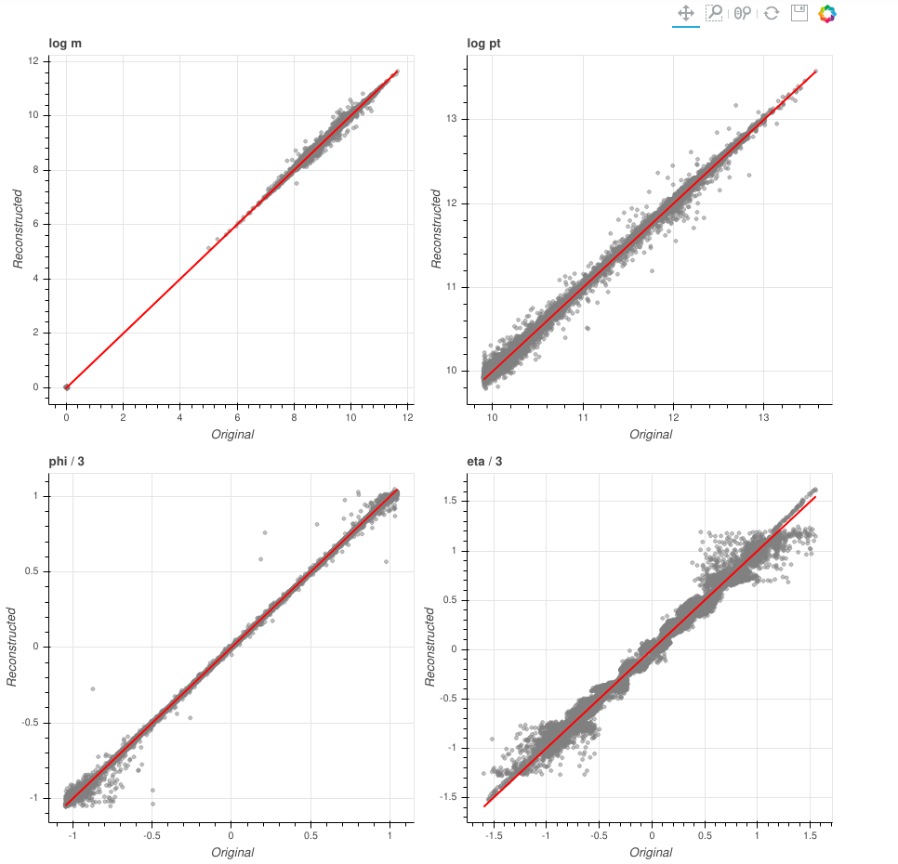
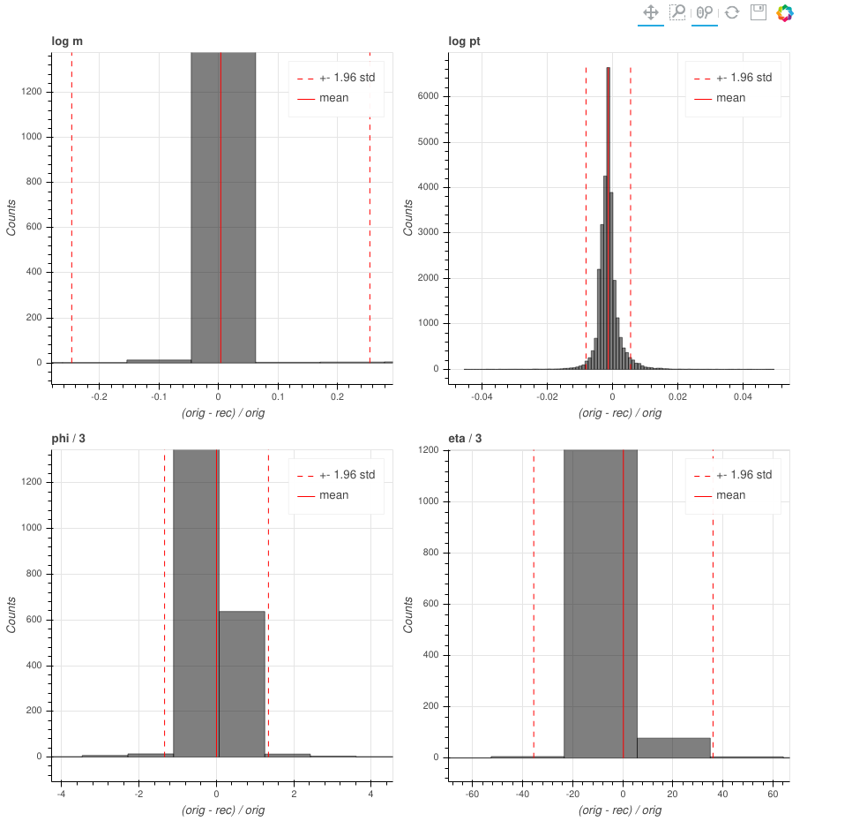
Reconstructed vs original
The red lines represents a perfect reconstruction
Most noticeable reconstruction failures are at the extremal values, see `phi` or `eta`

Slide 4
Improvements
Try out different architectures using Neural Architecture Search, hyperparameter search
Transfer learning – use the network from previous project
Using our current knowledge of being unable to properly reconstruct variable `eta`, we could:
Used weighted random sampling to resample points with high reconstruction error
Switch Mean Squared Error loss function to a weighted equivalent (or use different loss)
  assign higher weights to badly reconstructed variables
Instead of compression 4 → 3, try compressing 3 → 2
  could be an easier task, especially 3 → 2, excluding `eta`

Slide 5
Other ideas to investigate
Try out different normalization schemes for the input variables, e.g. z-score
Try combining Generative Adversarial Networks into the framework (such as energy-based EBGAN)
  useful for modeling distribution – generate more samples
  adversarial training for robustness
Investigate different initialization schemes for the network
  interesting because we can use true gradients (whole dataset fits into the memory), so good initialization is crucial

