Slide 1
Development in the Ferda project
December 2006
Martin Ralbovský

Slide 2
Content
History
Changes in the 2.0 version, improved GUHA abilities
Background knowledge and ontologies
Further academic development

Slide 3
Ferda project history I
Ferda – successor of the LISp-Miner data mining system, visual and modular environment
Software project at MFF UK
KEG 10.11.2005
    Introduction of the system
    Description of parts of the working environment
    Implementation principles
Znalosti 2006 article
KEG 4.5.2006
    State of development in May 06
    Master theses themes discussed

Slide 4
Ferda project history II
Development since May 06
“Experimental GUHA Procedures” by Tomáš Kuchař completed
“Usage of Domain Knowledge for Applications of GUHA Procedures” by Martin Ralbovský completed
Further development + testing

Slide 5
Available versions of Ferda
Version 1.0 (1.1) - approved MFF project version (+ improvements)
Copy of the LISp-Miner system in terms of GUHA abilities (almost)
Dependent on the LISp-Miner hypotheses generation engine
Version 2.0 based on the master thesis of Tomáš Kuchař
Ferda no longer dependent on LISp-Miner system
Improved GUHA abilities (datasource, definition of relevant questions…)

Slide 6
Improved GUHA abilities theoretically I
Definition of a large set of relevant questions (original):
Attribute A, α non-empty subset of attribute α, then A(α) is basic boolean attribute
Each basic boolean attribute is a boolean attribute
If ϕ and ψ are boolean attributes, then ϕ ∧ ψ, ϕ ∨ ψ €and ¬ϕ are boolean attributes

Slide 7
Improved GUHA abilities theoretically II
Definition of a large set of relevant questions in LISp-Miner (and Ferda 1.0)
Literal ~ basic boolean attribute or its negation
Literal can be basic or remaining
basic – in each partial cedent there has to be at least one basic literal
remaining – the opposite
Partial cedent ~ conjunction of literals
Cedent ~ conjunction of partial cedents

Slide 8
Improved GUHA abilities theoretically III
Definition of a large set of relevant questions in Ferda 2.0
Ferda 2.0 fully supports the original definition, user can use conjunction, disjunction and negation multiple times
Basic boolean attribute can be
    Basic – the same meaning
    Forced – must be present in every relevant question
    Auxiliary – conjunction and disjunction cannot be formed only with auxiliary boolean attributes (there must be a basic or forced attribute).

Slide 9
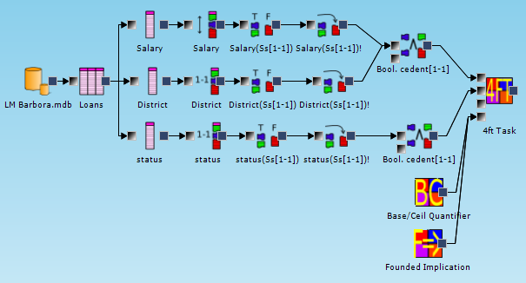
Improved GUHA abilities practically 4FT – Ferda 1.0

Slide 10
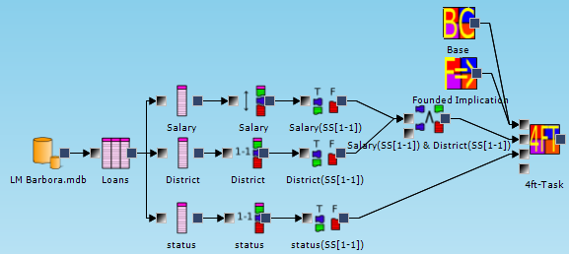
Improved GUHA abilities practically 4FT – Ferda 2.0

Slide 11
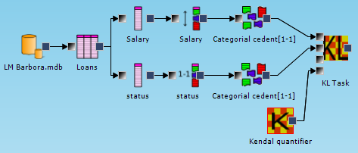
Improved GUHA abilities practically
KL – Ferda 1.0

Slide 12
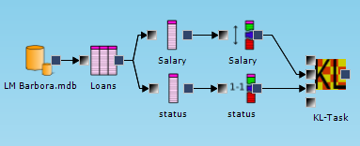
Improved GUHA abilities practically
KL – Ferda 2.0

Slide 13
Ferda 2.0 versus LISp-Miner
We compare only the hypotheses generation engines, not the whole systems
Running time of procedures
    4FT approximately equal
    KL faster in Ferda 2.0
    CF faster in Ferda 2.0
    SD procedures much faster in LISp-Miner (no jump optimalizations)
Some quantifiers not implemented in Ferda 2.0 (but are easy to implement)
LISp-Miner better tested

Slide 14
Background knowledge I – introduction
Background knowledge is a vague term for knowledge from the domain experts to aid in KDD.
No central definition or theory, different authors use it differently.
The definition for GUHA mining:
a set of various verbal rules that are accepted in a specific domain as a common knowledge.
Background knowledge can be used as an effective mean of communication between the knowledge expert and the data miner.
Usage of background knowledge in GUHA is described in master thesis of Martin Ralbovsky (and elsewhere)

Slide 15
Background knowledge II - examples
Sociomedical domain:
If education increases, wine consumption increases as well
Patients with greater responsibility in work tend to drive to work by car
Beer marketing domain:
Younger consumers prefer drought beer
Older consumers prefer beer in bottles
More expensive brands are better sold during holidays

Slide 16


Background knowledge III – preferred usage
Specification of interesting facts to the domain expert
Rules can be transformed into mining tasks
Tasks results
Soundness of DM techniques
Domain expert
Data miner
Knowledge about the domain
Data mining techniques
and interpretation knowledge

Slide 17
Background knowledge IV – in Ferda
Formalization of background knowledge rules sound for GUHA purposes created
Implemented modules of the Ferda system (version 1.1) to validate background knowledge rules
Experiments carried out to find presence of background knowledge rules in the data with the GUHA procedures 4FT and KL
So far rather disappointing results

Slide 18
Background knowledge V - experiment
Presumptions:
    Background knowledge rules are somehow stored in the data
    Data collection and attribute creation without mistakes
Question: Can the rules be found in data with “our” techniques?
Experiment: 8 background knowledge rules tested with the 4FT and KL

Slide 19
Background knowledge VI - results
Founded Implication with default values (base = 0,05, p = 0,95) – 1/8 rules approved
Above Average with default values (base= 0,05, P = 1,2) – 1/8 rules approved
Modifications of Kendall – 2/6 rules approved
Furthermore quantifiers showed strange results (4/8 FI results below with p below 0,4)
How good are our quantifiers???
Bigger experiments are planned to be done in the future

Slide 20
Ontologies I – introduction
In the past attempts to enhance GUHA mining with domain ontologies (also presented on KEG)
    Data understanding
    Attribute creation
    Decomposition of tasks
    Task creation
Ralbovský’s master thesis first work to examine automatic processing of domain ontologies
Deep analysis, however no tools implemented

Slide 21
Ontologies II – problems
Technical problems… not so bad
Conceptual problems
Ontologies express knowledge on very general level
For GUHA mining, we need specific knowledge that usually is not present in ontologies
Example: for attribute creation we need
    Maximum and minimum values
    Extreme values
    Significant values dividing the domain
    Typical values (for nominal domains)
Solution: probably specific ontologies for GUHA mining

Slide 22
Further academic development I
Alexander Kuzmin – “Relational GUHA procedures” master thesis
Implementation of relational 4FT miner (and possibly others)
Ferda 2.0, spring 2007
Daniel Kupka – “User support for 4ft-Miner procedure for data mining” master thesis
Help scenarios depending on the settings of 4FT task
Complex and modular system
Ferda 2.0, spring 2007

Slide 23
Further academic development II
Martin Zeman – “Using ontologies in GUHA procedures”
Definition of GUHA ontologies
Tools for ontology support
Ferda 2.0, autumn 2006
Michal Kováč – “User oriented language for solving KDD tasks”
Only Michal knows what this is about
Ferda 2.0, autumn 2006

Slide 24
Thank you for your attention.

