Slide 1
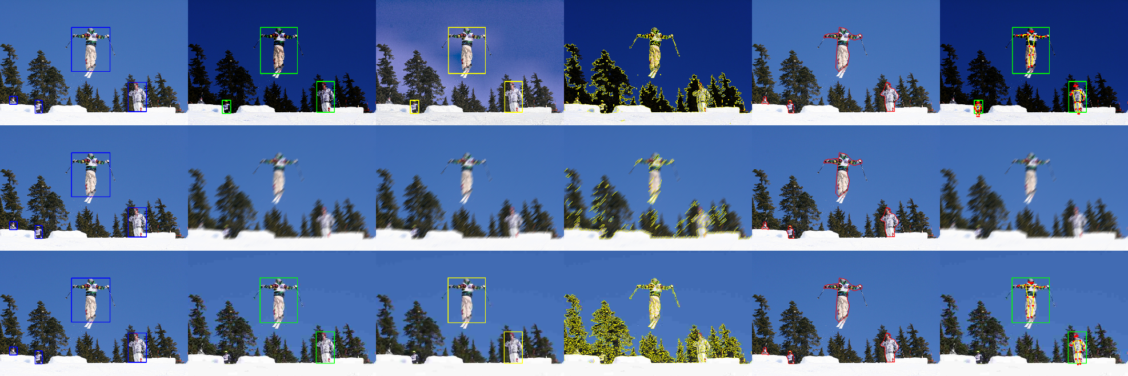
Robust Human Perception
Under Surveillance Camera Degradation
Course project presentation | COCO-person subset | 3 tasks x 3 distortions
Clean | Corrupted | Enhanced examples used in the evaluation
Question: how do human perception tasks survive low light, blur, and compression?
1

Slide 2
1. Problem and motivation
Surveillance images are often degraded before the vision model sees them.
Why this matters
Low light
nighttime / poor illumination
Motion blur
movement / slow shutter
JPEG compression
limited bandwidth
A surveillance system may still detect that a person exists, but fail to localize limbs or body pose when images are dark, blurred, or compressed.
The risk is not only lower image quality - it is lower task reliability.
The project measures how each degradation changes boundary, detection, and pose results - and whether recovery methods actually help the model.
Source: results/coco_person/tables/val_aggregate.csv
2

Slide 3
2. Research question and high-level design
The project compares task performance before degradation, after degradation, after enhancement, and after pose fine-tuning.
Research question
How do person-boundary extraction, detection, and pose estimation respond to increasing surveillance-like degradation?
And how much performance can be recovered through classical image enhancement or corruption-aware fine-tuning?
Clean images
baseline performance
Corrupted images
performance degradation
Enhanced images
image-level recovery
Fine-tuned pose
model-level recovery
Important: the fine-tuned pose model is evaluated on clean, corrupted, and enhanced inputs. This checks both robustness and whether clean-image accuracy was harmed.
Source: results/coco_person/tables/val_aggregate.csv
3

Slide 4
3. Dataset and ground truth
Public COCO 2017 person subset with boxes, masks, and keypoints.
Data source
800
training subset
pose fine-tuning
150
validation subset
all results
42
selection seed
deterministic
COCO 2017 person images provide the ground truth needed for all three tasks:
Ground truth
Used for
Person masks
Boundary F1 vs person silhouette
Fair comparison: the same fixed 150 validation images are used for every clean, corrupted, enhanced, and fine-tuned condition.
Person boxes
YOLO person detection matching
17 keypoints
YOLO pose PCK / OKS metrics
Source: results/coco_person/tables/val_aggregate.csv
4

Slide 5
4. The three vision tasks
The project covers both low-level image processing and high-level vision.
low-level
high-level
high-level
Task 1: Boundary
Task 2: Detection
Task 3: Pose
Canny edges vs person mask
YOLOv8n person detector
YOLOv8n-pose keypoints
Metric: Boundary F1, precision, recall
Metric: Detection F1, recall, miss rate
Metric: PCK@0.2, PCK@0.5, OKS
Key reason for 3 tasks: a method can improve low-level edges but still fail at high-level detection or pose.
Source: results/coco_person/tables/val_aggregate.csv
5

Slide 6
5. The three distortions and severity levels
Each distortion is evaluated at mild, medium, and severe intensity.
Distortion
Mild
Medium
Severe
Why it matters
Low light
gamma 1.5
gamma 2.2
gamma 3.0
night / poor illumination
Motion blur
kernel 5
kernel 15
kernel 25
movement / slow shutter
JPEG
quality 50
quality 20
quality 5
bandwidth-limited streams
The qualitative example shows why the same image can lead to different levels of task failure after corruption and enhancement.
Source: results/coco_person/tables/val_aggregate.csv
6

Slide 7
6. Recovery methods tested
Two recovery ideas: repair the image, or adapt the pose model.
Distortion
Enhancement
Intuition
Fine-tuning setup
Low light
CLAHE + gamma
increase local contrast and brightness
YOLOv8n-pose was fine-tuned on 800 training images with a mixed corruption set: clean + low light + motion blur + JPEG.
Motion blur
Stable unsharp masking
strengthen edges; not true deblurring
JPEG
Bilateral filtering
reduce block artifacts while preserving edges
Then it was evaluated on all 19 conditions: clean, corrupted, and enhanced.
The detector was not fine-tuned; one DL fine-tune satisfies the requirement and keeps the scope feasible.
Source: results/coco_person/tables/val_aggregate.csv
7

Slide 8
7. Evaluation and comparisons
Every condition is measured on the same validation subset.
What is compared?
Input to model
Model
Purpose
Clean image
Original models
Baseline performance
Corrupted image
Original models
Degradation curve
Enhanced corrupted image
Original models
Image-level recovery
Clean / corrupted / enhanced
Fine-tuned pose model
Model-level recovery and trade-off
Evaluation goal: compare performance change, not just visual image quality.
Source: results/coco_person/tables/val_aggregate.csv
8

Slide 9
8. Clean baseline: starting point
The clean baseline is the reference for all degradation and recovery comparisons.
0.547
Boundary F1
Canny vs mask
0.770
Detection F1
YOLOv8n
0.736
Detection recall
YOLOv8n
0.931
Pose PCK@0.2
pretrained pose
Interpretation
The pretrained pose model starts very strong on clean images. This makes it hard for a small fine-tuning run to outperform it.
Detection is measured by F1/recall, not official COCO AP. Pose uses PCK@0.2 and simplified OKS.
Clean baseline matters because robustness is measured as the drop from this reference.
Source: results/coco_person/tables/val_aggregate.csv
9

Slide 10
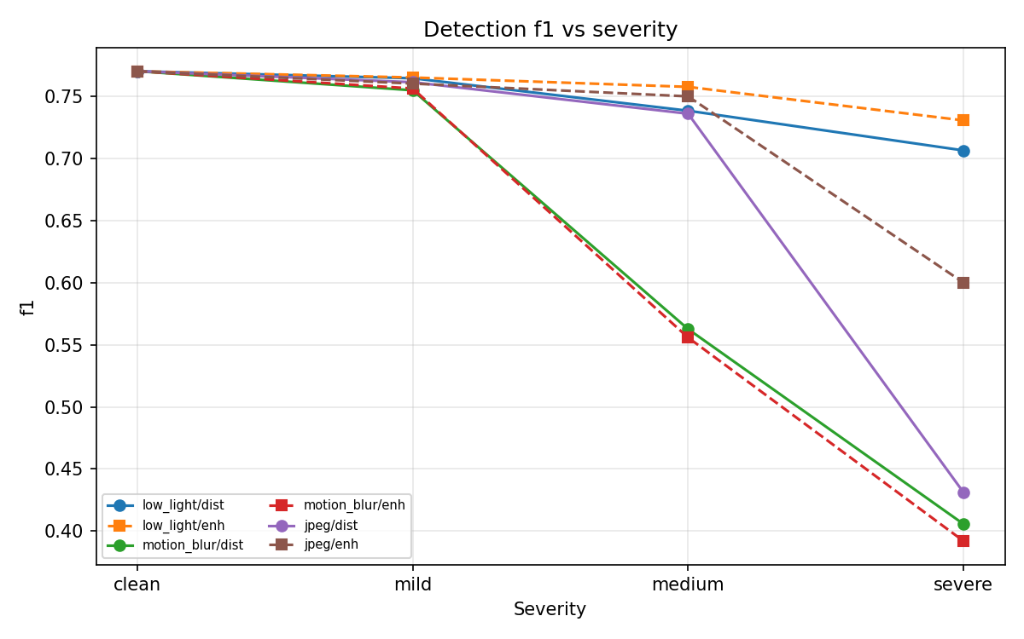
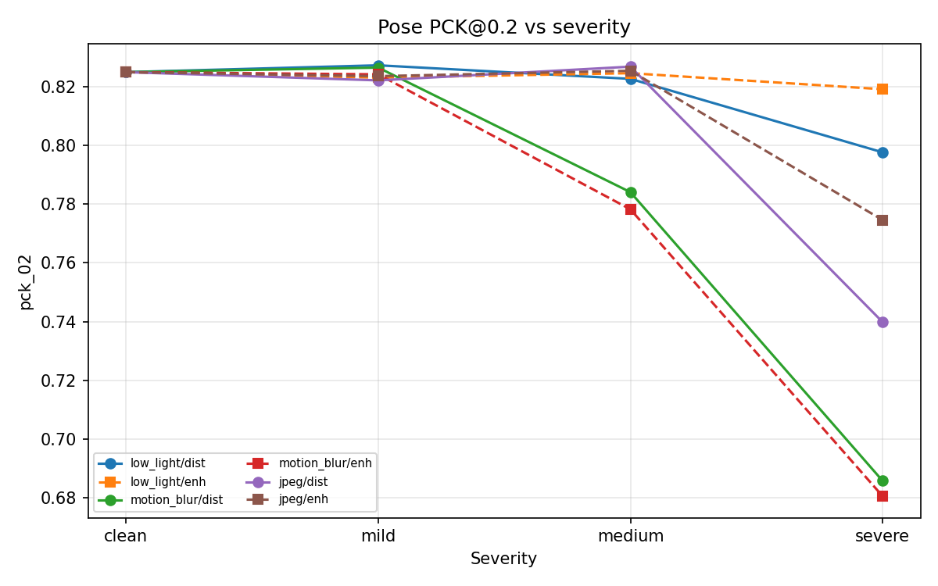
9. Overall degradation trends
Severity curves show how performance falls as image quality gets worse.
Detection F1: motion blur and severe JPEG are the largest high-level failures.
Pose PCK: severe JPEG is recoverable with bilateral filtering; motion blur remains difficult.
Source: results/coco_person/tables/val_aggregate.csv
10

Slide 11
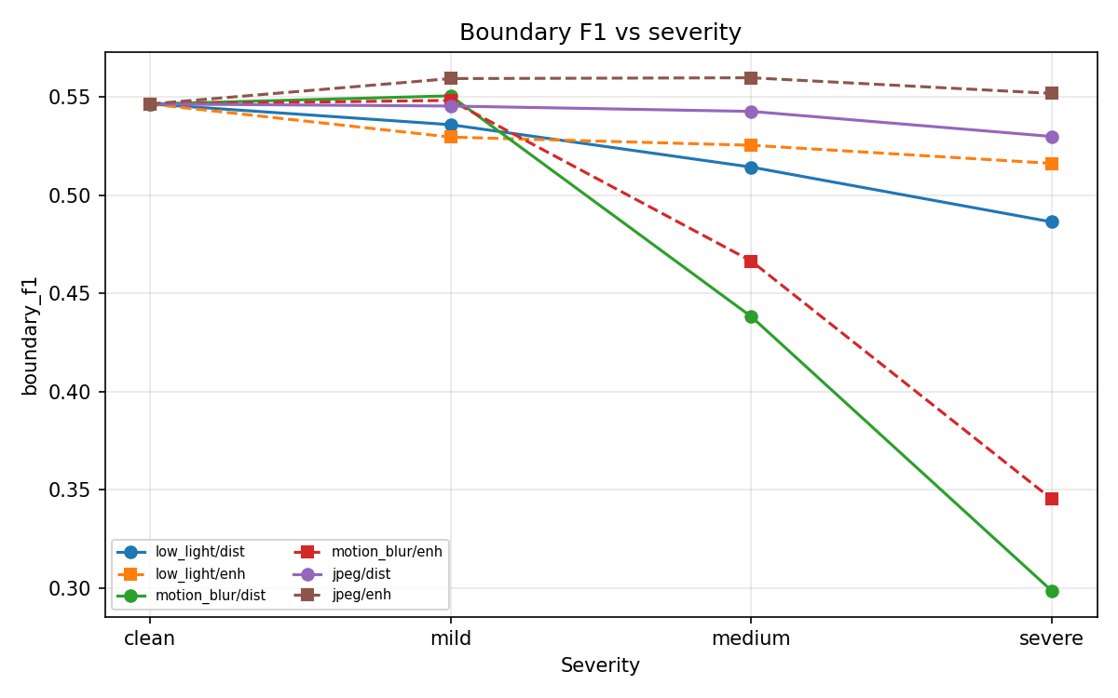
10. Main failure: severe motion blur
Motion blur damaged all three tasks and was the hardest distortion to recover.
Severe motion blur: clean -> corrupted
Task
Clean
Severe blur
Drop
Boundary F1
0.547
0.298
-0.249
Detection F1
0.770
0.406
-0.364
Pose PCK@0.2
0.931
0.745
-0.186
Why: blur removes spatial detail. Once limb and person boundaries are smeared, models cannot fully recover the missing structure.
Source: results/coco_person/tables/val_aggregate.csv
11

Slide 12
11. Best recovery: severe JPEG + bilateral filtering
JPEG artifacts were much more recoverable than severe motion blur.
Severe JPEG: corrupted -> enhanced
Task
Corrupted
Enhanced
Recovery
Boundary F1
0.530
0.552
+0.022
Detection F1
0.431
0.600
+0.169
Pose PCK@0.2
0.770
0.872
+0.102
Interpretation: bilateral filtering reduced compression artifacts enough to help YOLO detection and pose.
Source: results/coco_person/tables/val_aggregate.csv
12

Slide 13
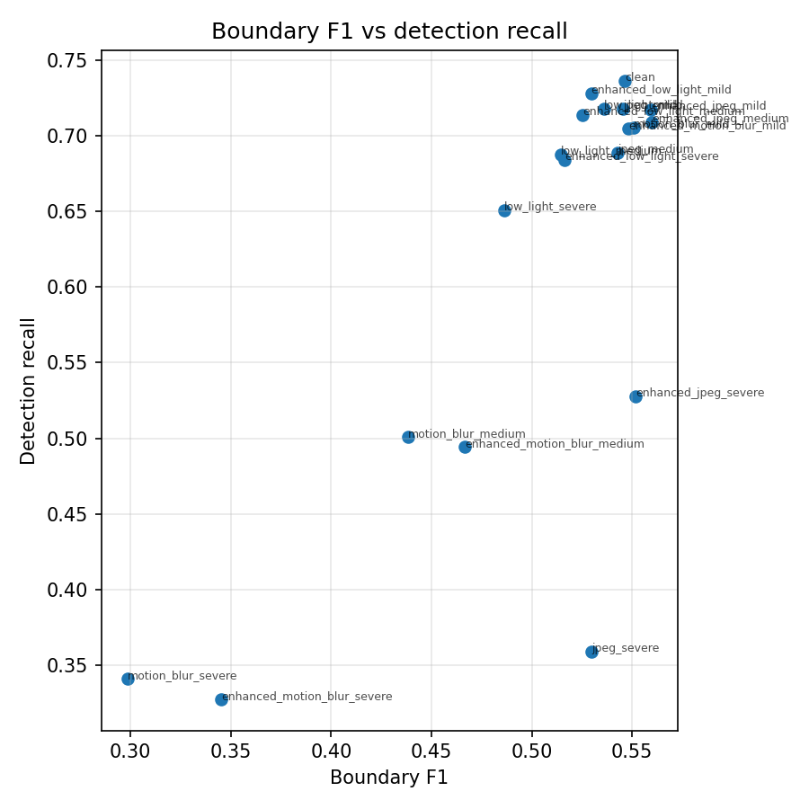
12. Cross-level result: low-level recovery is not enough
An image can have stronger edges but worse detection and pose.
Severe blur after unsharp masking
Metric
Raw severe blur
Enhanced
Result
Boundary F1
0.298
0.345
improved
Detection F1
0.406
0.392
slightly worse
Pose PCK@0.2
0.745
0.730
slightly worse
Main lesson: improving edge contrast does not guarantee high-level semantic recovery.
This is why the project evaluates three tasks, not only image quality or edge quality.
Source: results/coco_person/tables/val_aggregate.csv
13

Slide 14
13. Fine-tuning result: robustness training underperformed
The small corruption-aware fine-tuning run did not beat the pretrained pose model.
Condition
Pretrained PCK@0.2
Fine-tuned PCK@0.2
Winner
0.931 -> 0.825
clean PCK drop
fine-tuned lower
Clean
0.931
0.825
pretrained
Severe low light
0.908
0.798
pretrained
Severe JPEG
0.770
0.740
pretrained
19 / 19
matched conditions
pretrained higher
Severe JPEG + enhanced
0.872
0.775
pretrained
Severe blur
0.745
0.686
pretrained
Severe blur + enhanced
0.730
0.681
pretrained
Interpretation: the 800-image mixed-corruption subset was not enough to improve a model already pretrained on large-scale COCO data.
Source: results/coco_person/tables/val_aggregate.csv
14

Slide 15
14. Conclusions and limitations
Conclusions
Limitations
1. Severity matters: stronger corruptions usually reduce performance.
2. Motion blur is the hardest distortion for all tasks.
3. JPEG enhancement gives the strongest high-level recovery.
4. Stronger edges do not necessarily improve detection or pose.
5. Small corruption-aware fine-tuning reduced pose localization accuracy.
- 150-image validation subset, not full COCO val.
- Detection uses F1 / recall, not official AP.
- Pose uses simplified OKS, not official keypoint AP.
- No complete per-joint or person-size final aggregate.
- One fine-tuning run does not prove fine-tuning generally fails.
Final answer: enhancement is distortion-specific; fine-tuning requires enough data and the right validation criterion.
Source: results/coco_person/tables/val_aggregate.csv
15

