Slide 1
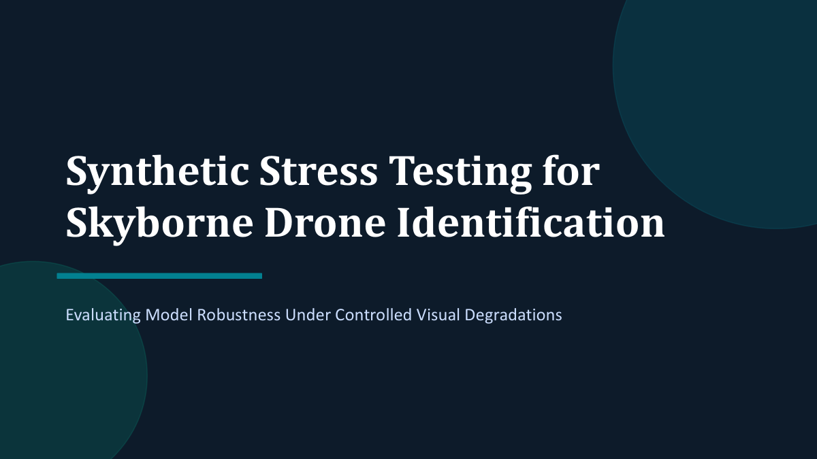

Slide 2
motivation
Drones can be tiny, blurred, noisy, or partially blended into sky backgrounds.
Birds and airplanes create hard negatives that are visually similar to drones.
A useful benchmark should expose robustness limits, not only average performance.
The purpose was not just to make more drone images. The purpose was to create a dataset where we can control the conditions under which detection becomes hard, then compare detector behavior under those conditions.

Slide 3
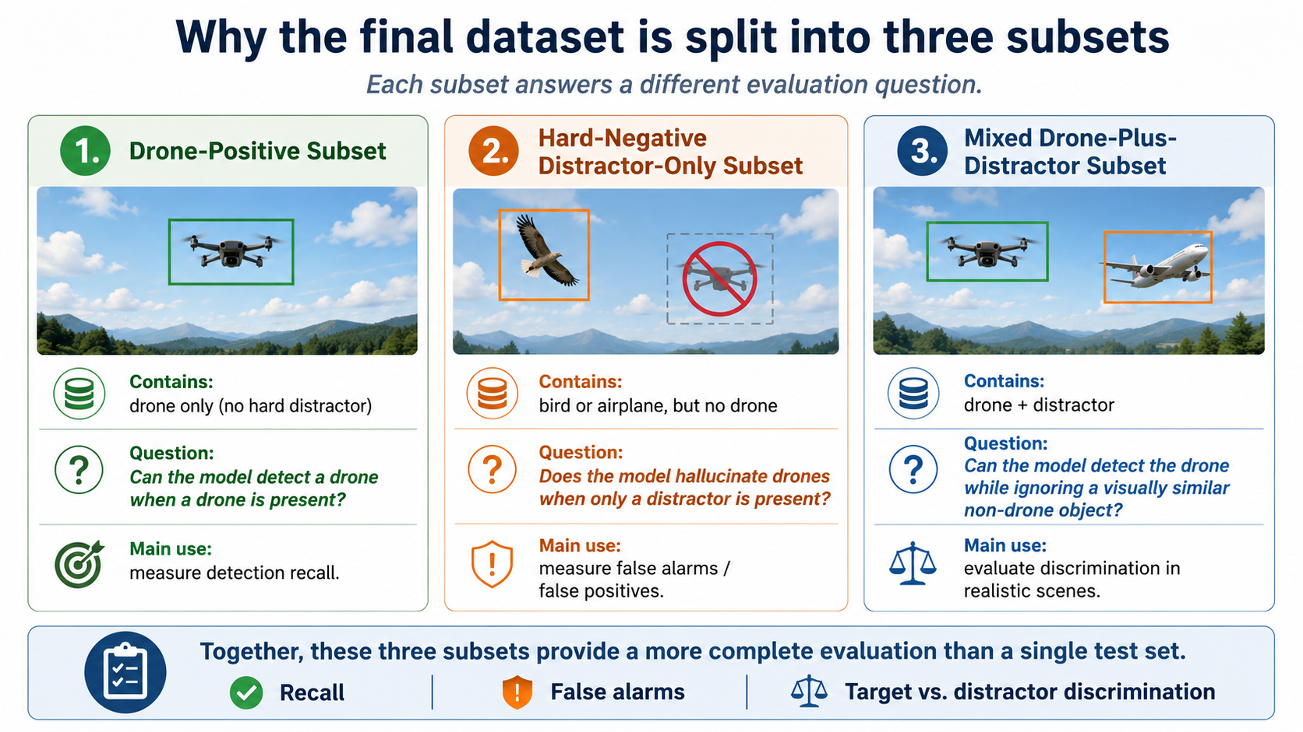
datasets
drone-positive images- contains images with a drone and no additional hard distractor. Answer:
Can the model detect a drone when a drone is present?
distractor-only hard negatives – contains a bird or airplane but no drone. Answer: Does the model hallucinate drones when only a distractor is present?
drone-plus-distractor mixed images – The mixed subset contains both a drone and a distractor.
Answer: Can the model detect the drone while ignoring a visually similar non-drone object?

Slide 4
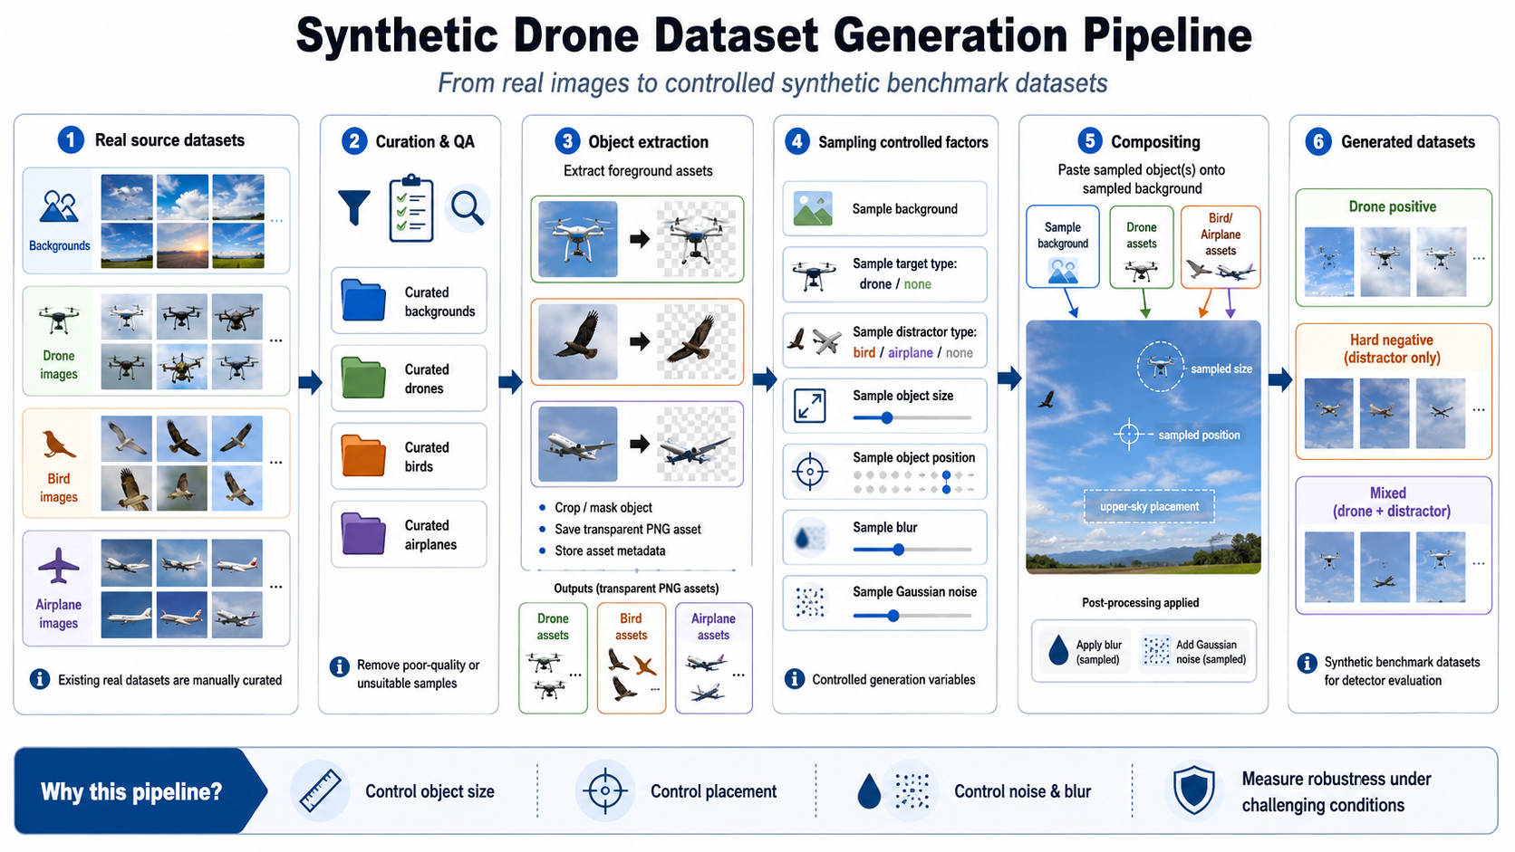

Slide 5
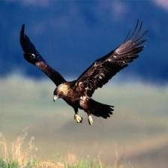
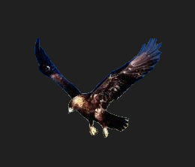
Birds Extraction

Slide 6
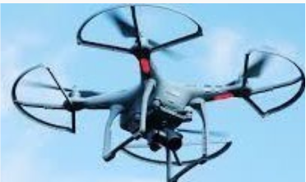
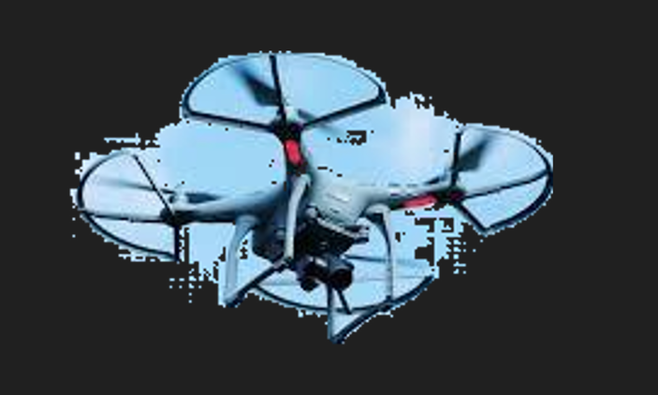
Drone Extraction

Slide 7
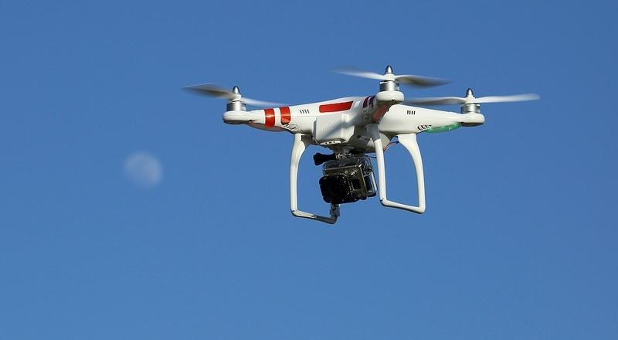
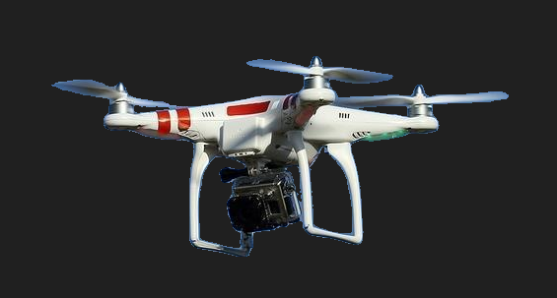
Drone Extraction

Slide 8
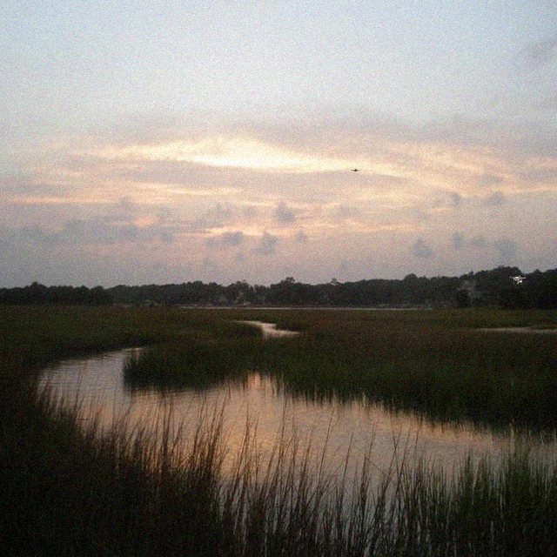
Example of mix dataset- drone+airplane

Slide 9
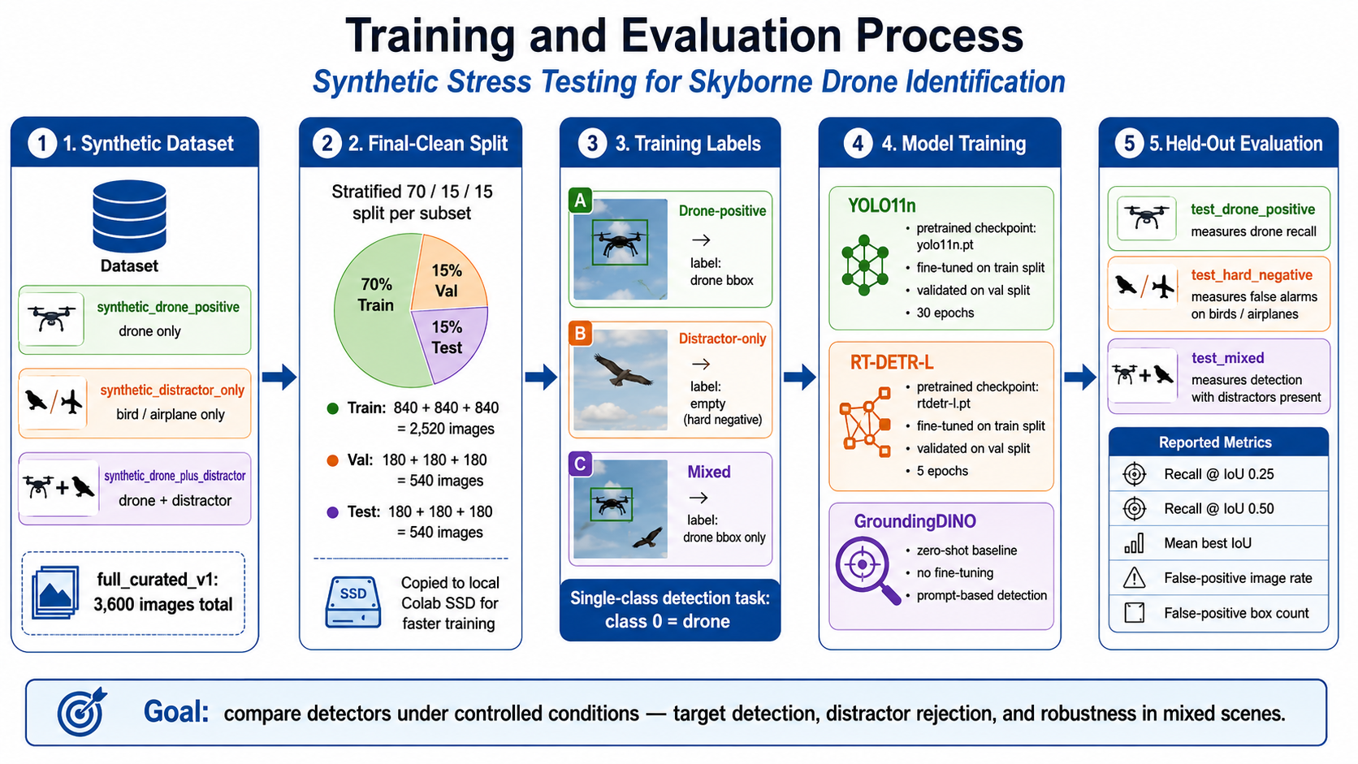

Slide 10
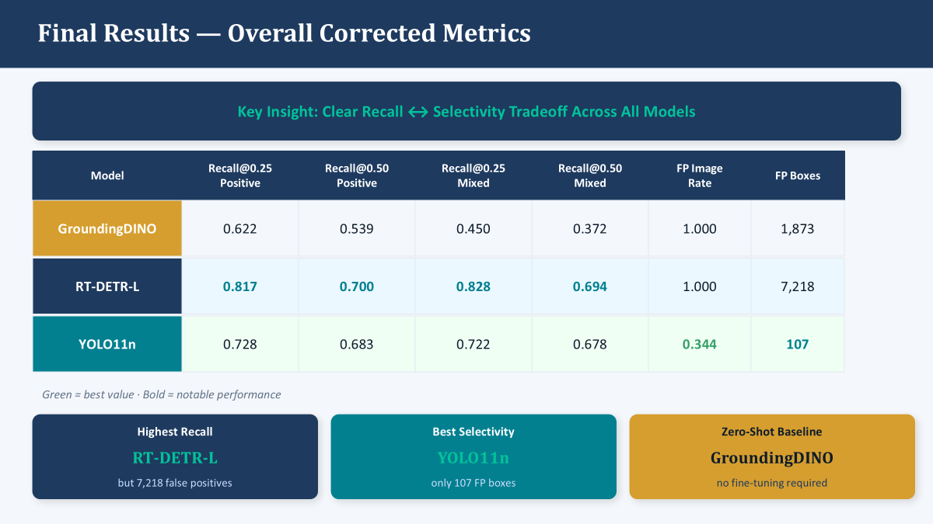

Slide 11
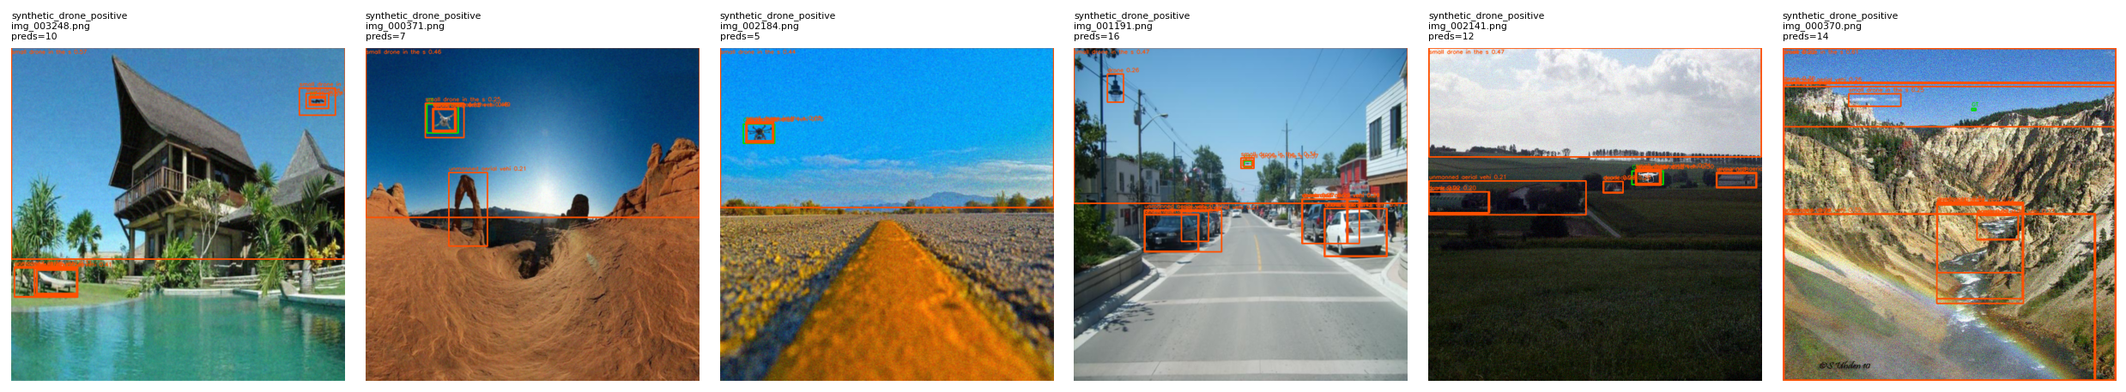
GroundingDino prediction on Positive drone dataset

Slide 12
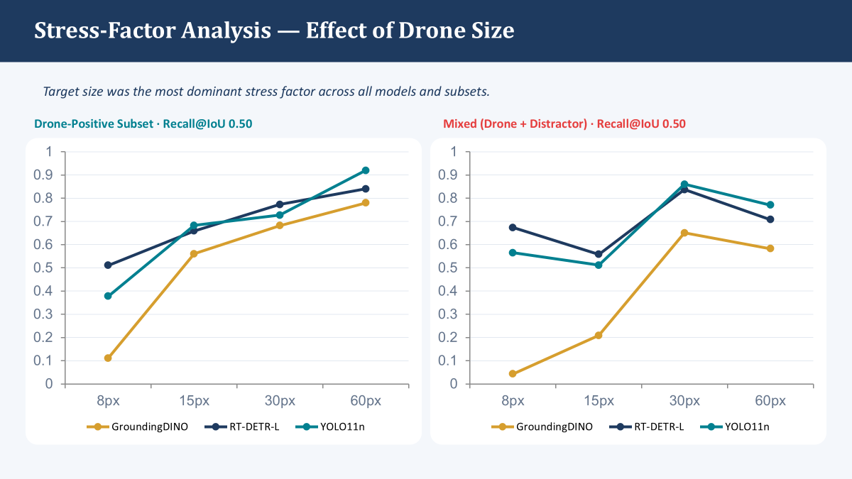

Slide 13
Conclusion
drone detection should not be evaluated only by recall. A model that detects more drones may also hallucinate drones on birds or airplanes. Therefore, robust evaluation requires both target detection metrics and hard-negative false-positive analysis

Slide 14
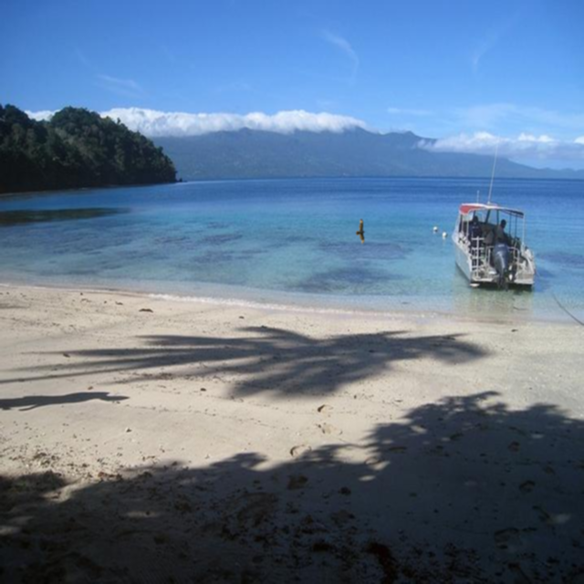
Example of hard negative dataset - bird

Slide 15
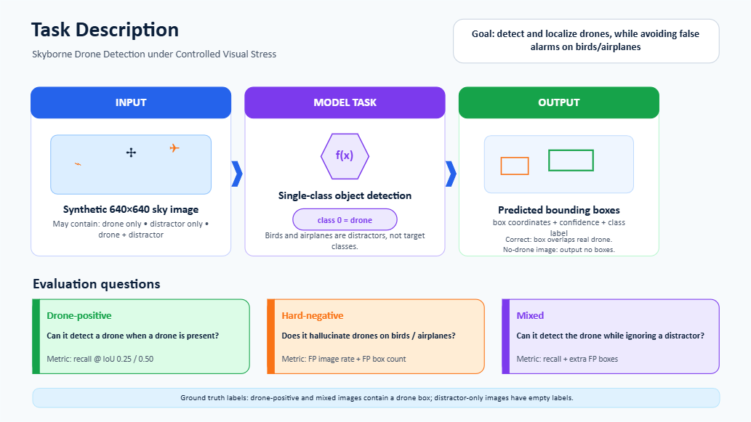

Slide 16
End-to-end example
subset: synthetic_drone_plus_distractor
Distractor: bird
background_type: cloudy_sky
drone_size_px: 15
distractor_size_px: 30
gaussian_noise_sigma: 10
blur_level: mild

