Slide 1
AI Gateway
Azure API Management as Your AI Control Plane
Multi-Model Failover · Load Balancing · FinOps · Observability
March 2026
Notes:
Opening slide for the AI Gateway presentation. This deck covers Azure API Management (APIM) as an AI Gateway — the pattern of placing APIM in front of AI model endpoints to manage security, reliability, performance, and cost. Project repo: AI-Gateway/labs/multi-model-failover

Slide 2
Agenda
Overview
01
Key Concepts
APIs, Backends, Policies, Subscriptions, Observability
02
Architecture
Azure services and how they interconnect
03
Scenario 1
Load Balancing & Backend Failover
04
Scenario 2
Department Access via Product Subscriptions
05
Scenario 3–4
Usage & Cost Monitoring
06
Scenario 5
Per-Product Token Quota Enforcement
07
Summary & Takeaways
1
Notes:
Agenda overview — 7 sections. Sections 1-2 set the conceptual and architectural foundation. Sections 3-6 walk through each verified scenario with live test data. Section 7 wraps up with key takeaways.

Slide 3
Key Concepts
Foundations
API
The interface exposed by APIM that clients call — abstracts the underlying AI model endpoints.
Backend
The actual AI model endpoint (Azure AI Foundry) that processes requests behind APIM.
Backend Pool
A group of backends with priority/weight routing — enables load balancing and failover.
Policy
XML rules applied at inbound/outbound phases — rate limiting, retry logic, token metrics, auth.
Product
A package of APIs offered to a department — defines access scope and rate limits.
Subscription
A key-based credential linking a department to a product — tracks usage per consumer.
Observability
Monitoring via App Insights + Log Analytics — logs, metrics, costs, distributed tracing.
2
Notes:
Key APIM concepts mapped to the AI Gateway pattern: • API: In this project, the 'inference' API is the single entry point for all chat completions. • Backend: Two Azure AI Foundry services — foundry1 (swedencentral, priority 1) and foundry2 (eastus2, priority 2). • Backend Pool: 'pool-foundry' groups both backends. Priority-based routing sends traffic to foundry1 first; foundry2 is the failover. • Policy: product-level policy.xml applies azure-openai-token-limit; API-level policy.xml applies retry, emit-token-metric, and error normalization. • Product: Finance (2000 TPM, $20 quota), Marketing (1000 TPM, $10 quota), HR (500 TPM, $5 quota). • Subscription: One per product — the subscription key is passed as 'api-key' header. APIM resolves the subscription → product → policies. • Observability: App Insights for distributed tracing, Log Analytics Workspace for KQL queries, custom tables PRICING_CL and SUBSCRIPTION_QUOTA_CL for FinOps.

Slide 4
Architecture
Azure Services
Clients
Azure API Management
Finance
Products & Subscriptions
Azure AI Foundry 1
Primary
Sweden Central · Priority 1
Token Rate Limiting Policy
gpt-4.1-nano · gpt-4.1 · gpt-5.2
Marketing
Retry Policy (2x on 429)
HR
Failover
Azure AI Foundry 2
Token Metrics Emission
East US 2 · Priority 2 (failover)
gpt-4.1-nano · gpt-4.1 · gpt-5.2
Backend Pool (priority)
Observability Layer: Application Insights · Log Analytics Workspace · Token Metrics · FinOps Custom Tables · Cost Analysis Workbook
3
Notes:
Architecture details: DEPLOYMENT: • Resource Group: lab-multi-model-failover • APIM: apim-g3mjvytixvcoc (Consumption or Standard tier) • AI Foundry 1: foundry1-g3mjvytixvcoc (swedencentral) — primary, priority=1 • AI Foundry 2: foundry2-g3mjvytixvcoc (eastus2) — failover, priority=2 • Models deployed on both: gpt-4.1-nano, gpt-4.1, gpt-5.2 APIM CONFIGURATION: • Backend Pool 'pool-foundry' with priority-based routing • Circuit breaker: trips after 1 failure, 1-minute trip duration, acceptRetryAfter=true • Retry policy: 2 retries on 429/503 with exponential backoff • Product-level policy: azure-openai-token-limit per subscription • API-level policy: azure-openai-emit-token-metric with Product dimension MONITORING: • App Insights: insights-g3mjvytixvcoc • Log Analytics: workspace-g3mjvytixvcoc • Custom tables: PRICING_CL (model pricing), SUBSCRIPTION_QUOTA_CL (dept quotas) • FinOps automation: Logic App + scheduled query rules for auto-suspend/activate subscriptions All deployed via Bicep (main.bicep) with modular references to modules/apim/v2/ and modules/cognitive-services/v2/

Slide 5
Load Testing Approach
Methodology
Load Test Summary
5 Scenarios Verified
227
134
✓
Load Balancing & Failover
Total Requests
Successful (59%)
✓
Department Access Control
93
0
✓
Usage Monitoring
✓
Cost Monitoring
Rate Limited (41%)
Errors
✓
TPM Quota Enforcement
4
Notes:
Load test methodology: TWO TEST MODES: 1. Standard mode: 60 requests at concurrency=10, distributed across Finance (50%), Marketing (30%), HR (20%) — tests load balancing and failover. - foundry1 TPM was lowered to 1K to trigger 429s and force failover to foundry2. 2. Quota mode: Tests each product independently until TPM limit is hit — 40 requests (HR), 62 (Marketing), 125 (Finance) at concurrency=5. TOOLS: • load-test.py: Python concurrent load generator using raw HTTP requests to capture response headers • verify-scenarios.py: Queries Log Analytics via ARM REST API, generates markdown report + 16 charts METRICS: • 4,782 total tokens consumed • Average latency: 1,468 ms • Zero errors (all 429s are from rate limiting, not failures)

Slide 6
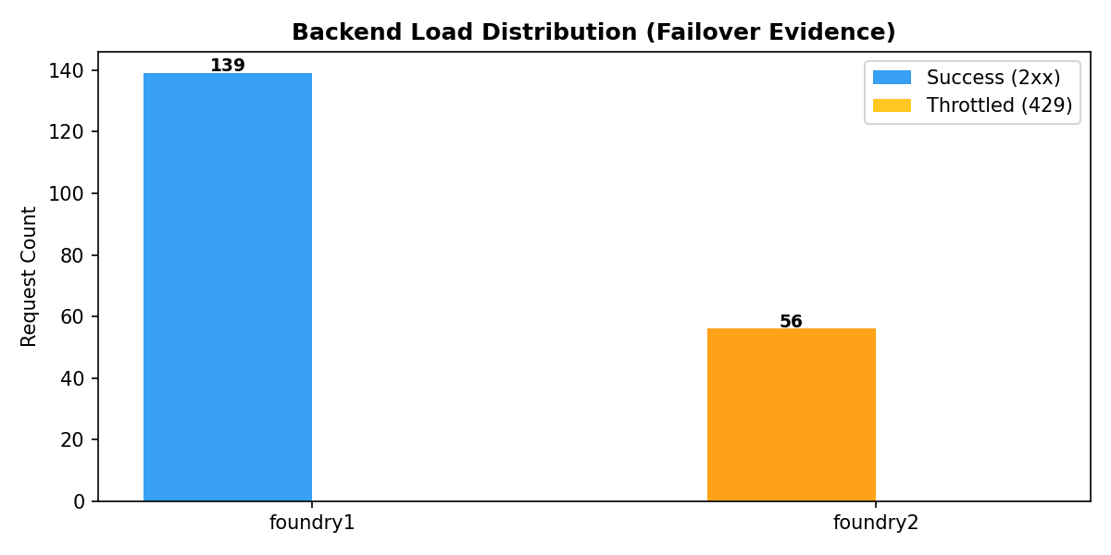
Scenario 1: Load Balancing & Failover
Results
Failover confirmed — when Foundry 1 was throttled, APIM automatically routed to Foundry 2 with zero client-visible errors.
Backend Distribution
Backend | Requests | %
Foundry 1 (Primary) | 139 | 71.3%
Foundry 2 (Failover) | 56 | 28.7%
5
Notes:
SCENARIO 1 DETAILS: To trigger failover, foundry1 model deployments were lowered to 1K TPM (from 200K). 60 requests sent at concurrency=10. HOW IT WORKS: 1. APIM backend pool sends to foundry1 (priority=1) first. 2. foundry1 returns 429 when TPM exceeded. 3. Retry policy catches 429, re-selects from pool → routes to foundry2 (priority=2). 4. Circuit breaker trips after 1 failure, removing foundry1 for 1 minute. 5. Client sees 200 OK — failover is completely transparent. EVIDENCE FROM LOGS (ApiManagementGatewayLogs): • foundry1: 139 requests (71.3%) — includes initial successes before throttling • foundry2: 56 requests (28.7%) — failover traffic after foundry1 throttled • BackendUrl shows exact model endpoint used for each request • Both gpt-4.1-nano and gpt-4.1 were served by foundry2 during failover

Slide 7
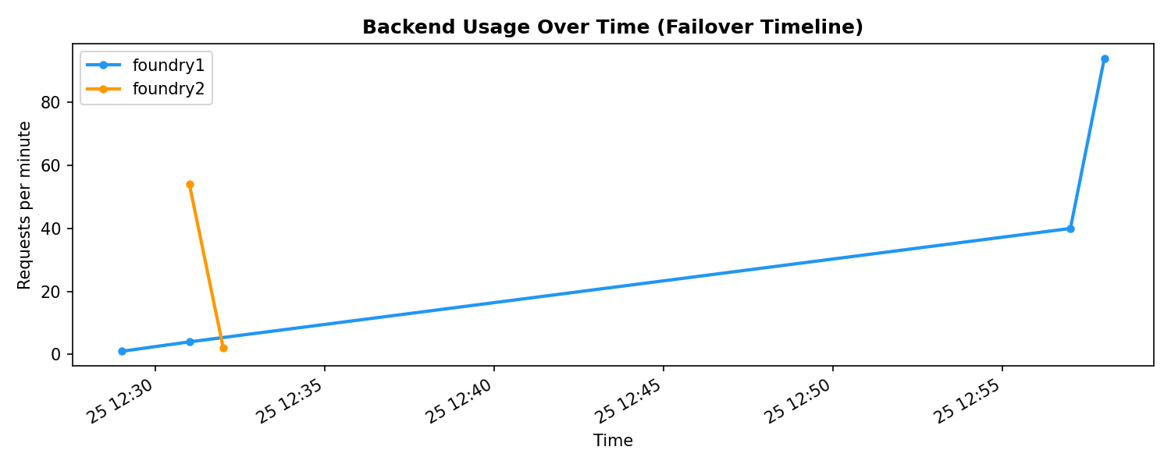
Scenario 1: Backend Timeline
Results
6
Notes:
This timeline chart shows backend usage over time. Key observation: foundry2 traffic appears after foundry1 starts getting throttled. The transition demonstrates APIM's retry + circuit breaker working together: - Retry policy handles individual 429s by trying another backend - Circuit breaker trips after sustained failures, routing ALL traffic to foundry2 for 1 minute - After circuit breaker resets, foundry1 may be tried again

Slide 8
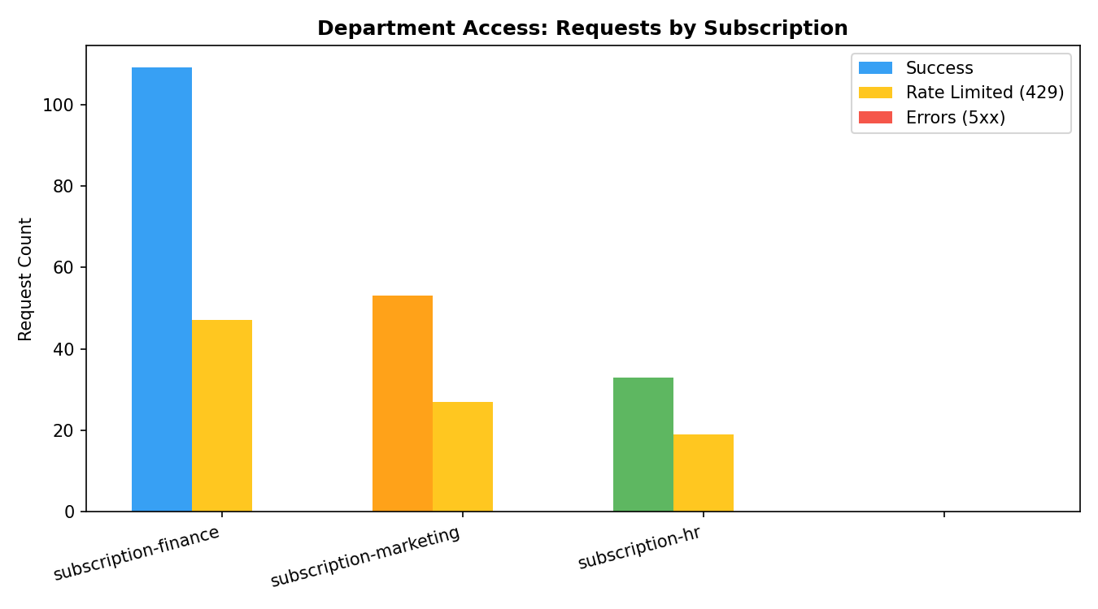
Scenario 2: Department Access Control
Results
Each department has its own APIM Product with a unique subscription key. Access is isolated and tracked independently.
Finance
Marketing
HR
TPM Limit
2,000
TPM Limit
1,000
TPM Limit
500
Cost Quota
$20
Cost Quota
$10
Cost Quota
$5
Requests
156
Requests
80
Requests
52
7
Notes:
SCENARIO 2 DETAILS: Products are defined in main.bicep with per-product configuration: • Finance: tpm=2000, tokenQuota=1,500,000 monthly, costQuota=$20 • Marketing: tpm=1000, tokenQuota=1,000,000 monthly, costQuota=$10 • HR: tpm=500, tokenQuota=500,000 monthly, costQuota=$5 Each product has a subscription (subscription-finance, subscription-marketing, subscription-hr). The subscription key is passed in the api-key header. APIM resolves subscription → product → applies product-level policies (token rate limit). All three products successfully accessed the API during load testing. The 429 responses visible here are from the quota enforcement test, NOT access failures.

Slide 9
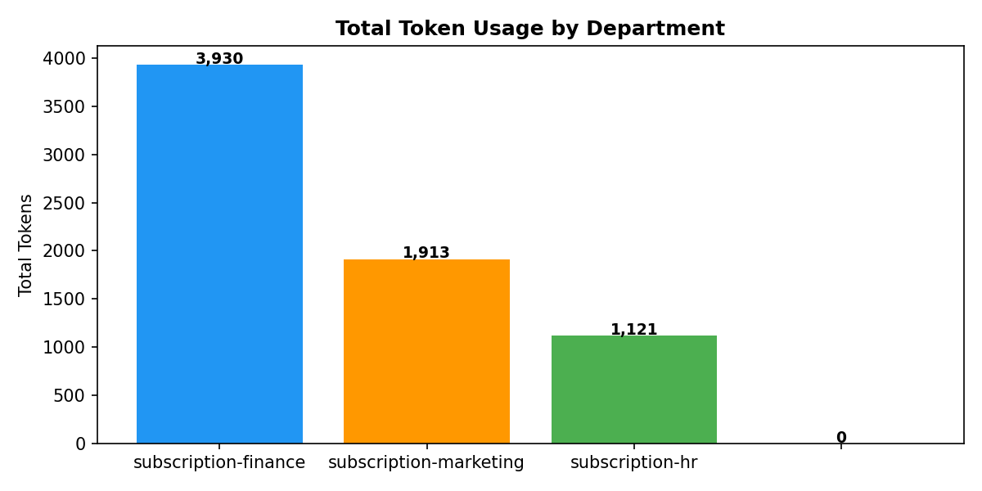
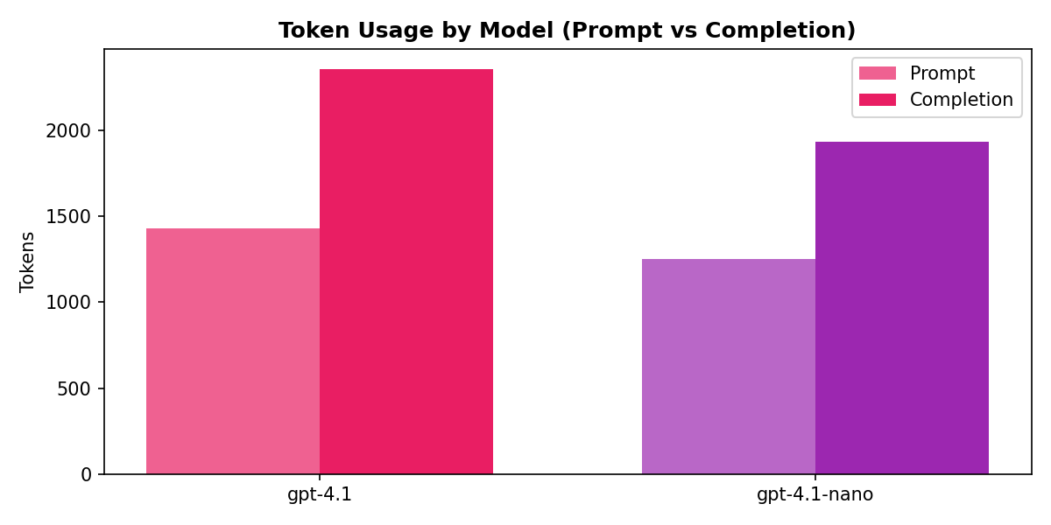
Scenario 3: Usage Monitoring
Results
Token usage is tracked per product, model, and over time via the azure-openai-emit-token-metric policy.
8
Notes:
SCENARIO 3 DETAILS: Usage data comes from ApiManagementGatewayLogs in Log Analytics. The azure-openai-emit-token-metric policy emits custom metrics with: - Dimension: Product (maps to APIM product name) - Metrics: prompt tokens, completion tokens, total tokens TOKEN USAGE BY DEPARTMENT: • Finance: 3,930 tokens (109 successful requests) • Marketing: 1,913 tokens (53 successful requests) • HR: 1,121 tokens (33 successful requests) TOKEN USAGE BY MODEL: • gpt-4.1: 3,783 tokens (104 requests) — higher per-request token usage • gpt-4.1-nano: 3,181 tokens (92 requests) — efficient for simpler prompts This data enables chargeback models: each department's usage is metered and attributable.

Slide 10
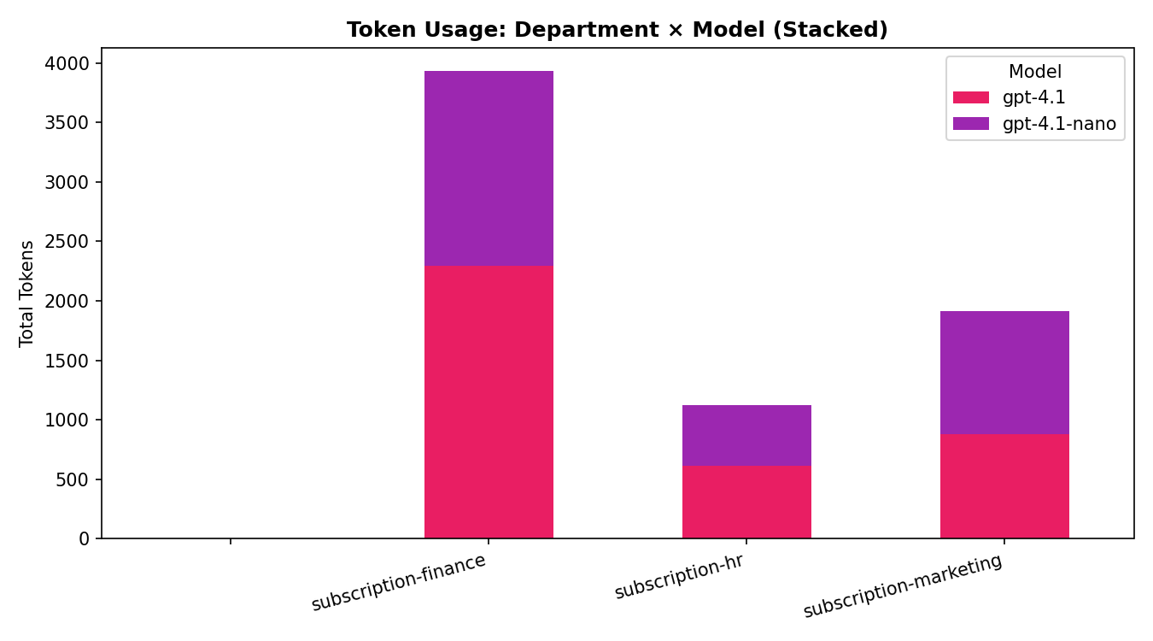
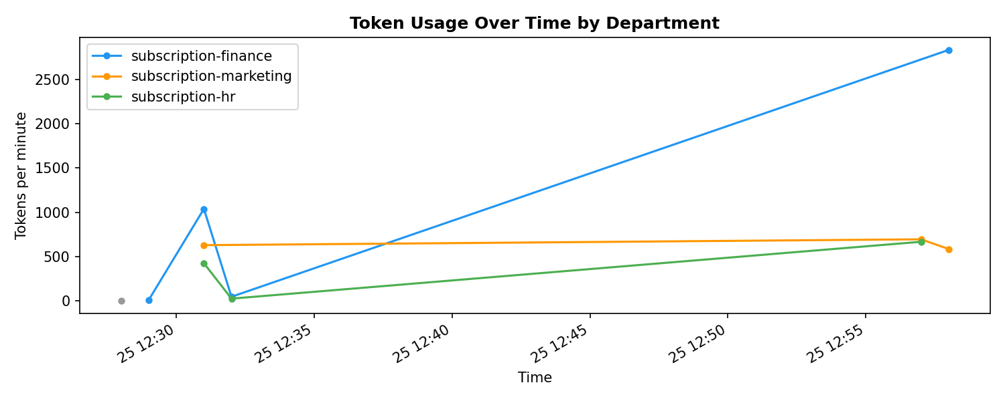
Scenario 3: Usage Deep Dive
Results
Left: Token usage by department × model | Right: Usage over time
9
Notes:
Cross-reference and timeline views: DEPT × MODEL BREAKDOWN: • Finance uses both models heavily — largest consumer • Marketing/HR prefer gpt-4.1-nano for cost efficiency on simpler tasks TIMELINE: Shows token consumption over time during the load test window. Burst patterns visible when concurrent requests land simultaneously. This data feeds the FinOps workbook for real-time cost dashboards.

Slide 11
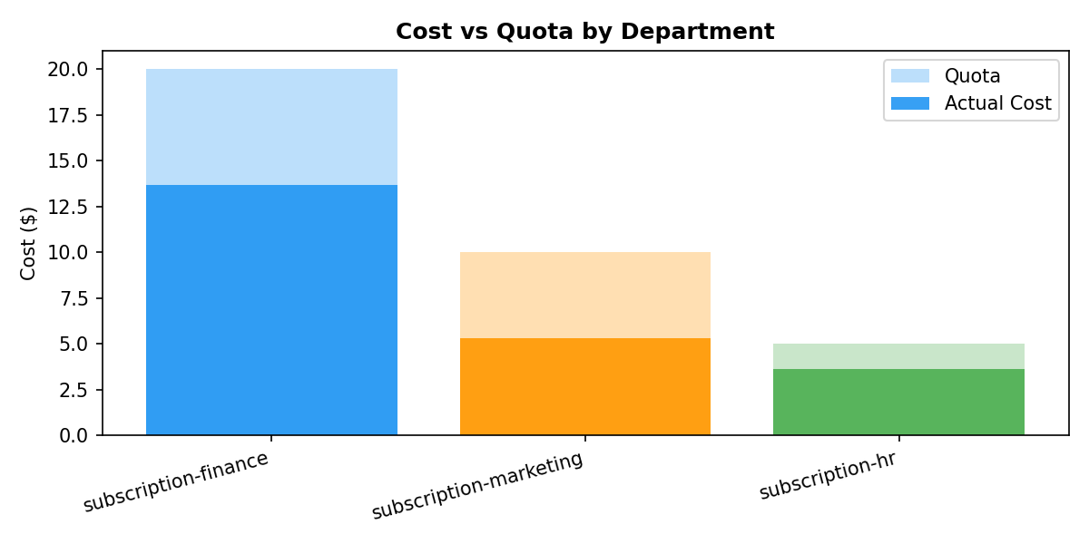
Scenario 4: Cost Monitoring
Results
Costs are calculated per request using model-specific pricing from the PRICING_CL custom table.
Cost vs Quota (Monthly Budget)
Department | Cost | Quota | Usage
Finance | $13.66 | $20.00 | 68%
Marketing | $5.29 | $10.00 | 53%
HR | $3.63 | $5.00 | 73%
10
Notes:
SCENARIO 4 DETAILS: Cost calculation uses two custom Log Analytics tables: 1. PRICING_CL: Model pricing per 1M tokens (input/output rates) - gpt-4.1: $2/M input, $8/M output - gpt-4.1-nano: $0.10/M input, $0.40/M output 2. SUBSCRIPTION_QUOTA_CL: Monthly cost quotas per subscription - Finance: $20, Marketing: $10, HR: $5 COST BY MODEL: • gpt-4.1: $21.68 total (96% of all costs) — powerful but expensive • gpt-4.1-nano: $0.90 total (4%) — 24x cheaper per token FINOPS AUTOMATION: When cost exceeds quota, scheduled query rules trigger alerts. Logic App (la-update-sub) receives alerts and suspends the subscription. When cost drops below quota (e.g., new month), subscription is reactivated. This creates automated guardrails preventing cost overruns.

Slide 12
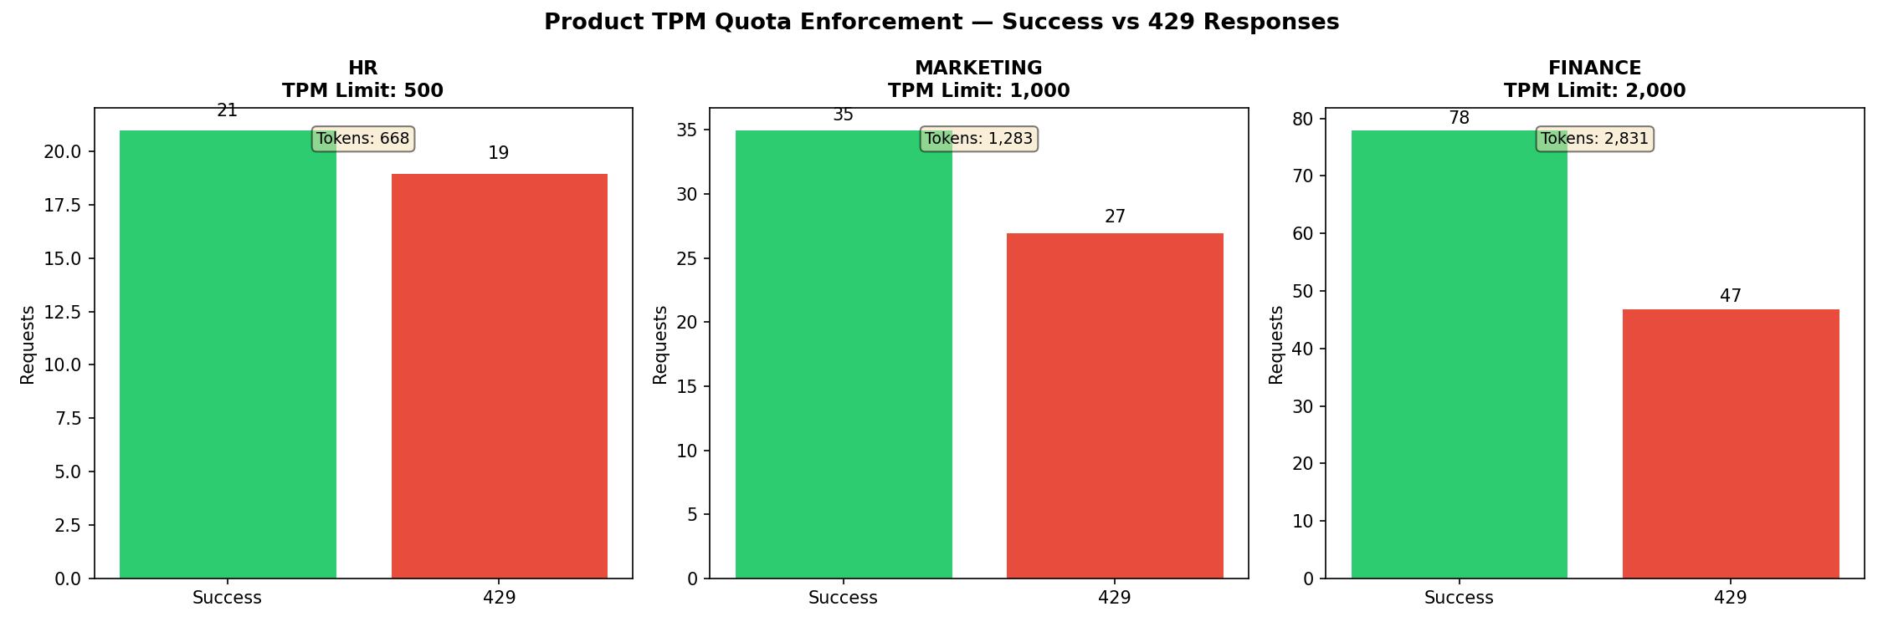
Scenario 5: TPM Quota Enforcement
Results
All three product TPM limits were enforced — requests exceeding the quota received HTTP 429 (Too Many Requests).
Product | TPM Limit | Success | 429s | Tokens | First 429 At
HR | 500 | 21 | 19 | 668 | 134% of limit
Marketing | 1,000 | 35 | 27 | 1,283 | 128% of limit
Finance | 2,000 | 78 | 47 | 2,831 | 142% of limit
11
Notes:
SCENARIO 5 DETAILS: Per-product TPM enforcement is done by the azure-openai-token-limit policy in the product policy (products-policy.xml). The policy uses counter-key=context.Subscription.Id so each subscription gets an independent counter. When tokens consumed in a 1-minute window exceed the limit, APIM returns 429 BEFORE forwarding to the backend. WHY TOKENS EXCEED 100% OF LIMIT: With concurrency=5, multiple requests are in-flight simultaneously. Some complete before the counter is checked, causing slight overshoot. This is expected behavior — the policy checks BEFORE the request, but tokens are counted AFTER. ENFORCEMENT TIMELINE: • HR (500 TPM): 21 succeeded, then 429s started after ~668 tokens (134% of limit) • Marketing (1000 TPM): 35 succeeded, then 429s after ~1,283 tokens (128%) • Finance (2000 TPM): 78 succeeded, then 429s after ~2,831 tokens (142%) The 429 response from the token-limit policy is NOT retried by the retry policy because it occurs in the product inbound phase (before backend routing).

Slide 13
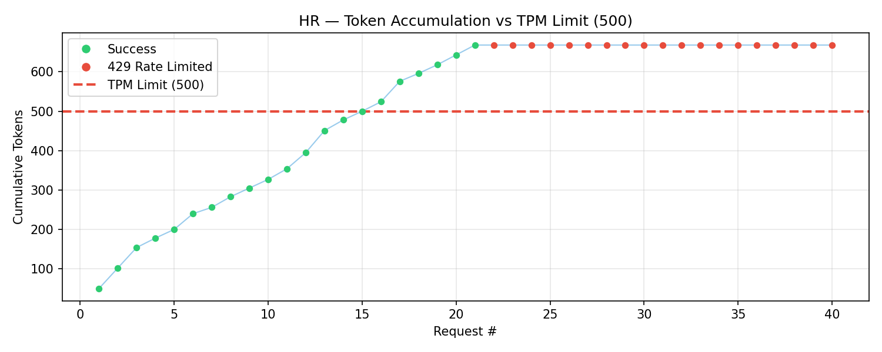
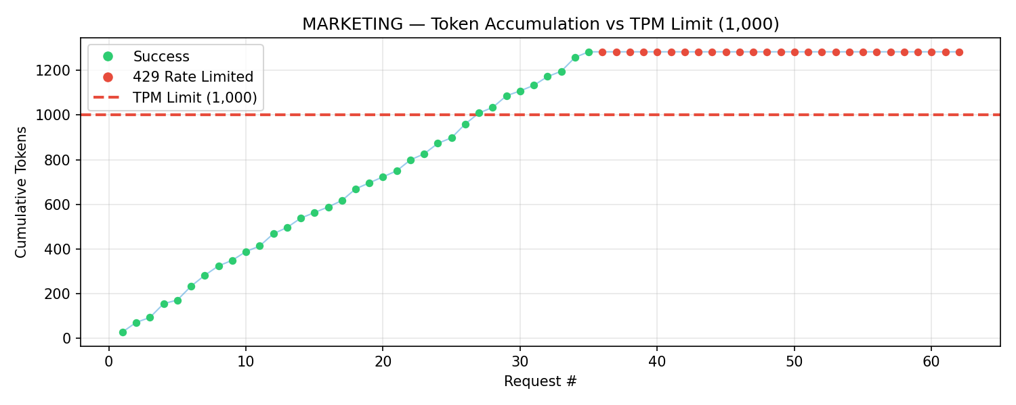
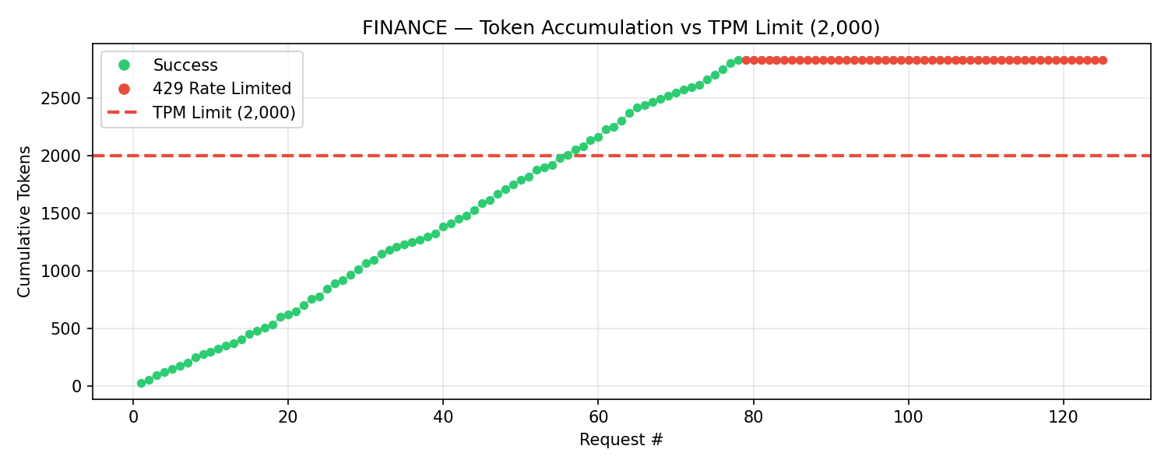
Quota Enforcement: Token Accumulation
Deep Dive
Green dots = successful requests · Red dots = 429 rate-limited · Dashed line = TPM limit
12
Notes:
Token accumulation curves for each product: Each chart shows cumulative tokens consumed (Y axis) as requests are sent (X axis). The red dashed line marks the configured TPM limit. Pattern visible across all three products: 1. Green dots climb as tokens accumulate from successful requests 2. Curve crosses the TPM limit line 3. Red dots appear — subsequent requests are rejected with 429 4. Occasional green dots still appear after the limit due to concurrent requests completing This pattern clearly demonstrates the sliding-window token counter in action.

Slide 14
Key Takeaways
Resilient by Design
Priority-based backend pool + retry + circuit breaker = zero client-visible failures during backend throttling.
Per-Department Governance
APIM Products enforce token rate limits per department — each team gets its own quota ceiling.
Full Cost Visibility
Token-level cost tracking per department and model enables precise chargebacks and budget control.
Automated FinOps Guardrails
Logic App + scheduled alerts automatically suspend subscriptions when cost quotas are exceeded.
Observable & Auditable
Every request is logged with backend, model, tokens, and cost — queryable via KQL in Log Analytics.
Notes:
SUMMARY: This presentation demonstrated Azure API Management as an AI Gateway with 5 verified scenarios: 1. LOAD BALANCING: Backend pool with priority routing. Failover from foundry1→foundry2 transparent to clients. Evidence: 71.3% foundry1, 28.7% foundry2 in gateway logs. Zero client errors. 2. DEPARTMENT ACCESS: Three APIM products (Finance, Marketing, HR) with independent subscriptions. Evidence: All three products successfully accessed the API. 3. USAGE MONITORING: Token consumption tracked per department and model. Evidence: Finance 3,930 tokens, Marketing 1,913, HR 1,121. Breakdowns by model available. 4. COST MONITORING: Per-request cost calculation using model pricing tables. Evidence: All departments within budget (Finance 68%, Marketing 53%, HR 73% of quota). 5. QUOTA ENFORCEMENT: Per-product TPM limits enforced via azure-openai-token-limit policy. Evidence: All three products hit their 429 ceiling — HR at 134%, Marketing at 128%, Finance at 142% of TPM. NEXT STEPS: • Enable gpt-5.2 model in load tests • Add semantic caching for repeated prompts • Integrate with Azure Cost Management for enterprise dashboards

