Slide 1
Project report
Analysis of “Netflix Customer Churn & Engagement Analytics” Dataset
Authors:
Michał Matysik
Daniil Solodylov

Slide 2
Content
Data Preparation
Descriptive Statistics
Hypothesis Testing
Predictive Modeling
Decision Trees
K-Means & K-Medoids

Slide 3
Dataset Description

Slide 4

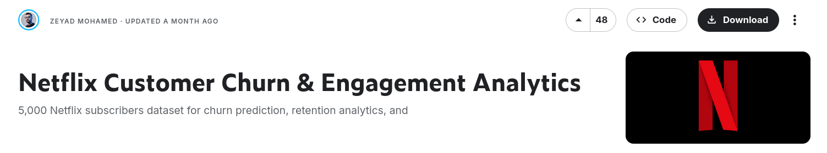
Selected Dataset
< Link : https://www.kaggle.com/datasets/zeyadmohamed26/netflix-customer-churn-and-engagement-analytics/data >

Slide 5
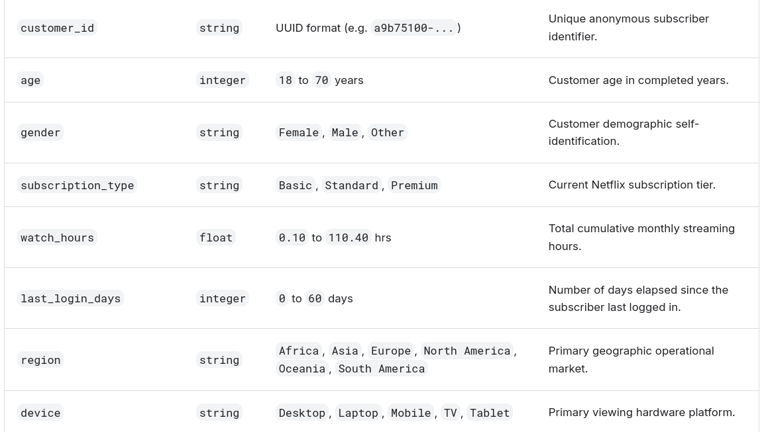
Attributes Description (Part 1)

Slide 6
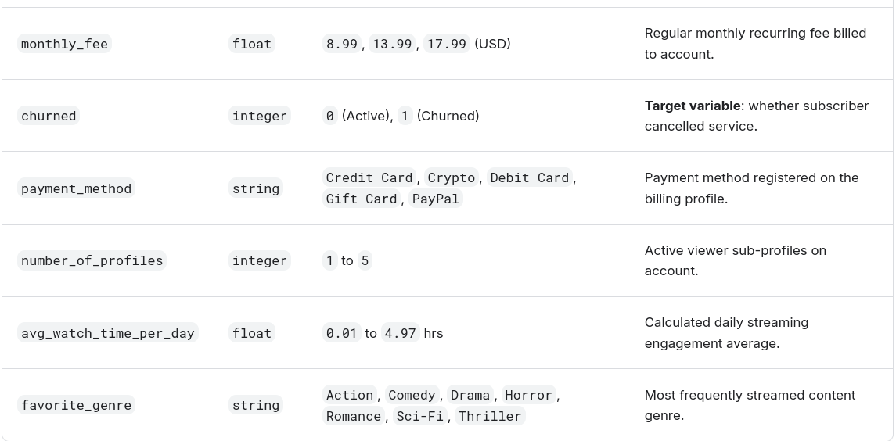
Attributes Description (Part 2)

Slide 7
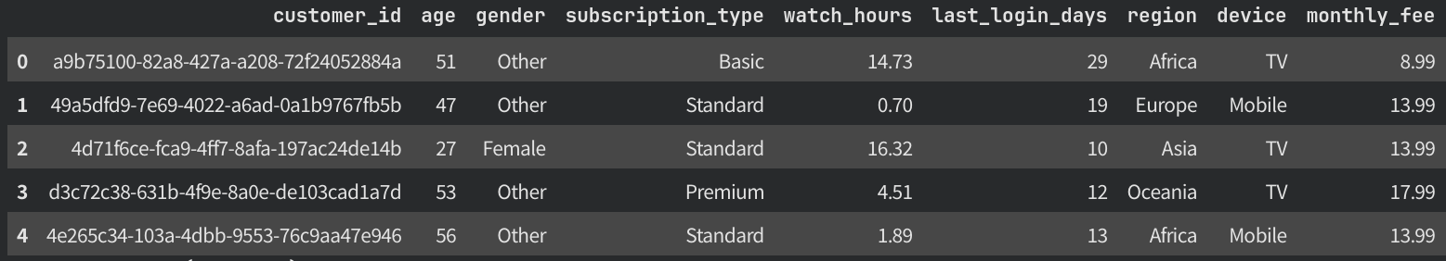
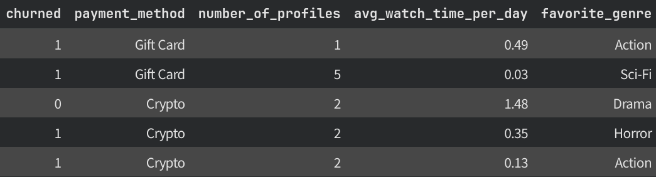
Entries Showcase

Slide 8
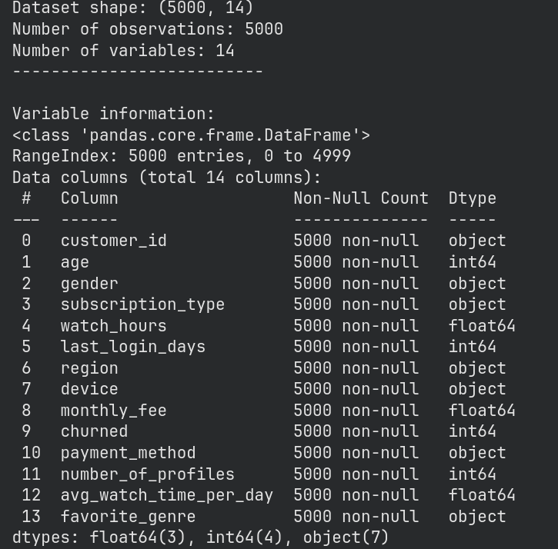
Dataset dimensions

Slide 9
Data Preparation

Slide 10
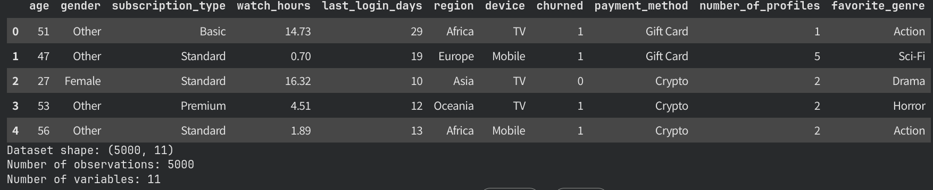
Attributes pruning

Slide 11
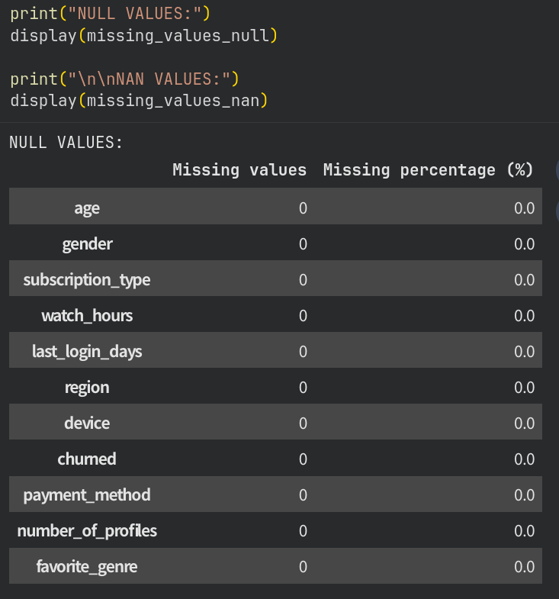
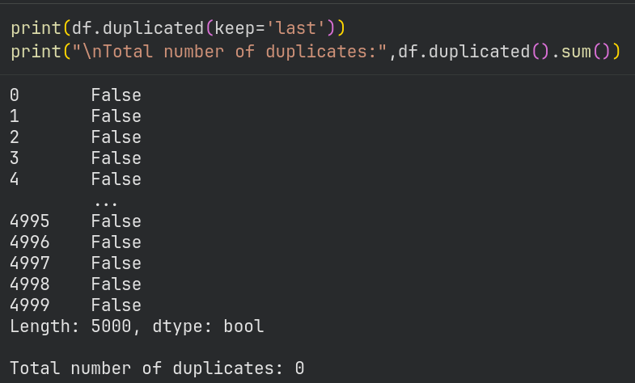
Checking Missing Values and Duplicates

Slide 12
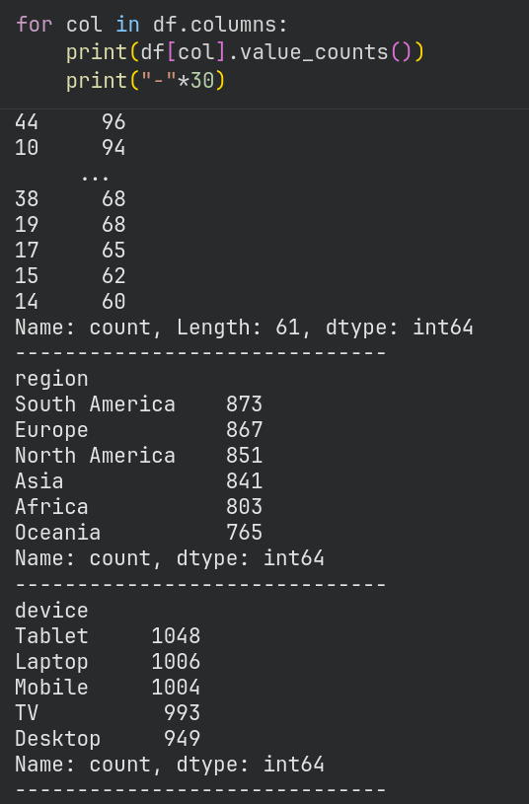
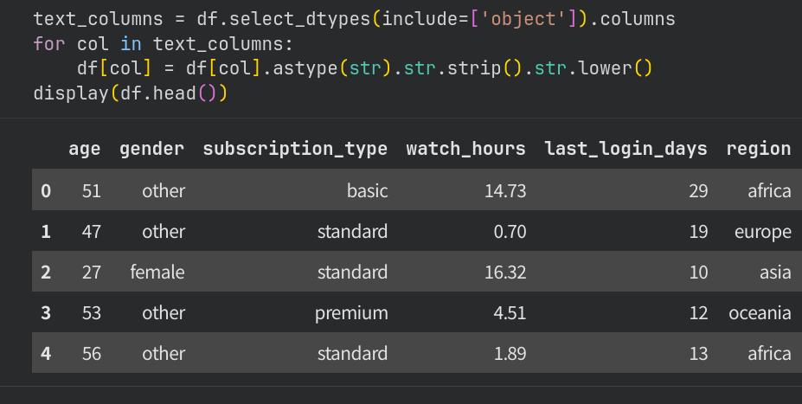
Text standardization

Slide 13
Descriptive Statistics

Slide 14
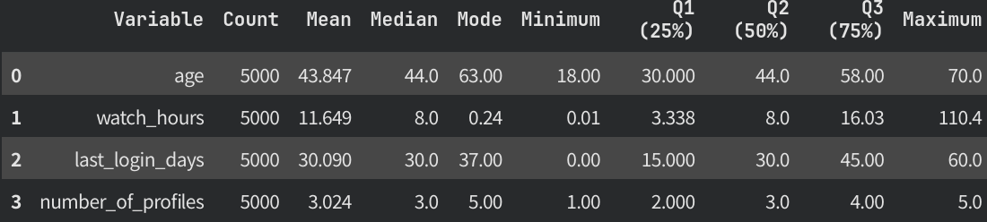
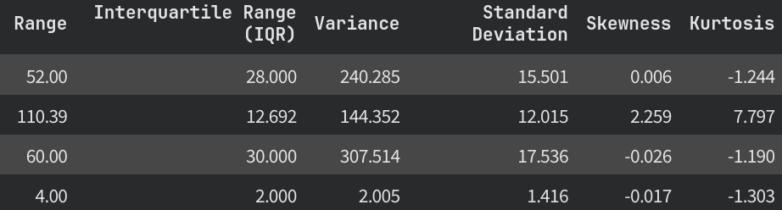
Description of Discrete Variables

Slide 15
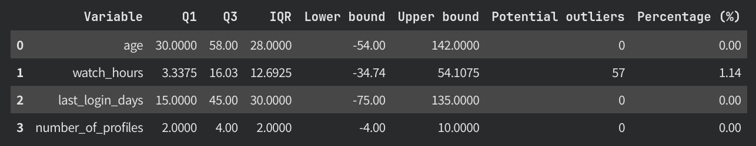
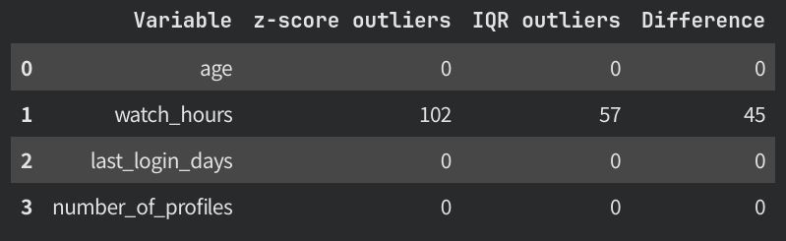
Outliers Handling (Detection)

Slide 16
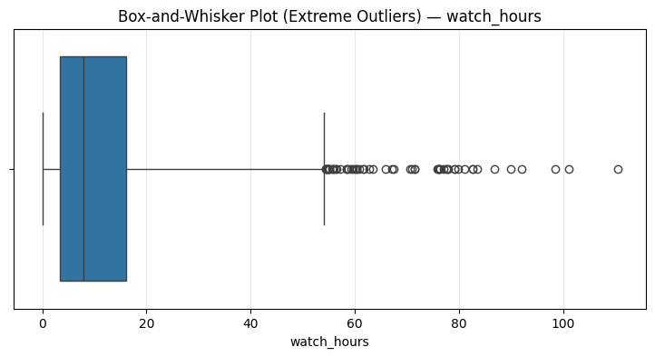
Outliers Handling (Detection)

Slide 17
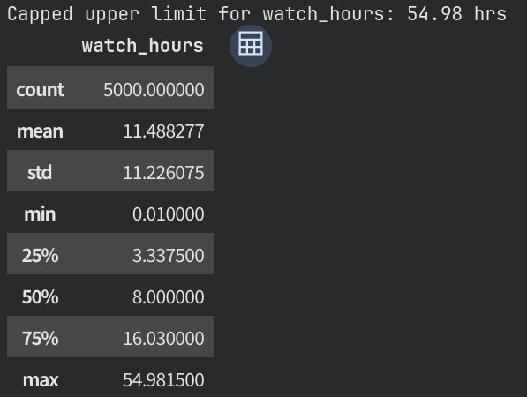
Outliers Handling (Deletion)

Slide 18
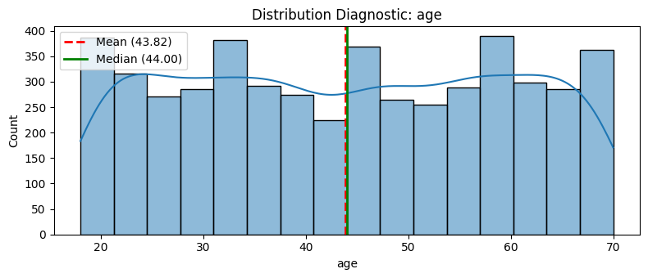
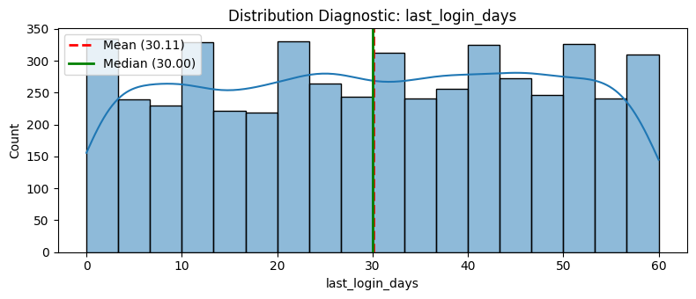
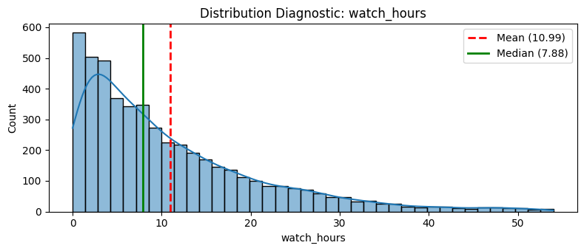
Visual Analysis of Attributes

Slide 19
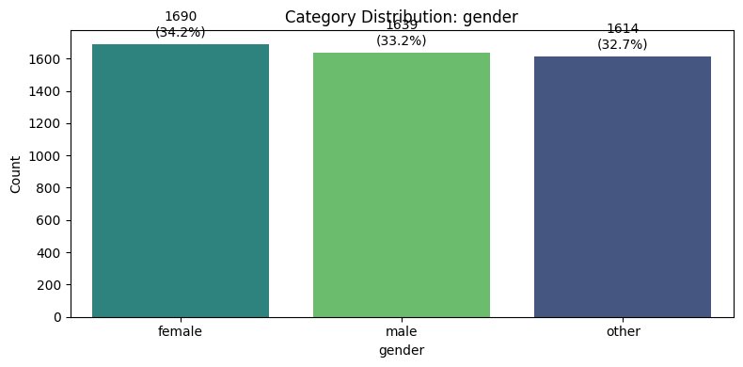
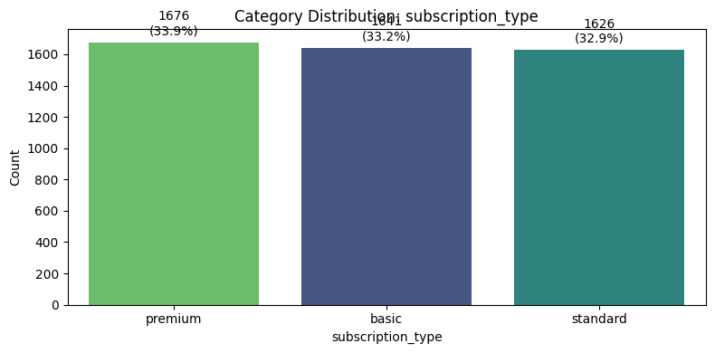
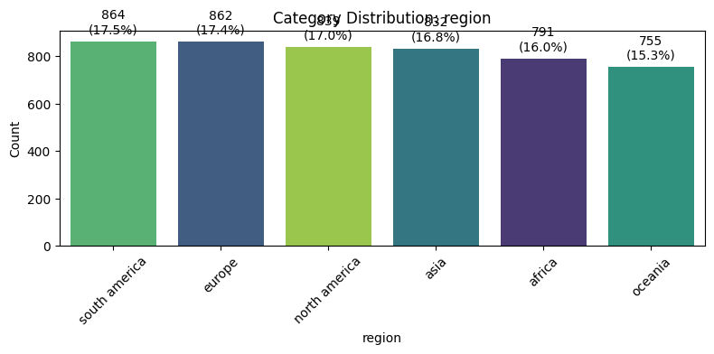
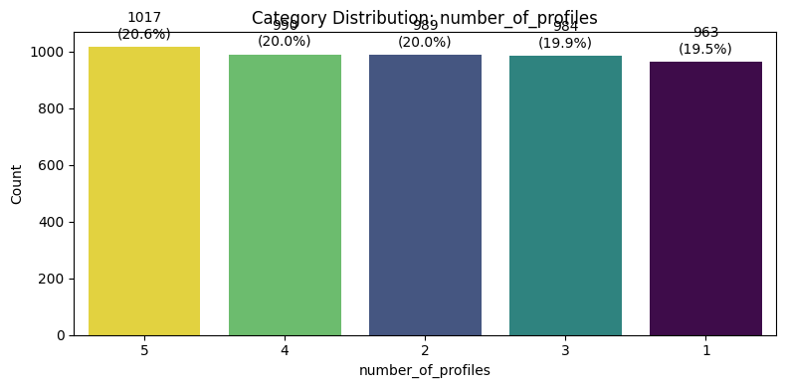
Visual Analysis of Attributes

Slide 20
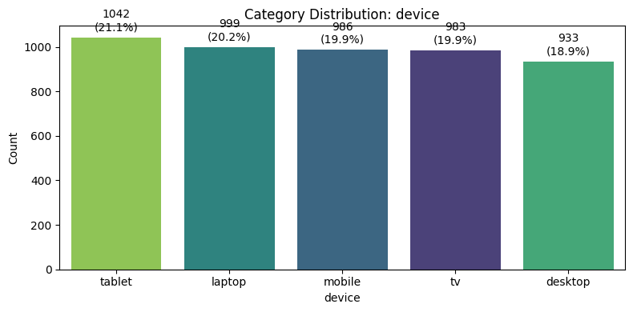
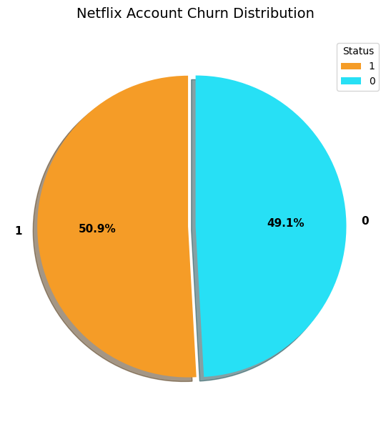
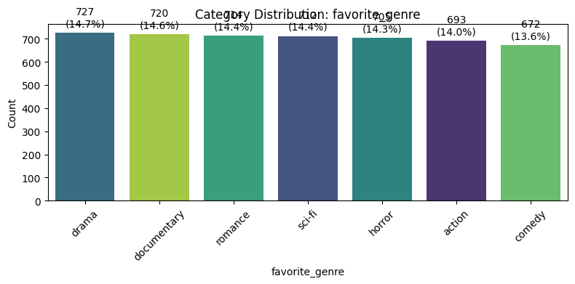
Visual Analysis of Attributes

Slide 21
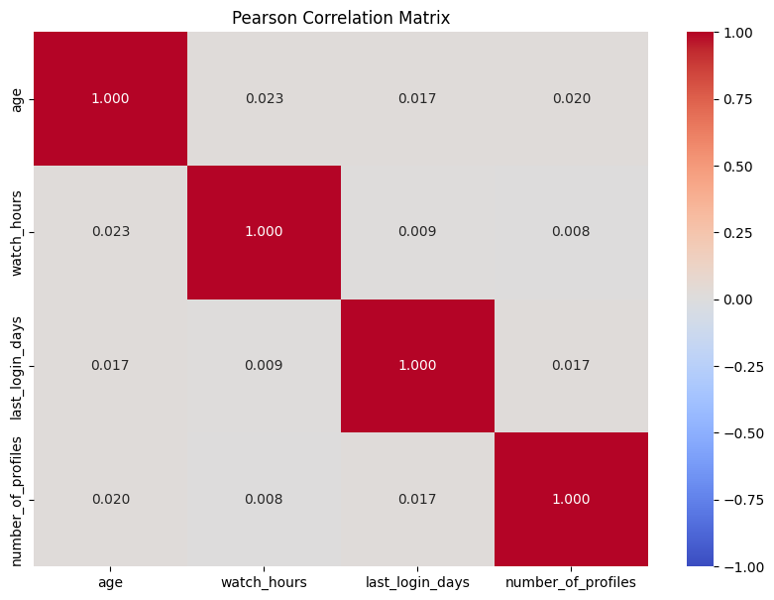
Pearson Correlation for Integers

Slide 22
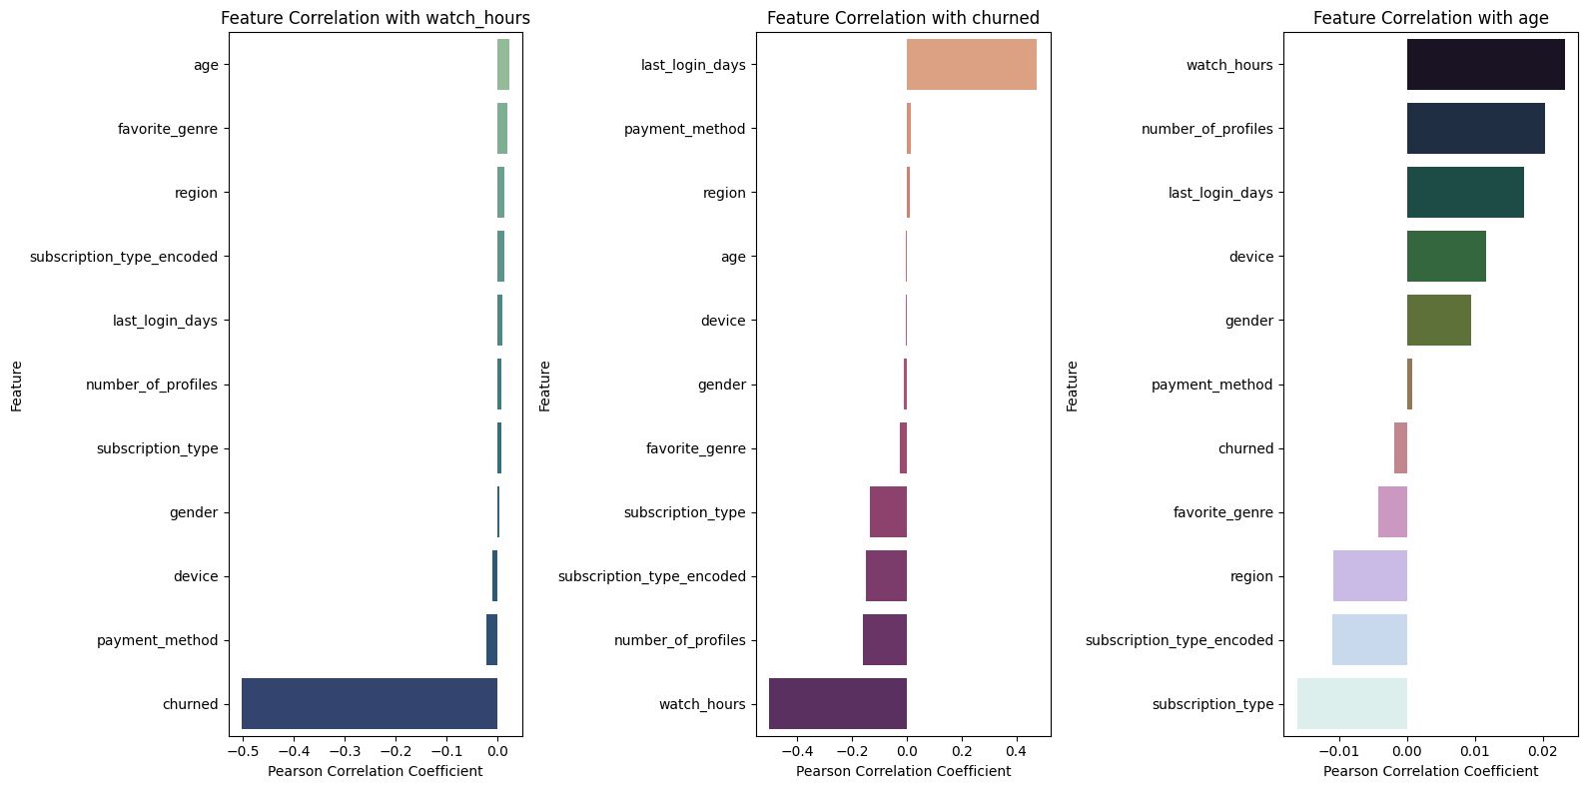
Pearson Correlation for Targets

Slide 23
Hypothesis testing

Slide 24
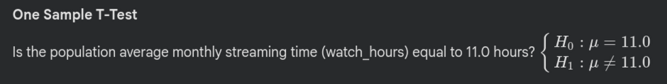
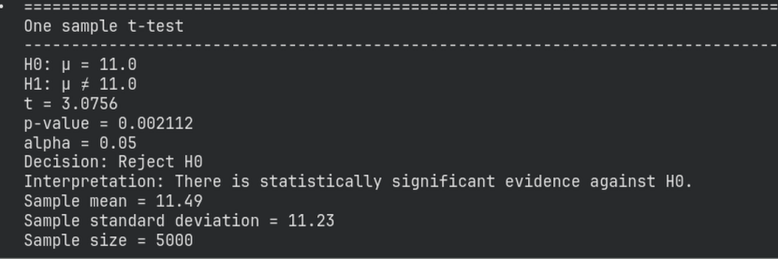
One-Sample T-test for the population mean

Slide 25

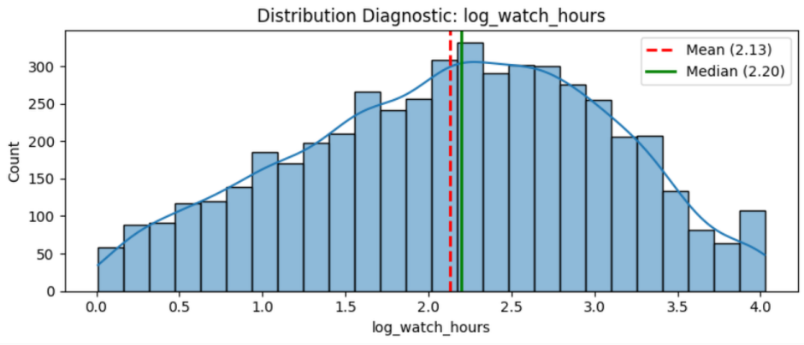
One-Sample T-test for the population mean

Slide 26
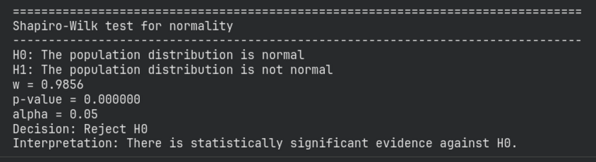
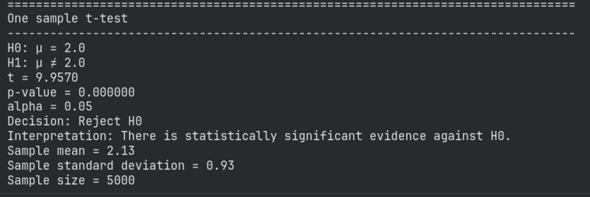
One-Sample T-test for the population mean

Slide 27
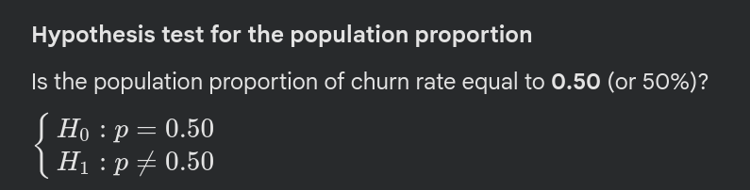
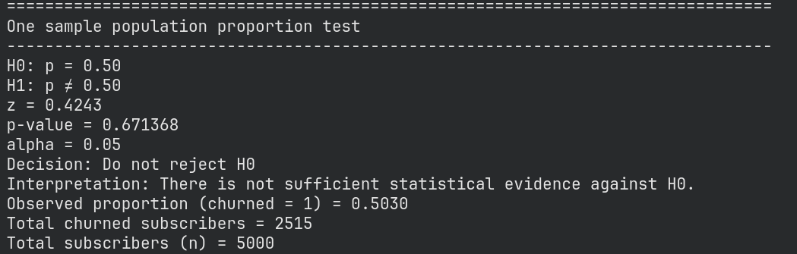
One-Sample T-test for the population proportion

Slide 28
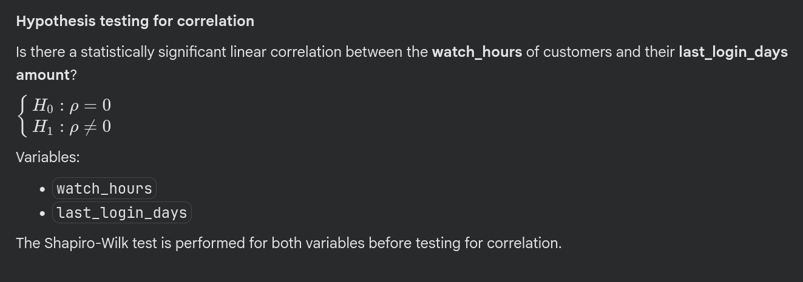
Hypothesis testing for correlation

Slide 29
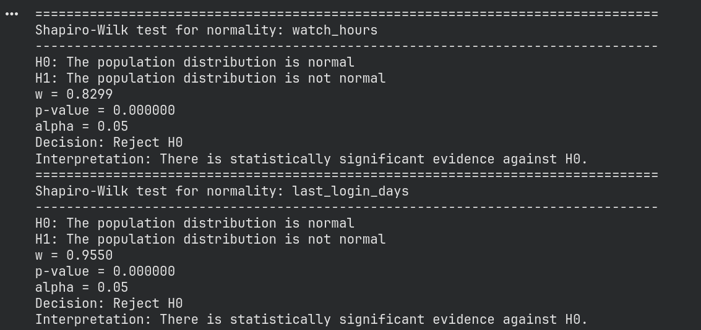
Hypothesis testing for correlation

Slide 30
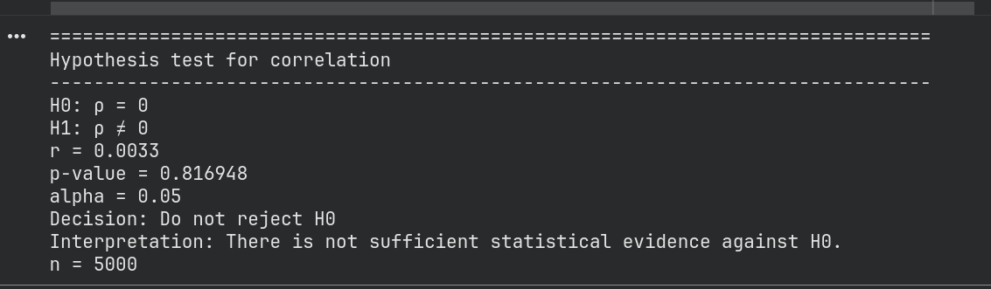
Hypothesis testing for correlation

Slide 31
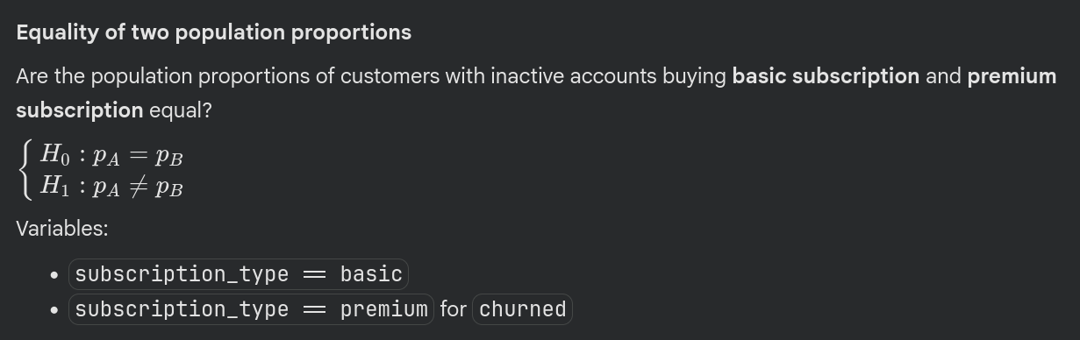
Equality of two population proportions

Slide 32
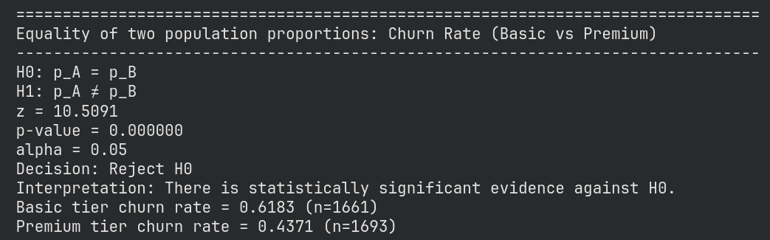
Equality of two population proportions

Slide 33
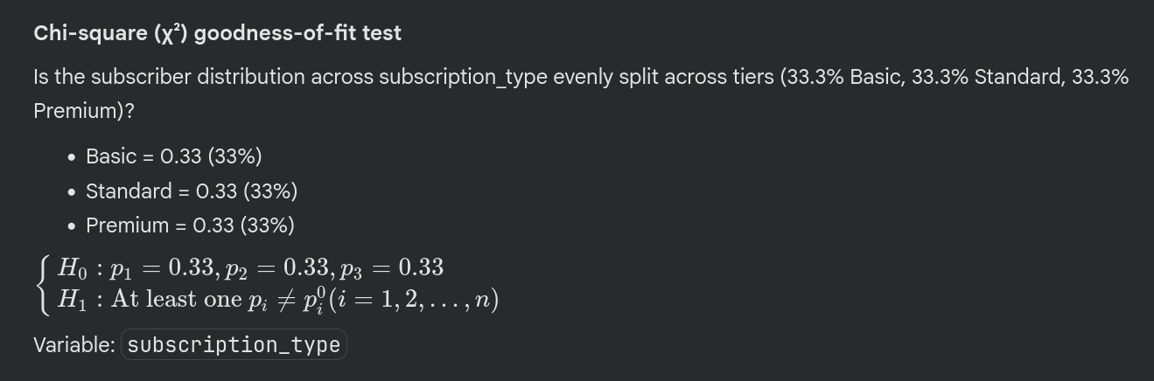
Chi-Square goodness-of-fit test

Slide 34
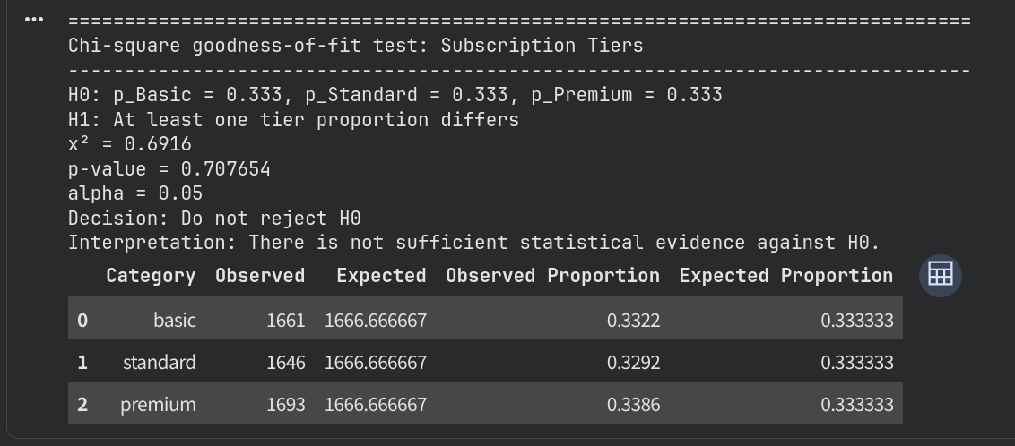
Chi-Square goodness-of-fit test

Slide 35
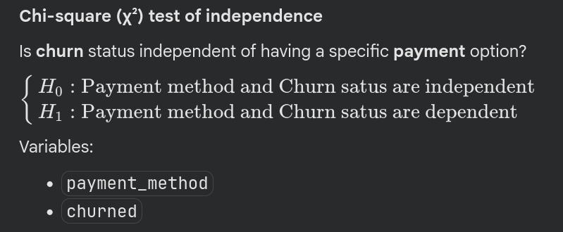
Chi-Square test of independence

Slide 36
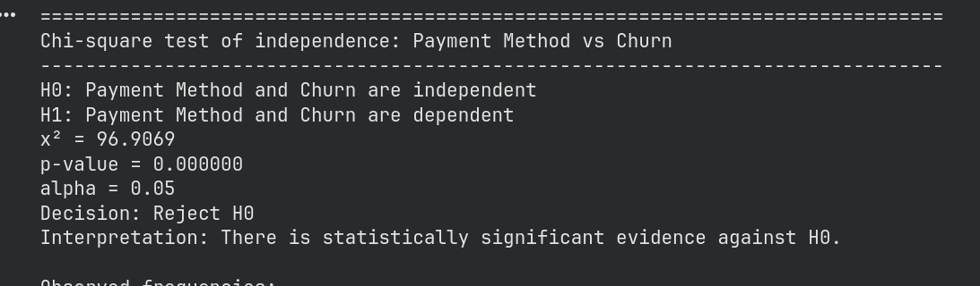
Chi-Square test of independence

Slide 37
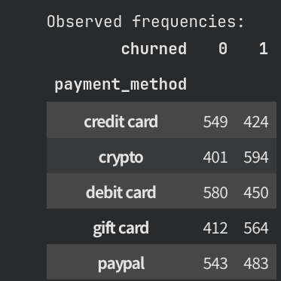
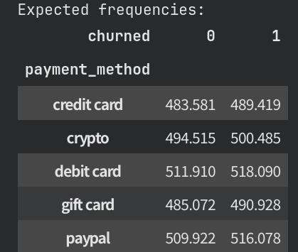
Chi-Square test of independence

Slide 38
Linear Regression

Slide 39
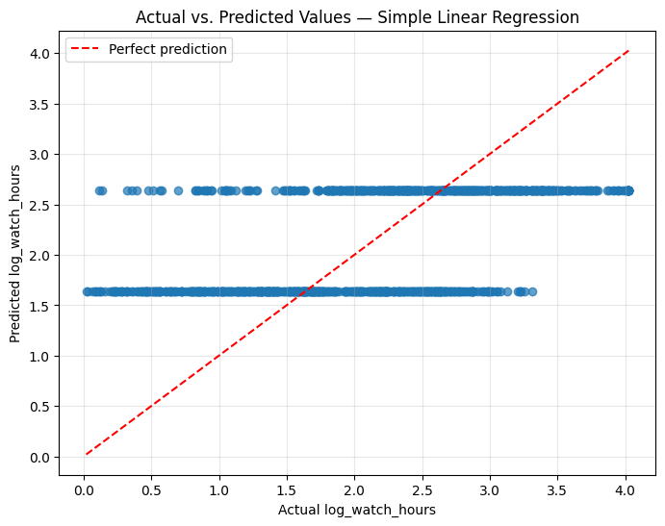
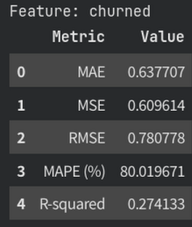
Single-Variable Regression

Slide 40
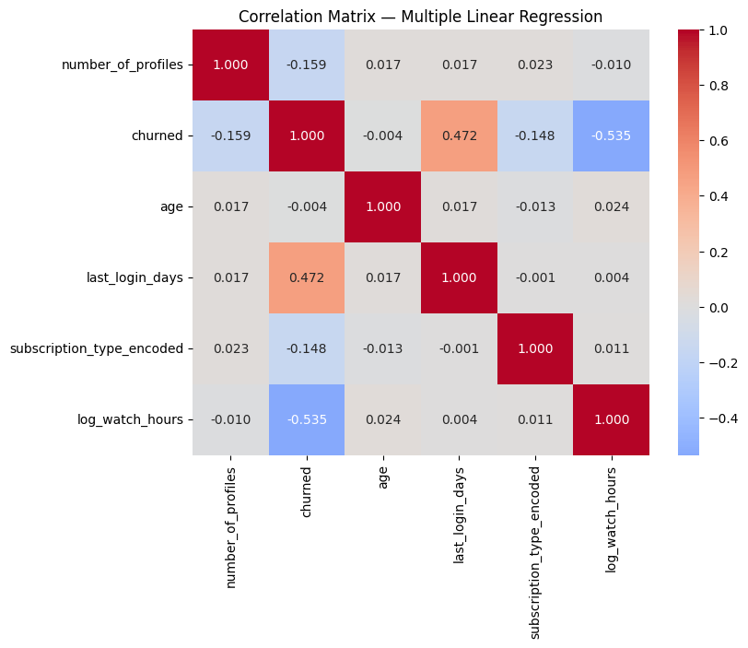


Multi-Variable Regression

Slide 41


Multi-Variable Regression

Slide 42
Logistic Regression

Slide 43


Confusion Matrix & AUC

Slide 44

Statistics

Slide 45


New User Prediction

Slide 46
Decision Trees

Slide 47


Decision Trees - Hyperparameter Tuning

Slide 48



Decision Trees - Cross-Validation & Rules

Slide 49

Decision Tree

Slide 50
Clusters: K-Means & K-Medoid

Slide 51


Customer Segmentation - Choosing K

Slide 52


K-Means vs K-Medoids

Slide 53
References
Project’s Github Link - https://github.com/michalmatysik6/Data_Science---Winter-school
Dataset ”Netflix Customer Churn & Engagement Analytics” on Kaggle - https://www.kaggle.com/datasets/zeyadmohamed26/netflix-customer-churn-and-engagement-analytics/data (Last Reviewed : October 8th 2026)

