Slide 1
By Team 2
Smart Home Devices
Michal Borowski
Jonathan Devaux
Jarogniew Witkowski
Earl Quadros
Leon Sebastian

Slide 2
Innovatively Creating an App Using Qt
Proper elaboration and clarification on how the items described function can be found within the report.
Link to report:
Product Demonstration Report

Slide 3
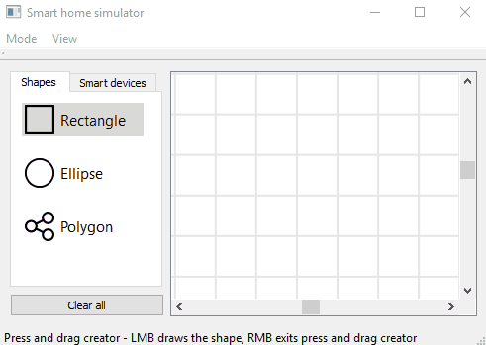
Layout
Code was created to allow for controlling the size and shape of the features listed below:
Grid
Sizing
Basic menu
Shapes creation
Snapping to the grid while moving shape

Slide 4
Behaviour of the App
List of things that the app can do:
Select move and delete multiple shapes
Opaque area detection
Detect the smallest shape under the cursor
Status info bar
Gif showing detection of smallest feature under the cursor

Slide 5
Additional Features
Placing smart devices
Actor selection and movement
Control screen usage
Implementation details
Devices Being placed

Slide 6
You can ask questions

