Slide 1
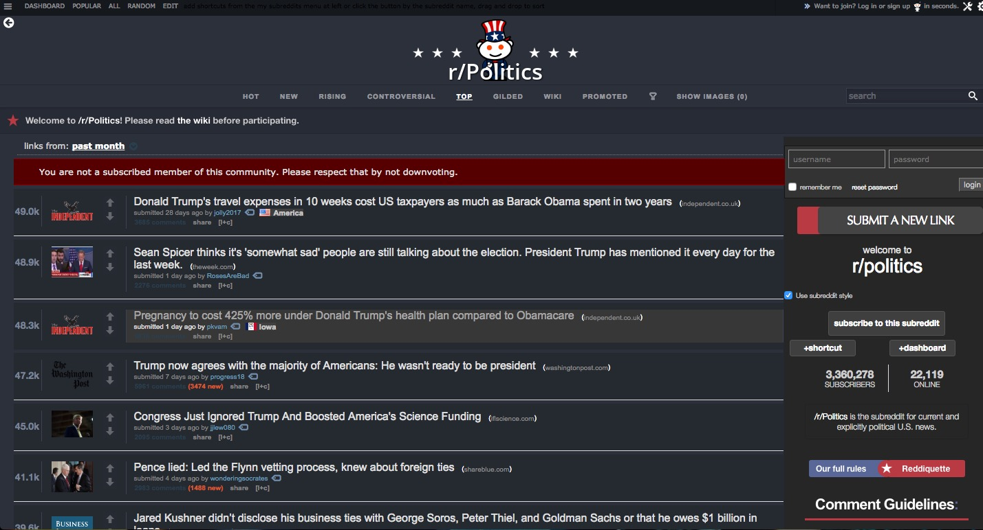


Slide 2
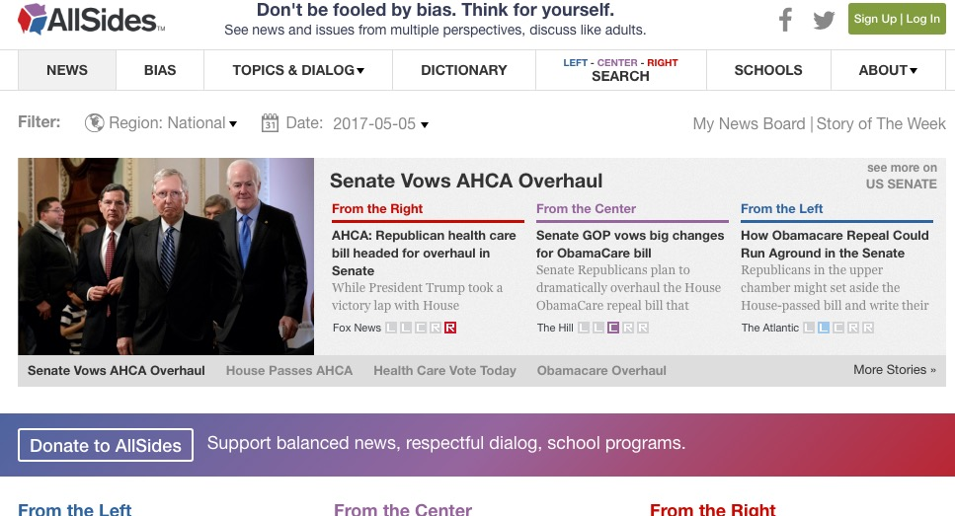
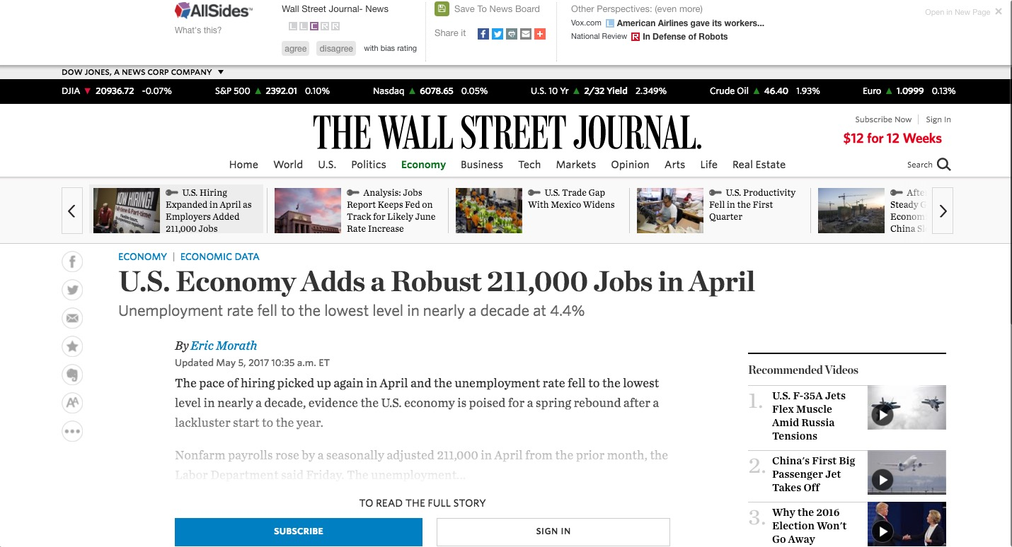

Slide 3
Trump revealed highly classified information to Russian foreign minister and ambassador.
Comments
2. Trump's EPA Greenlights a Nasty Chemical. A Month Later, It Poisons a Bunch of Farmworkers.
Comments
3. Trump no longer wants to talk about secret White House recordings
Comments
4. Trump admits he fired Comey over Russia. Republican voters don't believe him.
Comments
5. Firing James Comey to impede an investigation isn't smoke. It's fire.
Comments
6. Trump’s Russia scandal keeps getting deeper: At this point, campaign collusion might be the least of his problems
Comments
7. Rand Paul: Sessions' sentencing plan would ruin lives
Comments
8. U.S. Supreme Court Refuses to Revive North Carolina Voter-ID Law
Comments
9. Donald Trump closely tied to Russian mob, could face racketeering charges, Dutch TV doc claims
Comments
10. Report: Top aide gave Trump fake news
Comments

Slide 4
Trump revealed highly classified information to Russian foreign minister and ambassador.
Comments
2. Trump's EPA Greenlights a Nasty Chemical. A Month Later, It Poisons a Bunch of Farmworkers.
Comments
+
3. Trump no longer wants to talk about secret White House recordings
Comments
4. Trump admits he fired Comey over Russia. Republican voters don't believe him.
Comments
5. Firing James Comey to impede an investigation isn't smoke. It's fire.
Comments
L
R
6. Trump’s Russia scandal keeps getting deeper: At this point, campaign collusion might be the least of his problems
Comments
7. Rand Paul: Sessions' sentencing plan would ruin lives
Comments
-
8. U.S. Supreme Court Refuses to Revive North Carolina Voter-ID Law
Comments
9. Donald Trump closely tied to Russian mob, could face racketeering charges, Dutch TV doc claims
Comments
10. Report: Top aide gave Trump fake news
Comments

Slide 5
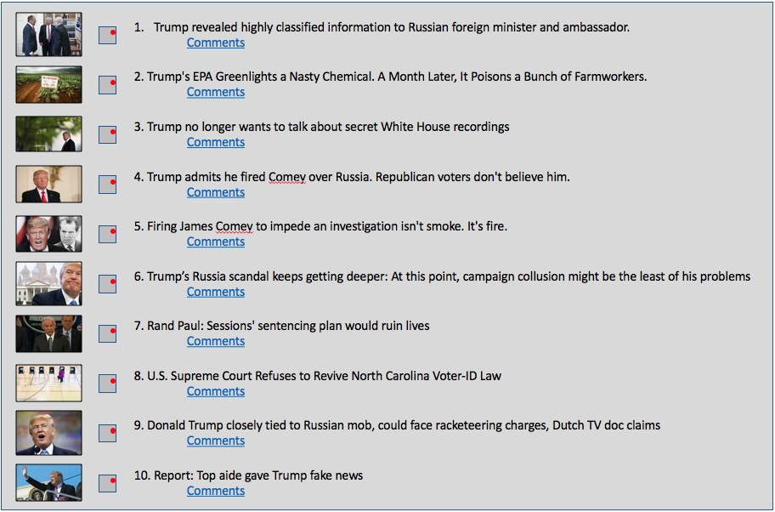
Single Event Commenting
Report: Top aide gave Trump fake news
+
This is one comment on one event
This is one comment on one event
This is one child comment on the same event
This is one child comment on the same event
L
R
This is one grandchild comment on the same event
This is one grandchild comment on the same event
-
This is another child comment on the same event
This is another child comment on the same event

Slide 6
Best possible
High Quality
Bias Left
Bias Right
Worst Possible
Low Quality

Slide 7
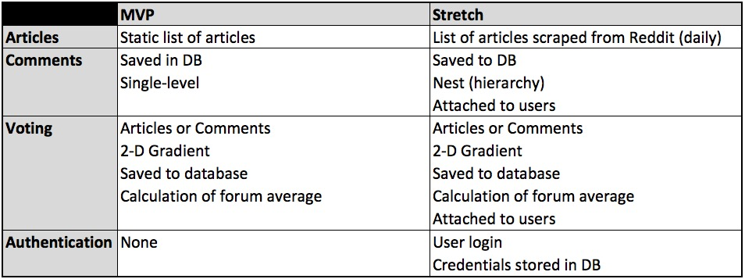
Features

Slide 8
Archive

Slide 9
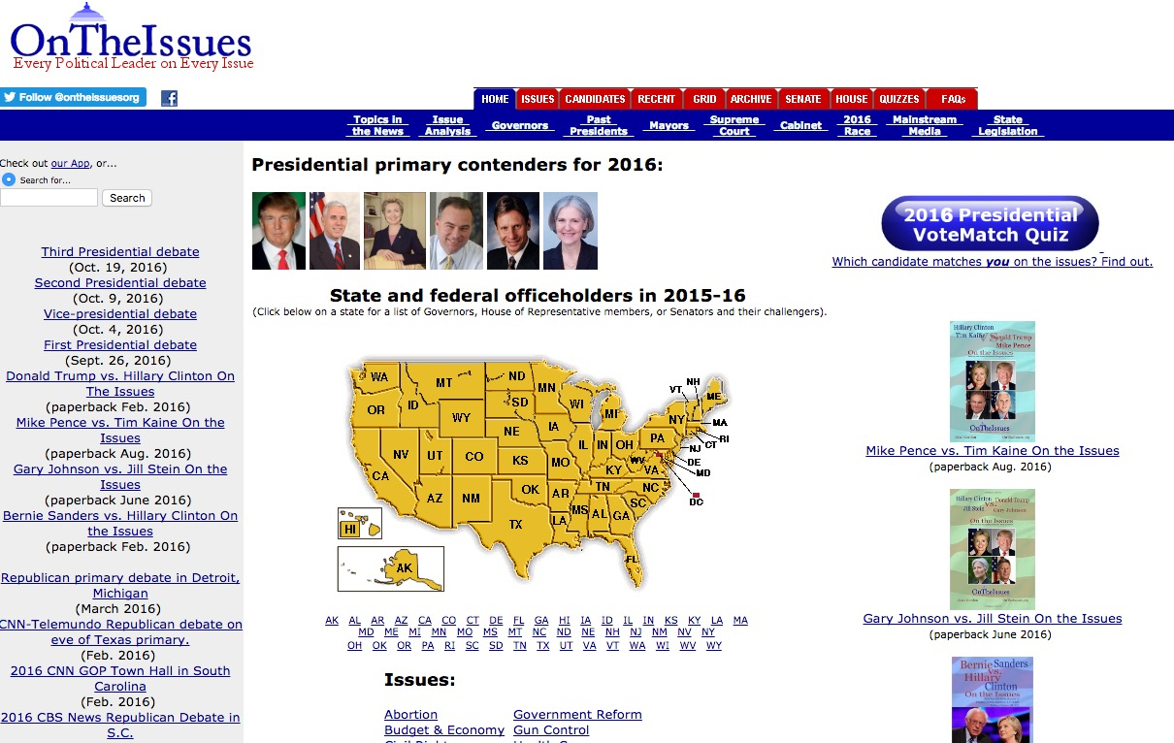
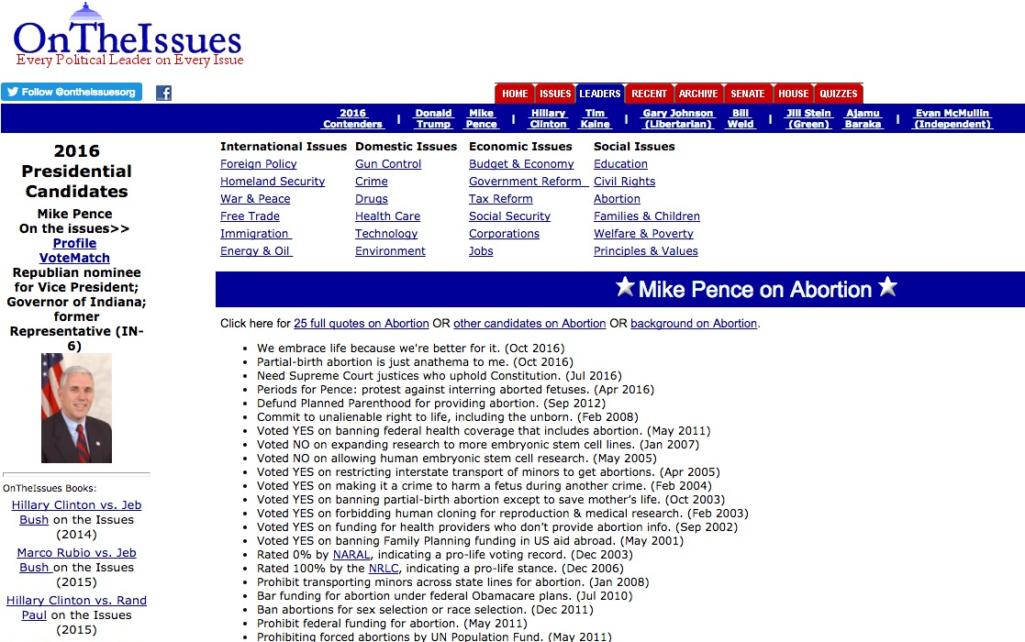

Slide 10

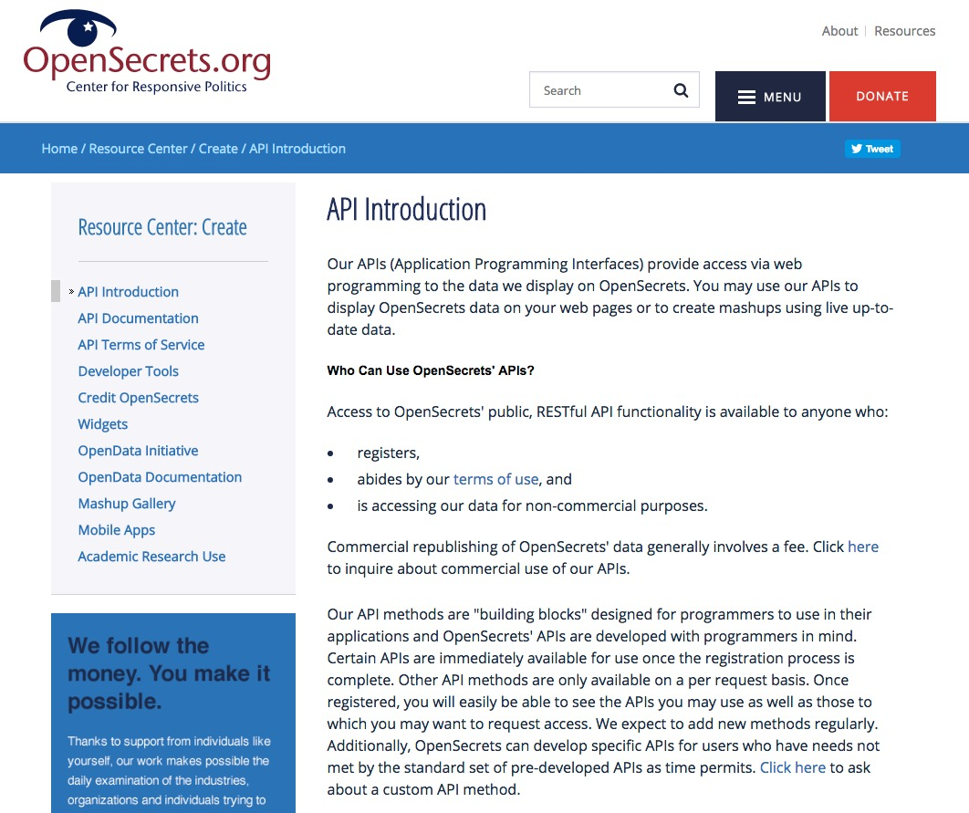
https://www.opensecrets.org/resources/create/apis.php

Slide 11

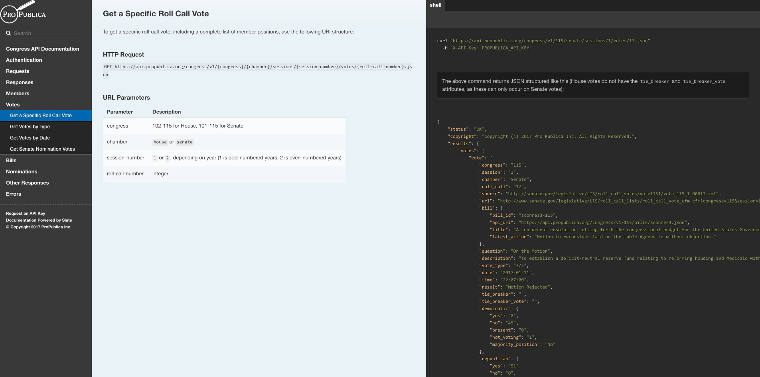
https://propublica.github.io/congress-api-docs/#get-a-specific-roll-call-vote

Slide 12
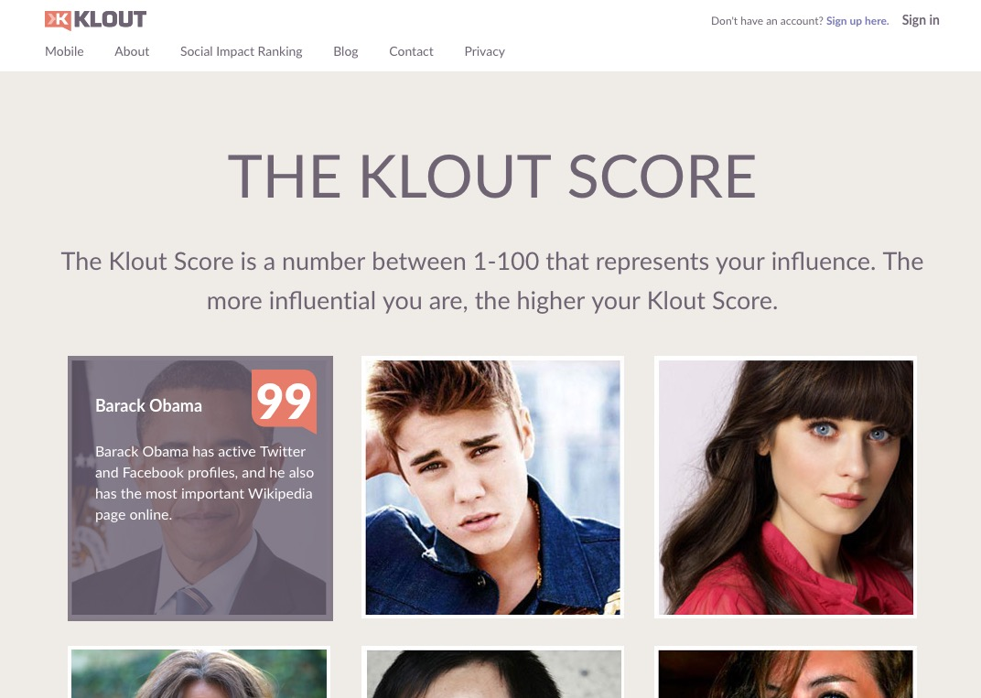
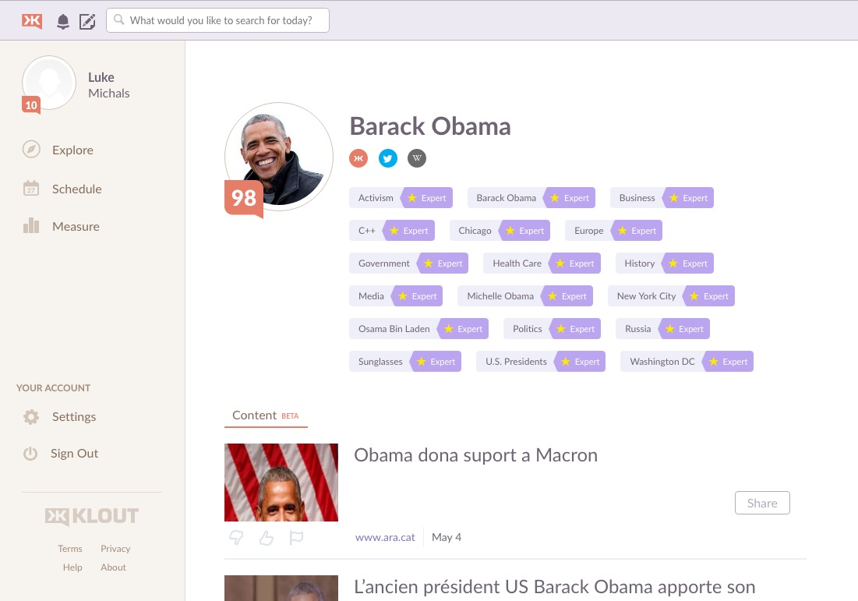

Slide 13
Chuck Schumer
Senator from New York
Event Types
Single
Continuous
Stance Categories
Career Categories
Event Categories
Tax Policy
Senator
Political
Healthcare
Military Service
War
War / Defense
Private Citizen
Economy
Record
Career
Events
2004
War in Iraq
Presidential Election
Vote
Presidential Election
2016
Presidential Election
Today
2020

Slide 14
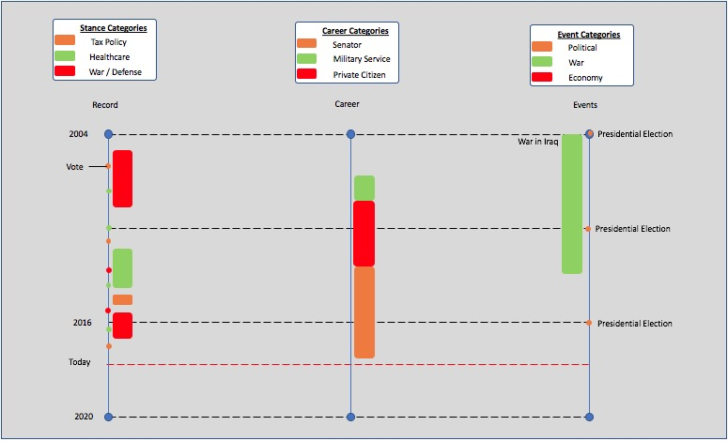
Single Event Commenting
Event: Stance on ACA
Politician: Chuck Schumer
Forum average
+
This is one comment on one event
This is one comment on one event
This is one child comment on the same event
This is one child comment on the same event
L
R
This is one grandchild comment on the same event
This is one grandchild comment on the same event
-
This is another child comment on the same event
This is another child comment on the same event
Your vote

Slide 15
Build Tools
React
PostgreSQL
Create React App (link)

