Slide 1
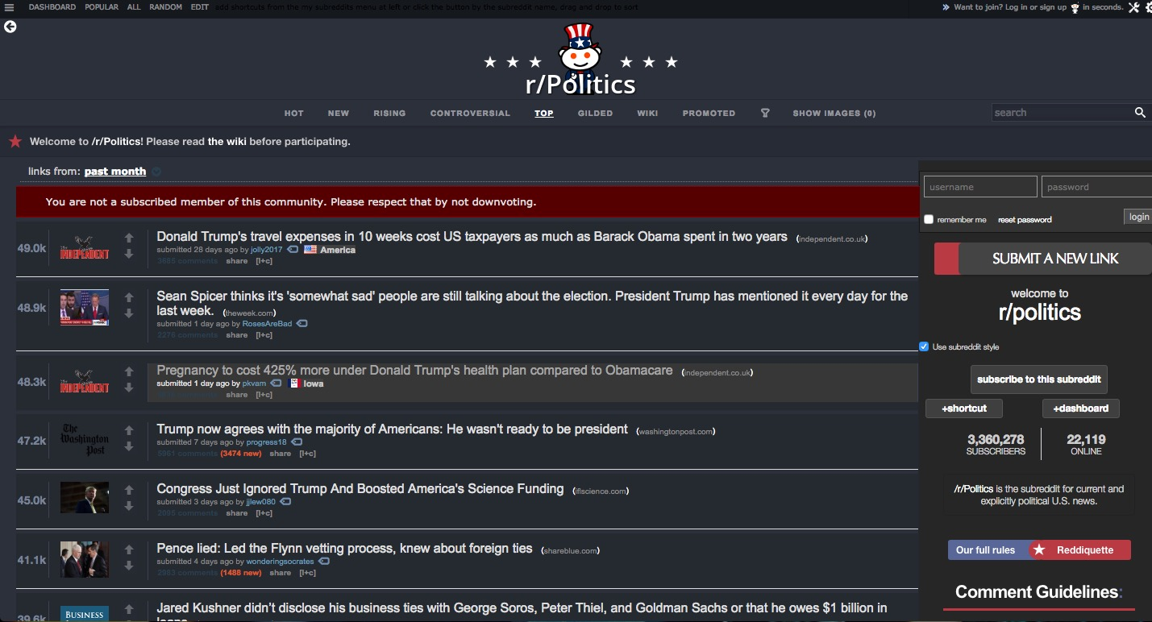


Slide 2
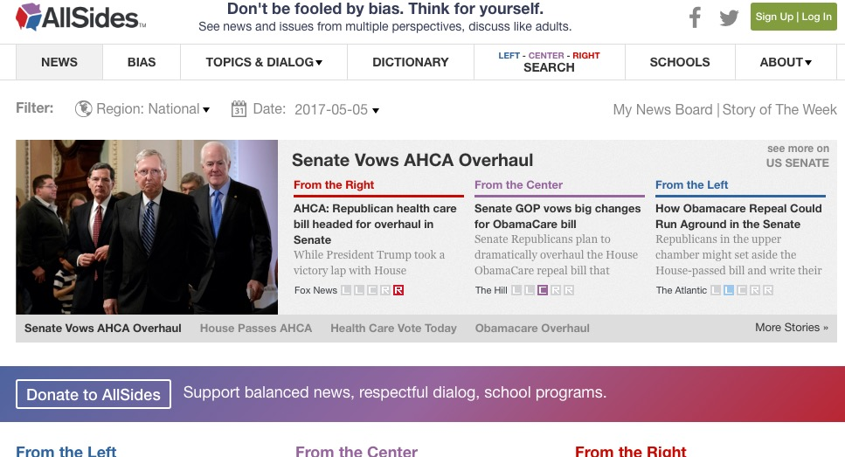
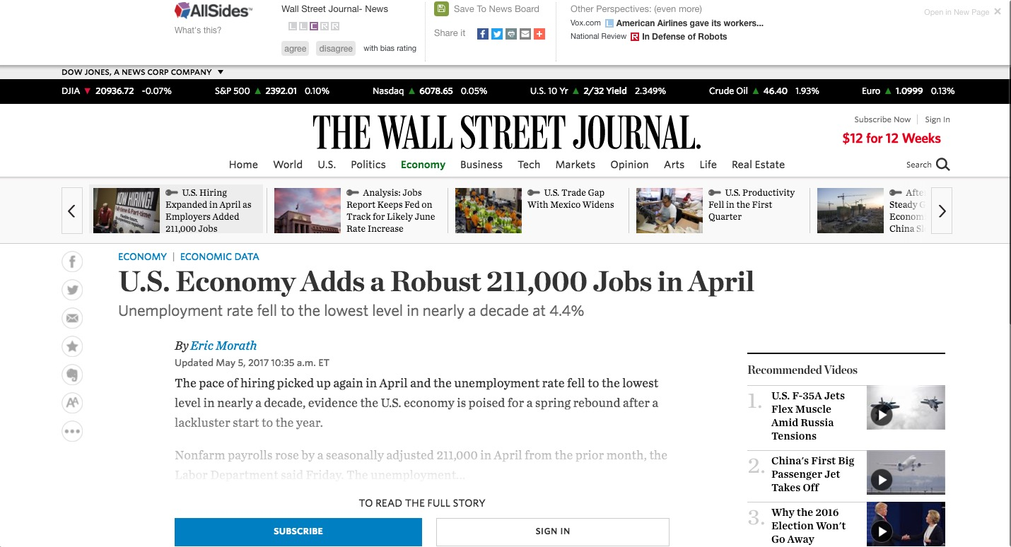

Slide 3
Trump revealed highly classified information to Russian foreign minister and ambassador.
Comments
2. Trump's EPA Greenlights a Nasty Chemical. A Month Later, It Poisons a Bunch of Farmworkers.
Comments
3. Trump no longer wants to talk about secret White House recordings
Comments
4. Trump admits he fired Comey over Russia. Republican voters don't believe him.
Comments
5. Firing James Comey to impede an investigation isn't smoke. It's fire.
Comments
6. Trump’s Russia scandal keeps getting deeper: At this point, campaign collusion might be the least of his problems
Comments
7. Rand Paul: Sessions' sentencing plan would ruin lives
Comments
8. U.S. Supreme Court Refuses to Revive North Carolina Voter-ID Law
Comments
9. Donald Trump closely tied to Russian mob, could face racketeering charges, Dutch TV doc claims
Comments
10. Report: Top aide gave Trump fake news
Comments

Slide 4
Trump revealed highly classified information to Russian foreign minister and ambassador.
Comments
2. Trump's EPA Greenlights a Nasty Chemical. A Month Later, It Poisons a Bunch of Farmworkers.
Comments
+
3. Trump no longer wants to talk about secret White House recordings
Comments
4. Trump admits he fired Comey over Russia. Republican voters don't believe him.
Comments
5. Firing James Comey to impede an investigation isn't smoke. It's fire.
Comments
L
R
6. Trump’s Russia scandal keeps getting deeper: At this point, campaign collusion might be the least of his problems
Comments
7. Rand Paul: Sessions' sentencing plan would ruin lives
Comments
-
8. U.S. Supreme Court Refuses to Revive North Carolina Voter-ID Law
Comments
9. Donald Trump closely tied to Russian mob, could face racketeering charges, Dutch TV doc claims
Comments
10. Report: Top aide gave Trump fake news
Comments

Slide 5
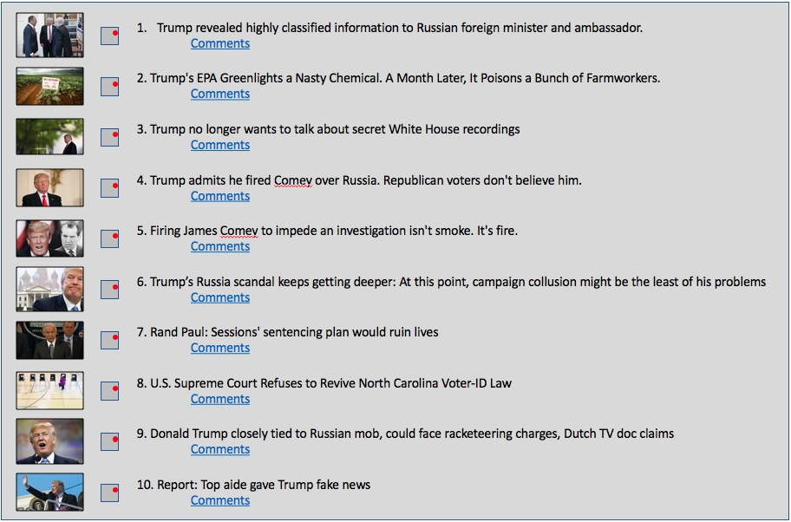
Report: Top aide gave Trump fake news
+
This is one comment on one event
This is one comment on one event
This is one child comment on the same event
This is one child comment on the same event
L
R
This is one grandchild comment on the same event
This is one grandchild comment on the same event
-
This is another child comment on the same event
This is another child comment on the same event

Slide 6
Best possible
High Quality
Bias Left
Bias Right
Worst Possible
Low Quality

Slide 7
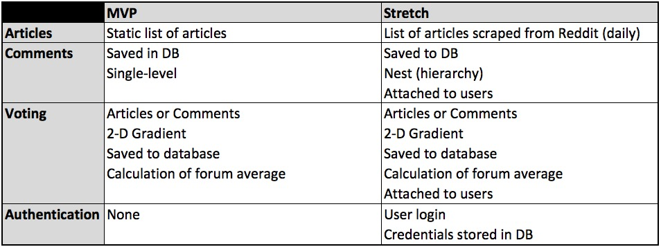
Features

