Slide 1



Slide 2
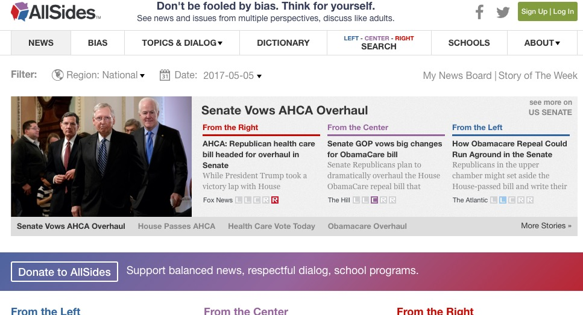
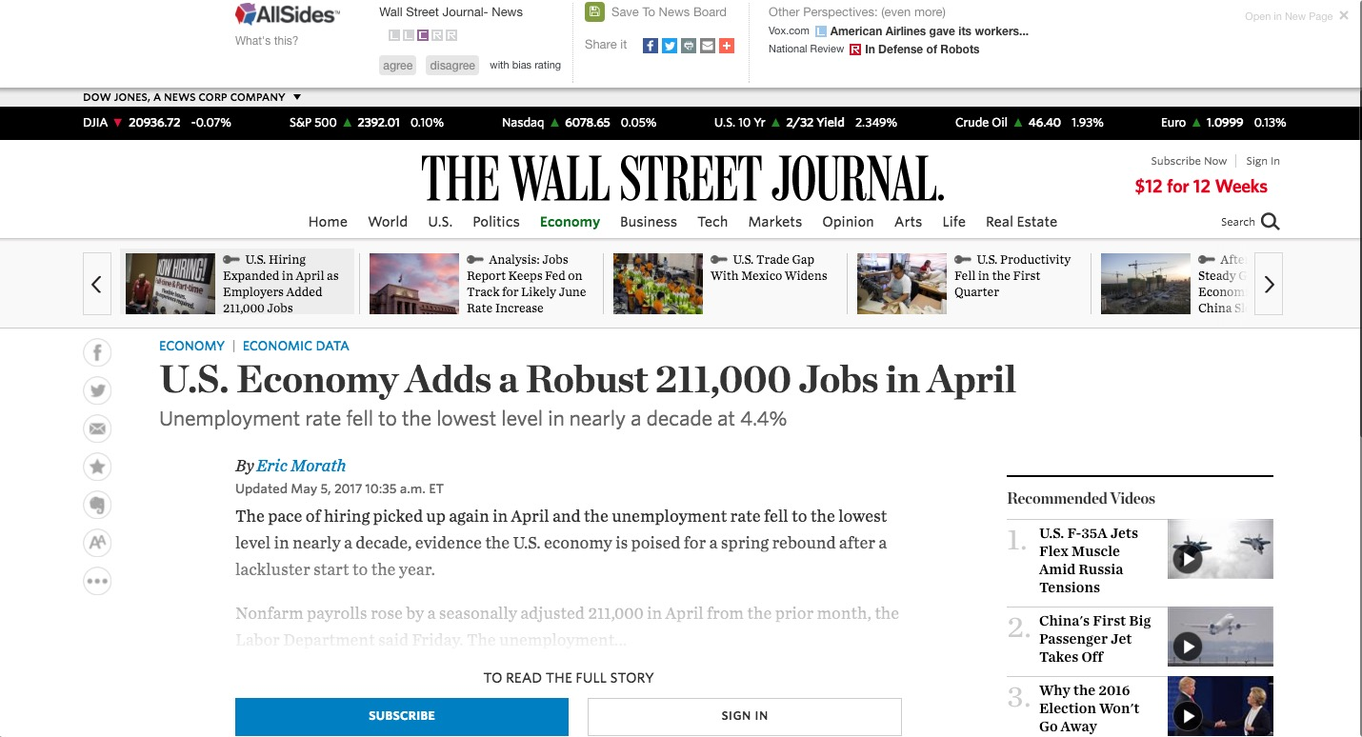

Slide 3
Trump revealed highly classified information to Russian foreign minister and ambassador.
Comments
2. Trump's EPA Greenlights a Nasty Chemical. A Month Later, It Poisons a Bunch of Farmworkers.
Comments
3. Trump no longer wants to talk about secret White House recordings
Comments
4. Trump admits he fired Comey over Russia. Republican voters don't believe him.
Comments
5. Firing James Comey to impede an investigation isn't smoke. It's fire.
Comments
6. Trump’s Russia scandal keeps getting deeper: At this point, campaign collusion might be the least of his problems
Comments
7. Rand Paul: Sessions' sentencing plan would ruin lives
Comments
8. U.S. Supreme Court Refuses to Revive North Carolina Voter-ID Law
Comments
9. Donald Trump closely tied to Russian mob, could face racketeering charges, Dutch TV doc claims
Comments
10. Report: Top aide gave Trump fake news
Comments

Slide 4
Trump revealed highly classified information to Russian foreign minister and ambassador.
Comments
2. Trump's EPA Greenlights a Nasty Chemical. A Month Later, It Poisons a Bunch of Farmworkers.
Comments
+
3. Trump no longer wants to talk about secret White House recordings
Comments
4. Trump admits he fired Comey over Russia. Republican voters don't believe him.
Comments
5. Firing James Comey to impede an investigation isn't smoke. It's fire.
Comments
L
R
6. Trump’s Russia scandal keeps getting deeper: At this point, campaign collusion might be the least of his problems
Comments
7. Rand Paul: Sessions' sentencing plan would ruin lives
Comments
-
8. U.S. Supreme Court Refuses to Revive North Carolina Voter-ID Law
Comments
9. Donald Trump closely tied to Russian mob, could face racketeering charges, Dutch TV doc claims
Comments
10. Report: Top aide gave Trump fake news
Comments

Slide 5
Report: Top aide gave Trump fake news
This is comment #1 on this article
This is comment #2 on this article
This is comment #3 on this article
This is comment #4 on this article
This is comment #5 on this article
This is comment #6 on this article
This is comment #7 on this article
This is comment #8 on this article

Slide 6
Report: Top aide gave Trump fake news
This is comment #1 on this article
+
This is comment #2 on this article
This is comment #3 on this article
L
R
This is comment #4 on this article
This is comment #5 on this article
This is comment #6 on this article
-
This is comment #7 on this article
This is comment #8 on this article

Slide 7
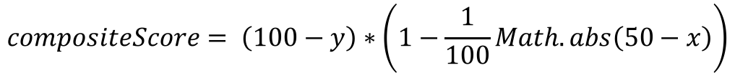


X
High Quality
0
100
0
Y
20
(65, 20)
$$compositeScore= \left(100−y\right)∗\left(1−\frac{1}{100}Math.abs\left(50−x\right)\right)$$
Quality Score
Range: 0-100
Bias Factor
Range: 0.5-1
Left Bias
Right Bias
65
Ex:
$$compositeScore= \left(100−20\right)∗\left(1−\frac{1}{100}Math.abs\left(50−65\right)\right)$$
$$compositeScore=80∗.85$$
100
$$compositeScore=68$$
Low Quality

Slide 8
X
High Quality
Y
50
100
50
Left Bias
25
50
25
Right Bias
0
0
0
Low Quality

Slide 9
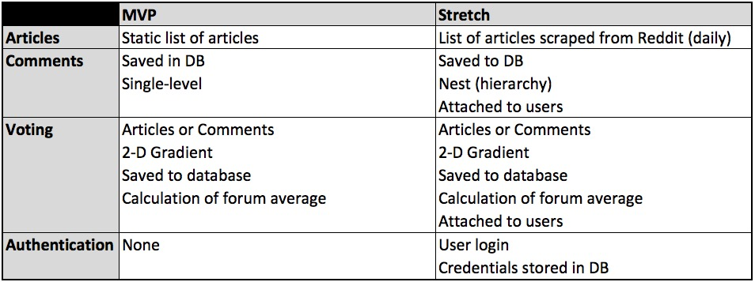

Features
$$compositeScore= \left(100−20\right)∗\left(1−\frac{1}{100}Math.abs\left(50−65\right)\right)$$
$$compositeScore=80∗\frac{1}{100}Math.abs\left(50−65\right)$$

