Slide 1
Saved State ViewModel

Slide 2
View Model
Saved State View Model
Stores values independently of View (basically a container for view’s values)
Separate lifecycle, which persist our data after Orientation Change
Provide key-value map that lets you write and retrieve objects to and from the saved state (SavedStateHandle)
These values persist after the process is killed by the system and remain available through the same object.

Slide 3
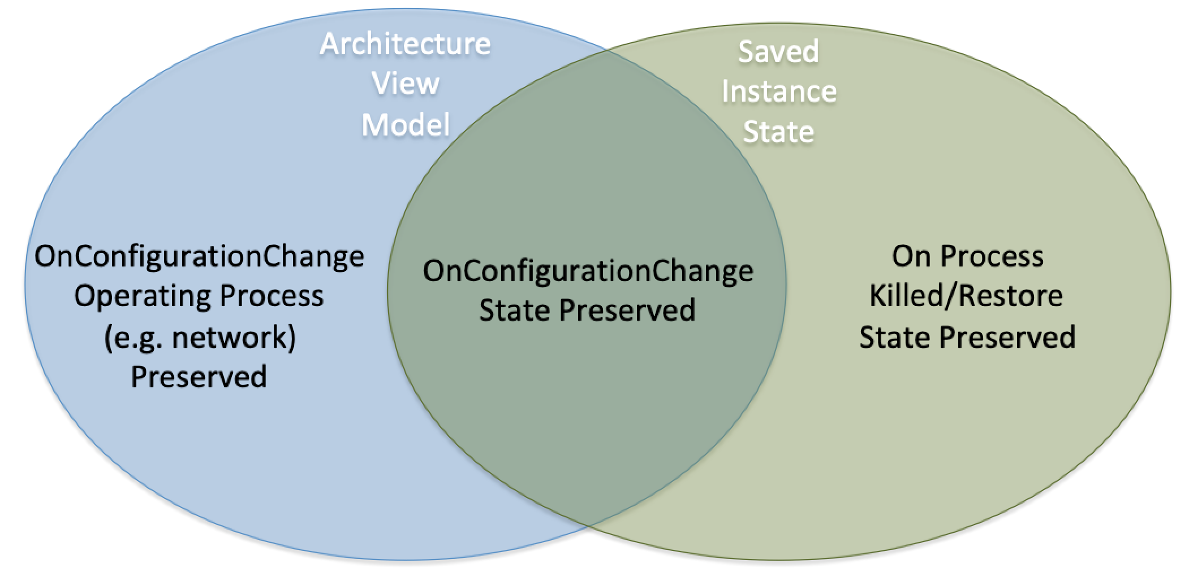

Slide 4
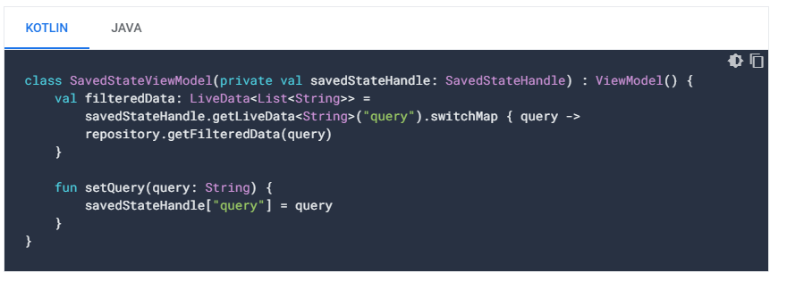
SavedStateHandle
The SavedStateHandle class is a key-value map that allows you to write and retrieve data to and from the saved state through the set() and get() methods. Additionally, you can retrieve values from SavedStateHandle that are wrapped in a LiveData observable using getLiveData().

Slide 5
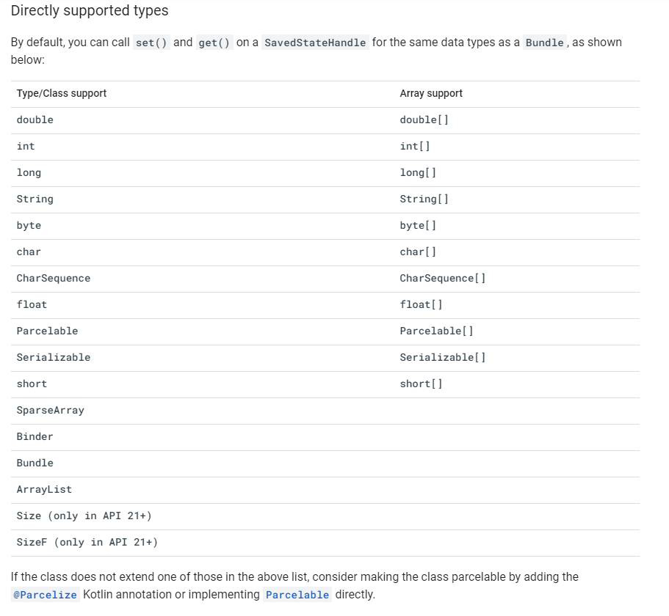
Supported Types

