Slide 1
Agenda
TDD & BDD
Groovy
Spock

Slide 2
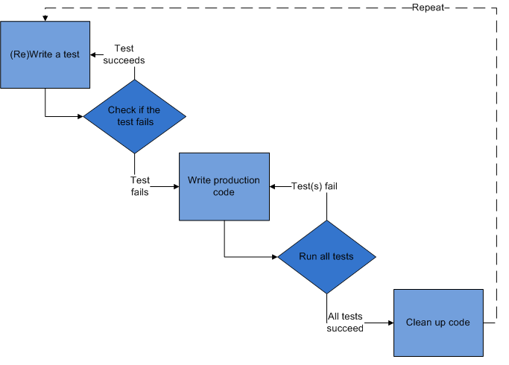
TDD
Test-driven development (TDD) is a software development process that relies on the repetition of a very short development cycle:

Slide 3
TDD
Test-driven development (TDD) is a software development process that relies on the repetition of a very short development cycle:

Slide 4
Acceptance Test-Driven Development (ATDD)
A development methodology based on communication between the business customers, the developers, and the testers:
User’s point of view
They examine externally visible effects
Tests are specified in business domain terms

Slide 5
Acceptance Test-Driven Development (ATDD)
Test Format
Acceptance tests usually follow this form:[1]
Given (Setup) - A specified state of a system
When (Trigger) - An action or event occurs
Then (Verification) - The state of the system has
changed or an output has been produced

Slide 6
Behaviour Driven Development
Behavior-driven development specifies that tests of any unit of software should be specified in terms of the desired behavior of the unit.

Slide 7
Behaviour Driven Development
Story: Returns go to stock
In order to keep track of stock
As a store owner
I want to add items back to stock when they're returned

Slide 8
Behaviour Driven Development
Scenario 1: Refunded items should be returned to stock
Given a customer previously bought a black sweater from me
And I currently have three black sweaters left in stock
When he returns the sweater for a refund
Then I should have four black sweaters in stock

Slide 9
BDD vs TDD
TDD – inside out: we usually start with lowest layer of implementation, and gradually move to the higher level components once they are available
BDD – outside in: we start from bussines requirements and mock all objects that are not available

Slide 10
Mock objects
Stub – responds to any interaction
Mock – responds only to interactions provided by specification
Spy – can intercept invocations to a real object and change/report it's behaviour

Slide 11
Spock Mocks
def "events are published to all subscribers"() {
def subscriber1 = Mock(Subscriber)
def subscriber2 = Mock(Subscriber)
def publisher = new Publisher()
publisher.add(subscriber1)
publisher.add(subscriber2)
when: “publisher fires”
publisher.fire("event")
then: “both subscribers should receive the message”
1 * subscriber1.receive("event")
1 * subscriber2.receive("event")
}

Slide 12
Benefits of Mockist BDD
need-driven development - helps with thinking about what an object needs to do
the expectations on the mocks provide a specification for the next step
Test isolation – SUT is the class being tested
Encourages "Tell Don't Ask" - tell an object to do something rather than rip data out of an object

Slide 13
Data driven testing (random)
class AccountSpecDataDriven extends Specification {
static final Random random = new Random()
@Unroll("withdraw amount of #balance")
def "withdraw some amount (3)"() {
given:
def account = new Account(balance)
when:
account.withdraw(withdrawn)
then:
account.balance == remaining
where:
balance << (1..3).collect { random.nextInt(100) + 2 }
withdrawn = balance - 2
remaining = 2
}
}

