Slide 1
Implementation of neural gas on Cell Broadband Engine
Michal Augustýn (augusm1@fel.cvut.cz)
Michal Trs (trsm1@fel.cvut.cz)

Slide 2
Introduction - Algorithm
One of method for competitive learning
Can be used in machine vision
Iteratively algorithm
Input: large set of points describe any area
Output: significantly smaller set of point describe the same area

Slide 3
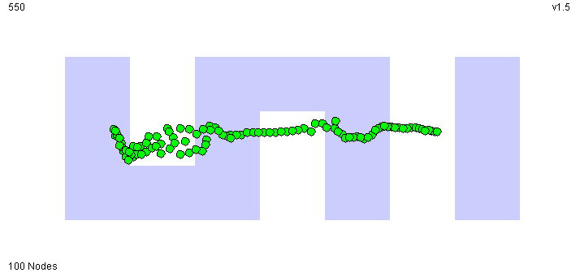
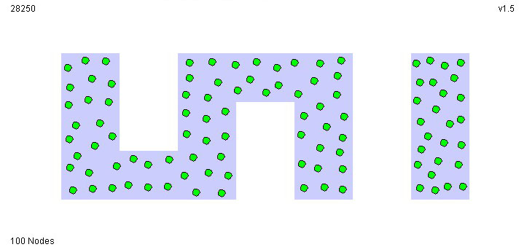
Graphical example
Initial cover
Final cover (~after 28000 iterations)
http://www.neuroinformatik.ruhr-uni-bochum.de/VDM/research/gsn/DemoGNG/GNG.html

Slide 4
Algorithm – explanation
check minimal and maximal values of input data
generate initial positions of neurons
compute distance between actual input and each neuron
Accuracy
improving
sort neurons by distance from actual distance
move each neuron

Slide 5
Our solution
First - code for PC (so for PPU only)
Then - optimizing code for just one SPU
Limited SPU memory resources and large input data – huge DMA transfers between SPU local memory and main memory
PPU program executes SPU program only and then waits until it ends

Slide 6
SPU implementation
SIMD instructions used for vector-based operations
Operations on data stored in main memory simplified by own functions with parameter of type „pointer to function“
This functions abstract DMA transfers – DMA transfers written once – source codes more readable

Slide 7
The end
Questions?
Thank you for your attention

