Slide 1
std::span
Michal Žamboch
Vsetín 2.4.2025

Slide 2
Span
Not owning collection type
“Interface” for collections
Used for safe view of collections
Similar to std::string_view (iterate over std::strings)
C++20

Slide 3
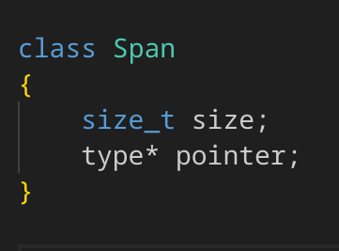
Pseudo implementation

Slide 4
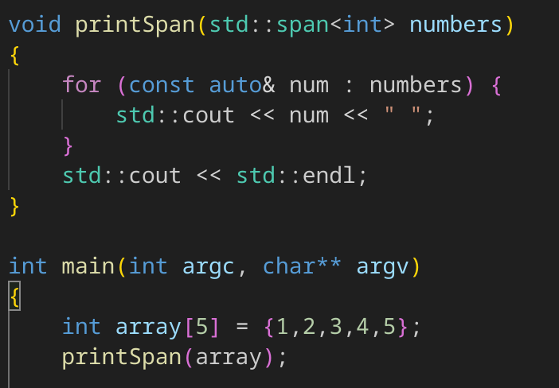
How to use it?
By passing collection types into span.
Basic arrays, std::vector, std::array

Slide 5
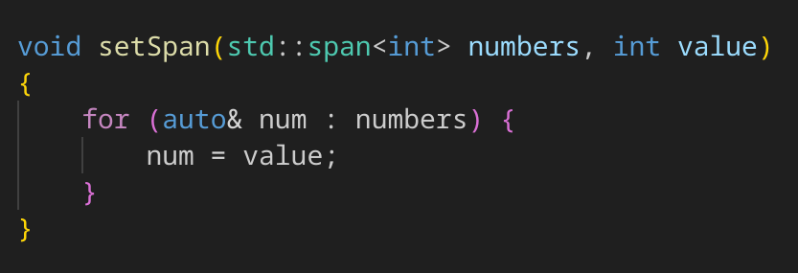
Data access
Index
Front, back
.data()
Iteration, sub spans

Slide 6
Extent
Static – size known at compile time
Dynamic

Slide 7
Sources
https://www.youtube.com/watch?v=OQu2pZILjDo
https://en.cppreference.com/w/cpp/container/span
https://www.youtube.com/watch?v=t_xm-vzLOjM

