Slide 1
Advanced CDK Techniques Tokens! Tokens! Tokens!
Michael Antonio
Notes:
Hello everybody it’s Michael Antonio! Welcome to Advanced CDK Techniques. This channel is for users familiar with the AWS CDK who want to create more powerful infrastructure as code solutions.
If you are new to the AWS CDK or infrastructure as code, we recommend the CDK Live channel. See the link in the description.
Today’s topic is Tokens! Tokens! Tokens!

Slide 2
Notes
@michanto/cdk-orchestration 0.1.16
Code for this lesson is checked in to @michanto/cdk-orchestration-examples in github.
Tokens documentation
Notes:
A few notes: I’ll be using my CDK orchestration library, and the code for this lesson is checked into cdk orchestration examples in GitHub. I’ll put a link to those in the description, and a link to the Tokens documentation in case you want to dive deeper into Tokens.

Slide 3
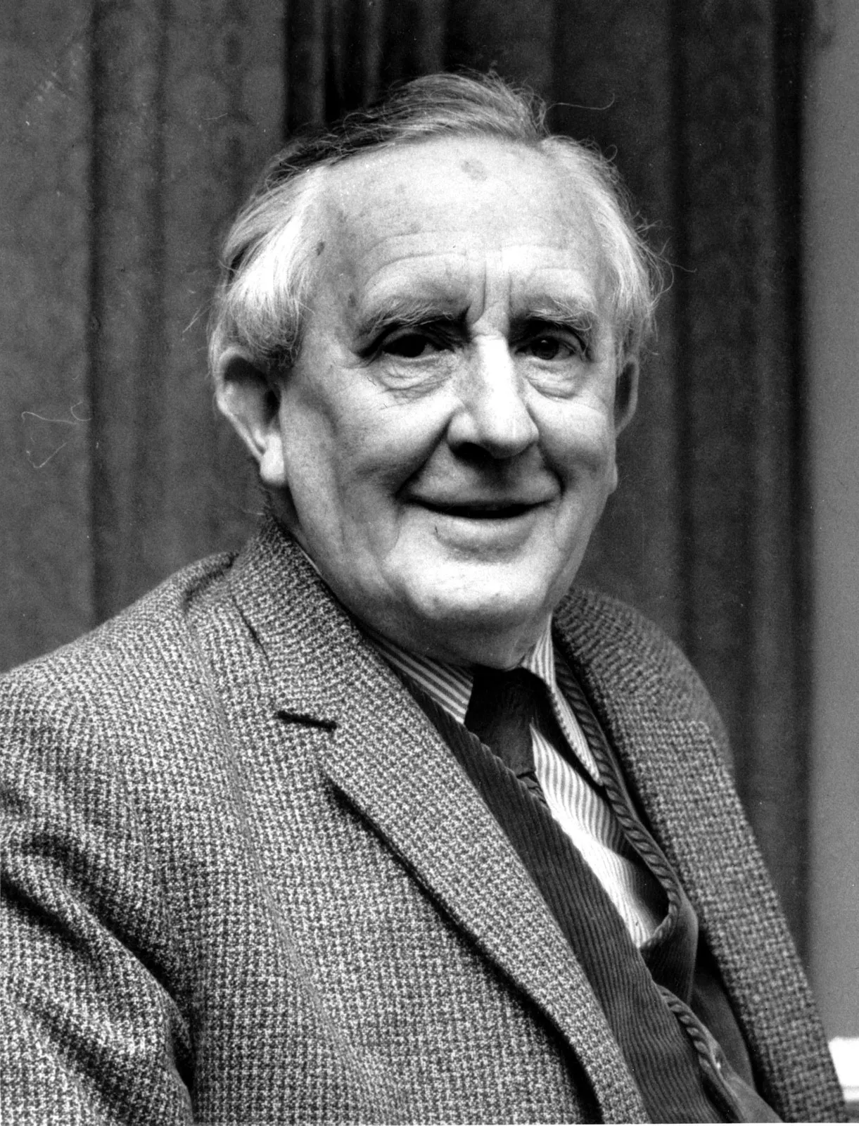
Tokens
Notes:
Not Tolkien, Tokens! We’ll get back to you later professor!

Slide 4
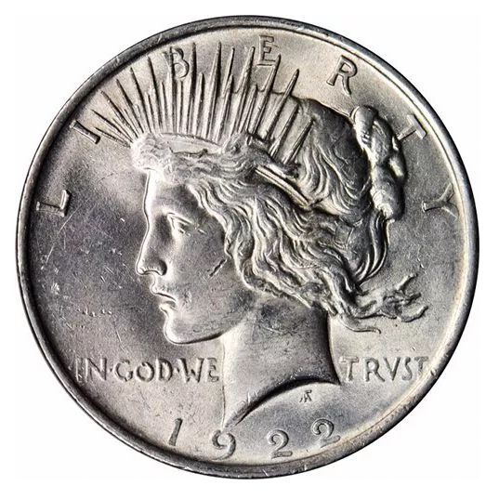
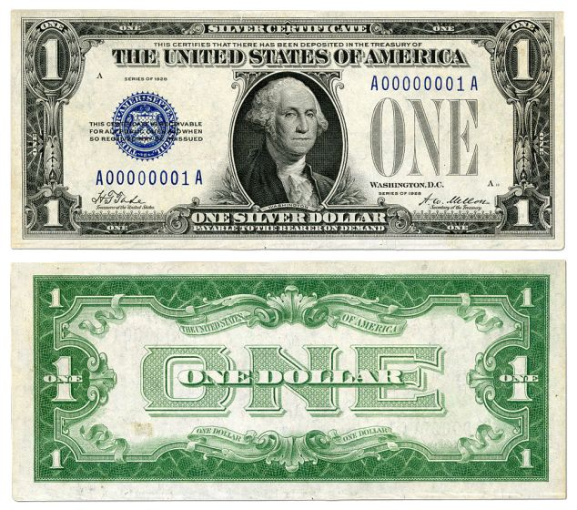
Tokens
=
Notes:
This is a perfect example of a token. This is a silver certificate and you can see that it looks a lot like a dollar bill. But it's not a federal reserve note. These were used in my grandparents day, and it says here, this certifies that there has been deposited in the Treasury of the United States of America. One silver dollar payable to the bearer on demand. So I fyou had a silver certificate with the blue symbol here the blue number here and what not. You could just bring this to any bank and they would give you a silver dollar which had in it, $1 worth of silver. You would get the actual metal. This is how people did business before there were Federal Reserve notes. You could use a silver certificate instead. And um, and that's very similar to what a token is here. You, you have one set of atoms, you give it to the government, they give you another set of atoms and they, they promise that they're gonna do that because it says payable to the bearer on demand. OK.

Slide 5
What are CDK tokens?
An object that represents a String, CloudFormation snippet, or a number.
Example: The Aws.REGION constant is a CloudFormation string token.
If you print this token:
console.log(Aws.REGION); ${Token[AWS.Region.10]}
Resolved at synthesis time by calling a produce function.
Written to your template.json file as a CloudFormation intrinsic function:
{"Ref":"AWS::Region"}
Notes:
CDK Tokens are objects that can be used as strings, objects, or numbers whose value will be determined later - at synthesis time. When the CDK sees a token, it will call a PRODUCE function that resolves the token to the correct string, number, or CloudFormation snippet. Instead of exchanging one set of atoms for another set of atoms, CDK tokens exchange one set of bits, for another set of bits.
A good example is the Aws.REGION token. This token represents the AWS::Region intrinsic variable (or pseudo-parameter). When you reference an intrinsic variable in your CDK code, it resolves to a CloudFormation snippet in your template. If you print the token to the console it looks a bit odd: it's got this dollar sign and these curly braces, then it says “Token” and has these square brackets. That’s how the CDK identifies that a string contains a token. The next part is a hint, and here it says AWS Region,and that gives you a clue to how this token will be resolved. You don't always get a hint but sometimes you do. The 10 at the end of the hint tells you that it's the 10th token that was created, which allows the CDK to look up the resolution for the token in its internal table. When you start using the CDK it creates some tokens automatically, and one of them is this region token. You can pass this token to resources in the CDK instead of hard coding the region, and it will resolve to a CloudFormation snippet that calls the REF intrinsic function and references the REGION variable. It doesn’t resolve to the region string you passed to your stack, and we’ll look at that in detail later. At deployment time CloudFormation will replace this function call with the region you are deploying to.
That's kind of a Nifty thing and it’s good for you to know what you’re getting in your template.json file

Slide 6
CDK Tokens
Stable Tokens
Always return the same string.
Value is cached by the CDK.
This is why you never call “Stack.resolve” – the token might not be resolvable yet, or might resolve to the wrong value.
Uncached Tokens
Can return different values based on the context.
Intrinsic Tokens
Examples: Aws.REGION, Fn.join
Resolve to CloudFormation statements.
Notes:
There are different types of tokens. Stable tokens always return the same value. The CDK resolves stable tokens by calling a PRODUCE function and caching the value, so that will be the value of that token whenever it is encountered so the CDK doesn’t have to call PRODUCE every time it sees that token. This is why you should never call stack.resolve unless you're debugging because the token might not be resolvable yet so that could produce an error or it might resolve to the wrong value. I'll show you some
examples of that a little bit later.
There are also uncashed tokens. For uncashed tokens the cdk will call the produce function every time it needs to write out the value of that token to the template. The CDK passes the construct it is resolving against (usually a CfnElement, or L1 construct or a Stack), and the token can return different values based on the context. I’ll show you examples of those as well.
There are also intrinsic tokens. Intrinsic tokens can be either stable or uncached and those are things like the AWS region token that I showed you or the Fn.join function and these make it easier for you to reference CloudFormation intrinsic functions and variables in your template. They can resolve to strings or CloudFormation snippets, and I’ll show examples of that as well.

Slide 7
Quick Tour of CDK Token lifecycle
Create time – Create App, Stacks and other constructs. Tokens are (mostly) created here.
Synthesis time – Generate the cdk.out directory with CloudFormation templates and code. Tokens are resolved.
Notes:
And this is a quick reminder that tokens are mostly created at Create time, when your App, Stack, Resources and other constructs are created, and they are resolved at synthesis time, when the CDK generates templates in the CDK.out directory.

Slide 8
Demo
Notes:
And it’s demo time!

