Slide 1

Introduction 600.243.13: Hardware Hacking

Slide 2

Survey Time
Visit the following link:
https://www.surveymonkey.com/s/YN5YWWF
Survey responses are anonymous
You do not have to answer
Survey provided by SurveyMonkey…
Notes:
Before we introduce ourselves, please take 10 minutes to answer our survey
Why: This is a new course. We want to see what works, what doesn’t, and how it applies to cyber

Slide 3

Michael Rushanan
Mike
PhD Student
Computer Science
Health and Medical Security Lab
Programming & Tinkering
Practice teaching
Courtesy Gravatar…
michaelrushanan.org for more info!

Slide 4

Paul Martin
Paul
PhD Student
Computer Science
Health and Medical Security Lab
Modding and lifting
Share hardware hacking fun
Courtesy LinkedIn…

Slide 5
Tell us about YOU
Name
Nickname
Major
Minor [if it’s cool]
Interests
Reason for taking this class
“To graduate,” is acceptable
Notes:
Opportunity to have students talk

Slide 6

Syllabus
Areas of interest (per student opinion):
Grade Policy
Homework
Blogging
Piazza
Show up!
Read!
Blog!
PASS
Notes:
Hardcopy of syllabus provided on the first day of class
Areas of interest for students may be different for instructors

Slide 7

Assigned Reading
How electricity works
http://www.howstuffworks.com/electricity.htm
Read up to Ohm’s Law
https://www.faa.gov/ regulations_policies/ handbooks_manuals/ aircraft/amt_handbook/ media/FAA-8083-30_Ch10.pdf
If you don’t read, you will be embarrassed…
Notes:
How electricity works is a nice introduction
The FAA regulation manual is a nice reference

Slide 8
Blogging
Public blog
https://www.blogger.com/
Example blog
http://michael-rushanan.blogspot.com/
Best blog posts tweeted and linked
Notes:
Show my blog post about the Mediasonic Probox

Slide 9
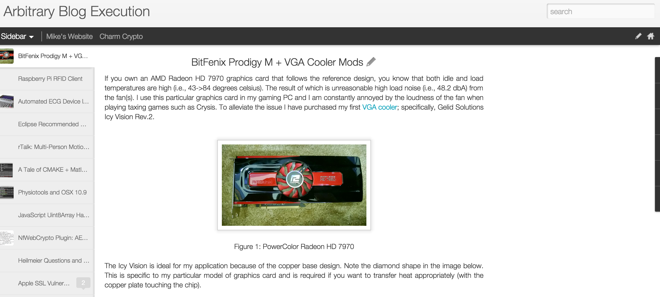
Example Blog Post

Slide 10
Blogging Assignment
Laptop charger specifications:
Voltage (volts)
Current (amps)
Resistance (ohms)
KWh cost
Specifications found online and on the back of the charger
Notes:
Assuming its plugged in for an hour

Slide 11
Piazza for More
If you’re enrolled, you have Piazza
https://piazza.com/jhu/other/en60024313/home
Why we use Piazza:
To post course updates
Interact with each other (i.e., answer questions)
Post current events and assignments
Notes:
Blackboard will not be used
Post any questions you have on Piazza
We will post everything to Piazza

Slide 12

Achievement Unlocked
I survived the first hour block!

Slide 13
Assemble Groups
Form five groups:
Ten students
Create a group name
Draw a symbol [or take from the internet]
Assignment:
Go to newegg.com or tigerdirect.com
Assemble a computer
Present the computer to the class

