Slide 1

Return Oriented Programming
What if an attacker cannot reliably inject her own code?
Recall return-to-libc
  Overwrite saved EIP w/ address of any ____.
Why might this not be a huge threat?
  Hint: system() not available
Notes:
1.Question: What protections did Paul mention that might prevent this? DEP/ASLR.
All writeable memory locations as non-executable.
2.libc routine, executing the sequence starting from this instruction.
3.Attacker cannot execute arbitrary code.
Cool because you can perform arbitrary computation using no injected code at all.
4.Execution will passed back to where the wor

Slide 2
Return Oriented Programming
What if instruction sequence contains RET?
  Execution transferred
  WORD pointed to by ESP
Use this as new value for EIP
  Control transferred to address of attacker’s choice
Increment ESP to point to the next WORD on the stack.
Notes:
1.Question: What protections did Paul mention that might prevent this? DEP/ASLR.
All writeable memory locations as non-executable.
2.libc routine, executing the sequence starting from this instruction.
3.Attacker cannot execute arbitrary code.
Cool because you can perform arbitrary computation using no injected code at all.
4.Execution will passed back to where the wor

Slide 3
Return Oriented Programming
Mount the attack
  Control the code around ESP
Gadgets: Chain together sequences ending in RET
Build gadgets for operations such as:
  Load-store
  Arithmetic
  Control Flow
  System calls
Notes:
Rewrite stack (not executing code)… format string vulnerability is like a scalpel.
Move stack: overwrite FP (EBP) so that on ret move ESP to where the attacker wants

Slide 4
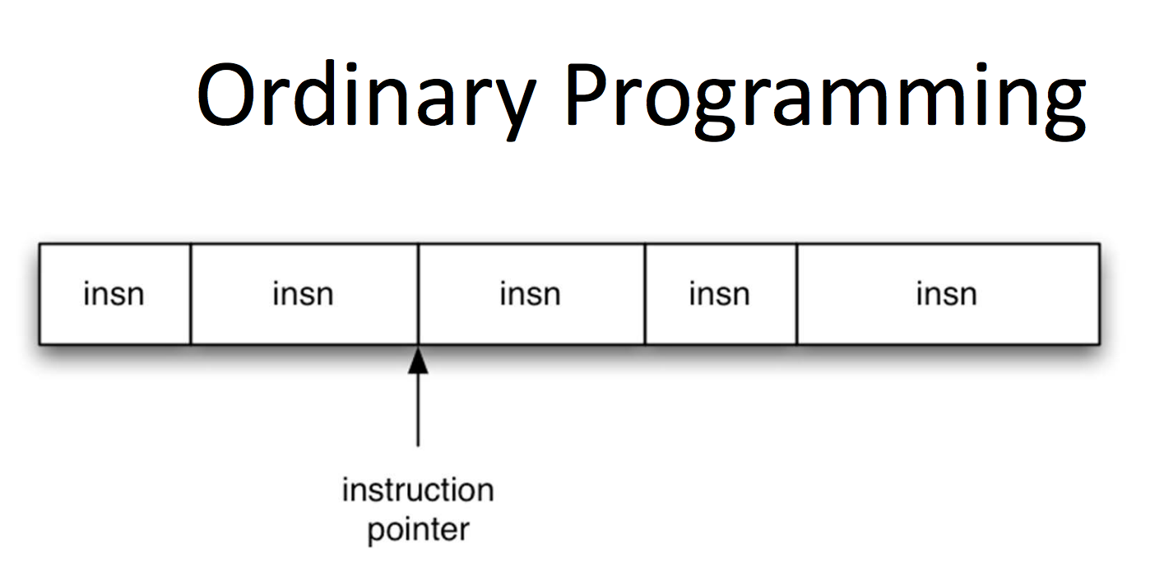
Return Oriented Programming
http://students.mimuw.edu.pl/~zbyszek/asm/slides/779.pdf
Notes:
EIP determines instruction to fetch/execute
EIP increments to next instruction
Control flow by changing value of EIP

Slide 5
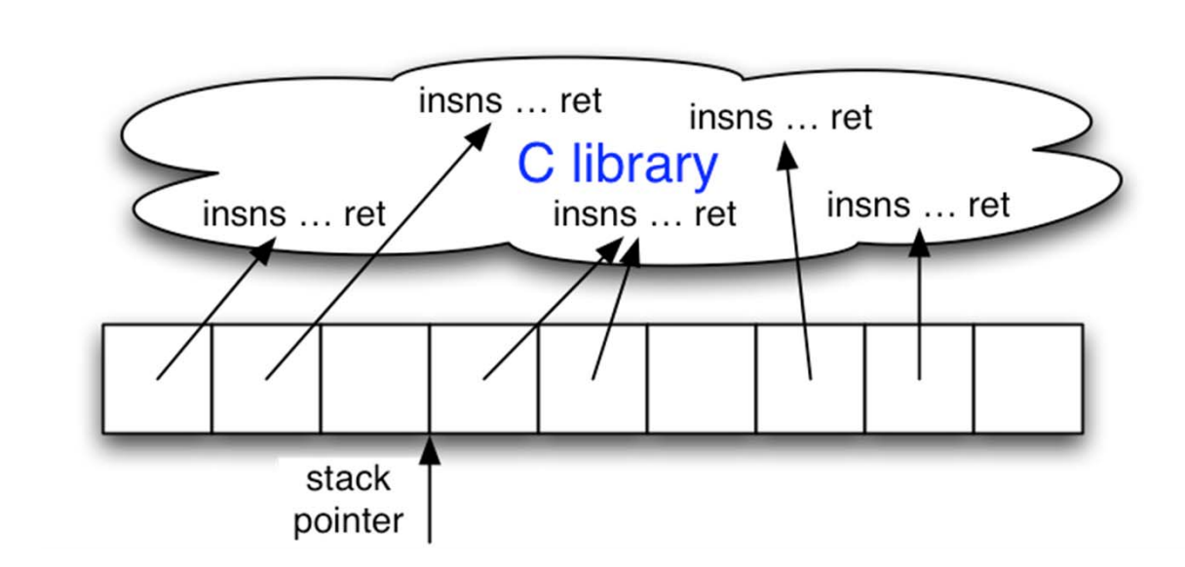
Return Oriented Programming
http://students.mimuw.edu.pl/~zbyszek/asm/slides/779.pdf
Notes:
ESP determines which instruction sequence to fetch and execute
Processor doesn’t automatically increment ESP

Slide 6
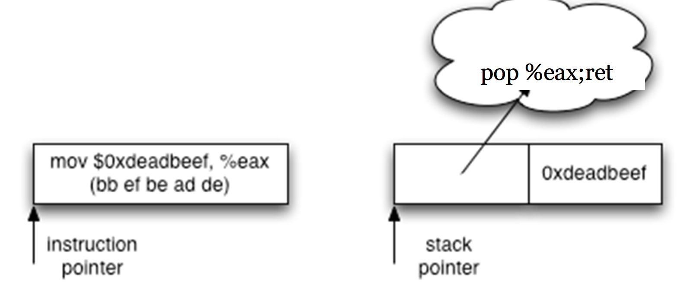
Return Oriented Programming
NOP Example
  NOP does nothing
  Advances EIP
Return-oriented equivalent

Slide 7
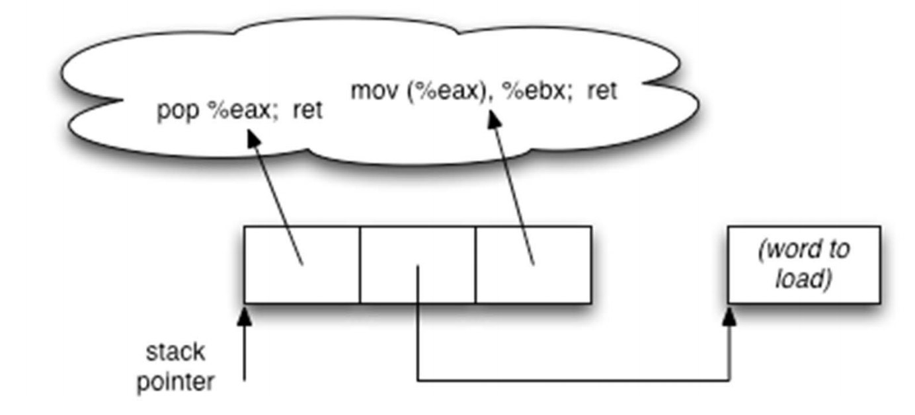
Return Oriented Programming
http://students.mimuw.edu.pl/~zbyszek/asm/slides/779.pdf
Notes:
Sometimes more than one instruction sequence
Want to load from memory into register
Load address of source word into EAX
Load memory at EAX into EBX

