Slide 1
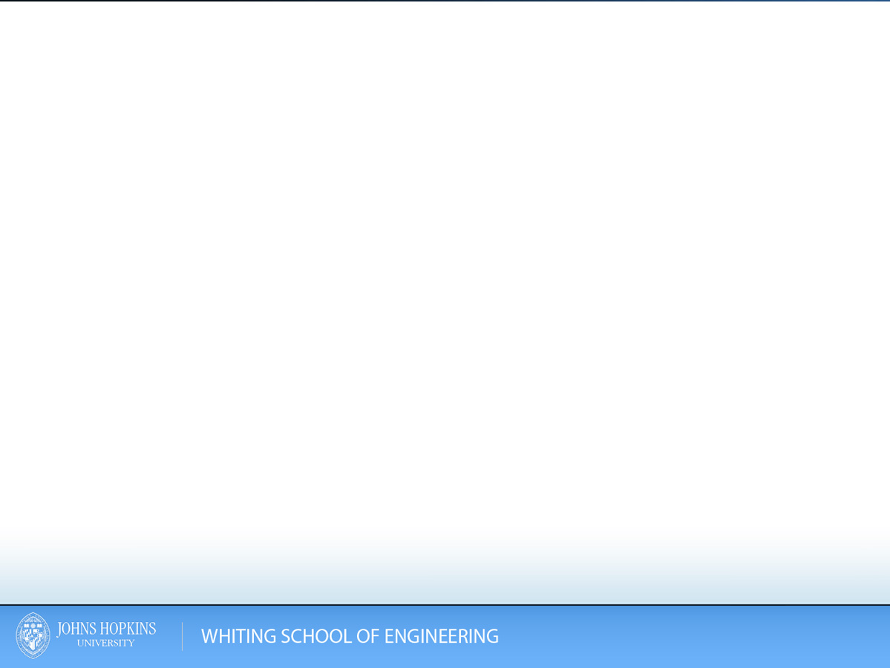
Introduction to x86 and GDB
Paul Martin
September 16, 2013
Slides from: 2013__CS443_Introduction_to_x86

Slide 2
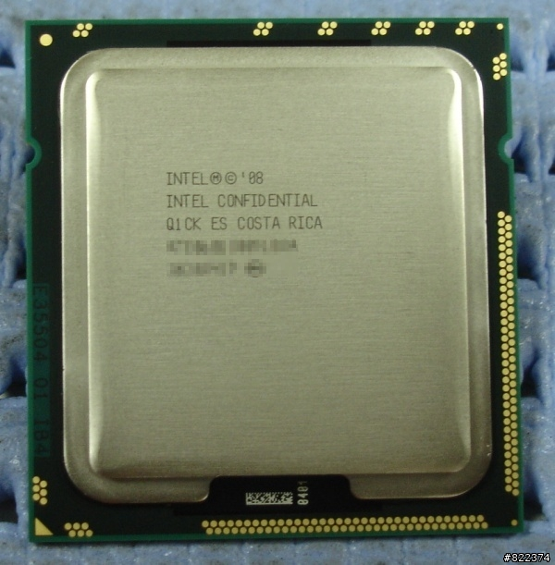
The IA-32 (x86) Architecture

Slide 3
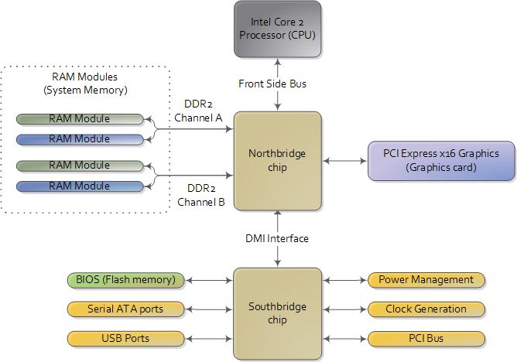
x86 Motherboard Layout
Source: gustavoduarte.com
Notes:
Standard x86 motherboard you have (not necessarily current anymore):
* CPU connected to northbridge chip via FSB
CPU knows nothing about what it is connected to—it just accesses the world via its pins
CPU has pins (32 or 64) used to both read and write memory words
CPU has pins (48 in the case of a Core 2 Duo) used to specify a physical memory address
Note that these two values need not be the same—you can have a 64-bit system but only address 2^48 words of memory
Northbridge chip translates these logical addresses into hardware addresses and accesses memory at the proper location
Northbridge chip also deals with accessing high-speed peripherals
System RAM provides a physical memory address space for the entire system, but each program receives the same address space and believes that it has the same amount of RAM as every other program (on x86 this is 4GB which may be less or more than your actual system RAM)
Each program believes that it has full access to system RAM
Peripherals are accessed using memory-mapped IO—gets mapped into 4GB address space on x86—who can tell me what this means about how much RAM x86 can actually be addressed?
Direct Media Interface to south bridge
Access to low(er) speed devices

Slide 4
x86 Modes of Operation
Real Mode
Protected Mode
Source: gustavoduarte.com
Notes:
Trailer Windfall Analogy
Real mode:
Original 16 bit
Can only address up to of 640KB of RAM (640K should be enough for anybody!)
Only mode of operation until 286
Protected Mode
Allows access to extended memory
CPU must physically run in protected mode to address the higher amounts of RAM
Allows RAM to be separated from processes such that if a process tries to access RAM it’s not intended to it will cause a hardware exception (protection fault or segmentation fault)

Slide 5
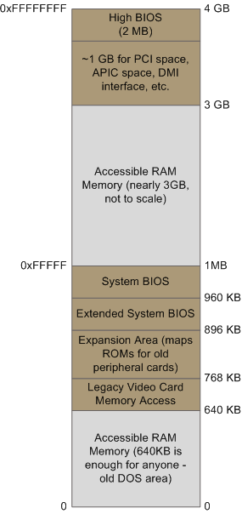
x86 Memory Layout
Source: gustavoduarte.com
Notes:
* This is System memory—the program gets a different view
* So I mentioned that x86 CPUs can only address 4GB of memory—this is what their address space looks like
* Briefly describe diagram
* This is the reason why 32-bit systems can’t fully use 4GB of memory without special chipsets
* Inside of the CPU, memory addresses are handled as logical addresses within a program space
* These logical addresses used by a program must be translated into physical memory addresses used by the Northbridge chip
This is done by the CPU when it accesses memory, and the way in which it is done differs based on whether the CPU is using real mode or protected mode

Slide 6
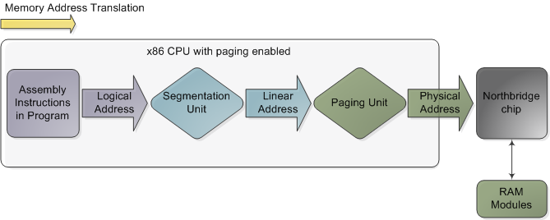
Memory Address Translation
Source: Gustavo Duarte
Notes:
CPU sees an assembly instruction
It sends the address to a segmentation unit to get a linear address (that is, an address starting at 0x0 in your address space)
This linear address goes to your paging unit to create a physical address (which, depending on your physical hardware may be different from your linear address)
The physical address is sent to the Northbridge chip, which determines how to handle the memory request

Slide 7
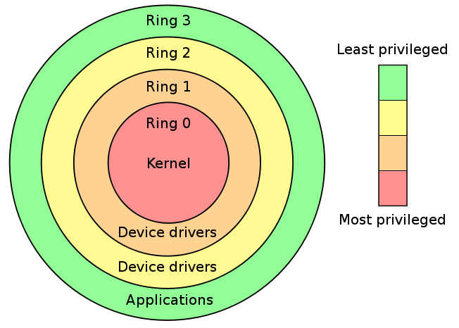
x86 Privilege Levels
Source: fluxius.handgrep.se
Notes:
Hardware-enforced privilege protection
Ring 3 is the least privileged and corresponds to user mode
Rings 1 and 2 and not used much in most common operating systems
Ring 0 is kernel mode and CPU must be in ring 0 to execute certain x86 instructions
New CPUs have ring -1. What do you think this is for?

Slide 8
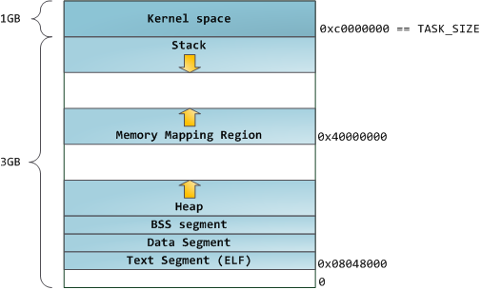
Virtual Address Layout
Source: Gustavo Duarte
Notes:
This is what the program sees
1GB reserved for kernel space
3GB reserved for user space
Local variables are managed on the call stack, which grows down on x86
When a new function is called, the parameters to the function, then other stuff, then the local variables for the new function are pushed onto the stack
We will talk about this in more detail later
Heap is for dynamically allocated memory (calls to malloc)
BSS stores uninitialized static variables
Data stores locations of initialized static variables
Text Segment stores all of the program code and string literals

Slide 9
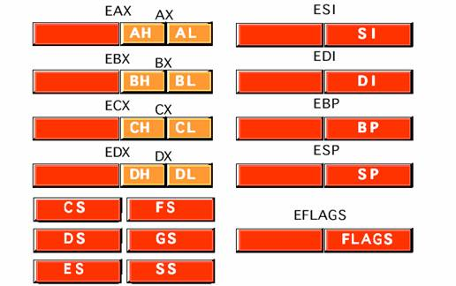
x86 Register Layout
Source: c-jump.com
Notes:
Registers are local storage on the processor
Each register holds a single 32 bit word
The EAX, EBX, ECX, EDX, EBP, EDI, and ESI registers are 32-bit general-purpose registers, used for temporary data storage and memory access.
Though general purpose, many of these registers have specific uses by convention and some are actually written to by x86 instructions
EAX - Accumulator Register
EBX - Base Register
ECX - Counter Register
EDX - Data Register
Read Intel Architecture manuals for more info
These registers you should not use as general purpose
ESI - Source Index
EDI - Destination Index
EBP - Base Pointer (Frame Pointer)
ESP - Stack Pointer (Stack Pointer)
The AX, DX, CX, BX, BP, DI, and SI registers are 16-bit equivalents of the above, they represent the low-order 16 bits of 32-bit registers.
The AH, DH, CH, and BH registers represent the high-order 8 bits of the corresponding registers.
The AL, DL, CL, and BL registers represent the low-order 8 bits of the corresponding registers
CS, DS, ES, FS, GS, SS are segment registers
EFLAGS is special and contains flags that can be set by an executing instruction
IP/EIP (not shown) is the instruction pointer

Slide 10
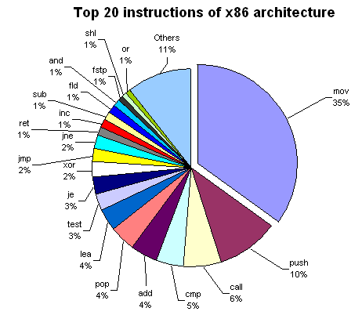
x86 Instructions
Source: c-jump.com
Notes:
Variable Length
These top 20 instructions account for 89% of the instructions you will see
Nop not on here but important

Slide 11
x86 Instruction Format
X86 Instructions are typically of the form:
instruction source, dest
Immediates are denoted with $
  Ex: $5
Registers are denoted with %
  ex: %reg
Pointers are dereferenced with ()
ex: (%reg)
Pointers can be indexed before dereference
  ex: 8(%reg) = value at (%reg + 8)
Pointers can be computed with an offset and scalar multiplier
  Scalar multiplier applies to %offset only
  ex: 8(%base, %offset, scalar) = (%base + 8 + %offset*scalar)
Notes:
I’m going to work in AT&T syntax because that is the default for GCC/GDB

Slide 12
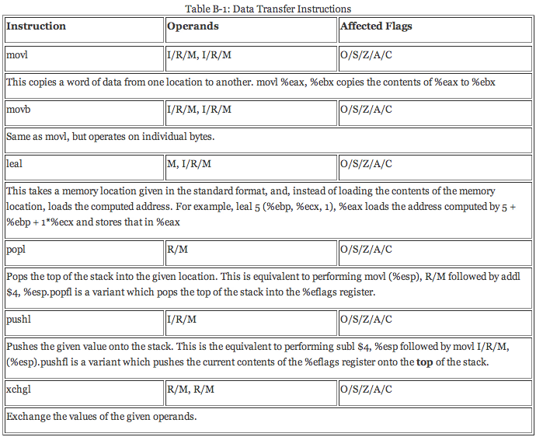
x86 Data Transfer Instructions
http://programminggroundup.blogspot.com/
Notes:
I = immediate
R = register
M = memory address
Ignore O/S/Z/A/C

Slide 13
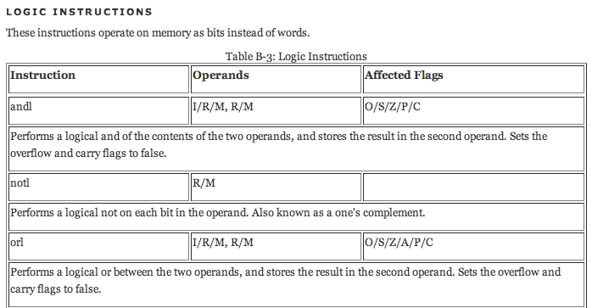

x86 Logical Arithmetic Instructions
http://programminggroundup.blogspot.com/

Slide 14
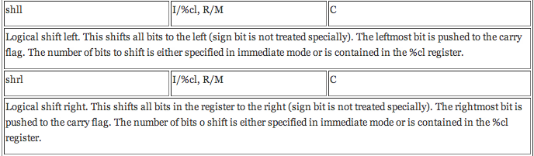
x86 Logical Arithmetic Instructions
http://programminggroundup.blogspot.com/
Notes:
Somebody tell me what a left shift does

Slide 15
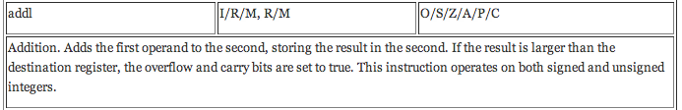

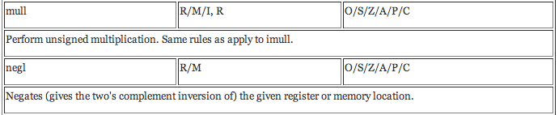
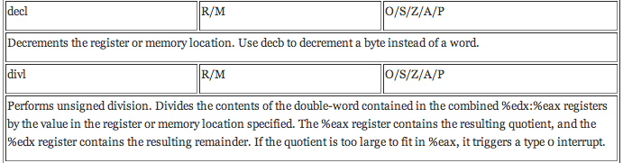
X86 Arithmetic Instructions
http://programminggroundup.blogspot.com/
Notes:
Somebody tell me what a left shift does

Slide 16

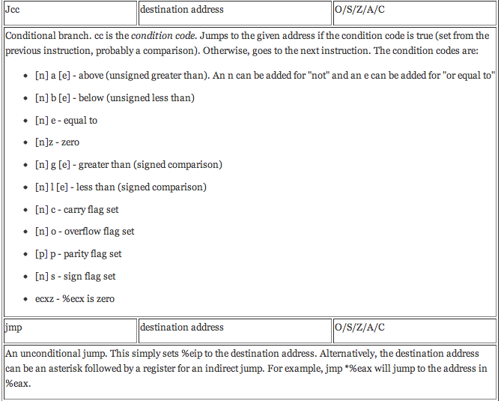
X86 Comparison Instructions and Jumps
http://programminggroundup.blogspot.com/

Slide 17
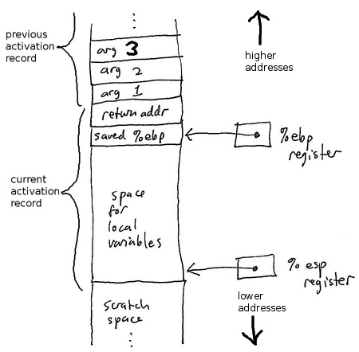
x86 Call Stack
Source: faculty.ycp.edu
Notes:
Functions have arguments and return a value
There are several conventions used for function calls in x86 assembly, but C compilers usually use CDECL
Microsoft uses STDECL
In CDECL, the caller has to save EAX, ECX, and EDX
After this, the caller pushes the arguments to the function onto the stack in reverse order
The function call automatically pushes return address onto the stack
The callee saves the EBP and sets the EBP value to the current ESP value
Stack frames are actually a linked list where each frame references the prior frame via the saved EBP value
The callee sets aside space for its local variables on the stack (remember that ESP ALWAYS points to top of stack, so it will grow down as we push initial values for local variables onto the stack)
Before returning, we set ESP to EBP and restore EBP this is done with a shortcut function called leave
Ret sets EIP to the return address

Slide 18
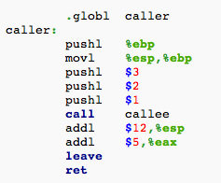
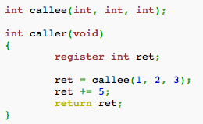
x86 Call Stack
Source: http://en.wikipedia.org/

