Slide 1
COURSE UNIT; PROGRAMMING FOR SURVEYORS
Group 8 Project Report
Cut and Fill Volume Calculator with Mass Haul Analysis
Date: 8th November 2026
Group 8 :
MICH BARBARA (25/1/324/D/2060)
ATUGONZA JOYCE (25/1/324/D/1960)
NSEMIRIIRWE MACKLEAN (25/1/324/D/2115)
SEMUJJU PATRICK (25/1/324/D/293)
GitHub Link: https://github.com/michbarbara3-code/cut-and-fill-project

Slide 2
INTRODUCTION & PROBLEM IDENTIFICATION
In land surveying and civil engineering, determining the volume of soil to be excavated i.e. cut or added i.e. fill is a fundamental requirement before construction begins. This is traditionally done by taking cross-sectional areas at fixed intervals also i.e. chainages and calculating the volumes between them using the End-Area Method.
However, doing this manually is extremely time-consuming and highly prone to arithmetic errors, especially on long road or railway alignments.
Furthermore, surveyors must calculate the Mass Haul i.e. the cumulative movement of soil along the route to know where there is excess soil and where there is a deficit.
Doing this manually makes it difficult to visualize the overall earthwork balance and can lead to expensive mistakes
This means there is clear need for automated tools that can perform these calculations with speed and precision which our python based program addresses . The program reads survey data from a CSV file , automatically calculate the cut and fill volume using the End Area method then computes the cumulative Mass Haul and then finally generates a visual mass haul diagram hence automating the whole process

Slide 3
OBJECTIVES
The primary objectives of this project were:
To develop a Python program that automatically calculates Cut and Fill volumes between survey stations using the End-Area Method.
2. To compute the cumulative Mass Haul to show the net movement of soil.
3. To enable the program to read input data easily from a CSV file, simulating real-world survey data handling.
4. To generate a visual Mass Haul Diagram (graph) for easy interpretation and to aid in earth work planning .
5. To deploy the working code to GitHub .

Slide 4
METHODOLOGY
The program was developed using Python within Visual Studio Code (VS Code).
Input Handling
The program is designed to read data from a CSV file (sample_stations.csv) containing three columns: Chainage, Cut Area, and Fill Area. The csv module in Python is used to read and convert this text data into decimal numbers (floats).
Calculation Logic (The Loop)
The program uses a for loop to iterate through consecutive pairs of stations. For each section, the distance (L) is calculated by subtracting the current chainage from the next chainage.
The volume is then calculated using the End-Area formula:
V = (L / 2) × (A1 + A2)
Mass Haul Analysis
For each section, the net volume is calculated as Cut Volume - Fill Volume. This net value is added to a running mass_haul variable. The program saves the chainage and the running mass haul total into two separate lists for graphing.
Output and Visualization
The results are printed to the terminal using formatted strings (f-strings) to align the columns neatly. Finally, the matplotlib.pyplot library is used to plot the Chainages against the Mass Haul ordinates, generating a visual Mass Haul Diagram.

Slide 5
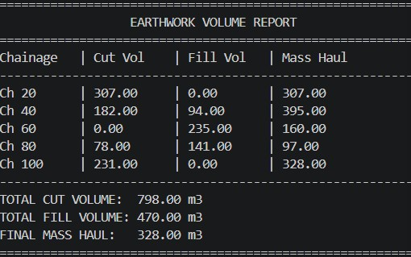
METHODOLOGY
Results and Testing
To test the program, we used a standard textbook dataset representing a 100-meter road section.
Figure 1: The Terminal Output showing the Earthwork Volume Report

Slide 6
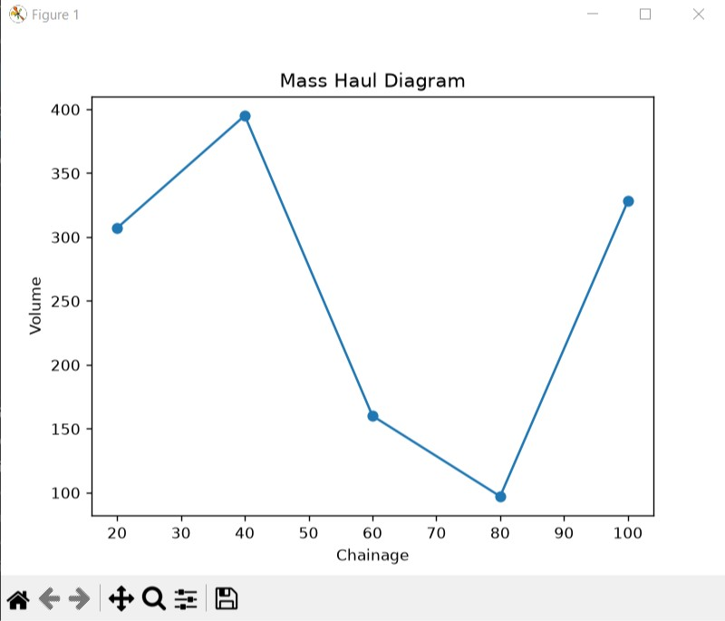
METHODOLOGY
Analysis of Results
As seen in Figure 1, the program successfully calculated the volumes for each 20m section. The Total Cut Volume was 798.00 m³ and the Total Fill Volume was 470.00 m³.
The Final Mass Haul was 328.00 m³.
Because this number is positive, it indicates a net surplus of soil at the end of the alignment, meaning soil will need to be hauled away.
Figure 2: The generated Mass Haul Diagram.
In figure 2 , the peaks indicate areas of maximum cut surplus, while the dips or troughs indicate areas of fill deficit. This visual output allows engineers to plan the most efficient haul distances

Slide 7
CHALLENGES FACED
During the development of this project, we encountered several challenges:
· Environment Setup: Installing Python and configuring the PATH environment variables was a significant hurdle, starting with installing the correct version of python as we initially had the old version , then went ahead configure correctly before installing VS Code
· Python Indentation: Python is strict about spacing. We initially encountered Indentation errors and name error messages when trying to calculate the cumulative mass haul before defining the variables i.e. cut variables hence learning that python relies on strict indentation to know that code belongs inside the loop. This taught us the importance of logical flow
.Formatting the Table : we wanted our terminal to look like a professional engineering report though our first attempts printed everything in a messy straight line but we researched and found out how we could use python f-strings to align our columns and round off our decimals to two dps.
· Version Control and Git merge conflicts :because we were still learning, we had edited the README.md file directly on the GitHub website and when we later tried to push our local python code from VS Code, Git rejected the push to prevent us from overwriting the online changes . To resolve this, we bypassed the VS Code buttons and used the Git terminal commands to force our local code to sync with the remote repository
These included
git add; we used this to stage all our modified files
git commit –m ; we used this to save a snap shot of our work locally on the laptop, attaching a descriptive message of what changed
git push ; because of the merge conflict, this force command told GitHub to ignore the remote conflict and over write the online files with our final verified local python code
· Data Visualization: Installing the matplotlib library required an internet connection, and figuring out how to pass our calculated data into the plotting functions took a lot of trial and error.

Slide 8
CONCLUSION
The project successfully met all its objectives. The Python program provides a fast, accurate, and automated way to calculate earthwork volumes and perform mass haul analysis. It proves that programming can save surveyors hours of manual calculation. By deploying the project to GitHub, we also gained valuable skills in version control and collaborative software development

