Slide 1
An implementation of Open-RMF in an office environment

Slide 2




Objectives
At Elettra Sincrotrone with the IT Group, we wanted to see the Open Robotics Middleware Framework ( Open-RMF ) capacities for use in our warehouse and offices and upgrade our Autonomous Mobile Robots (AMRs) to ROS 2, so we:
  Build 2 AMRs with ROS 2 and Nav2 creating 2 fleets:
    One from an UGV Mini
    One porting a Jobot AMR from ROS 1 to ROS 2
  Port the DStar global planner from ROS 1 to ROS 2 to be used in our robots
  And, finally, use Open-RMF as middleware for these two fleets

Slide 3
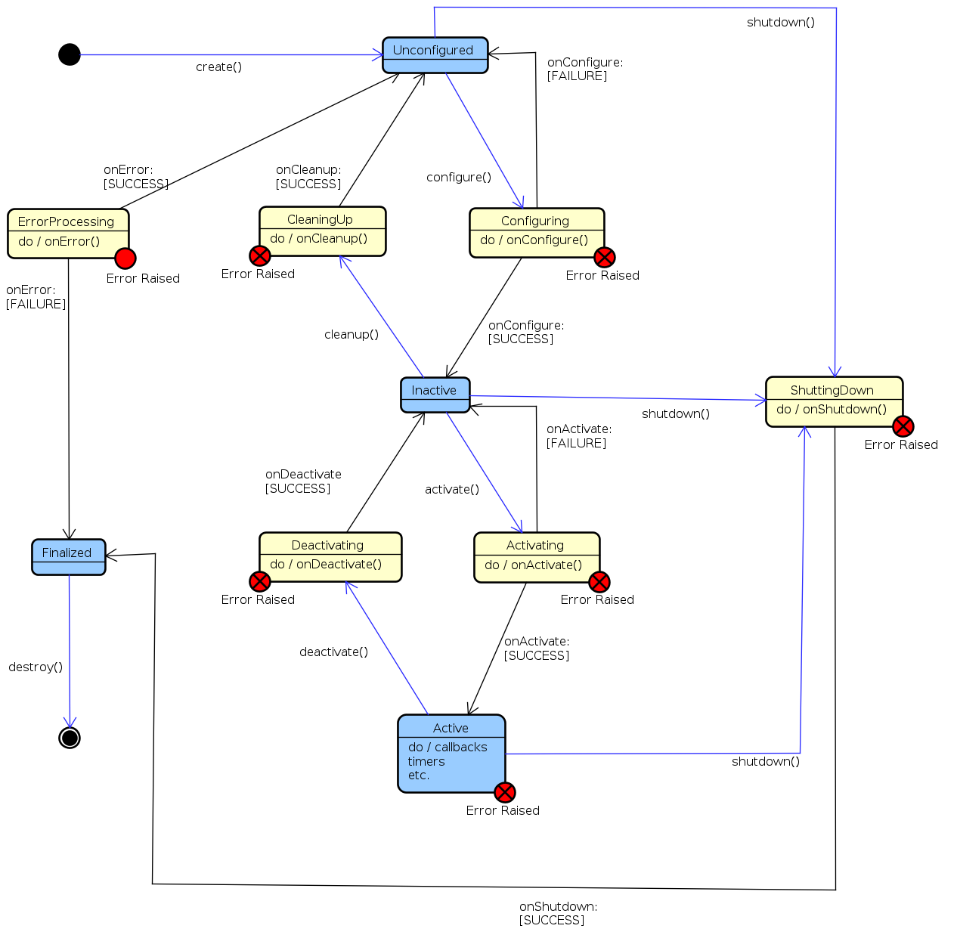
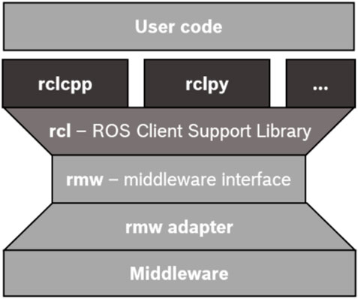
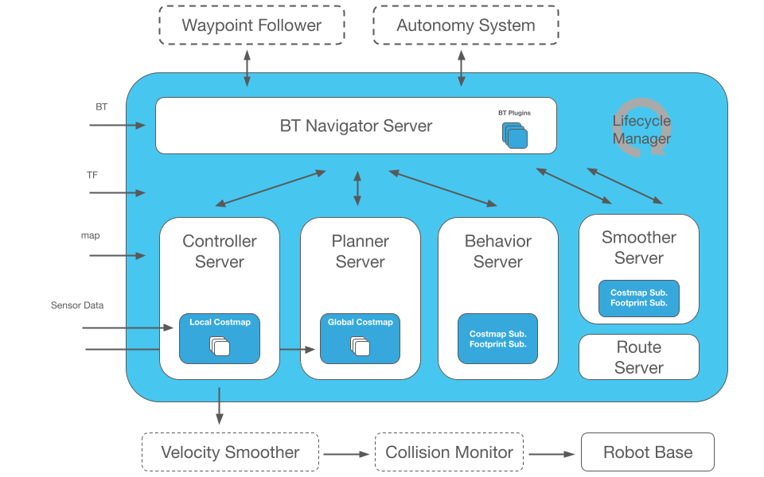
AMR control
ROS 2 structure
  Communication middleware
  Multiple client libraries : rclcpp, rclpy, rclrs, …
  Topics, Service, Action
  Lifecycle
  Composition
Nav2 structure
  Behavior Tree Navigation Server
  Planner Server
  Smoother Server
  Controller Server
  Behavior Server
  Route Server
  Lifecycle manager
require:
base_link → odom
odom → map
Structure
Lifecycle

Slide 4
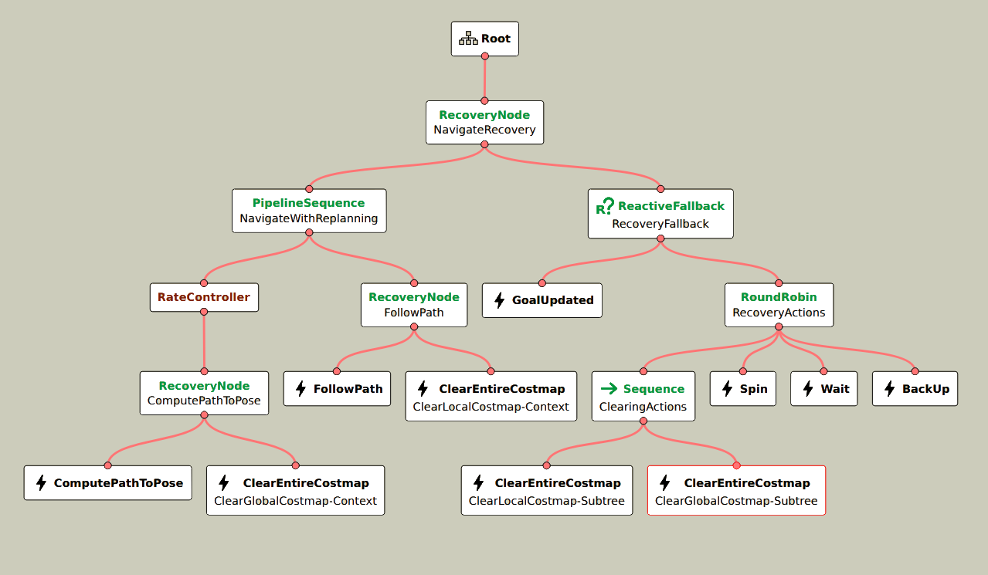
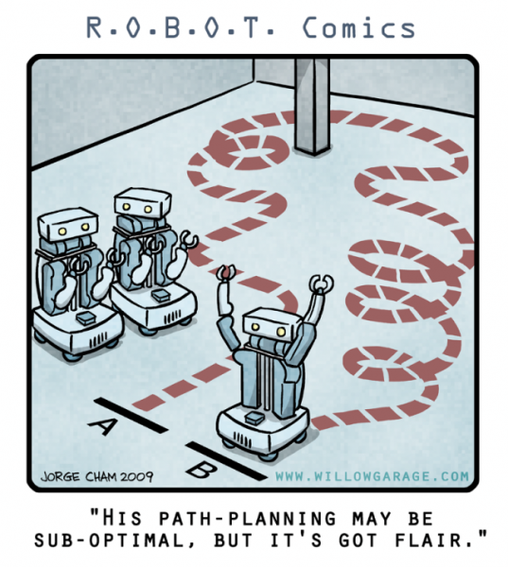
Nav2 project
Structure
  Behavior Tree Navigation Server
  Planner Server
  Smoother Server
  Controller Server
  Behavior Server
  Route Server
  Lifecycle manager

Slide 5
Nav2 Requirements
Need a TF tree based on REP 105
  base_link → odom → map
    base_link → odom (continuous link)
      Given by robot estimation (wheel encoders, … )
      ROS packages (robot_localization, fuse, ...)
    odom → map (can be a discrete link)
      SLAM (Simultaneous Localization And Mapping)
        Cartographer
      AMCL (Adaptive Monte Carlo Localization)

Slide 6
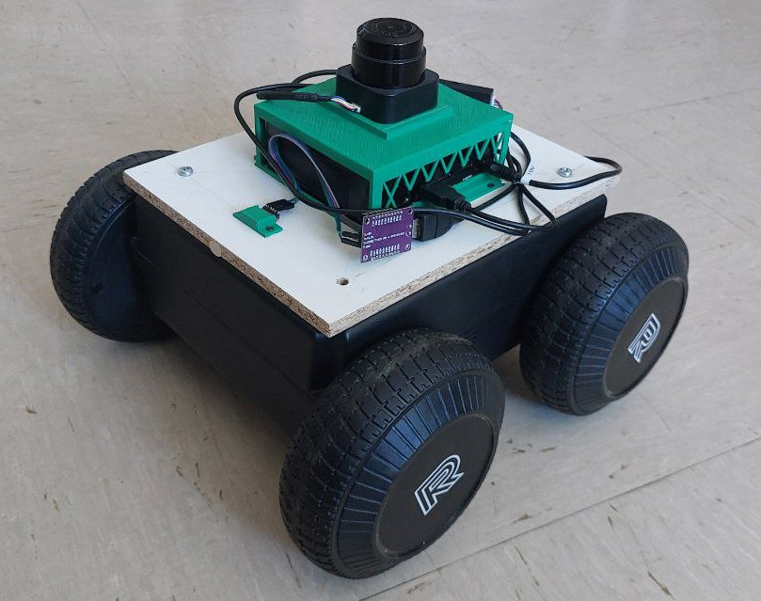
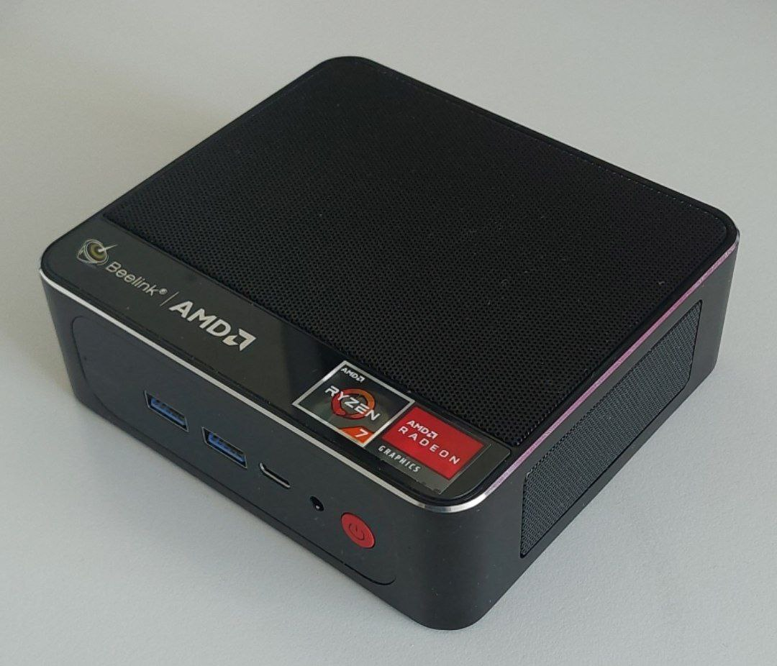

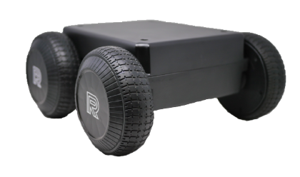
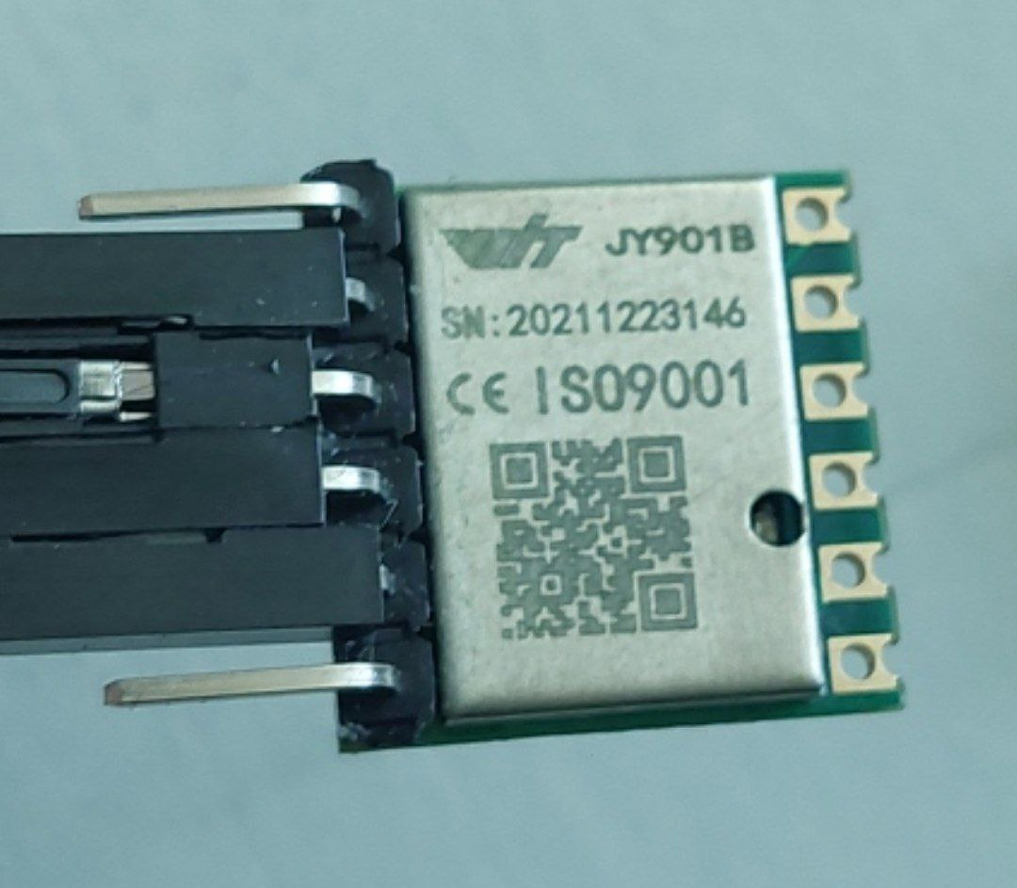
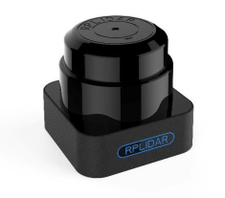
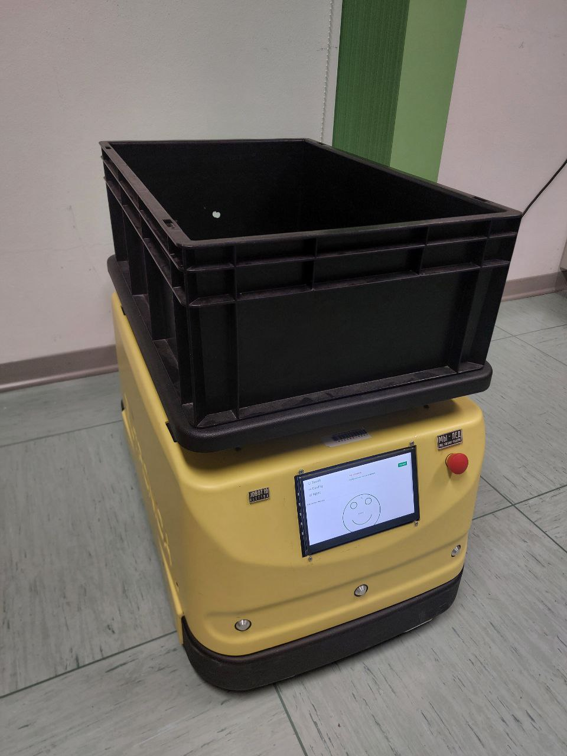

Build the AMRs
Mini:
AMR
Unmanned Ground
Vehicle (UGV)
Sensors
PC
IMU
LIDAR
Control the movement and give information about its state
Give more information about the system or about the world
Take all the data and control the robot without human interaction
Jobot:
ROS 1 AMR that get the data from the encoders and a IMU using a serial communication with an Arduino
It has also a LIDAR for mapping
Docker with
Generation of URDF (Unified Robot Description Format) files for simulation

Slide 7
Upgrade Jobot AMR - ROS 1→ ROS 2
Build system: catking → colcon (ament_cmake)
rclcpp with more C++ 17 features, like smart pointer and new cmake
Naming
ROS msgs update
Lifecycle implemented
  In on_configure() : add creation of secondary nodes (IMU), setup parameters and create callbacks
  In on_deactivate() : cleaning
Find ros-serial for ROS 2

Slide 8
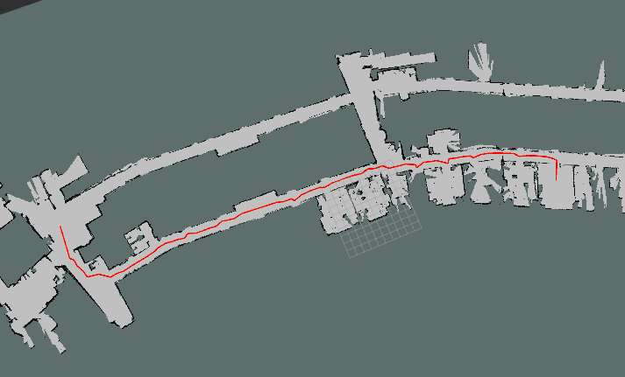
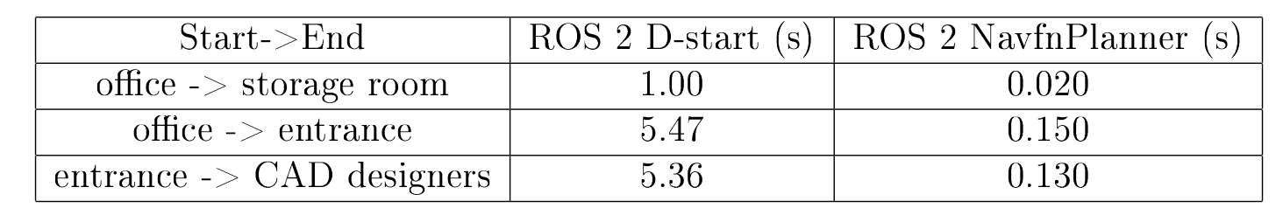
Updated DStar global planner and results
Upgrade planner
  Inheritance from nav2_core::GlobalPlanner
    Plugin
    Lifecycle structure
      configure() : setup parameters and get pointer
      activate() : fill DStar costmap
      cleanup() : destroy allocate memory
    createPlan() : return a path
Results:

Slide 9
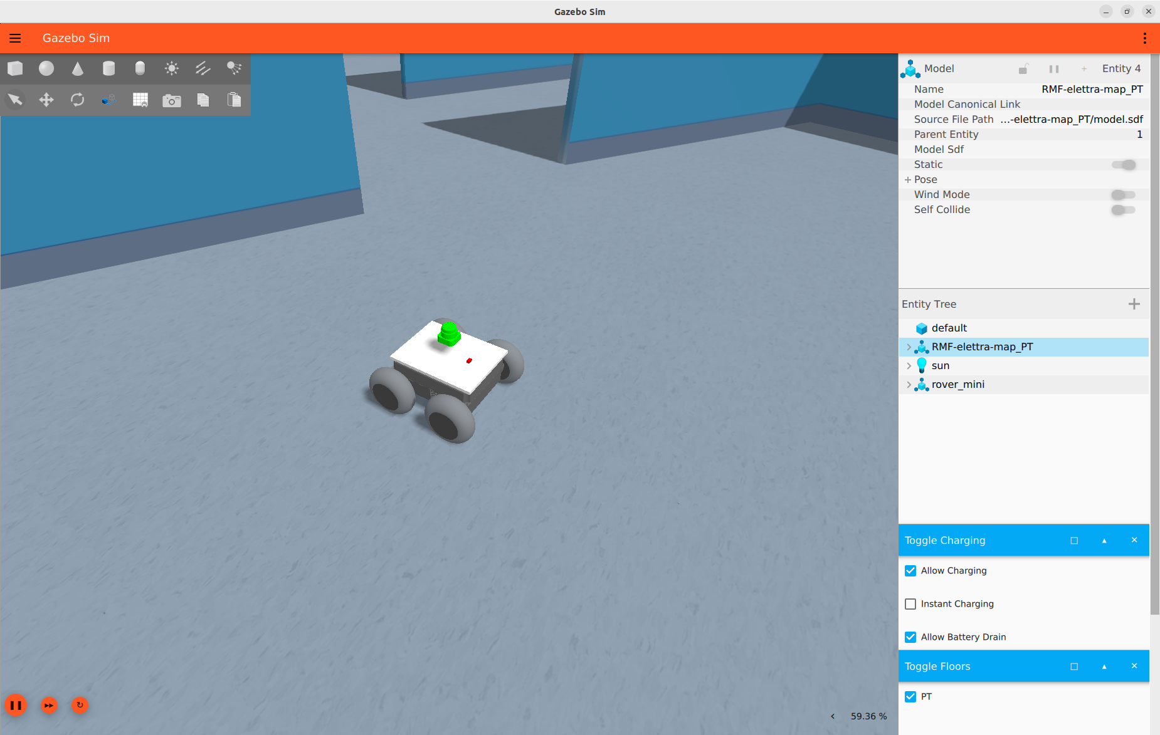
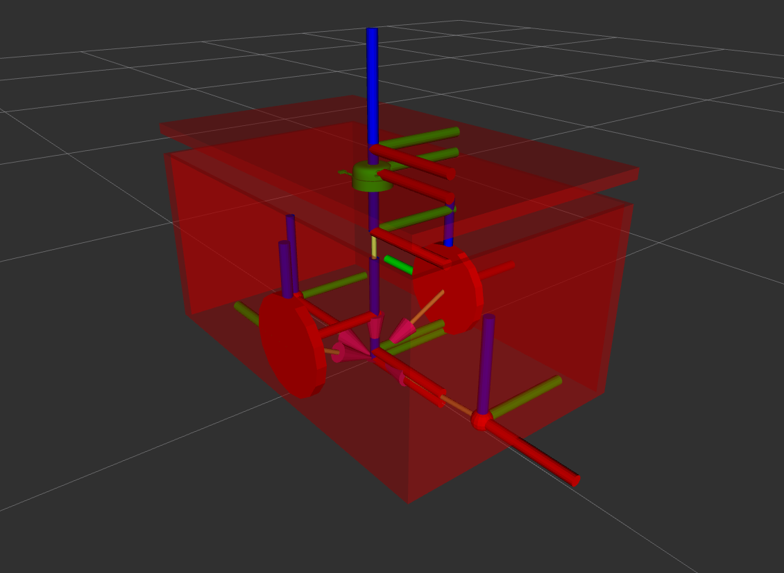
Adding also simulation
Mini: Edit URDF (Unified Robot Description Format) for sensors position
Jobot: Create an URDF description with sensors and movement control (DiffDrive)

Slide 10
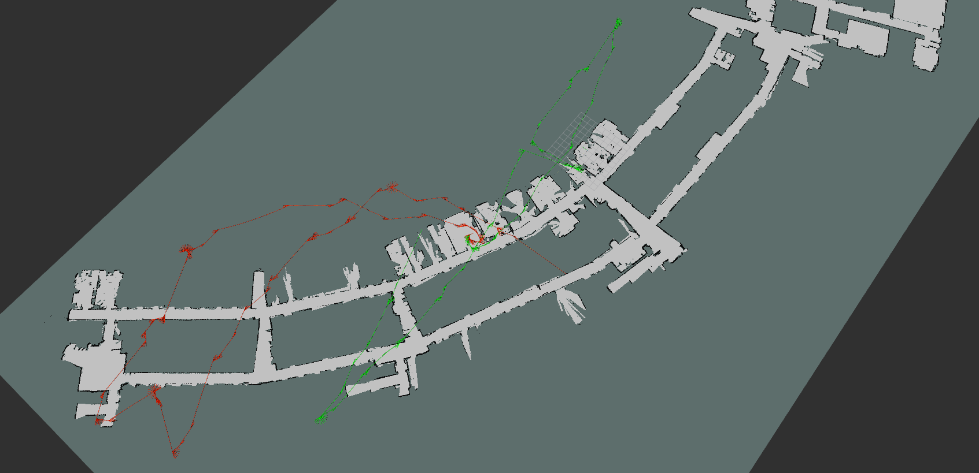
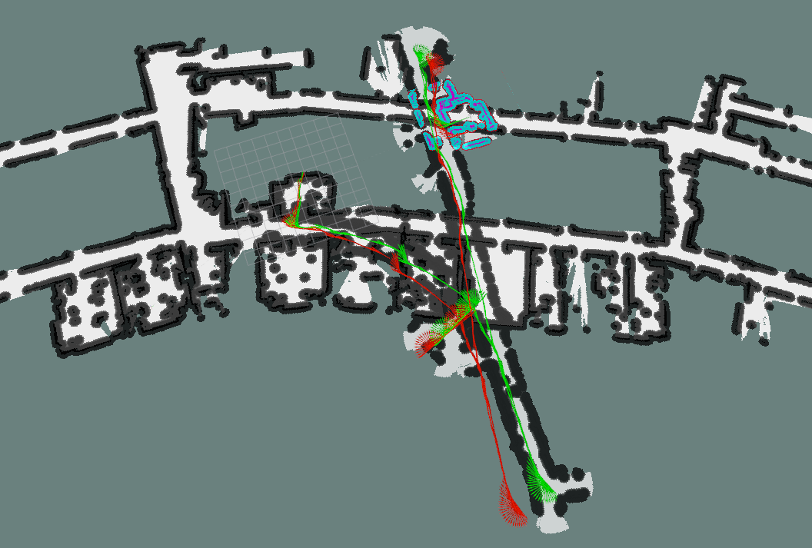
UGV – Estimation from encoders
Their returned odometry → need an improvement

Slide 11
How to improve Odometry
Using packages that fuse sensors data:
  robot_localization that fuse IMU data with odometry given by robot
And tuning that packages
  tuning the parameters of the EKF
Moving the robot and recording the data using rosbag2
  Repeatability
  Speed

Slide 12
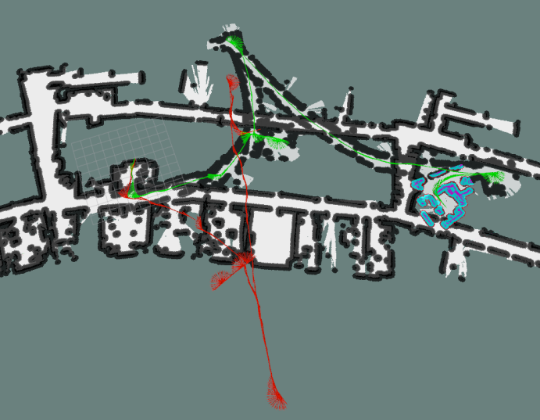
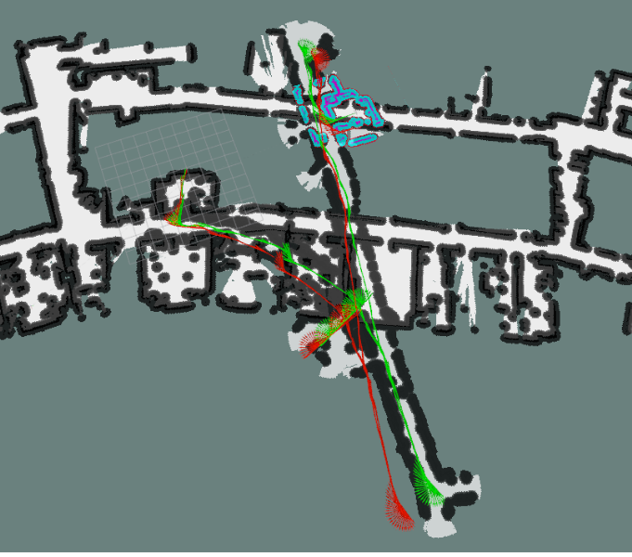
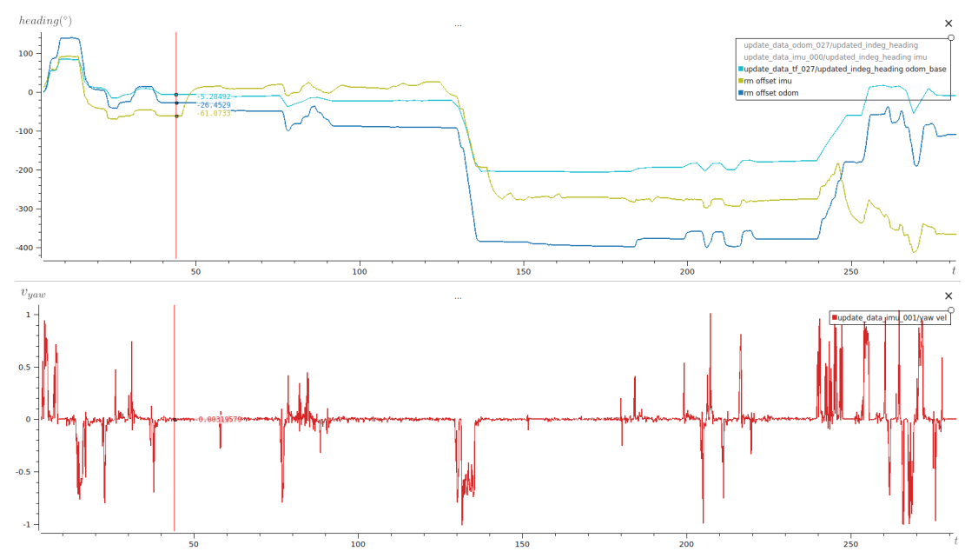
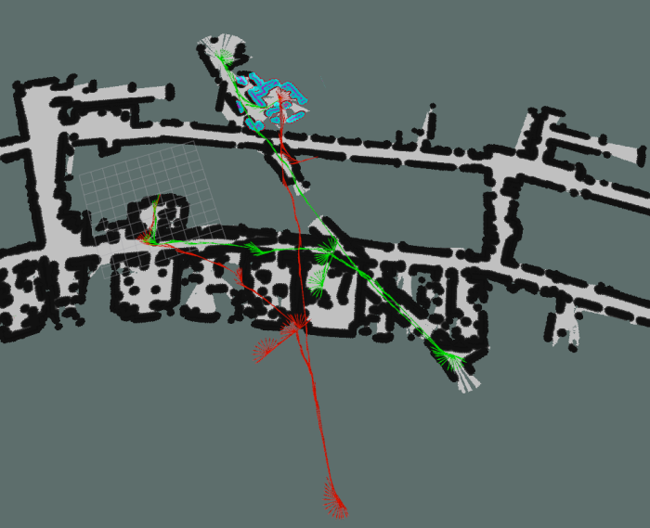
How to tune EKF of robot_localization
Choose what sensors use and how
Jobot with vyaw from odometry
Jobot with yaw from odometry
Mini error in heading
Jobot with vyaw from odometry and IMU

Slide 13



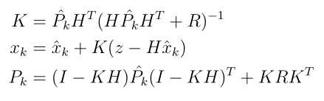
How to tune EKF of robot_localization
Change the process noise covariance matrix Q
  Prediction step Correction step

Slide 14
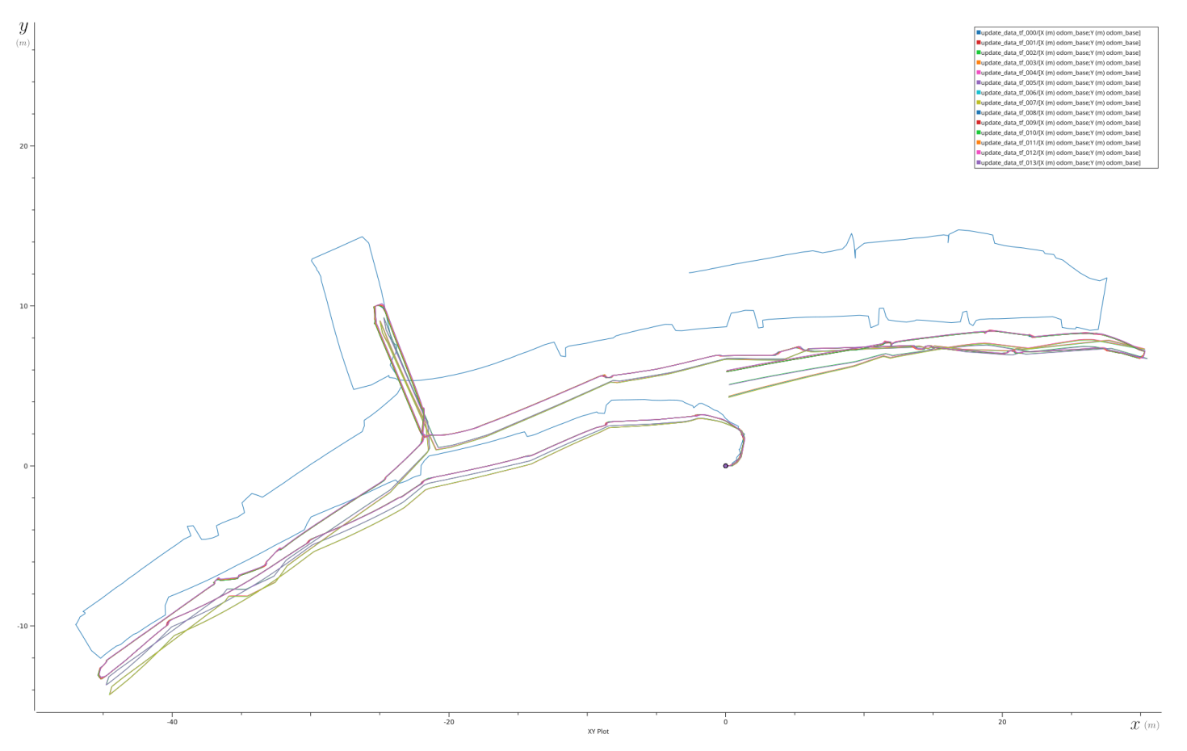
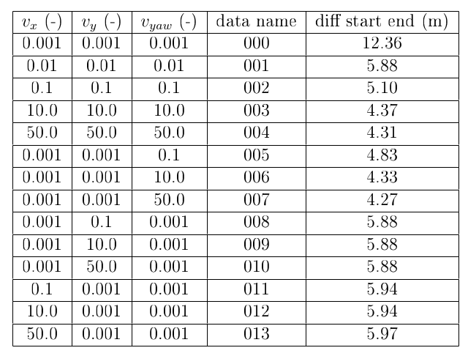
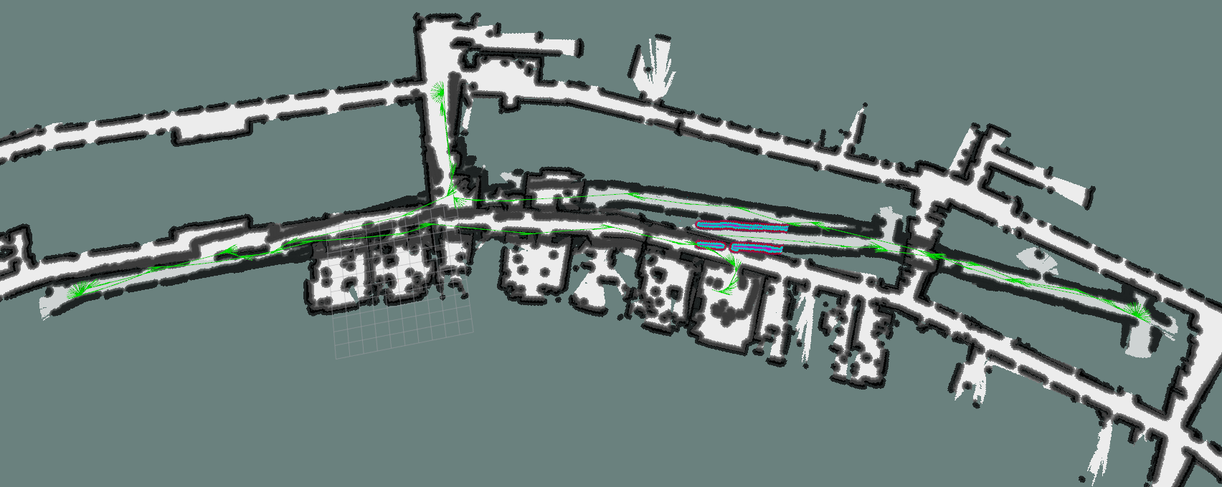
Results Mini
NB:
  Still translation error
  Still rotation error

Slide 15
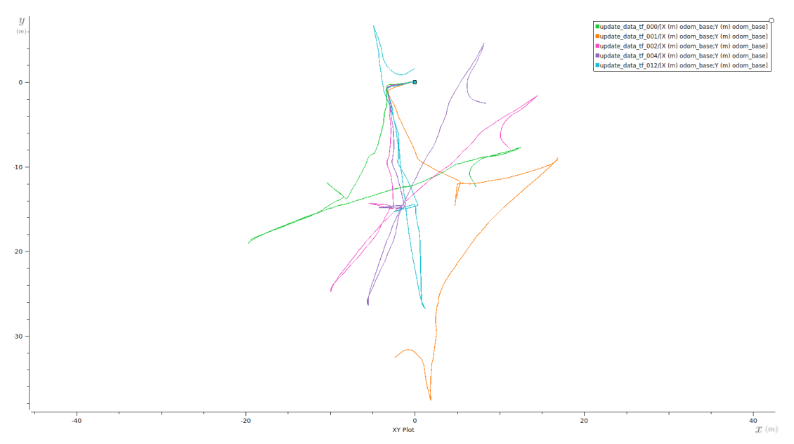
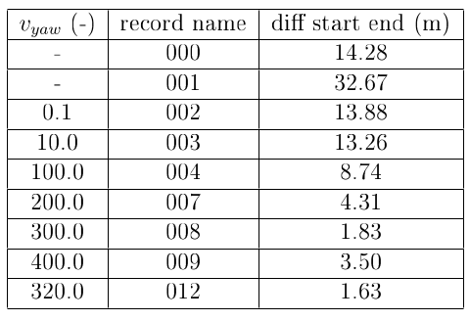
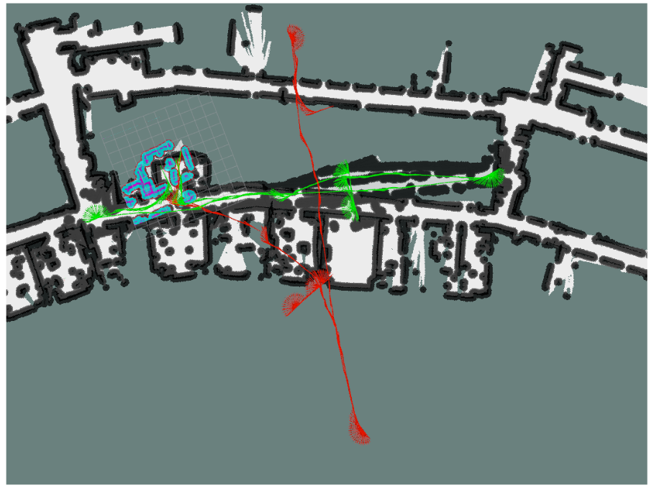
Results Jobot
NB:
  Little translation error
  Still rotation error

Slide 16
Improving odometry Mini and Jobot
robot_localization
  Choosing sensor to fuse
  Calibrating the process noise covariance matrix Q of the EKF

Slide 17
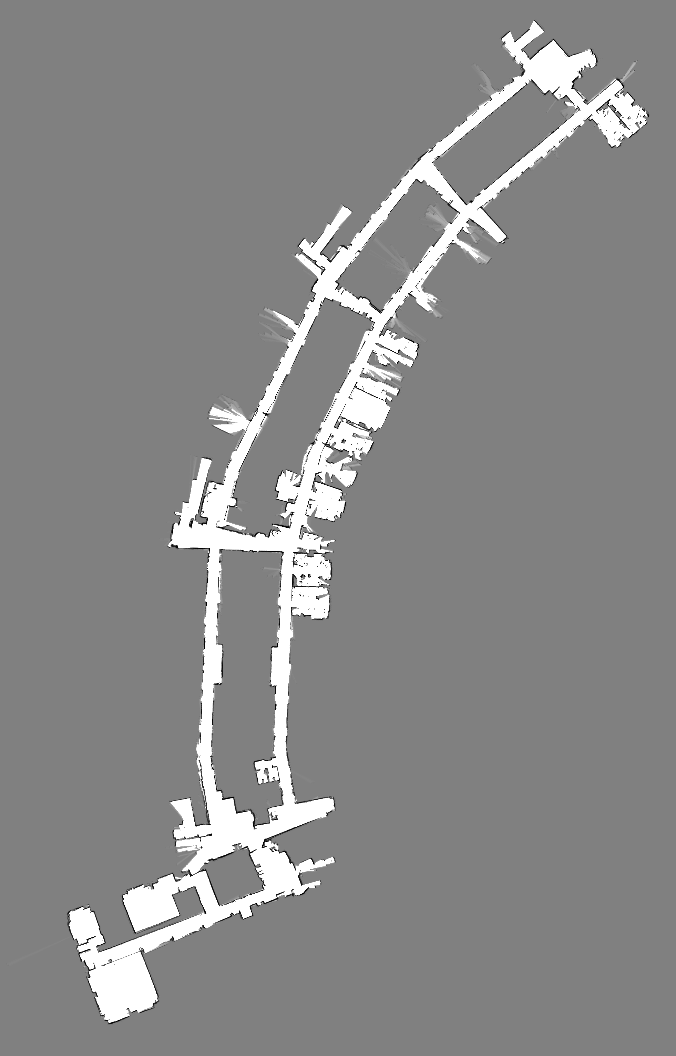
Global localization
We improve but still errors
correction using a map
SLAM or only localization?
  Localization:
    Cartographer
    AMCL
      Tuning:
        α parameters :
        Expected process noise in odometry’s
        rotation/translation estimate from
        rotation/translation

Slide 18
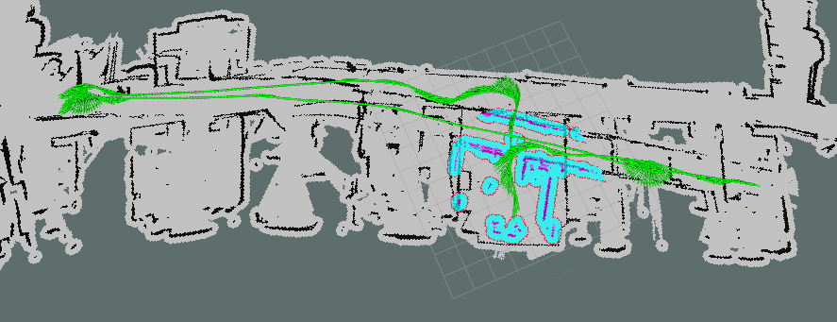
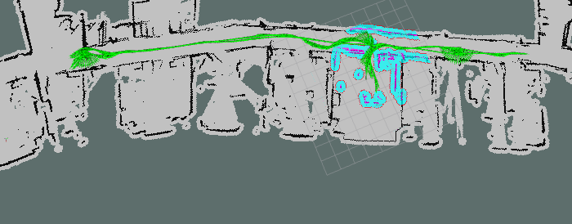
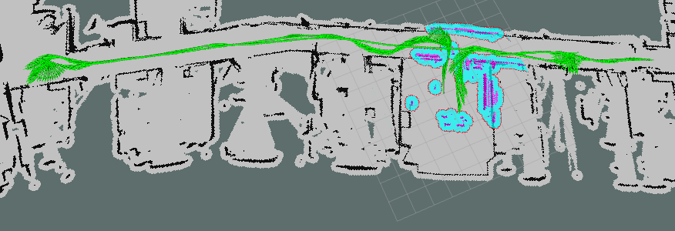
AMCL calibration Mini
Correcting rotation
Correcting translation

Slide 19
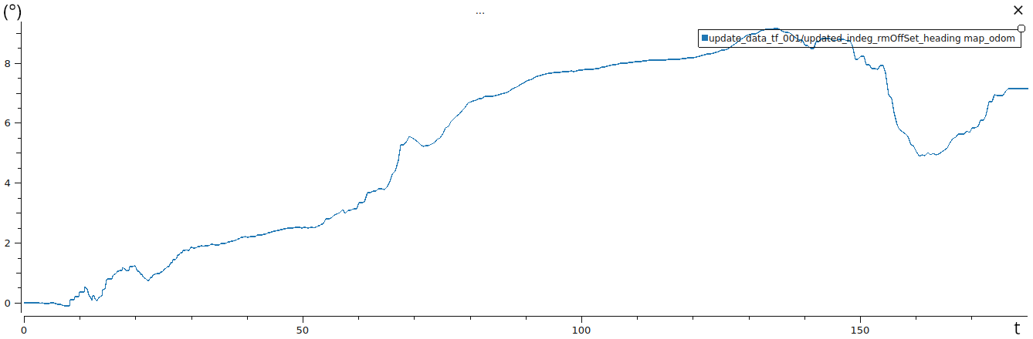
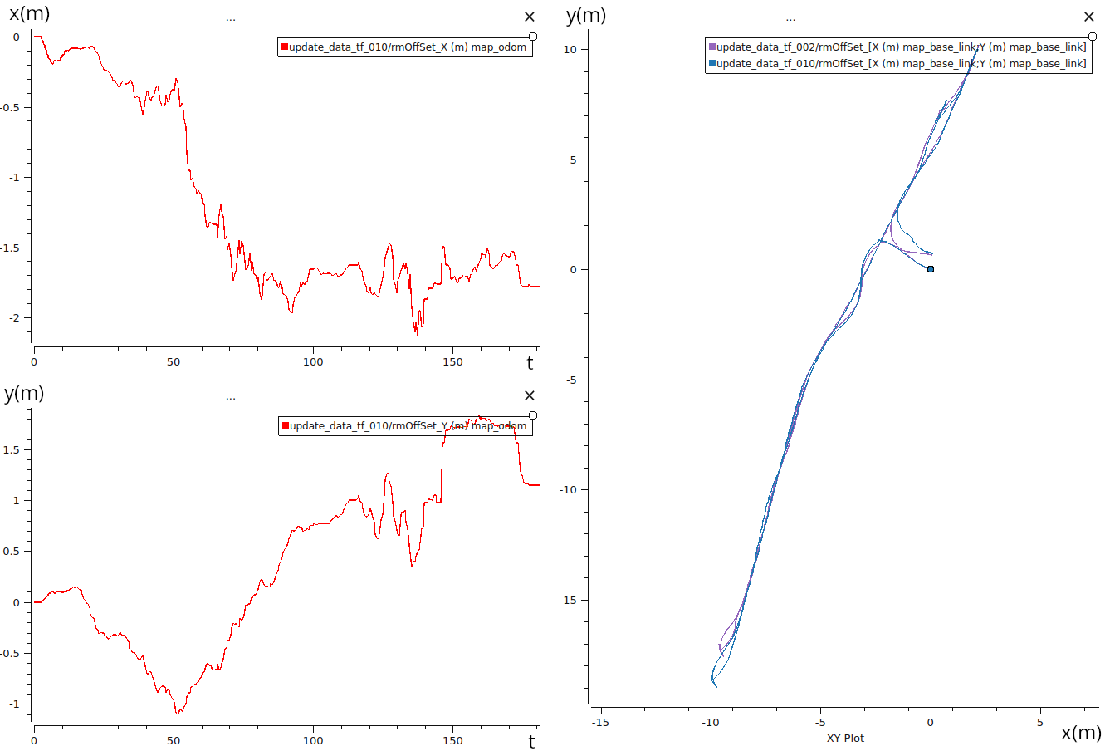
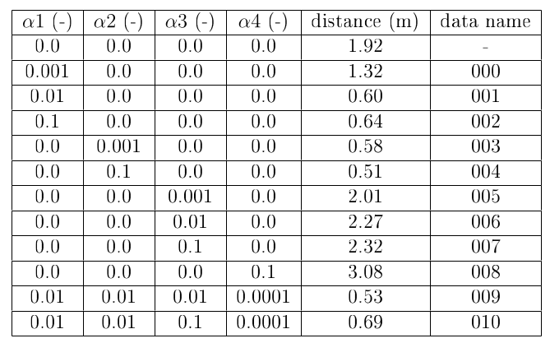
Results Mini - Correction with AMCL

Slide 20
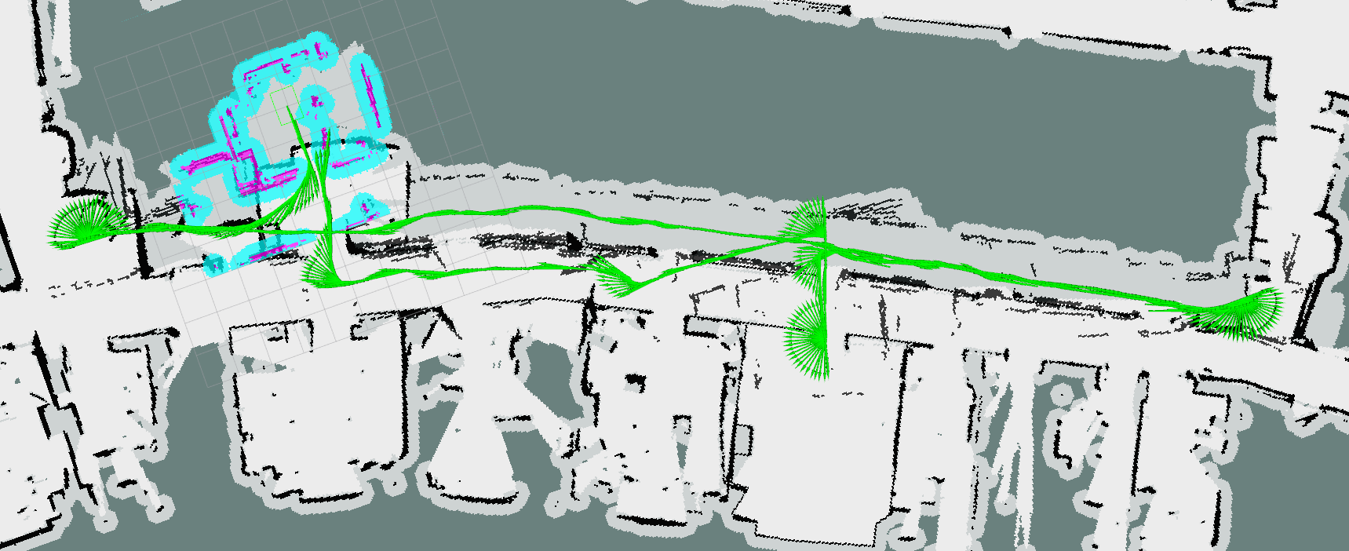
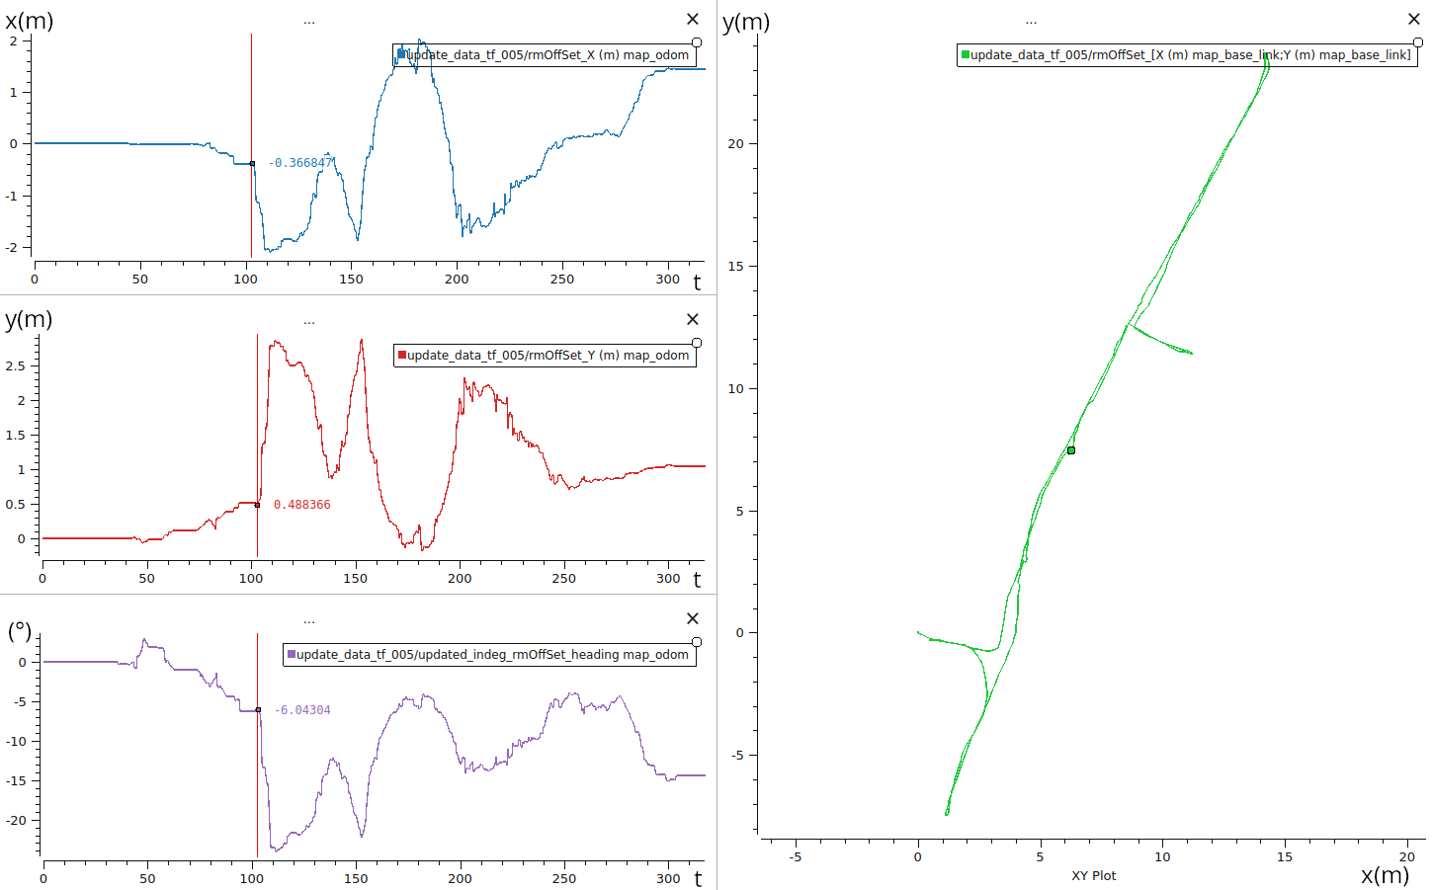
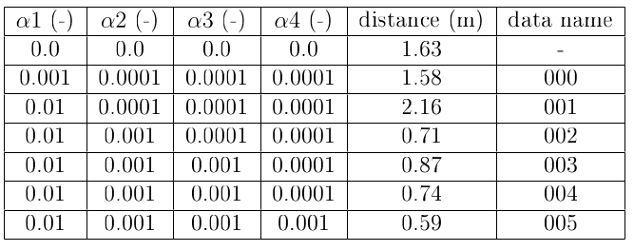
Results Jobot - Correction with AMCL

Slide 21
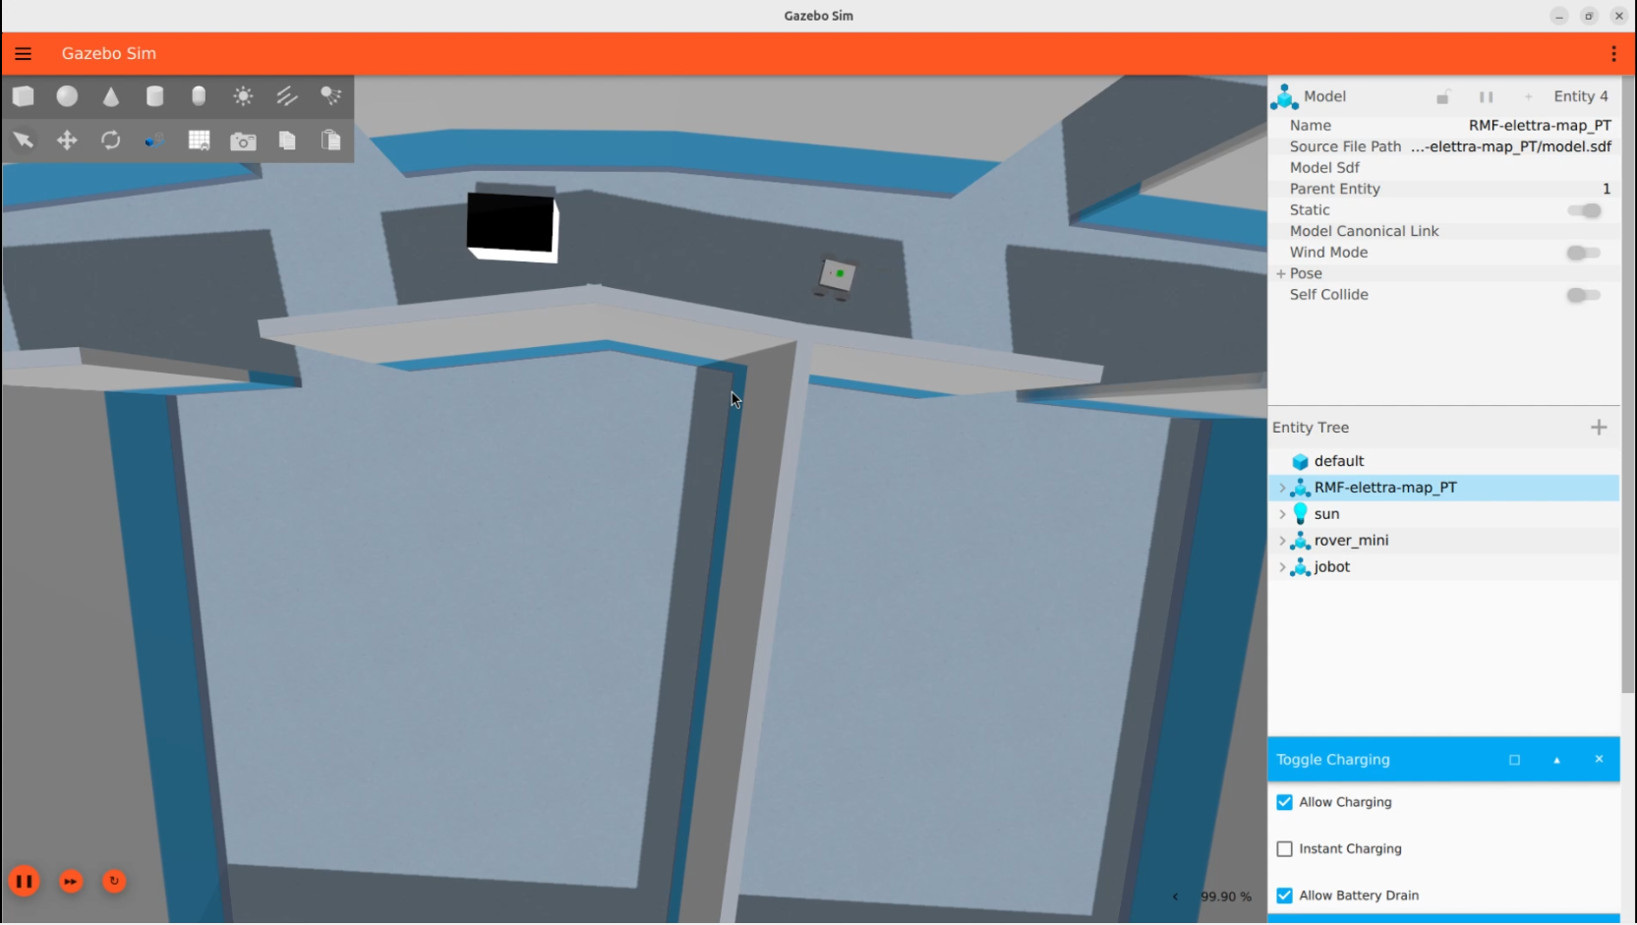
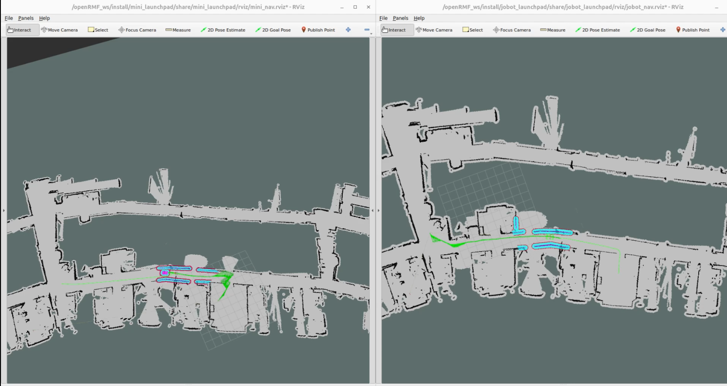
Results in simulation

Slide 22
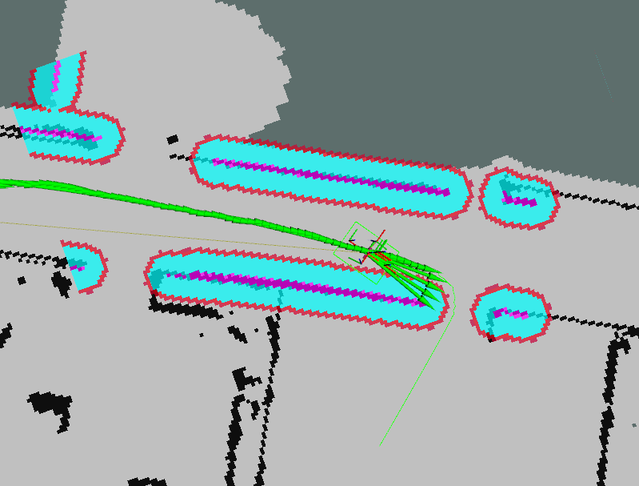
Discovery in simulation
Error with the controller
DWB (Dynamic Window Approach) Controller
MPPI (Model Predictive Path Integral) Controller

Slide 23
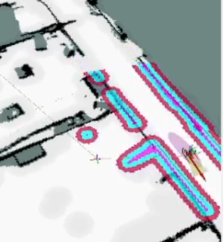
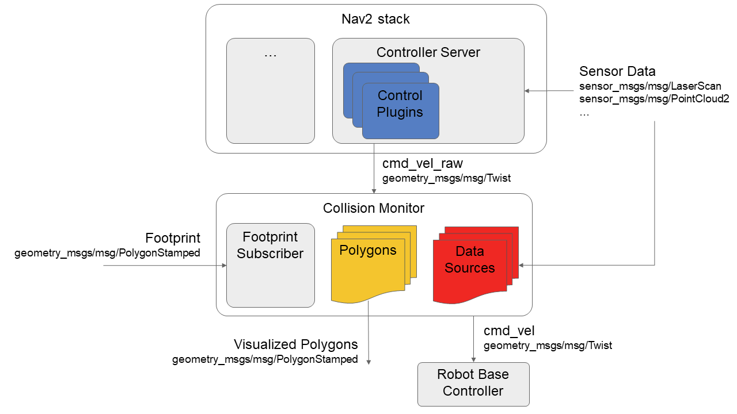
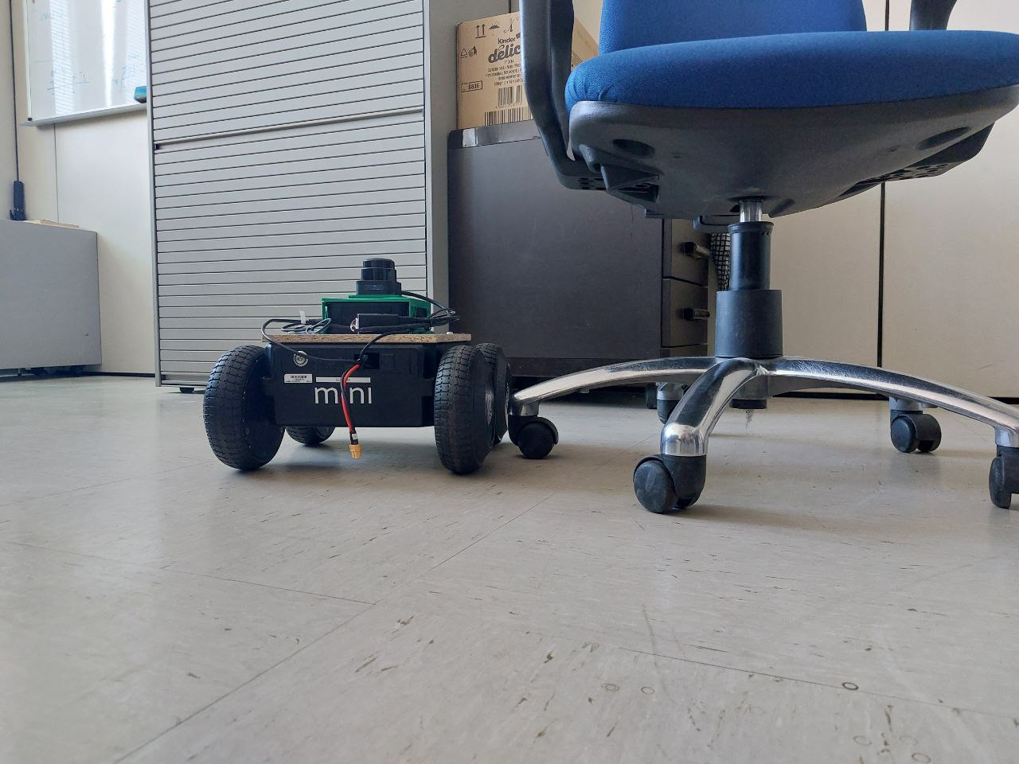
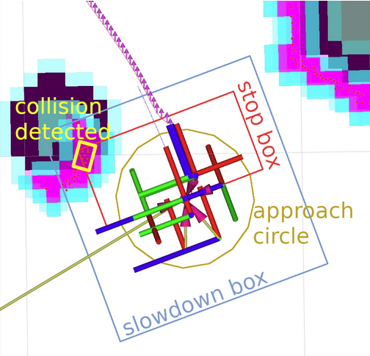
Discoveries in reality
Miss alignment from
local costmap and global costmap
Obstacles not visible
Improve safety
System fail to generate
a path to enter the room

Slide 24
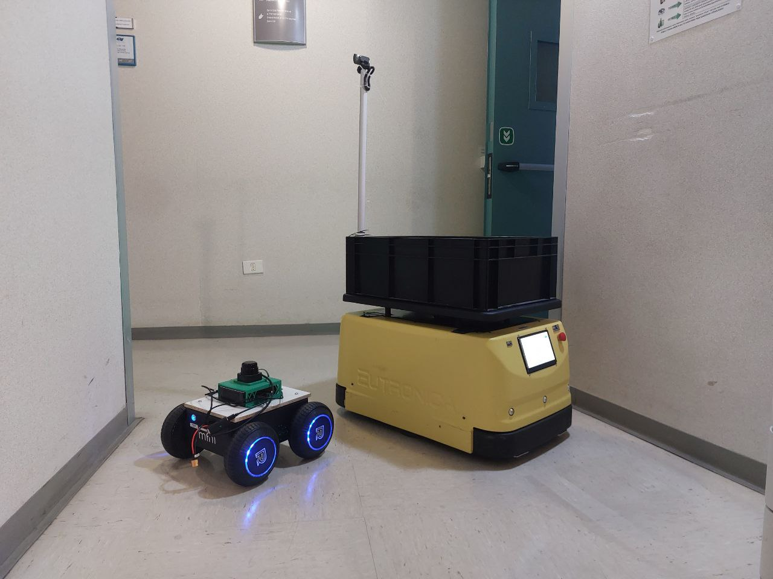
Discoveries in reality
Obstacle detection not visible
Improve safety

Slide 25
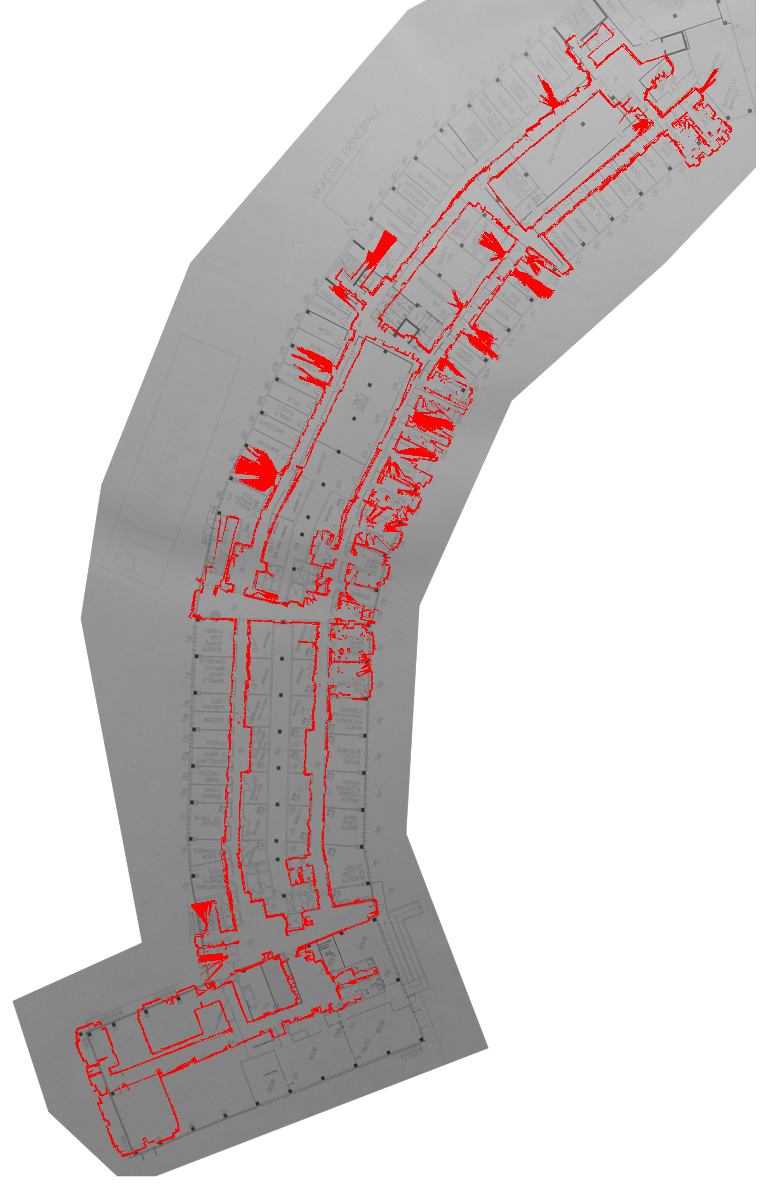
Discovery in reality
Misalignment Cartographer and building map
Communication solutions:
  ROS_DOMAIN_ID
  DDS properties
  namespace

Slide 26
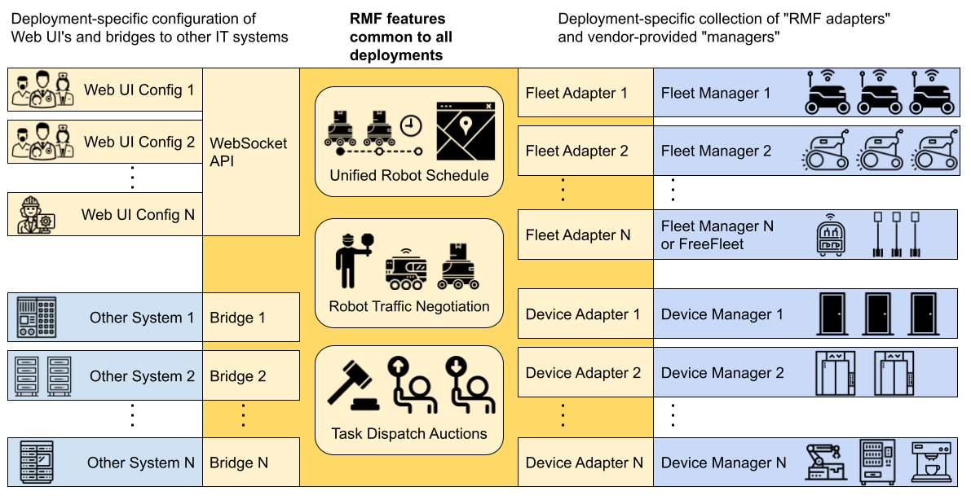
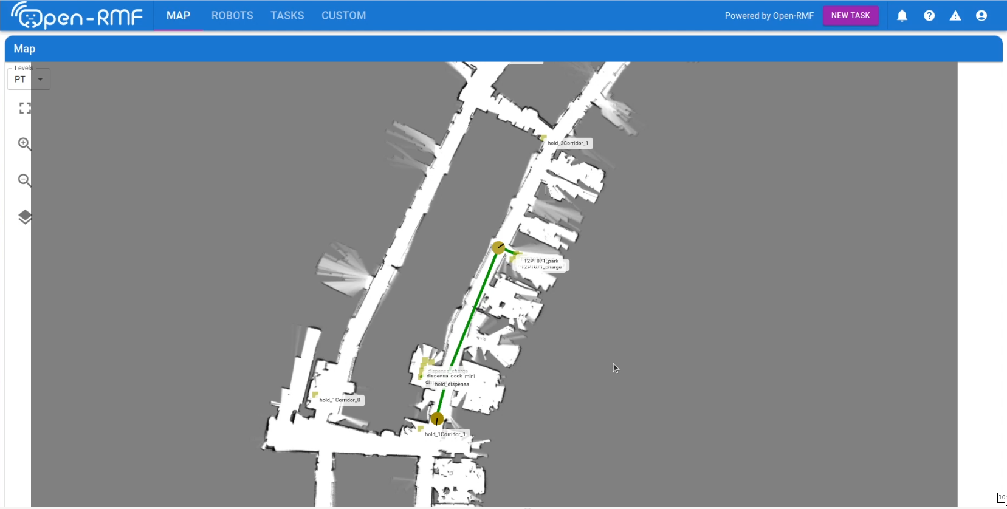
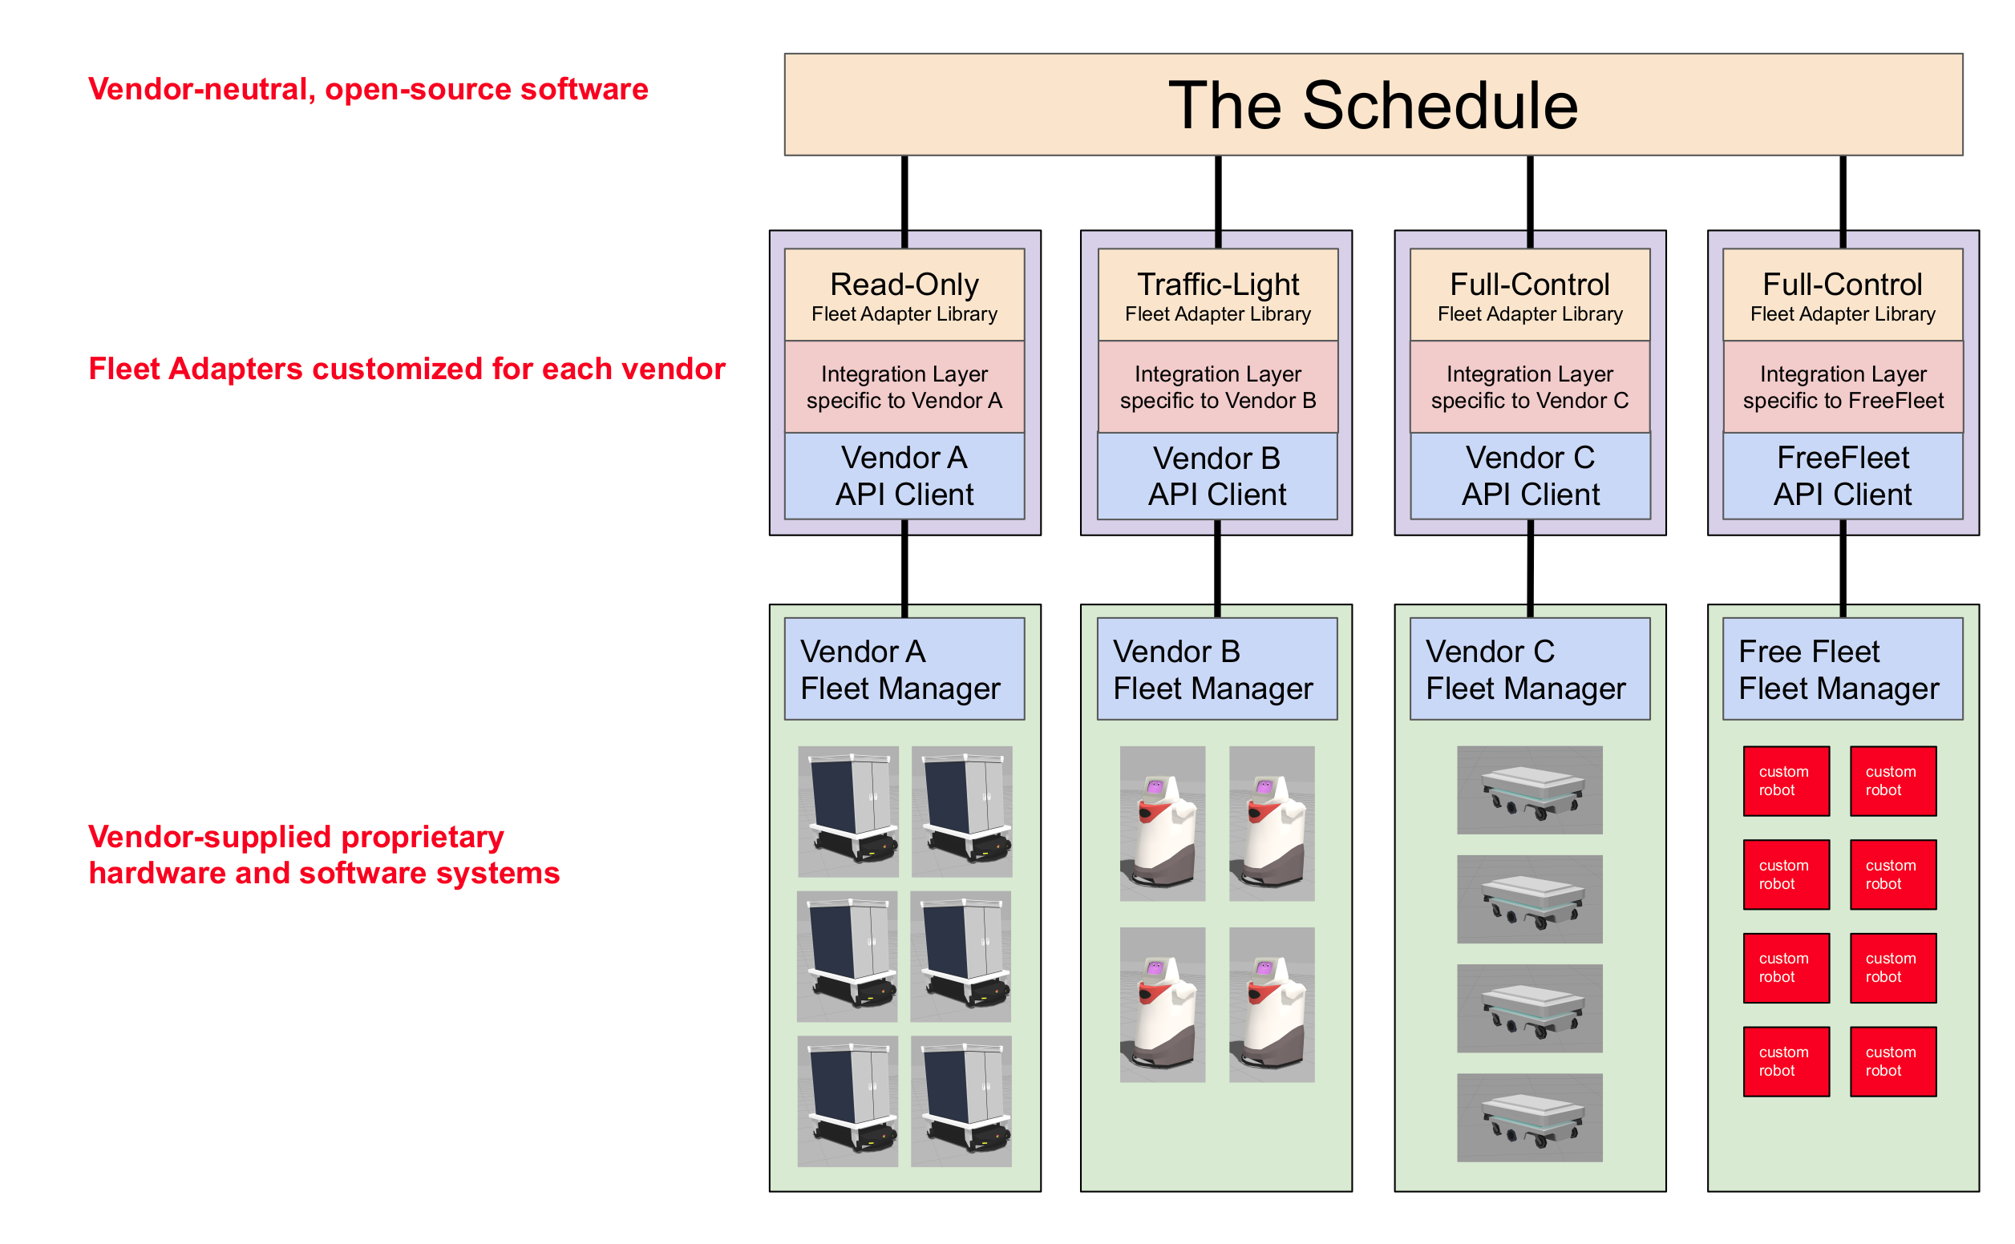

Open-RMF
Build a system manager for the fleet Mini and for the fleet Jobot
rmf_web
rmf_traffic_schedule
rmf_task_dispatcher

Slide 27
Open-RMF - Schedule and Bidding
rmf_traffic_schedule
rmf_task_dispatcher

Slide 28




Open-RMF - Navigation graph
rmf_traffic_editor
NEW!
rmf_site

Slide 29


Free Fleet
a ROS 2 dedicated Fleet adapter based on fleet_adapter_template

Slide 30


Open-RMF results
Patrol task without negotiation
Patrol task with negotation
Mini waiting the Jobot

Slide 31
Conclusion
ROS is an fast and easy solution to build an AMR
  Modularity
  Tools
  Open-Source
Open-RMF give all the tools for fleer management:
  Solve the problems of congestion in problematic environments
  Give an easy template for adding a fleet
  Gives a lot of tools to setup the system

Slide 32
Data and code
Thanks for the attention!
All the data is available at :
  http://dx.doi.org/10.1201/9780429489105
While the code:
  https://gitlab.elettra.eu/open-rmf-tesi/tesi_mag.git

