Slide 1
An Implementation of Open-RMF in an office environment

Slide 2
Objects
Build 2 AMR
  Mini from scrach
  Jobot port existing code from ROS 1 to ROS 2
Port the Dstar global planner
Build an infrastructure to control this robot using Open-RMF
An implementation of Open-RMF in an office environment
Università degli studi di Trieste 2024-2025

Slide 3






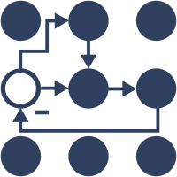


Build 2 AMR
Why ROS?
Why ROS 1 → ROS 2
    EOL

Slide 4
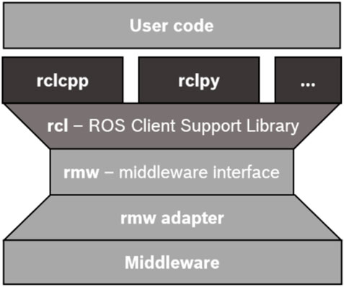
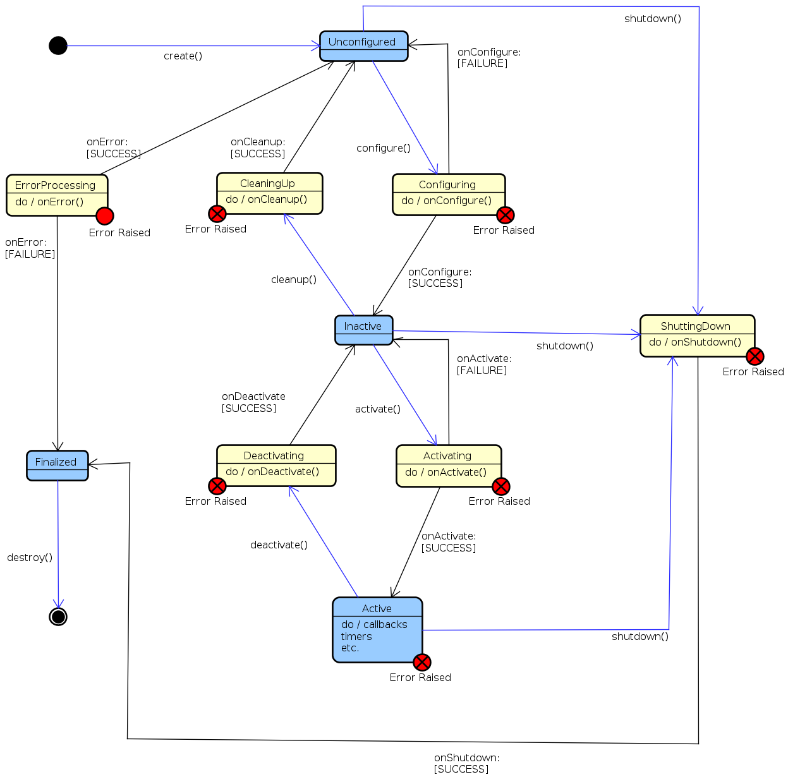
ROS Components
Middleware
  DDS (eProsima Fast DDS, Eclipse Cyclone DDS, … )
  No DDS (Eclipse Zenoh)
Code:
  Multiple client libraries : rclc, rclcpp, rclpy, rclrs, …
  Topics, Service, Action
  Lifecycle
  Composition
Structure
Lifecycle

Slide 5
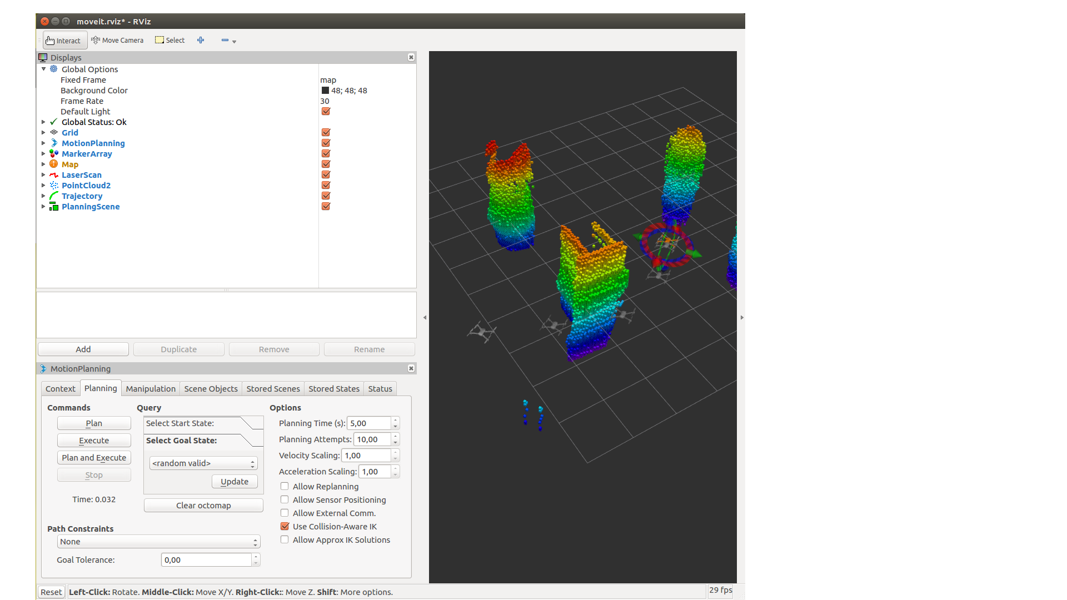
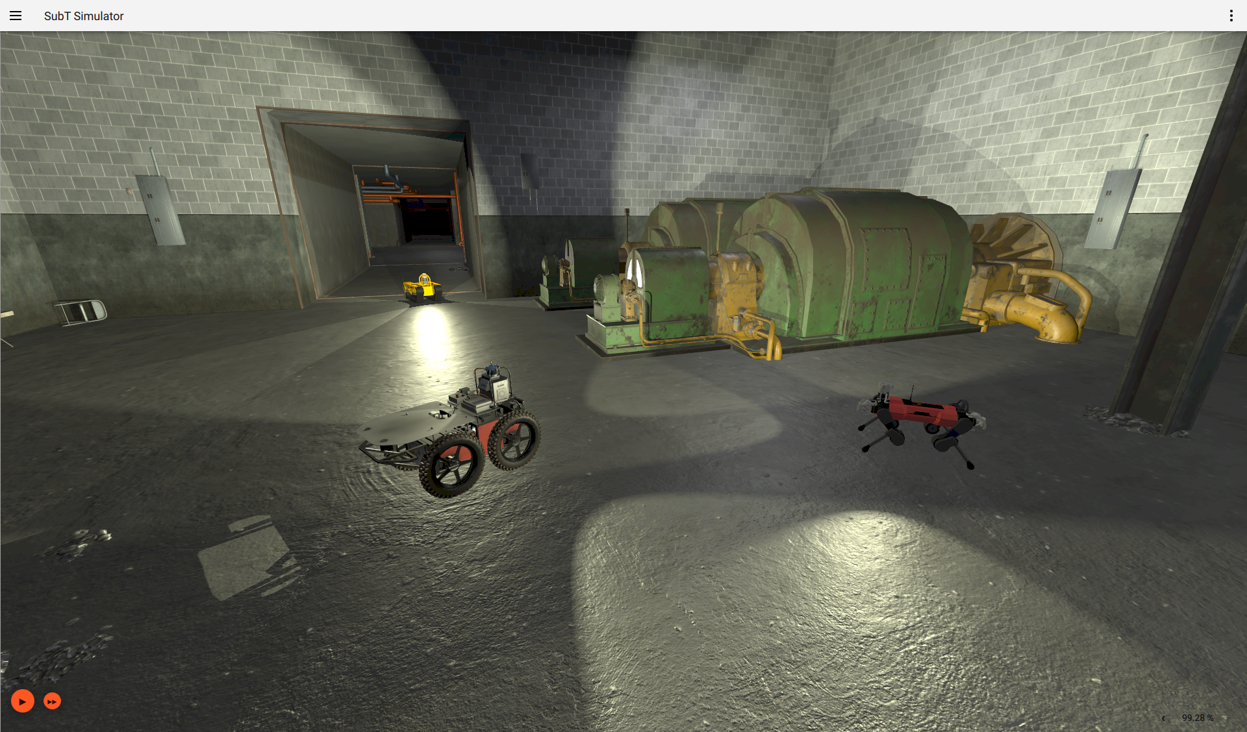
ROS Components
Tools
  Launch file (python, xml, ...)
  Rqt
  Visualization Rviz
External tools
  Gazebo
Rviz
Gazebo

Slide 6
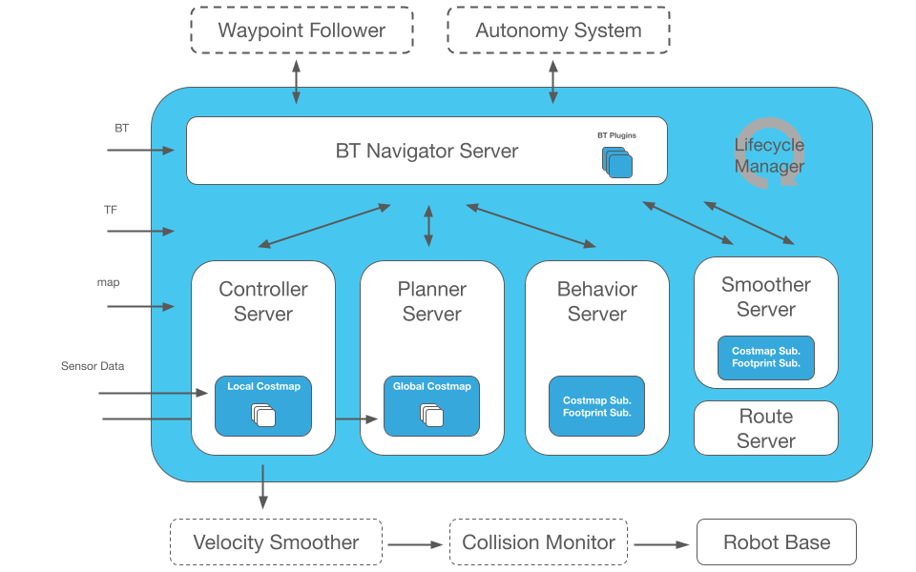
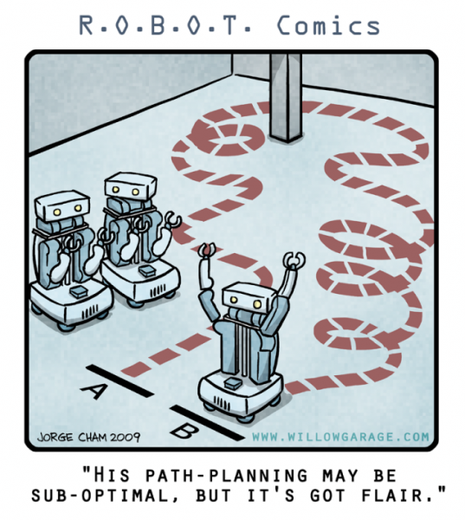
Nav2 - Components
BT Navigation Server
Behaviour Server
Planner Server
Controller Server
Smoother Server
Route Server
Lifecycle manager

Slide 7
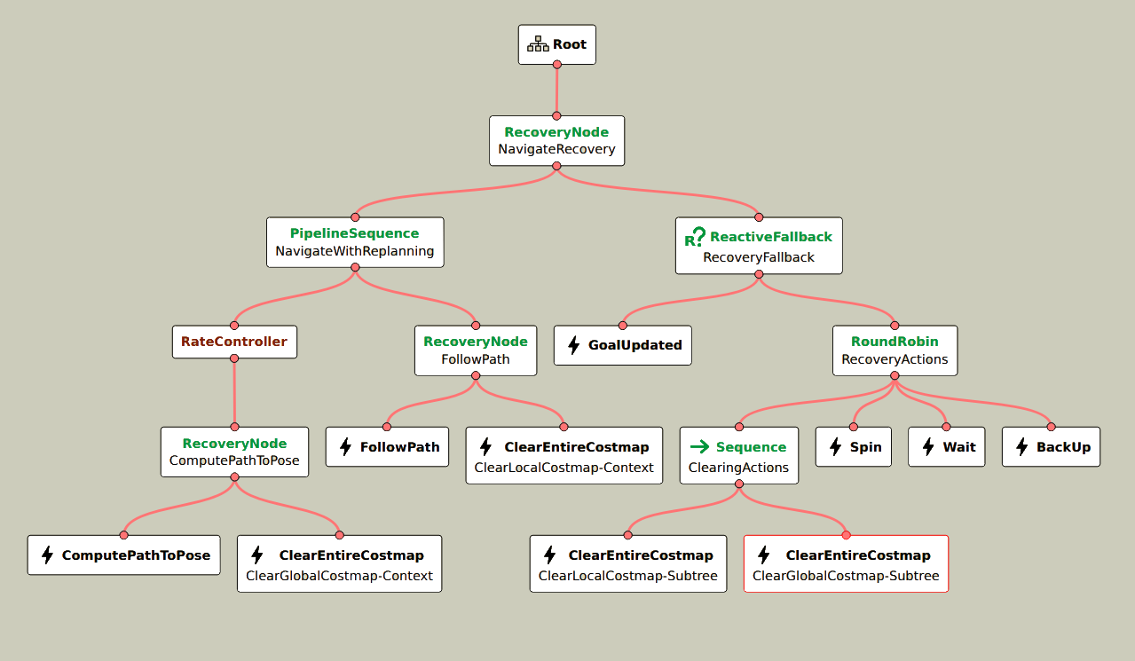
Behavior Tree
Navigate to pose with replanning and recovery in Humble loaded with Groot2

Slide 8
Nav2 Requirements
Need a TF tree based on REP 105
  base_link → odom → map
    base_link → odom ( continuous link)
      Robot_localization
      Fuse
    Odom → map ( can be discrete link )
      SLAM ( Cartographer, … )
      AMCL

Slide 9
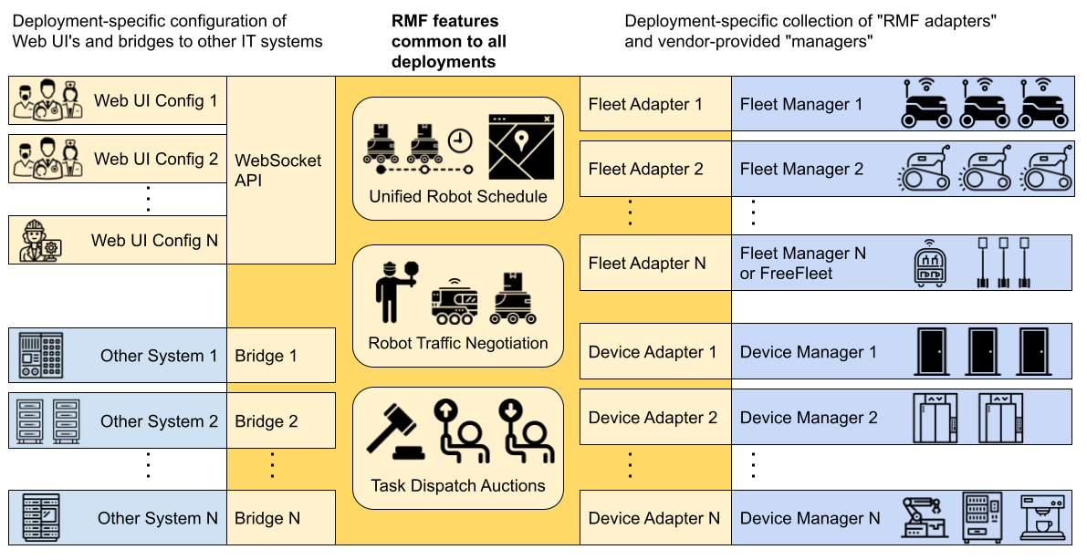
Open-RMF

Slide 10
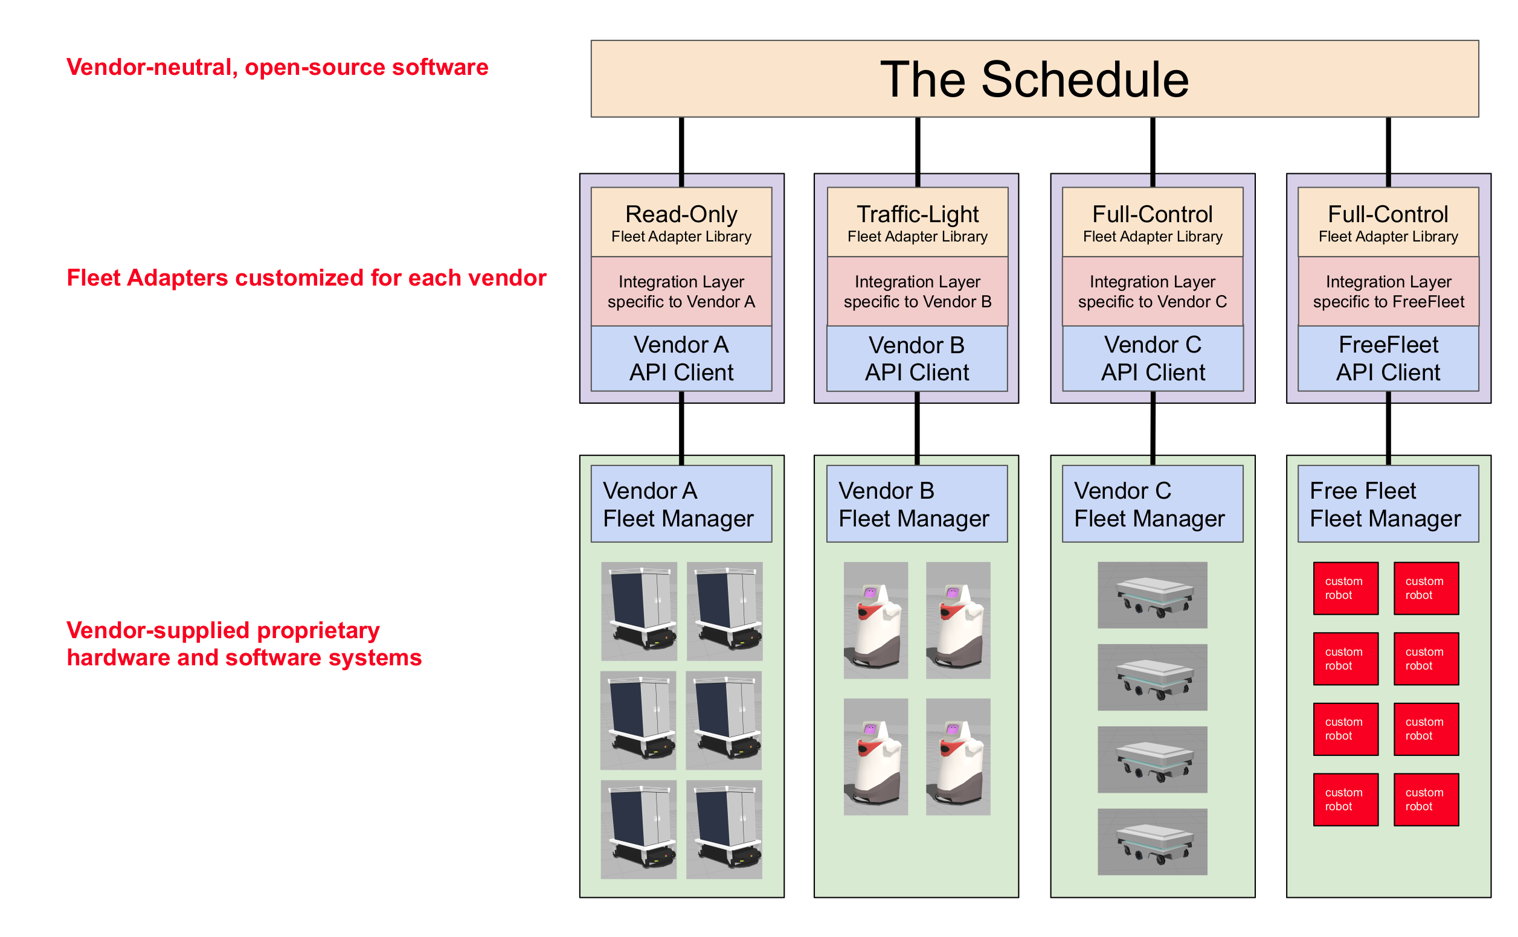
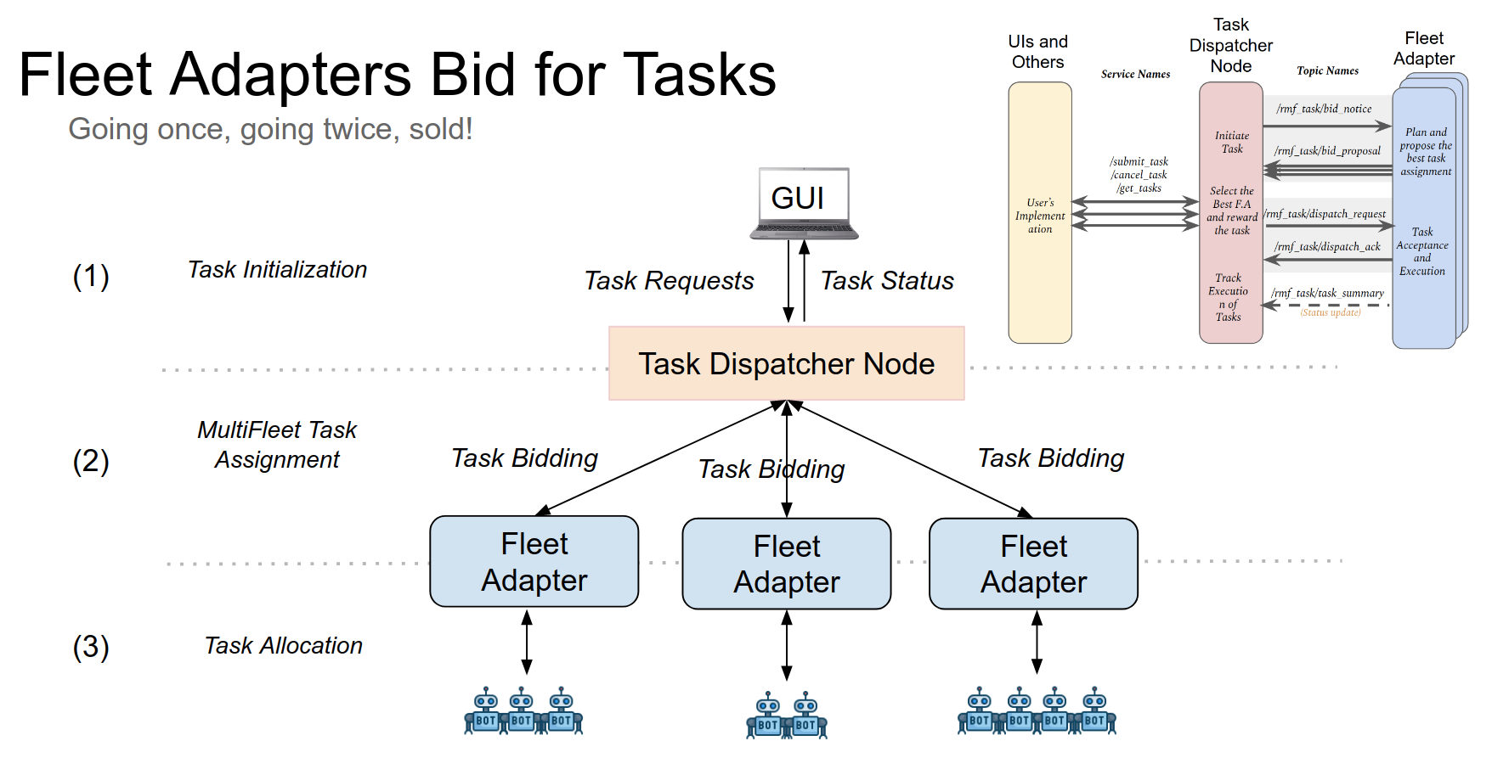
Open-RMF

Slide 11
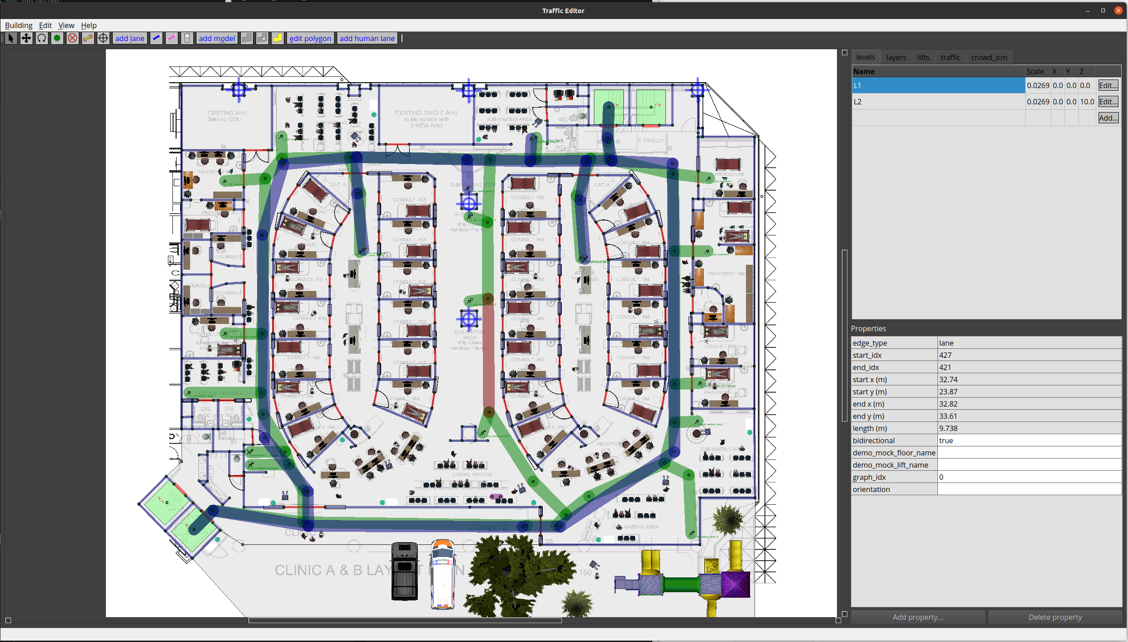
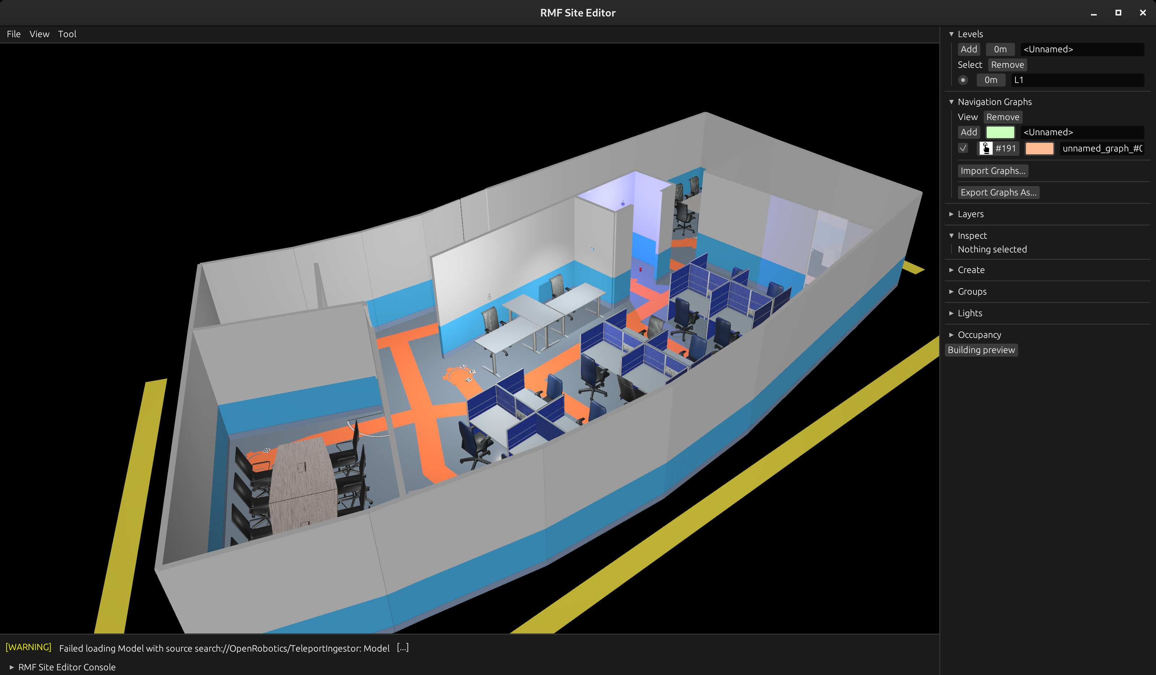
Open-RMF

Slide 12
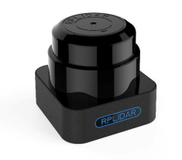
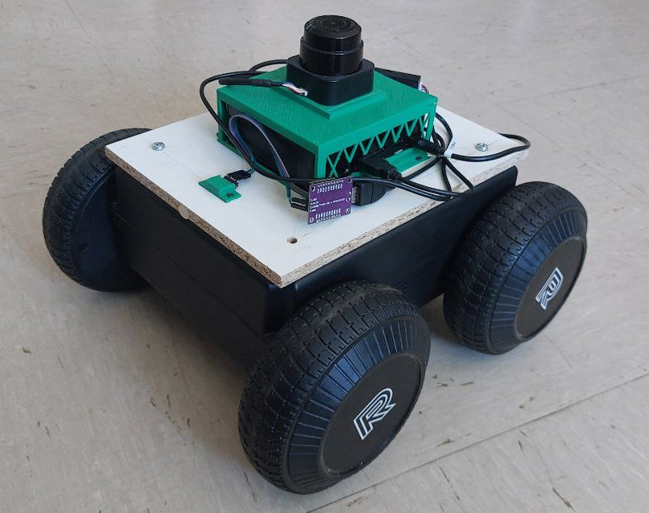
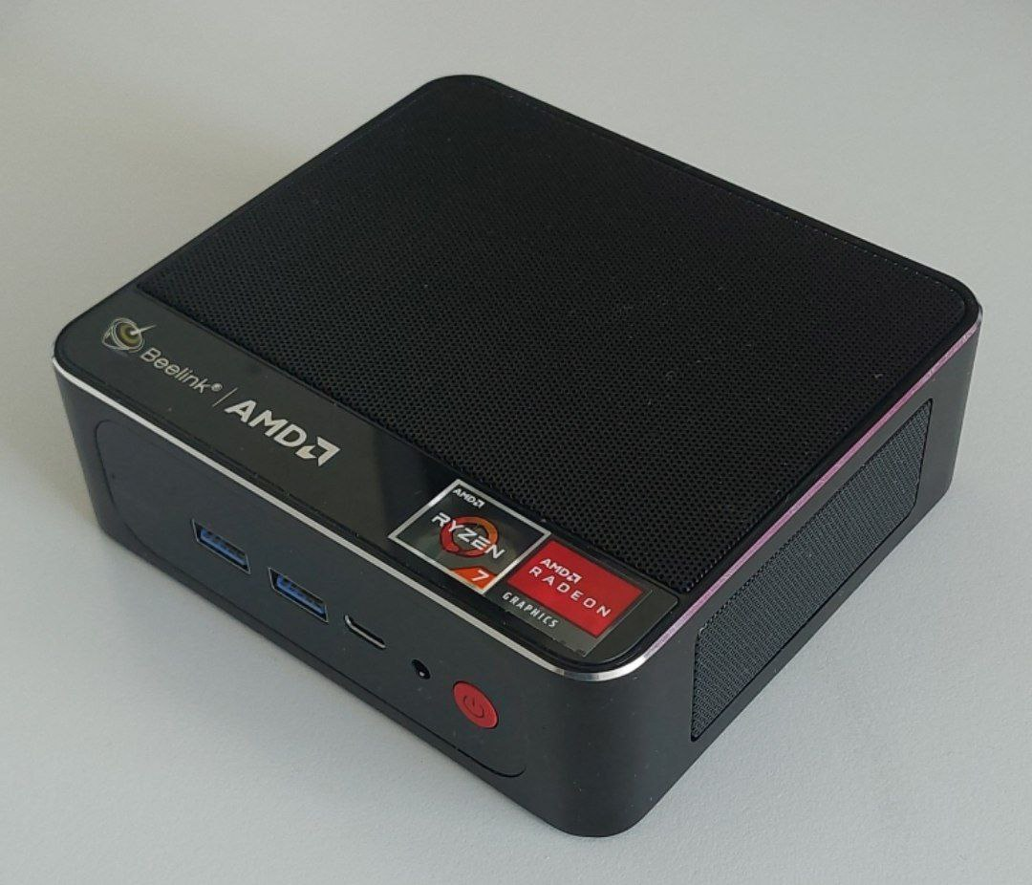
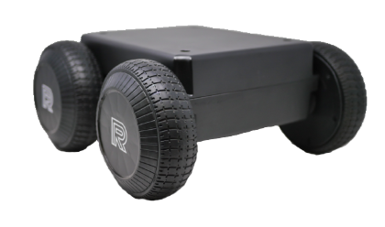
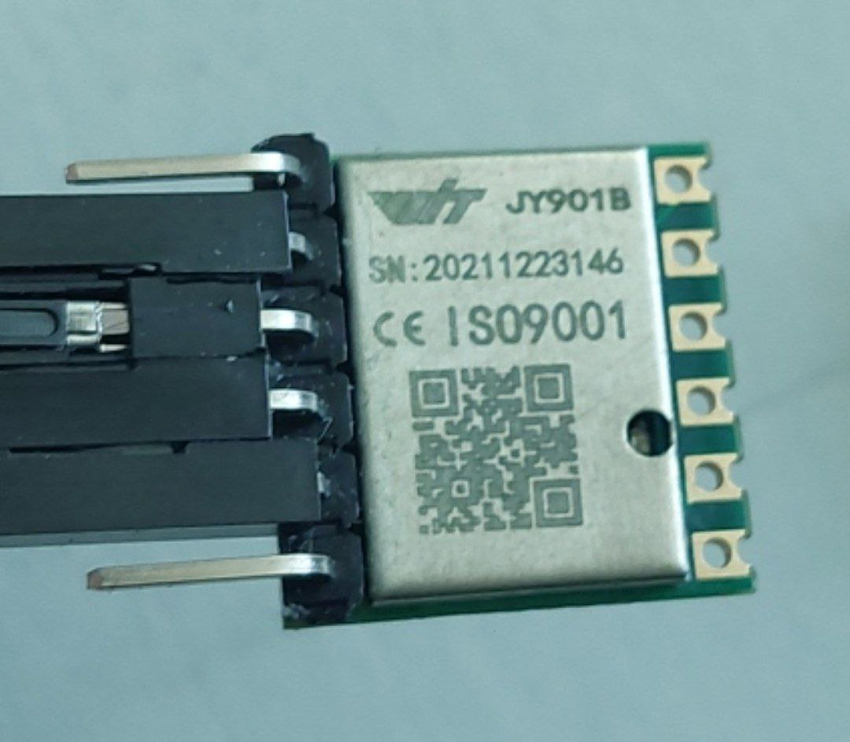
Build Mini AMR from 0.5
Sensors
AMR
PC
Mobile Base
Laser
Scan
IMU
Control movement and give information on movement
Take all the data and control the robot without human interaction
Give information about the world or improve information

Slide 13
Build Mini AMR from 0.5 – Mobile Base
Through CAN communication and ROS node:
  Send movement command to the motors
    ROS : /cmd_vel
  Receive information about encoders:
    ROS : /odometry/wheels

Slide 14
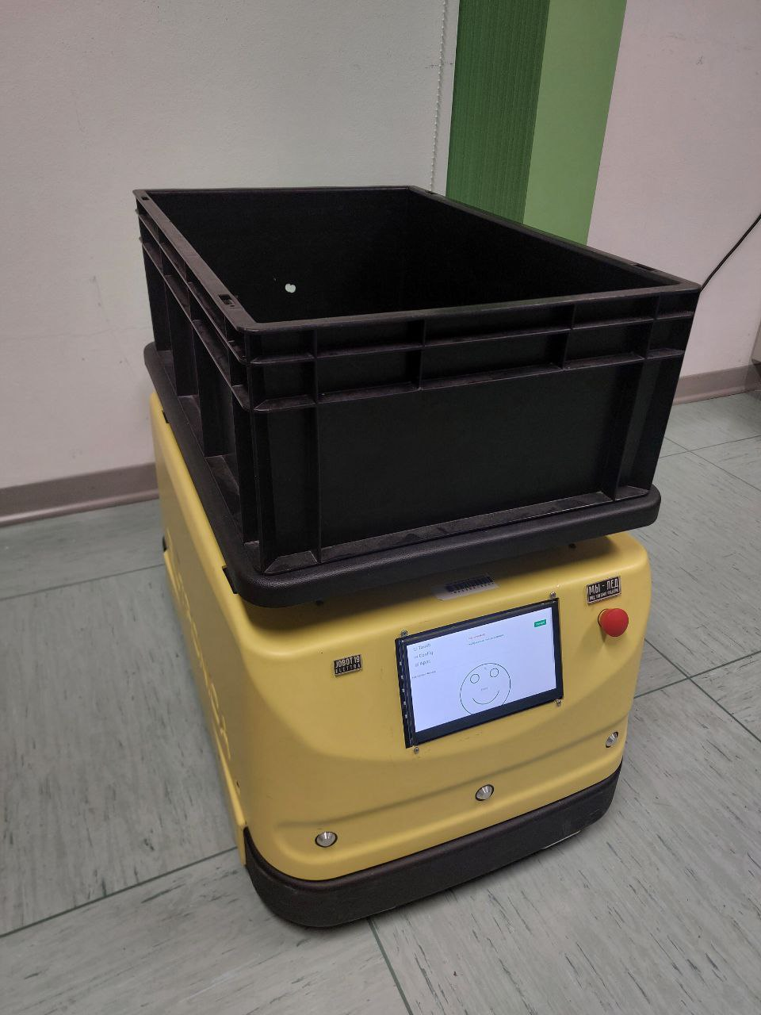
Upgrade Jobot AMR
With serial communication through arduino on PC with ROS1
IMU
Laser

Slide 15
Upgrade Jobot AMR - ROS 1→ ROS 2
ROS msgs update
Find ros-serial for ROS 2
Lifecycle implemented
  In configure() add creation of secondary nodes

Slide 16
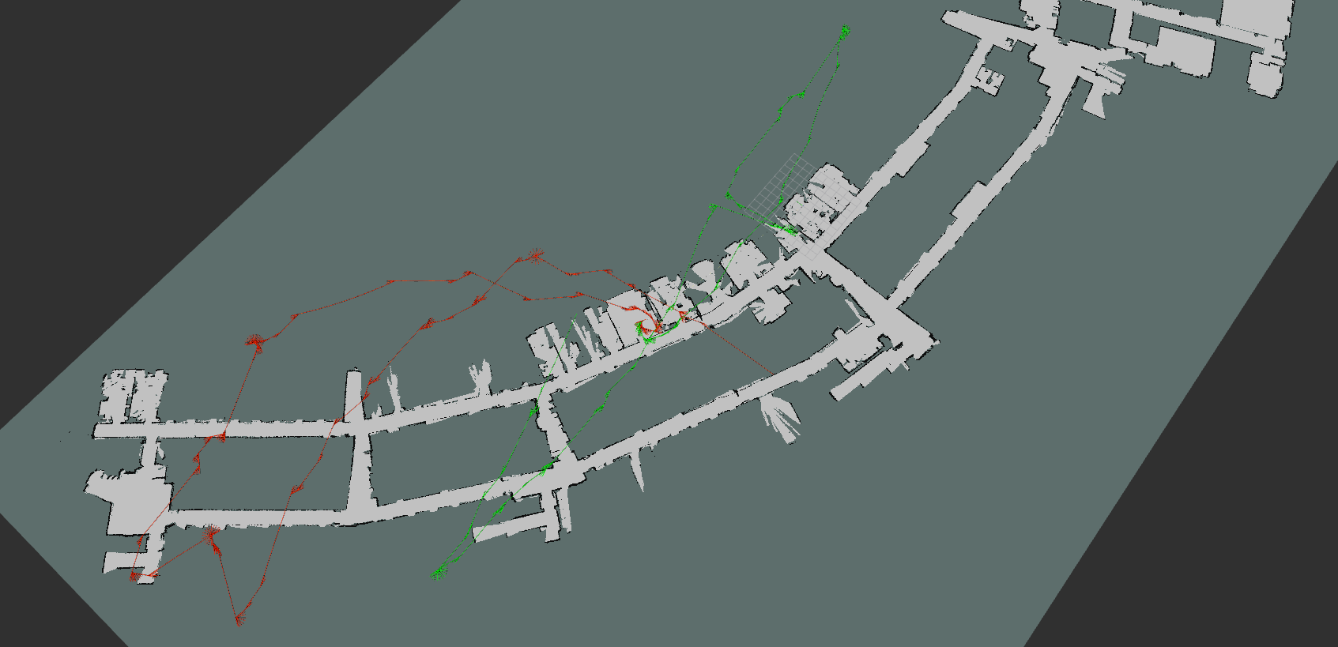
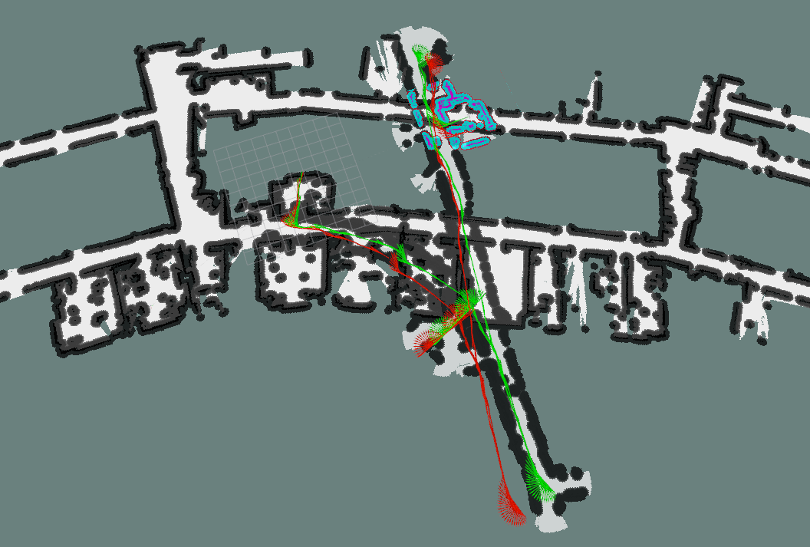
Move Base - Problems
Their returned odometry → need to improve

Slide 17
Good Odometry
Using packages that fuse sensors:
  robot_localization
    fuse IMU data with odometry given by robot

