Slide 1





Amplification curve pre-processing
Cq calculation
Data read-in
Output
Results
Visualization
Melting curve pre-processing
TM calculation
Absolute molecule quantification

Slide 2







A
B
C
SaaS
Desktop
Server
Cloud

Slide 3
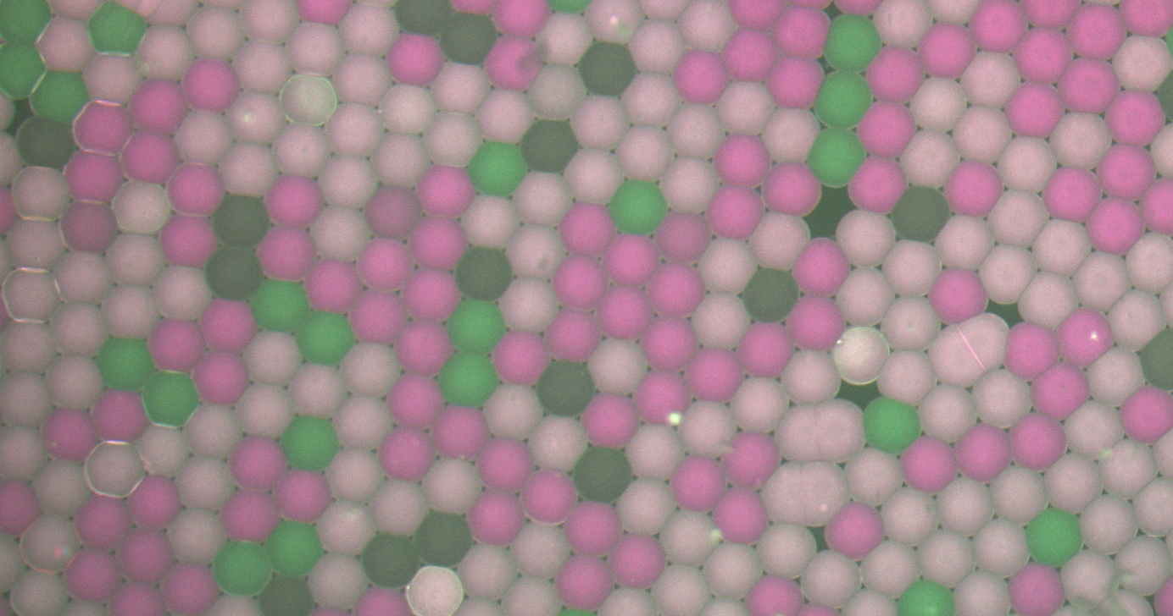
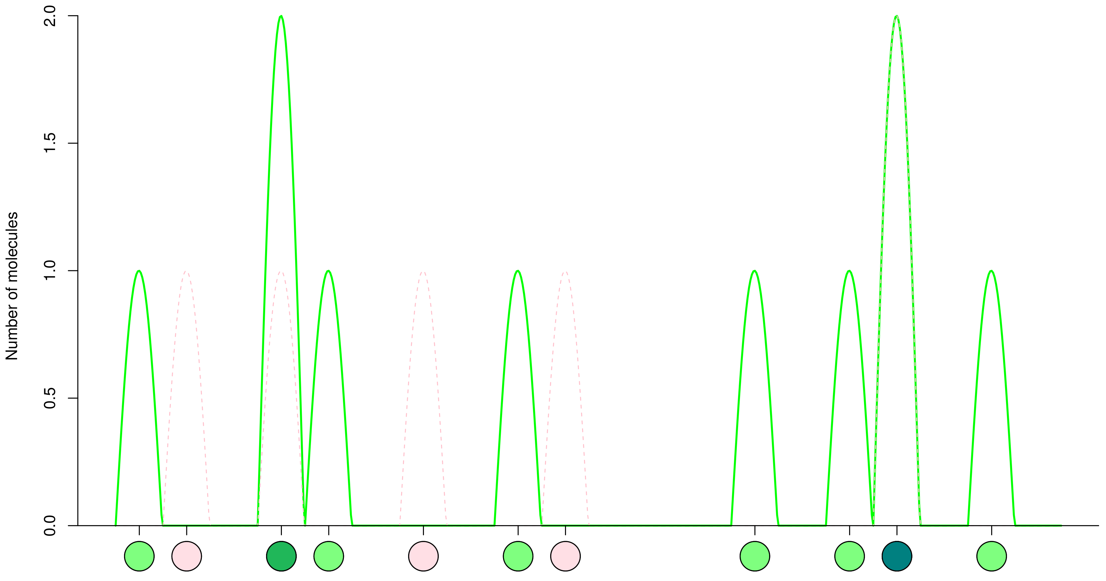
A
Negative droplet
Positive droplet
B
Positive droplet

