Slide 1
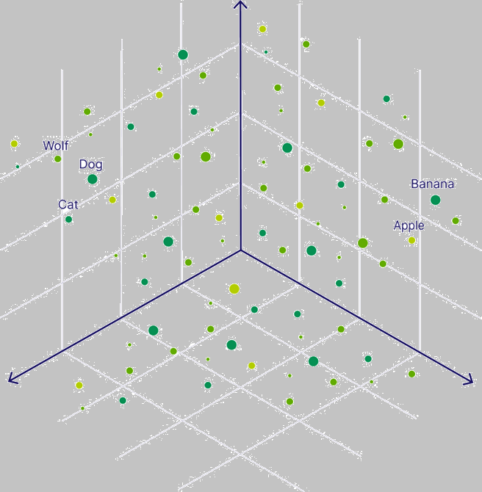
Vector Database Microhack
- Lace Lofranco
- Raihan Alam

Slide 2
Session Breakdown
Introduction to Gen AI & Vector Database
Logistics Check-up
Foundational Concepts
Microhack
Q&A

Slide 3
Introduction to
Gen AI & Vector Database

Slide 4
Gen AI use cases and Vector Databases
LLMs: Al models that can summarize, translate, predict and generate human-sounding text. LLMs are trained on huge sets of datasets.
Problem: Only as capable as the data it was trained with.
Very expensive to retrain LLMs to make them use-case specific.
Solution: Augment LLMs with Search
RAG (Retrieval Augmented Generation)
Example:
LLM + Medical Index = Doctors / Nurses assistant bot
LLM + Index of Company Policies = Company-specific policy bot
Search in RAG is generally powered by Vector Databases

Slide 5

Retrieval Augmented Generation (RAG)
Data sources
Vector Databases!
Search Index
2. Query
3. Info for enhanced context
1. Query
App
4. Query + Enhanced Context
6. Response
5. Response
User
LLM

Slide 6
Foundational Concepts

Slide 7
Foundational Concepts
We shall simplify concepts in the interest of time

Slide 8

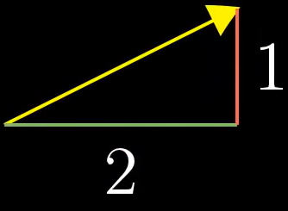


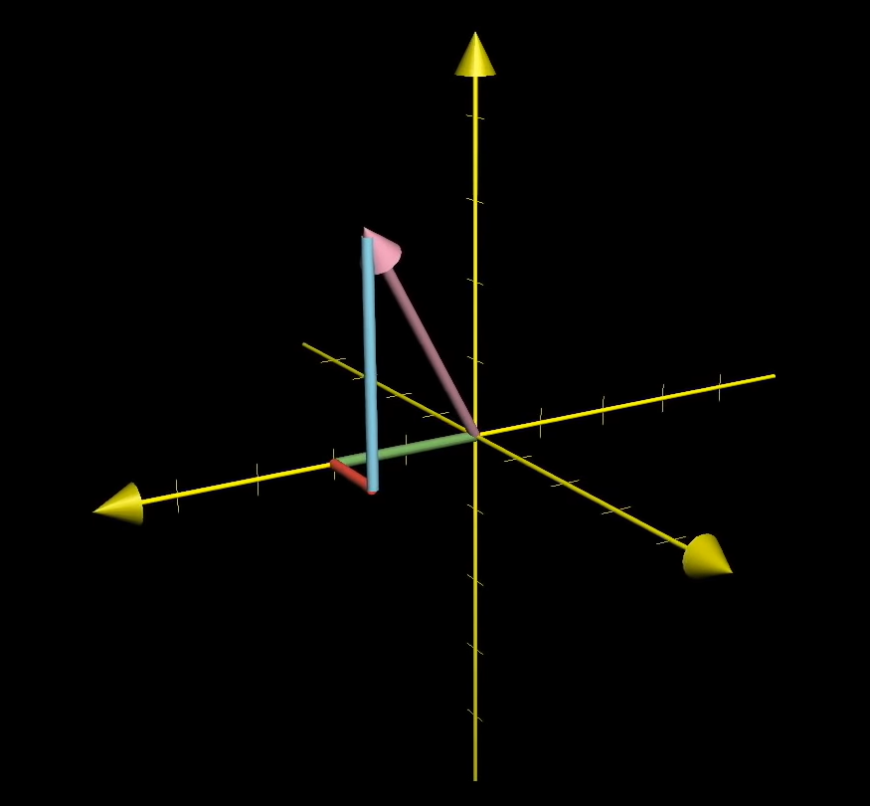
Vector
A vector is a list of numbers.
If a matrix has only one row or only one column it is called a vector.
2 dimensional
3 dimensional
Great link - Vectors | Chapter 1, Essence of linear algebra

Slide 9
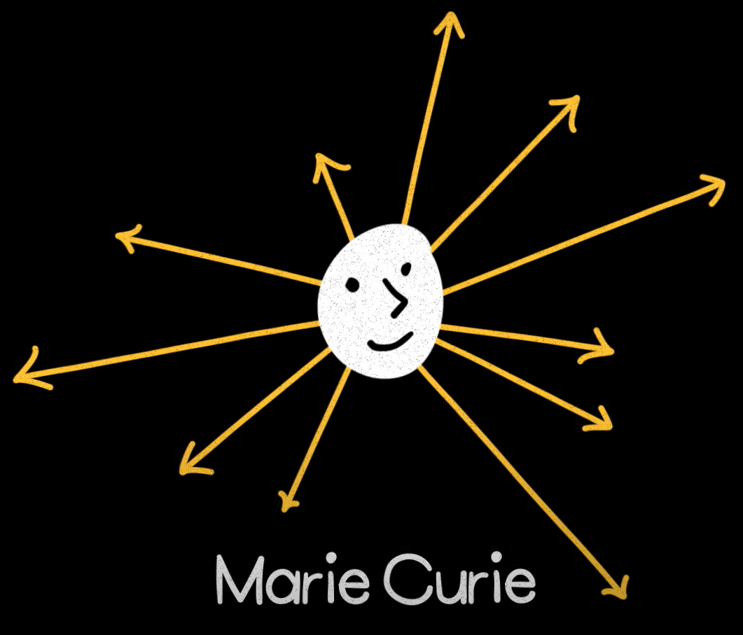
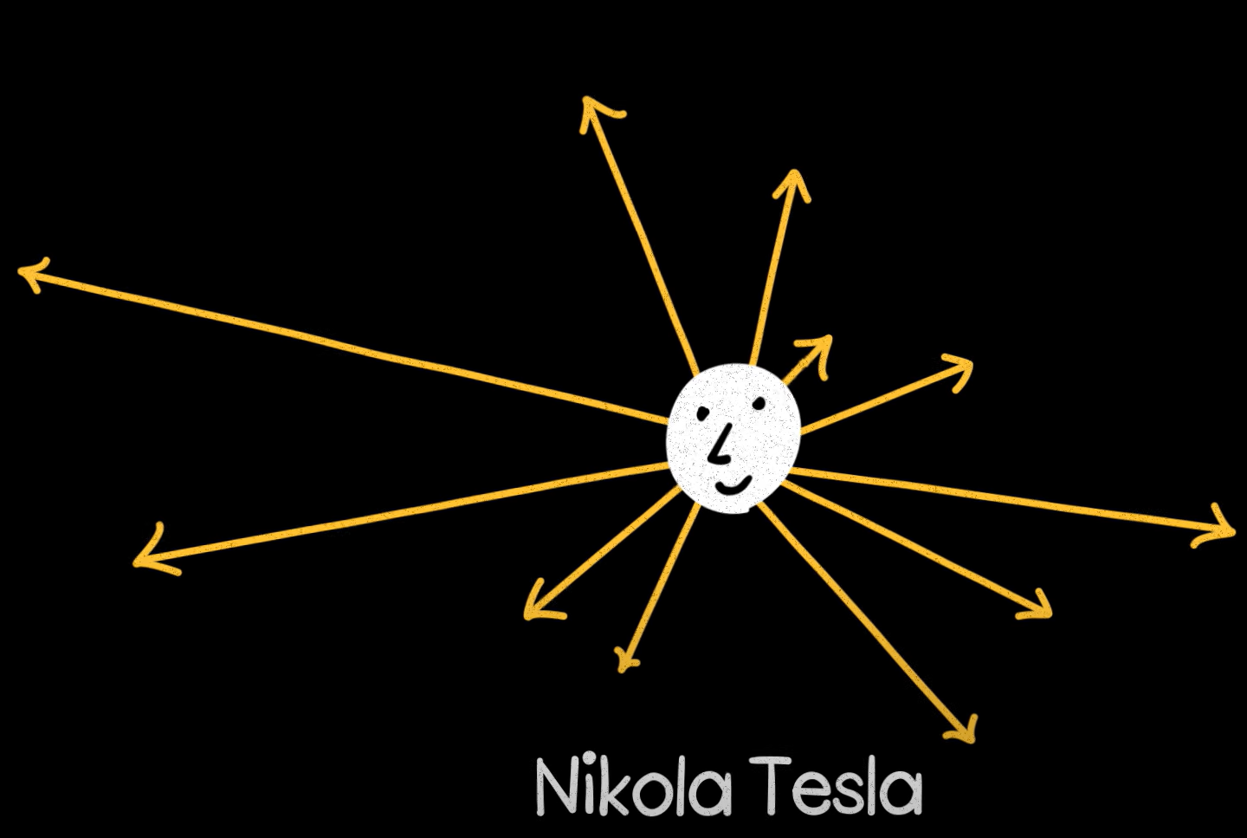
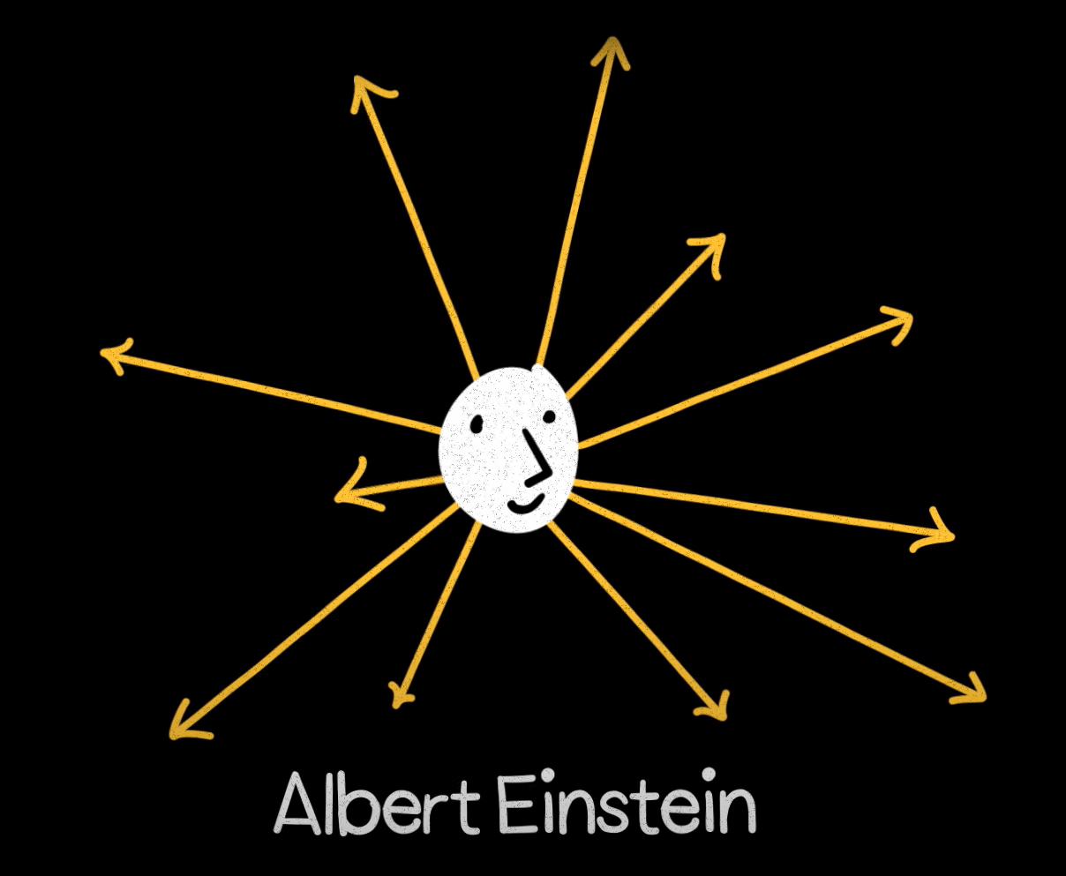
Country
High dimensional vector space
Research area
Geometrically counter-intuitive spaces.
Real world, an object has many possible dimensions.
Birthplace

Slide 10
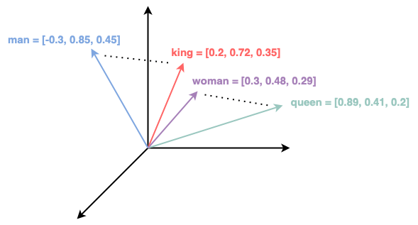
Dimensionality
Higher dimensionality => higher storage and computational resource.
Higher accuracy model (e.g., translation) requires higher dimension compared to models like entity recognition.
Experiment to find the optimal dimension.
Simple 3-dimensional word vectors
Details - Understanding Multi-Dimensionality in Vector Space Modelling

Slide 11
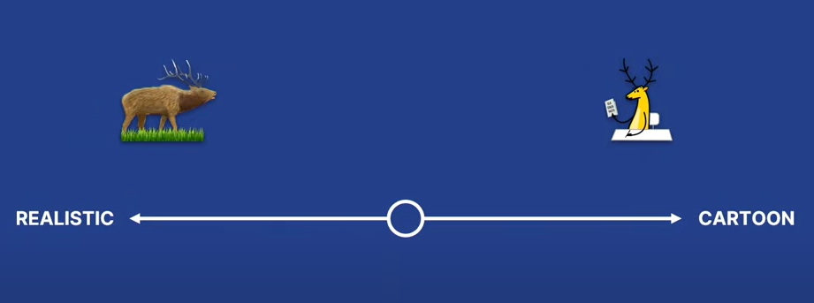
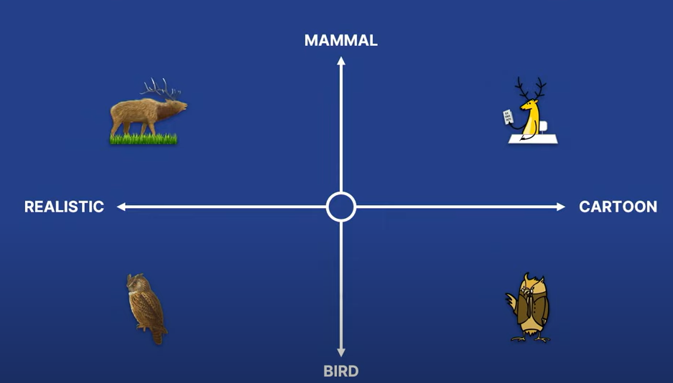
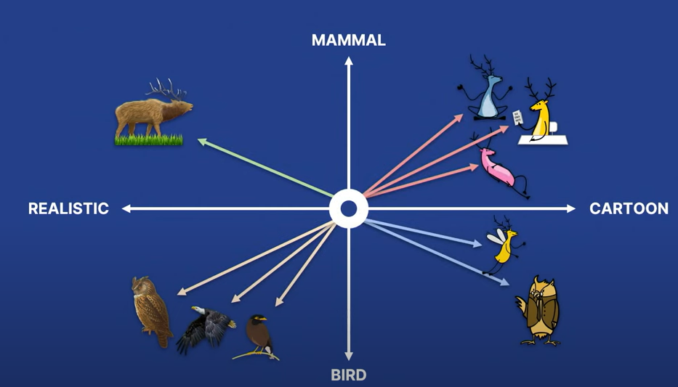
Goal
show me your friends, and I’ll tell who you are.
Similar data is in the similar dimensional space.
Try it - Visualization of high-dimensional data

Slide 12
How Search Works
Data
Generate Embeddings
Indexing
Vector Database
Calculate Similar Vectors
Search Result
Vectors
Search
Search Term
Generate Embeddings
Search Term Vector

Slide 13
Calculating Similar Vectors
Similarity metrics
Similarity Metrics convey how similar or dissimilar two vector embeddings are.
Indexing
indexing organizes the vectors for fast retrieval based on similarity or distance measures.

Slide 14
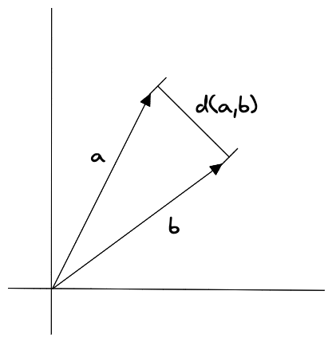
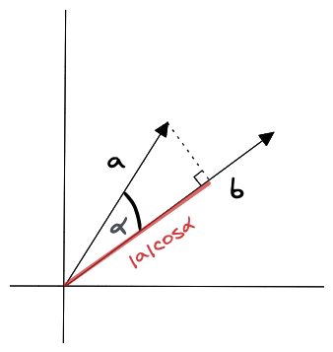
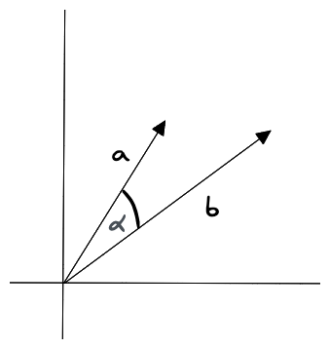
Similarity metrics
Similarity Metrics convey how similar or dissimilar two vector embeddings are.
Similarity Metric | Vector properties considered
Euclidean distance | Magnitudes and direction
Cosine similarity | Only direction
Dot product similarity | Magnitudes and direction
Euclidean distance
Dot product similarity
Cosine similarity

Slide 15
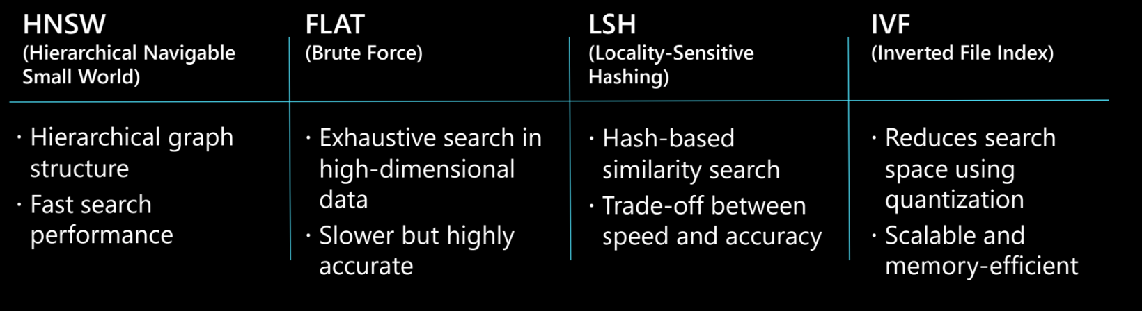
Indexing
KNN
works by calculating the distance between the query vector and all the vectors in the dataset.
ANN
sacrifices accuracy in exchange for executing efficiently in high dimensional spaces

Slide 16
Micorhack
Hands-on session – things may break

Slide 17
Steps
Generate Embeddings
Create Index
Ingest Vectors
Query

Slide 18
Q&A

