Slide 1
Description of the environment uc
Description of the UC: Credit Card (CC) Transaction for a Bank
Non-Functional Requirements (NFR):
NFR-1 The average number of transactions per second (TPS) is 500. 90% of the time the peak is below double of the average. The maximum peak that the system must handle is the double of the 90% peak.
NFR-2 The system must ensure a HA at 99.999%.
NFR-3 In case of a disaster, such as Earthquake or flooding in the Data Center site area, the system functionality must be restored and be able to provide Production and Non-Production capabilities and at least 50% of the Dev and Test Capabilities.
NFR-4 The Development team has available an environment that is half the size of the full Production environment.
NFR-5 Before putting in production any new release of software a complete round of functional test must be completed. The Test environment is the same size of the development environment.
NFR-6 Before putting in production any new release of software a complete round of performance test must be completed stressing the system at TPS peaks.
NFR-7 The Software is written in Java and run on the selected Application Server
NFR-8 The DB used by the system is the selected DB

Slide 2
SIZING
The input provided is that system must support up to 2000 TPS.
In fact, for the first Non-Functional Requirement (NFR-1), it has been considered the maximum possible peak manageable by the system. In particular, this has been derived from the notion that the 90% of the time the peak is below double of the average (chosen equal to 500 TPS), therefore below 1000 TPS, and that the maximum peak is equal to the double of the 90% peak.
This choice has been done, also, in order to satisfy the NFR-6. In fact, in this way it is possible to analize the system by stressing it at TPS peaks.
- The other input is that a x86 core is able to process 20 TPS
- A LinuxONE core is able to perform 10xTPS, therefore 200 TSP
For what concerns the second Non-Functional Requirement (NFR-2), the required HA percentage has been reached by increasing the max server faults value, from the minimum necessary for the workload to 3, in order to consequently increase the number of servers. This considaration has been made only for the x86 platform, beacause considered unnecessary for LinuxONE, thanks to its inner availability features.
For the other requirements, up to the sixth one, they have been satisfied by modifying the environments percentages, in such a way to obtain the desired configurations, either for the x86 and for the LinuxONE platforms.

Slide 3


Technical architecture for the two cases
Site 1
Site 2
Imputs:
Workload =
2000 TPS
(Maximum Peak)
Case 1:
X86 Server
Rack server w
Xeon Gold 5115 10C
2.40GHz
(2 Chips, 20 Cores)
34 servers 680 cores
Prod PreProd Dev
8 servers 5 servers 4 servers
160 cores 100 cores 80 cores
Test DR
4 servers 13 servers
80 cores 260 cores
Site 1
Site 2
Case 2:
LinuxONE Server
2 servers
50 cores (IFL)
and 20 spares (CBU)
1 LinuxONE with:
Prod Dev Spare
10 cores 5 cores 10 cores
1 LinuxONE with:
PreProd Test Spare
10 cores 5 cores 10 cores

Slide 4
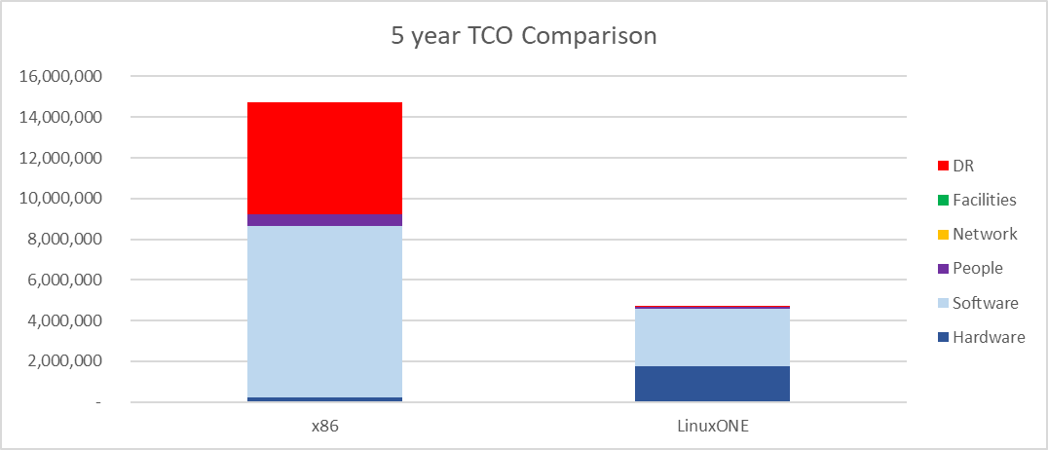
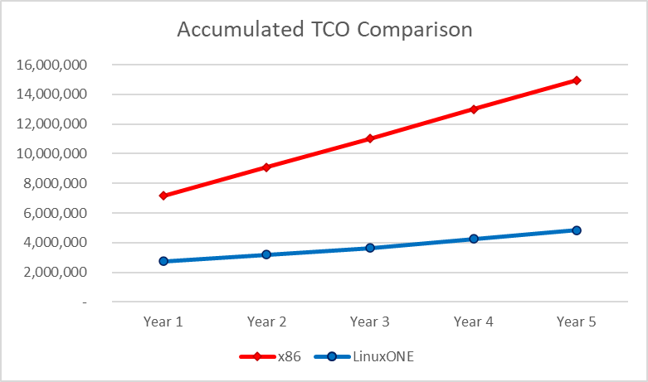
TCO COMPARISON ON 5 YEARS
Above schemas summarize the TCO for the different environments on 5 years, for each cost component
- The savings with the LinuxONE platform is 68% vs the x86 equivalent platform
Below diagrams highlights the component contribution to total cost and cost per year that make the accumulated TCO
Differences in the impacting costs for the two platforms in 5 years:
x86 Platform
Relevant costs:
Software
Disaster recovery
Irrelevant costs:
Hardware
People
Network
Facilities
LinuxONE Platform
Relevant costs:
Software
Hardware
Irrelevant costs:
Disaster recovery
People
Network
Facilities
LinuxONE scales more, with respect to costs, with increasing TPS;
X86 platform has lower costs only for small workloads;

Slide 5
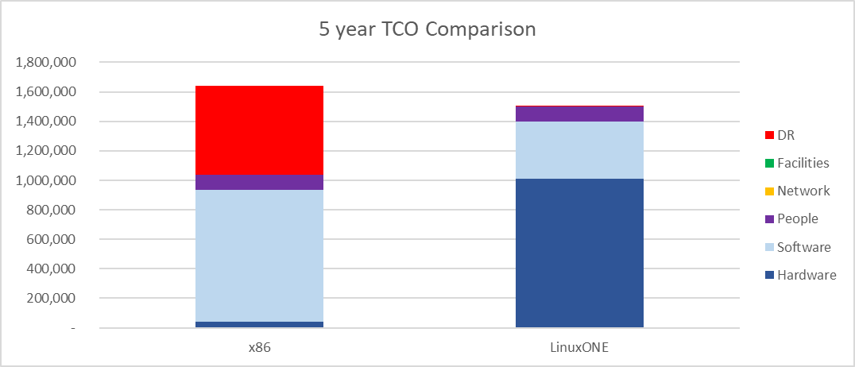
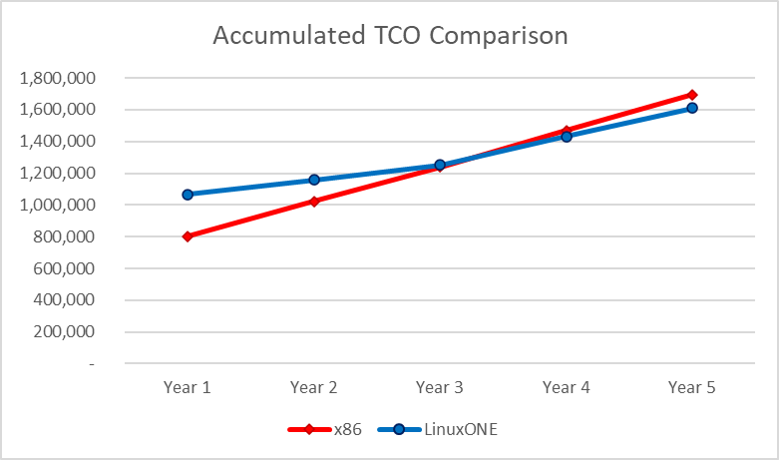
Similar costs tPS configuration
Above choice of TPS is the one for which the system presents the most similar costs
Below diagrams show this result in the TCO Comparison
In particular, 5 years TCO values are:
1696216 € for x86
1609011 € for LinuxONE

Slide 6
X86 tco assumptions
Hardware
- Rack server w Xeon Gold 5115 10C 2.40GHz (2 Chips, 20 Cores)
- Acquisition cost: 10K€ -30% discountincluding 3 years Support
- Support for following years is 20% of purchase price
Network
- 7000€ per Server -30% discMaint@ 10% of PP from y2
People
- One FTE covers 30 servers
- Average yearly fully loaded costs=100K€
Space
- Fully loaded cost of Sq. meter=2.600€
Electricity
- Cost per kWh=0,10€
Software
- OS: subscription 2000€/year -20% disc per socket
- VM: license @5000€/socket -20% disc maint@ 20% of purchase price from y2
- Application Server: IBM WebSphere license + software subscription & support 12 Months – @55.25€/PVU -75% disc (70 PVU per core)
- DB: Informix Advanced Enterprise license @36.978,00€ for 2 cores -75% disc
maint @9.245,00 €
- Data Replication Tools: subscription
3000€/year -75% disc per core
- Monitoring Tools: license @5.000€/server
-40% disc. Maint @ 20% of PP from y2
- Security Tools: license @5.000€/server
-40% disc. Maint @ 20% of from y2

Slide 7
LinuxONE tco assumptions
Hardware
- LinuxONE servers @ 725K€ for 3 years 30% disc
- Maint @ 10% PP from y4
Network
- 14000€ per Server -30% disc
- Maint@ 10% of PP from y2
People
- One FTE covers 10 servers
- Average yearly fully loaded costs=120K€
Space
- Fully loaded cost of Sq. meter=2.800€
Electricity
- Cost per kWh=0,10€
Software
- OS: subscription 6000€/year -20% disc per socket
- VM: included in HW
- Application Server: IBM WebSphere license + software subscription & support 12 Months – @55.25€/PVU -50% disc (120 PVU per core)
- DB: Informix Advanced Enterprise license @36.978,00€ per cores -50% disc
maint @9.245,00 €
- Data Replication Tools: subscription
3000€/year -50% disc per core
- Monitoring Tools: license @5.000€/server
-40% disc. Maint @ 20% of PP from y2
- Security Tools: license @5.000€/server
-40% disc. Maint @ 20% of from y2

Slide 8
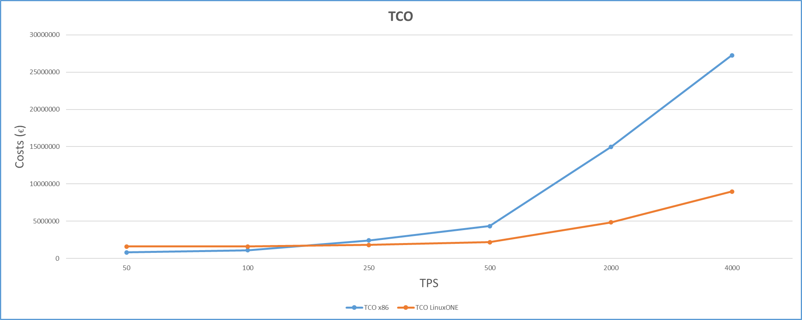
Considerations on the convenience
As it’s shown from the table and the diagram beside, LinuxONE behaves better, in terms of costs, with respect to x86, for workloads higher then 200 TPS.
This means that, apart from the case of small workloads, in which it could be preferable to use an x86 platform, in the other situations there are great benefits in the usage of LinuxONE.

