Slide 1
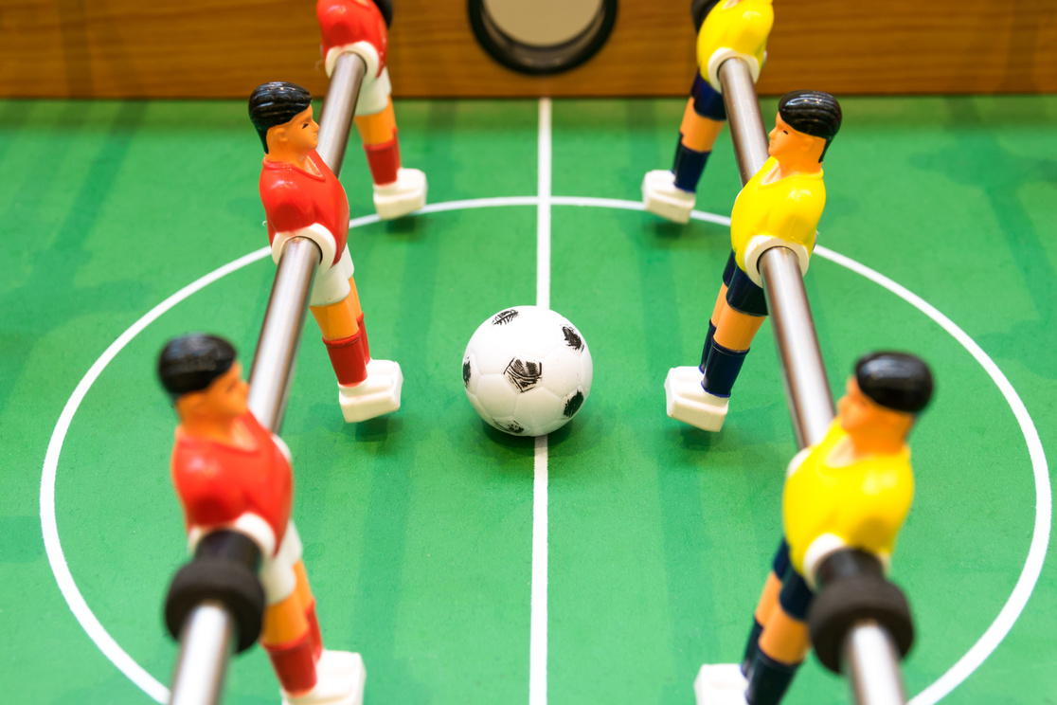
Statistics in play:
kick things off!

Slide 2

Today's plan
Short theoretical introduction
Table football practical activity

Slide 3
Pre-laboratory questionnaire
Insert the survey QR code

Slide 4
Probability
Consider tossing a fair coin.
The probability of getting HEADS is ...

Slide 5
Probability
Consider tossing a fair coin.
The probability of getting HEADS is ...
p(HEADS)=1/2=0.5

Slide 6
Probability
Consider tossing a fair coin.
The probability of getting HEADS is ...
p(HEADS)=1/2=0.5

Slide 7
Probability
Consider tossing a fair coin.
The probability of getting HEADS is ...
Probability as the ratio between
favorable outcomes and possible outcomes
p(HEADS)=1/2=0.5

Slide 8
Probability
Consider rolling a fair DIE.
The probability of rolling a 4 is ...

Slide 9
Probability
Consider rolling a fair DIE.
The probability of rolling a 4 is ...
p(4)=1/6

Slide 10
Probability
Consider rolling a fair DIE.
The probability of rolling a 4 is ...
Probability as the ratio between
favorable outcomes and possible outcomes
p(4)=1/6

Slide 11
Conditional probability
The die roll resulted in an EVEN number.
Given this information, the probability that the outcome is 4 is ...

Slide 12
Conditional probability
The die roll resulted in an EVEN number.
Given this information, the probability that the outcome is 4 is ...
p(4 | EVEN)=1/3

Slide 13
How many people live in Bergamo?
The website https://demo.istat.it/ provides the resident population of the XXX municipality on 01/01/2026 (by gender and age).
How many do you think there are?
< 100,000 people
100,000 - 200,000 people
> 200,000 people

Slide 14
How many people live in Bergamo?
The website https://demo.istat.it/ provides the resident population of the XXX municipality on 01/01/2024 (by gender and age).
How many do you think there are?
< 100,000 people
100,000 - 200,000 people
120'629
> 200,000 people

Slide 15
Joint frequency distribution
Age groups
 | 0-14 | 15-64 | 65+ | Total
M | 6'855 | 37'881 | 12'900 | 57'636
F | 6'480 | 38'475 | 18'038 | 62'993
Total | 13'335 | 76'356 | 30'938 | 120'629
Gender

Slide 16
Frequency distribution and probability
Age groups
 | 0-14 | 15-64 | 65+ | Total
M | 6'855 | 37'881 | 12'900 | 57'636
F | 6'480 | 38'475 | 18'038 | 62'993
Total | 13'335 | 76'356 | 30'938 | 120'629
Gender
What is the probability that a randomly selected resident is female?

Slide 17
Frequency distribution and probability
Age groups
 | 0-14 | 15-64 | 65+ | Total
M | 6'855 | 37'881 | 12'900 | 57'636
F | 6'480 | 38'475 | 18'038 | 62'993
Total | 13'335 | 76'356 | 30'938 | 120'629
Gender
What is the probability that a randomly selected resident of Bergamo is female?
p(F)=62'993/120'629=0.522

Slide 18
Frequency distribution and probability
Age groups
 | 0-14 | 15-64 | 65+ | Total
M | 6'855 | 37'881 | 12'900 | 57'636
F | 6'480 | 38'475 | 18'038 | 62'993
Total | 13'335 | 76'356 | 30'938 | 120'629
Gender
What is the probability that a randomly selected resident is female?
p(F)=62'993/120'629=0.522
Probability as a proportion

Slide 19
Frequency distribution and probability
Age groups
 | 0-14 | 15-64 | 65+ | Total
M | 6'855 | 37'881 | 12'900 | 57'636
F | 6'480 | 38'475 | 18'038 | 62'993
Total | 13'335 | 76'356 | 30'938 | 120'629
Gender
Given that the selected person is female, what is the probability that she belongs to the 15-64 age group?

Slide 20
Frequency distribution and probability
Age groups
 | 0-14 | 15-64 | 65+ | Total
M | 6'855 | 37'881 | 12'900 | 57'636
F | 6'480 | 38'475 | 18'038 | 62'993
Total | 13'335 | 76'356 | 30'938 | 120'629
Gender
Given that the selected person is female, what is the probability that she belongs to the 15-64 age group?
p(15-64 | F) = 38'475/ 62'993 = 0.61

Slide 21
Statistics!
Data
1 Target variable
Many explanatory variables
2. Statistical model that learns (training)
3. Output of the trained model
Prediction (conditional probability)

Slide 22
Other classification problems
Spam email vs legitimate email
Fraudulent vs legitimate credit-card transaction
Company in default vs financially healthy company
Satisfied vs dissatisfied customer
TV series liked vs not liked
...
Statistical
Machine Learning
Models
ALGORITHMS

Slide 23
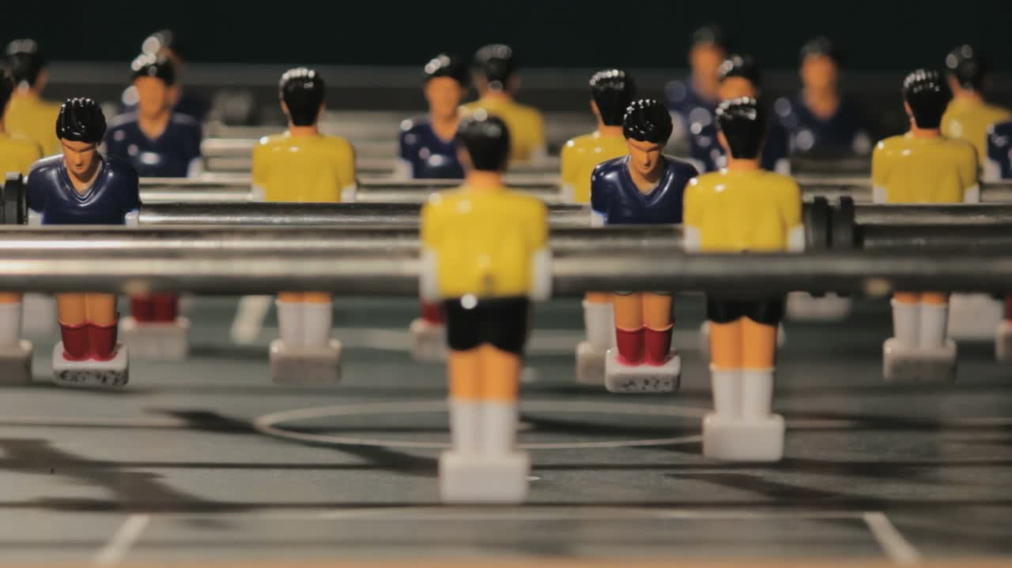
Time to play!

Slide 24
Target variable: match won/lost
characteristics of the two teams
Data
2. Statistical model (training)
3. Output of the trained model
Conditional probability of winning the match based on the characteristics of your team and the opposing team

Slide 25
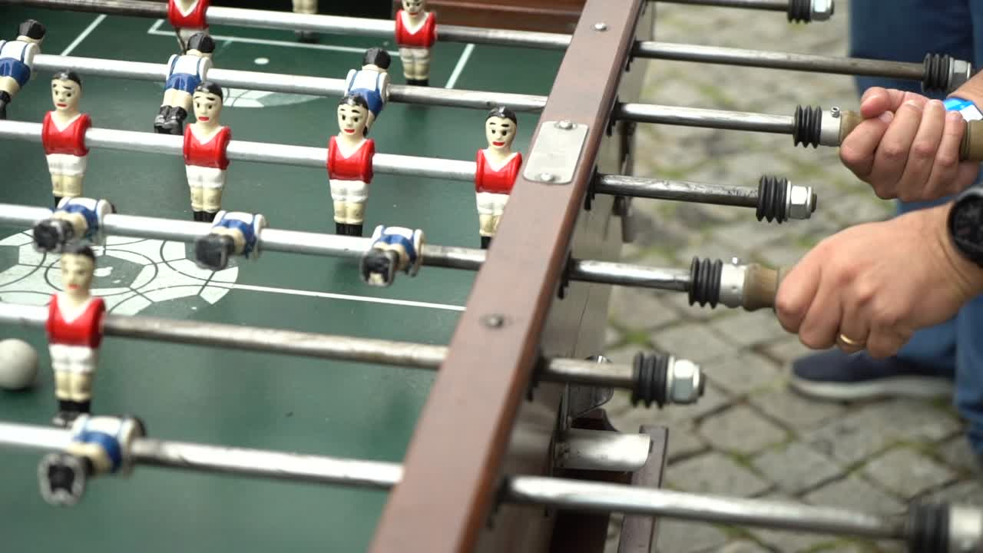
Choose your team!
We will ask you for:
team name
number of women on the team
age
self-assessed skill (0 to 10)
frequency of play during the year
whether you are playing in your preferred role (yes/no)
+ we will record which team scores first
Our model will estimate your probability of winning the match
(first to 3 goals)

Slide 26
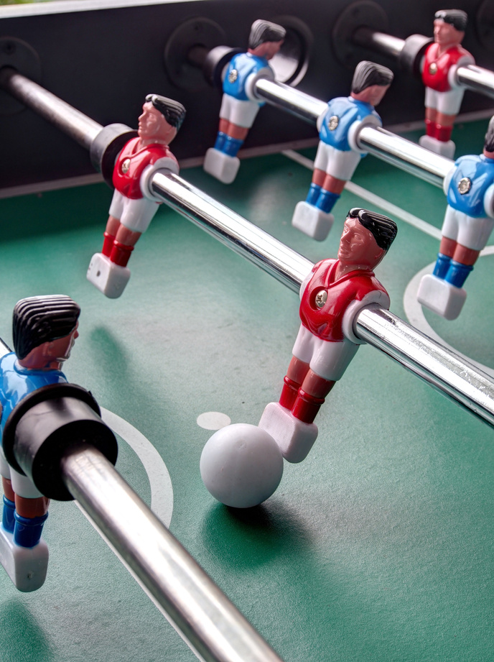
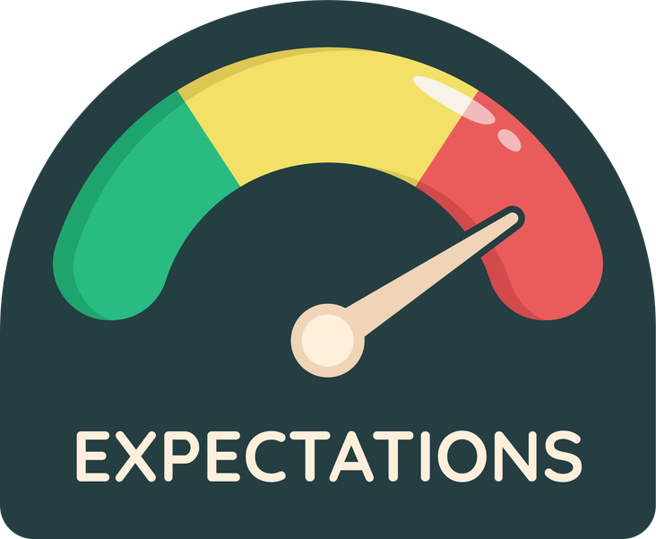
For each match...
Observed outcome
Win or loss for Team A
Conditional probability that Team A wins the match
The difference (Delta) between
the observed outcome and
the probability estimated by the model
provides a measure of
“performance relative to expectations”.

Slide 27
Play-off bracket
1
2
8
7
4
3
5
6
The team with the higher Delta advances

Slide 28
Post-laboratory questionnaire
Insert the survey QR code

