Slide 1

LATERAL VEHICLE TRAJECTORY OPTIMIZATION USING CONSTRAINED LINEAR TIME-VARYING MPC
Student:
Michelangelo Pozza
Teacher:
Prof. Davide Martino
Raimondo
ID:
IN2300012

Slide 2
INTRODUCTION
In recent years, autonomous driving has advanced rapidly
Research in this field focuses on trajectory generation algorithms that can cope with complex traffic scenarios
The goal is to optimize the lateral vehicle distance from a reference curve in order to avoid obstacles
The authors of this paper decided to use the formulation of a linear-quadratic optimal control problem for trajectory generation
The main technique we will see it is LMPC
michelangelo.pozza@studenti.units.it

Slide 3
1. TRAJECTORY GENERATION
The nominal trajectories used in the optimization problems were recorded with a real vehicle
Also, constraints and obstacles were recorded with advanced technologies like laser scanners
The velocity profile was recorded and give it to the system’s model
TRAJECTORIES?
CONSTRAINTS?
VELOCITY PROFILES?
michelangelo.pozza@studenti.units.it

Slide 4
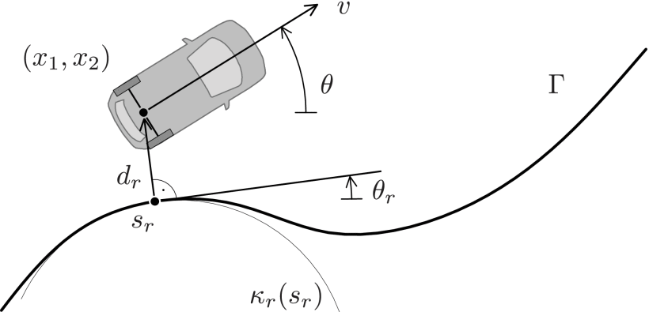
1. TRAJECTORY GENERATION
TRAJECTORIES
How can we compute a feasible trajectory?
The papers introduce some concepts like the curvature
Maybe there exists some advanced tool that can be used
michelangelo.pozza@studenti.units.it

Slide 5



1. TRAJECTORY GENERATION
TRAJECTORIES: ARCH-LENGTH PARAMETRIZATION
In practice, given a set of points in the Cartesian plane we can write the arc-length parametrization as:
michelangelo.pozza@studenti.units.it

Slide 6
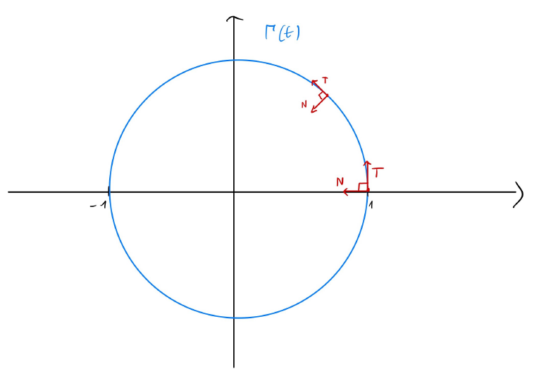

1. TRAJECTORY GENERATION
TRAJECTORIES: ARCH-LENGTH PARAMETRIZATION
Tangent and Normal vector
michelangelo.pozza@studenti.units.it

Slide 7
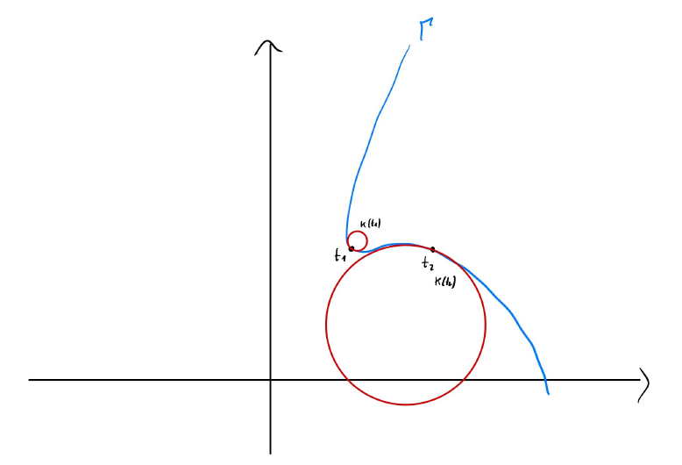

1. TRAJECTORY GENERATION
TRAJECTORIES: ARCH-LENGTH PARAMETRIZATION
The curvature!
michelangelo.pozza@studenti.units.it

Slide 8

1. TRAJECTORY GENERATION
TRAJECTORIES: ARCH-LENGTH PARAMETRIZATION
michelangelo.pozza@studenti.units.it

Slide 9
1. TRAJECTORY GENERATION
VELOCITY PROFILES
If we are in a straight road, it is very likely that we will go fast
If we are close to a curve, we may prefer to go slower and safer
Is there any way to generate a proper velocity profile?
Yes, but we will use constant velocities
michelangelo.pozza@studenti.units.it

Slide 10
2. VEHICLE PREDICTION MODEL
To predict and optimize the vehicle trajectory; we first need to find a mathematical model
The authors decided to consider a reference point on the car that coincides with the vehicle’s rear axle center to derive kinematic equations
Let’s plan the future vehicle motion locally
The goal is to optimize the vehicle’s lateral trajectory from the nominal one
michelangelo.pozza@studenti.units.it

Slide 11
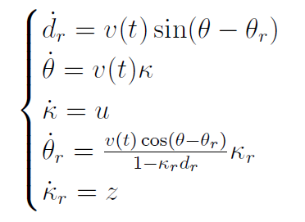
2. VEHICLE PREDICTION MODEL
Non-linear system’s equations
michelangelo.pozza@studenti.units.it

Slide 12


2. VEHICLE PREDICTION MODEL
We want to apply LMPC to control the system
Let’s linearize the non-linear system in every sampled point of the nominal trajectory
Assumptions:
michelangelo.pozza@studenti.units.it

Slide 13
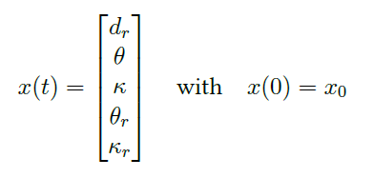

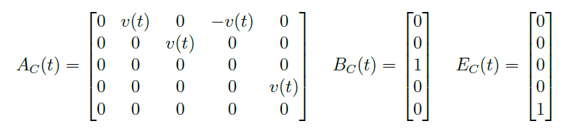
2. VEHICLE PREDICTION MODEL
Linear system’s equations
michelangelo.pozza@studenti.units.it

Slide 14
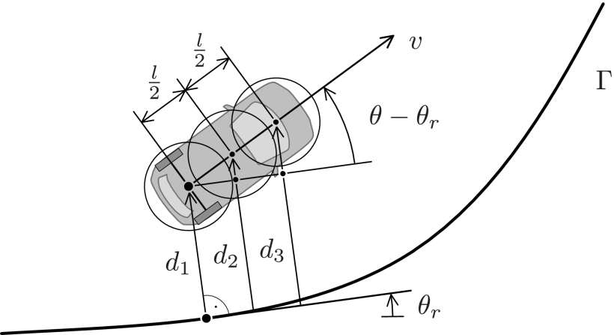
2. VEHICLE PREDICTION MODEL
Definition of the system outputs for an efficient formulation of system constraints
Three circle center points along the vehicle center line such that the vehicle shape is covered appropriately
michelangelo.pozza@studenti.units.it

Slide 15

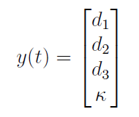
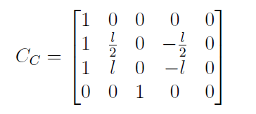
2. VEHICLE PREDICTION MODEL
Linear system’s output equations
michelangelo.pozza@studenti.units.it

Slide 16



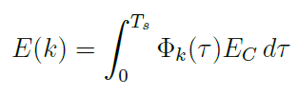
2. VEHICLE PREDICTION MODEL
Discretization of the system’s equations
michelangelo.pozza@studenti.units.it

Slide 17

2. VEHICLE PREDICTION MODEL
Discretization of the system’s equations
michelangelo.pozza@studenti.units.it

Slide 18
3. SYSTEM CONSTRAINTS
The generated trajectory is not isolated, when dealing with autonomous driving we need to take into account different objects:
Static obstacles: e.g. road lines
Dynamic obstacles: e.g. other traffic partecipants
CONSTRAINTS?
michelangelo.pozza@studenti.units.it

Slide 19
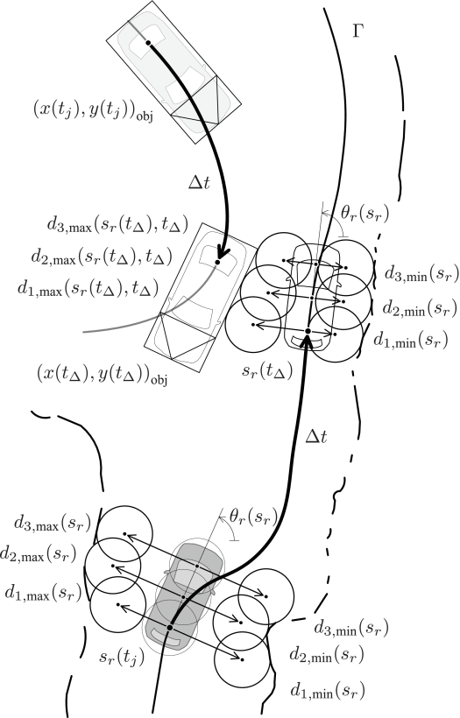
3. SYSTEM CONSTRAINTS
CONSTRAINTS
Circles are moved from both sides of the vehicle indicating their maximum (from left) and minimum (from right) values
In this case the vehicle is at the center of the lane and the obstacles are just the lines
michelangelo.pozza@studenti.units.it

Slide 20
3. SYSTEM CONSTRAINTS
CONSTRAINTS
Circles are moved from both sides of the vehicle indicating their maximum (from left) and minimum (from right) values
In this case the vehicle gets closer to the right lane to avoid the other vehicle
michelangelo.pozza@studenti.units.it

Slide 21


3. SYSTEM CONSTRAINTS
CONSTRAINTS
Input constraints -> derivative of curvature
Steering constraints from the Kamm’s circle
michelangelo.pozza@studenti.units.it

Slide 22
4. COST FUNCTION
The objective is formulated as the minimization of a cost function, the quadratic running cost:
We want to stay sollow (at least) the trajectory
The difference between the vehicle’s curvature and the trajectory’s curvature must be the lowest possible
It is preferrable to not steering often reaching the limits
It is preferrable to not do rapid changes in direction
michelangelo.pozza@studenti.units.it

Slide 23


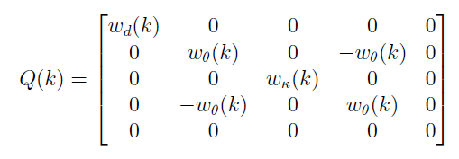

4. COST FUNCTION
michelangelo.pozza@studenti.units.it

Slide 24
5. CONSTRAINT OPTIMAL CONTROL PROBLEM
We need a formulation that is able to describe all the time instants if the horizon to solve it using a quadratic optimizer
The authors decided to use a dense formulation containing all the information from k to k+N
I decided also to change the dimension of the vectors and matrices to include the initial state and output in the optimization
michelangelo.pozza@studenti.units.it

Slide 25
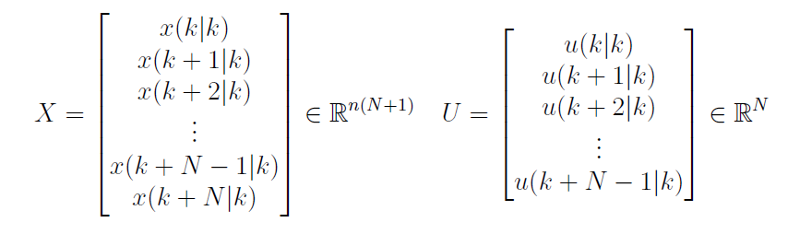
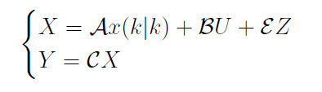
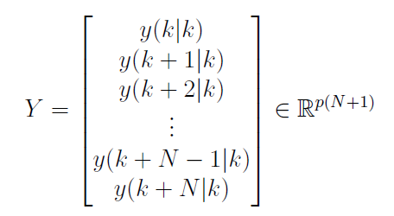
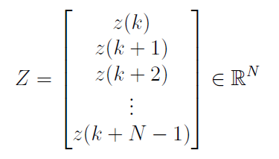
5. CONSTRAINT OPTIMAL CONTROL PROBLEM
New state-space description
michelangelo.pozza@studenti.units.it

Slide 26
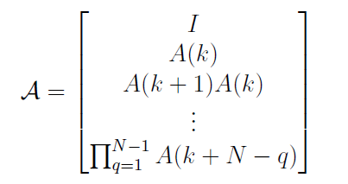
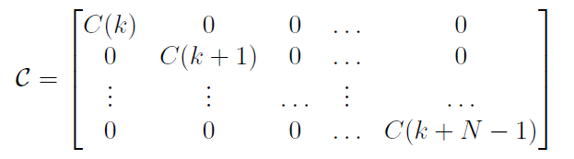

5. CONSTRAINT OPTIMAL CONTROL PROBLEM
New state-space description
michelangelo.pozza@studenti.units.it

Slide 27
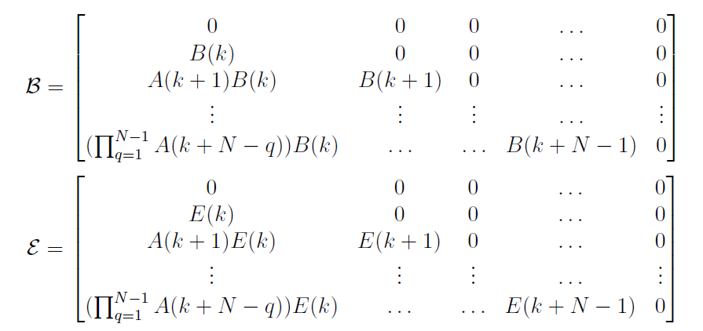
5. CONSTRAINT OPTIMAL CONTROL PROBLEM
New state-space description
michelangelo.pozza@studenti.units.it

Slide 28
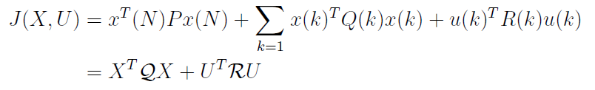
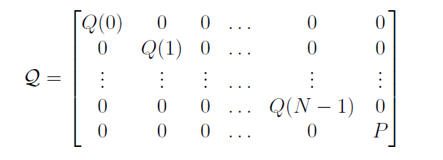
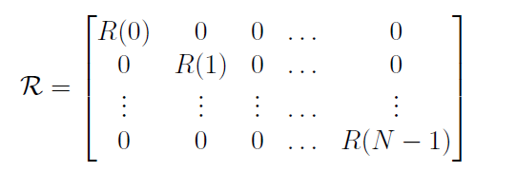
5. CONSTRAINT OPTIMAL CONTROL PROBLEM
New cost function
P is chosen with bigger weights than Q
michelangelo.pozza@studenti.units.it

Slide 29
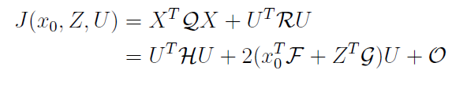
5. CONSTRAINT OPTIMAL CONTROL PROBLEM
New cost function
O is constant
michelangelo.pozza@studenti.units.it

Slide 30
5. CONSTRAINT OPTIMAL CONTROL PROBLEM
In order to avoid feasibility issues, the authors decided to use a technique to soft the constraints
They include some slack variables in the optimization problem
The motivation is due to the sensibility of the sensors which may detect the same object in two different position at consecutive time instants because of the noise
The output is soften only shortly before an obstacle is passed over a short prediction horizon Ns<<N
michelangelo.pozza@studenti.units.it

Slide 31
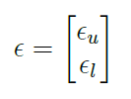




5. CONSTRAINT OPTIMAL CONTROL PROBLEM
Slack variables:
Modified cost:
Slack-variables weights:
michelangelo.pozza@studenti.units.it

Slide 32

5. CONSTRAINT OPTIMAL CONTROL PROBLEM
Let’s modify the vector sequence of output for separating the soft outputs and the hard outputs
michelangelo.pozza@studenti.units.it

Slide 33
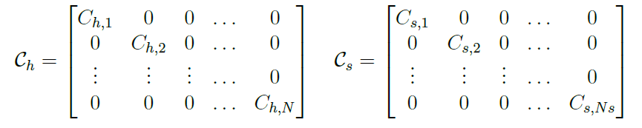
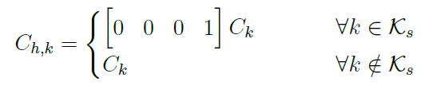

5. CONSTRAINT OPTIMAL CONTROL PROBLEM
michelangelo.pozza@studenti.units.it

Slide 34
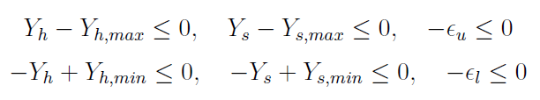
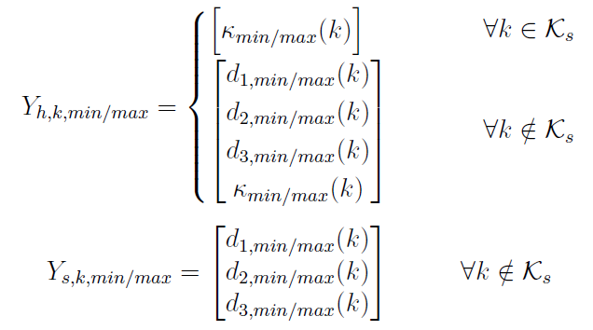
5. CONSTRAINT OPTIMAL CONTROL PROBLEM
Let’s modify also the constraints
michelangelo.pozza@studenti.units.it

Slide 35

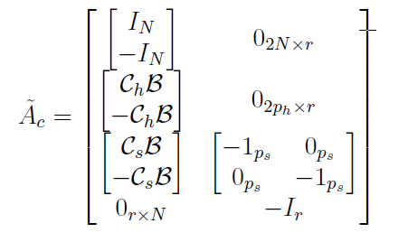
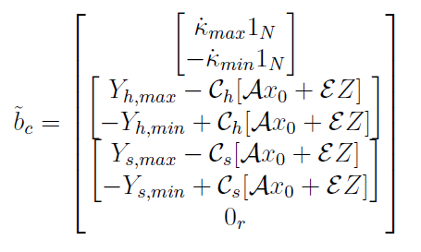
5. CONSTRAINT OPTIMAL CONTROL PROBLEM
Dense form of the system constraints
michelangelo.pozza@studenti.units.it

Slide 36
6. RESULTS
The tested the code in three different environments
The results of the paper show perfectly the optimization of the trajectory in different conditions
I simulate four different environments:
Straigth road with obstacle
Sine() road
Roundabout
Parking scenario with different objects
michelangelo.pozza@studenti.units.it

Slide 37
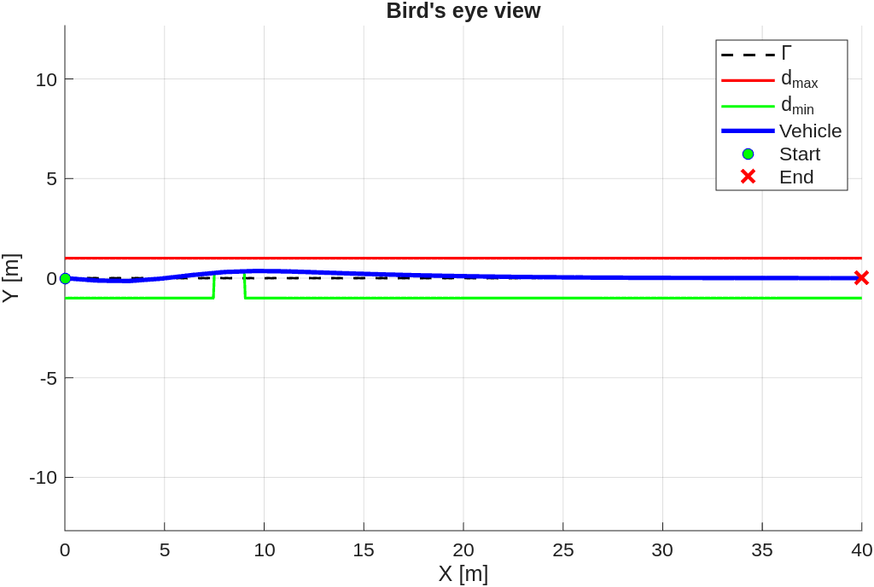
6. RESULTS
STRAIGHT ROAD
40m of straight road
Mamimum velocity of 8m/s because of an unplanned object
michelangelo.pozza@studenti.units.it

Slide 38
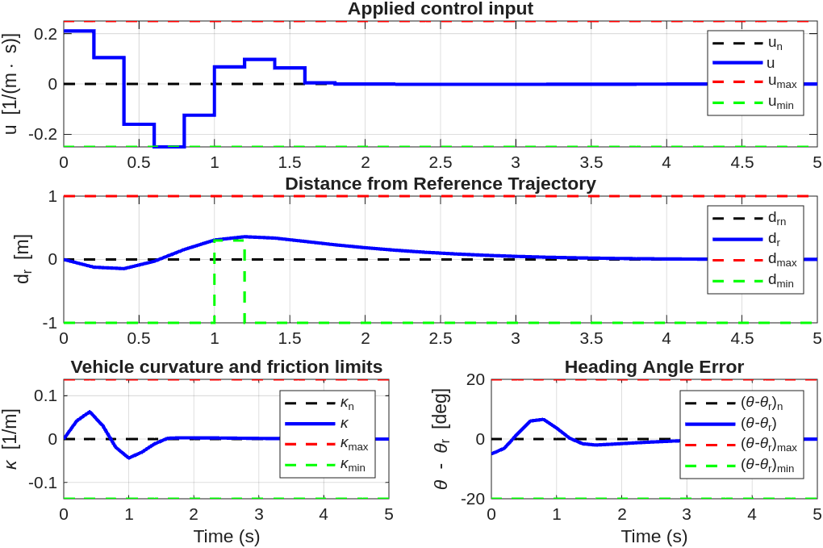
6. RESULTS
STRAIGHT ROAD
40m of straight road
Mamimum velocity of 8m/s because of an unplanned object
michelangelo.pozza@studenti.units.it

Slide 39
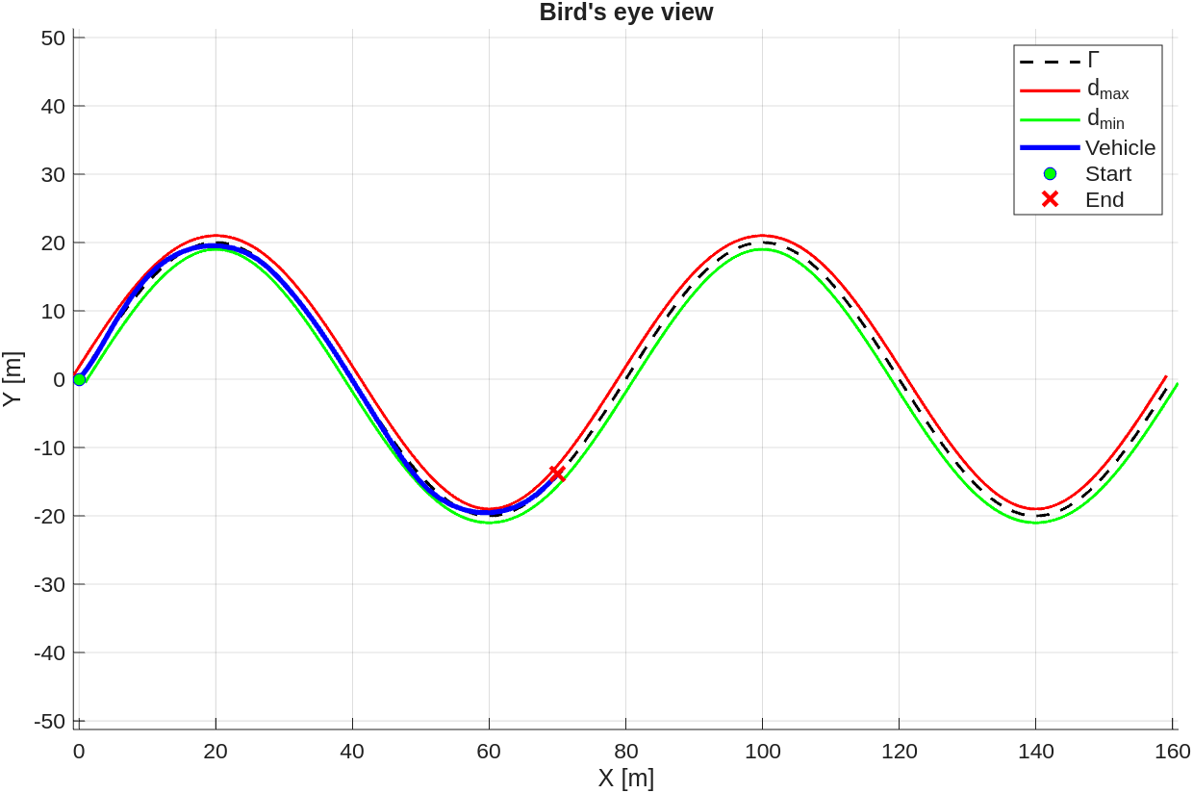
6. RESULTS
SINE() ROAD
60m of generated by a sine() function
Amplitude of 2
Wavelength of 30m
Mamimum velocity of 20m/s because there are no obstacles
michelangelo.pozza@studenti.units.it

Slide 40
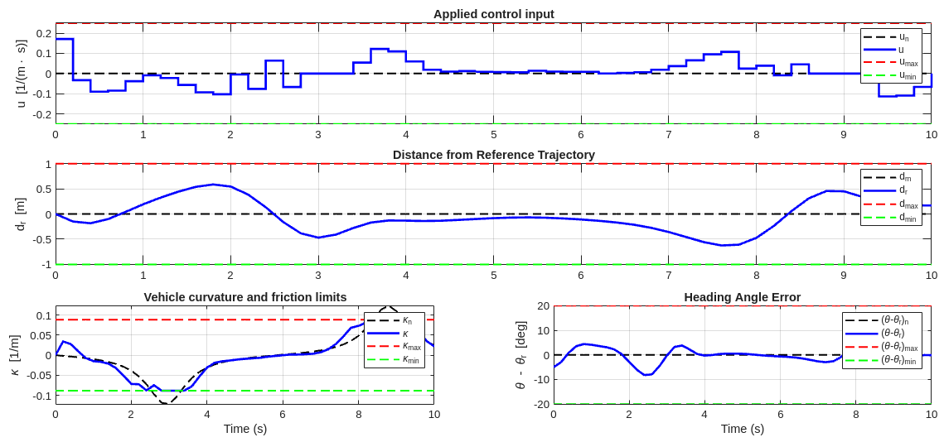
6. RESULTS
SINE() ROAD
60m of generated by a sine() function
Amplitude of 2
Wavelength of 30m
Mamimum velocity of 20m/s because there are no obstacles
michelangelo.pozza@studenti.units.it

Slide 41
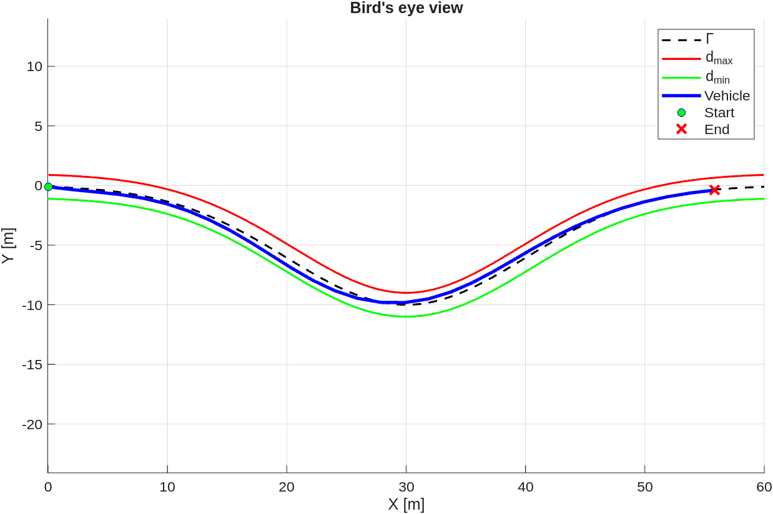
6. RESULTS
ROUNDABOUT
60m of generated by a exp() function
Amplitude of 6
Mean of 30m
Variance of 5m
Mamimum velocity of 20m/s because there are no obstacles
michelangelo.pozza@studenti.units.it

Slide 42
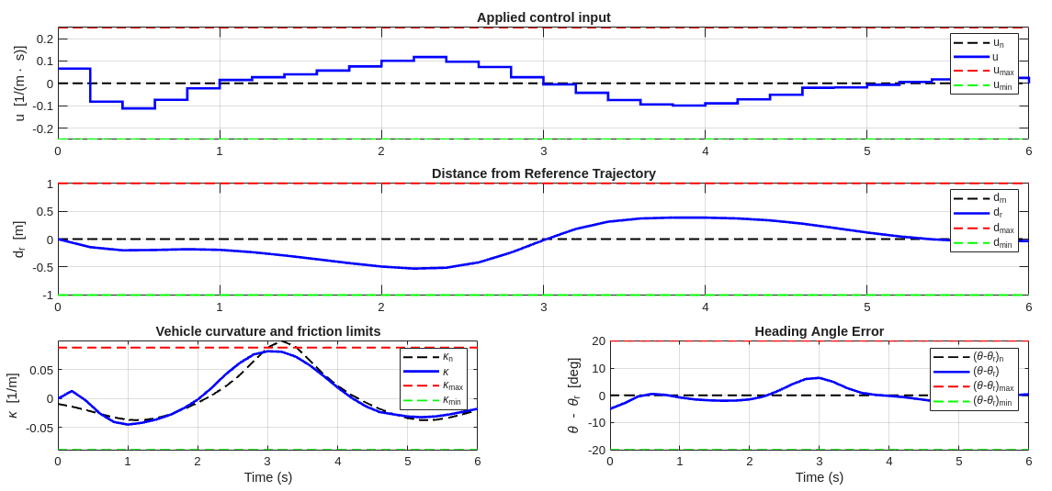
6. RESULTS
ROUNDABOUT
60m of generated by a exp() function
Amplitude of 6
Mean of 30m
Variance of 5m
Mamimum velocity of 20m/s because there are no obstacles
michelangelo.pozza@studenti.units.it

Slide 43
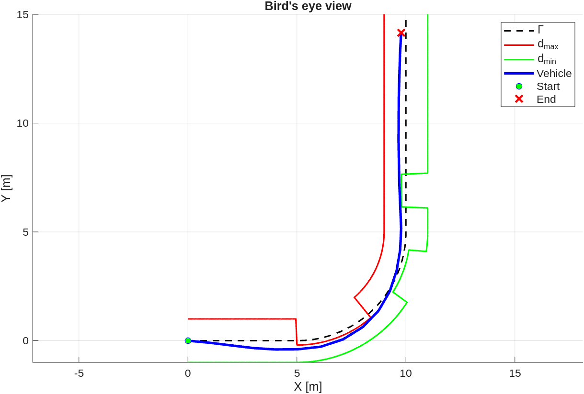
6. RESULTS
PARKING SCENARIO
Conjuction of two straight road with a circumference
Mamimum velocity of 5m/s because there are a lot of obstacles
michelangelo.pozza@studenti.units.it

Slide 44
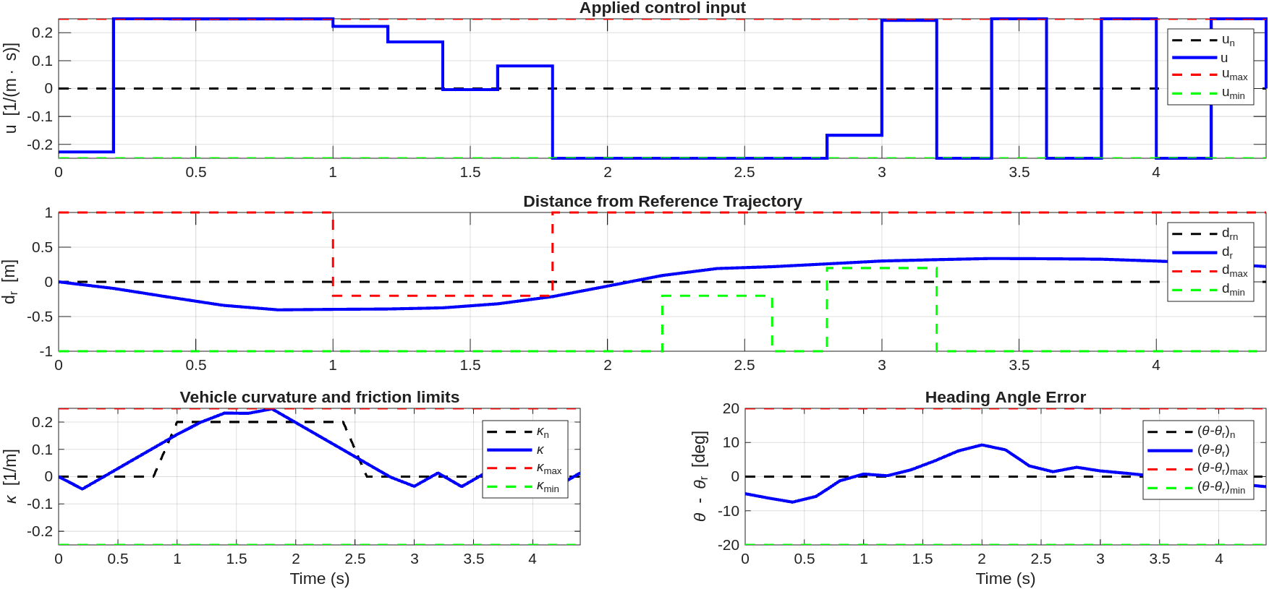
6. RESULTS
PARKING SCENARIO
Conjuction of two straight road with a circumference
Mamimum velocity of 5m/s because there are a lot of obstacles
michelangelo.pozza@studenti.units.it

Slide 45
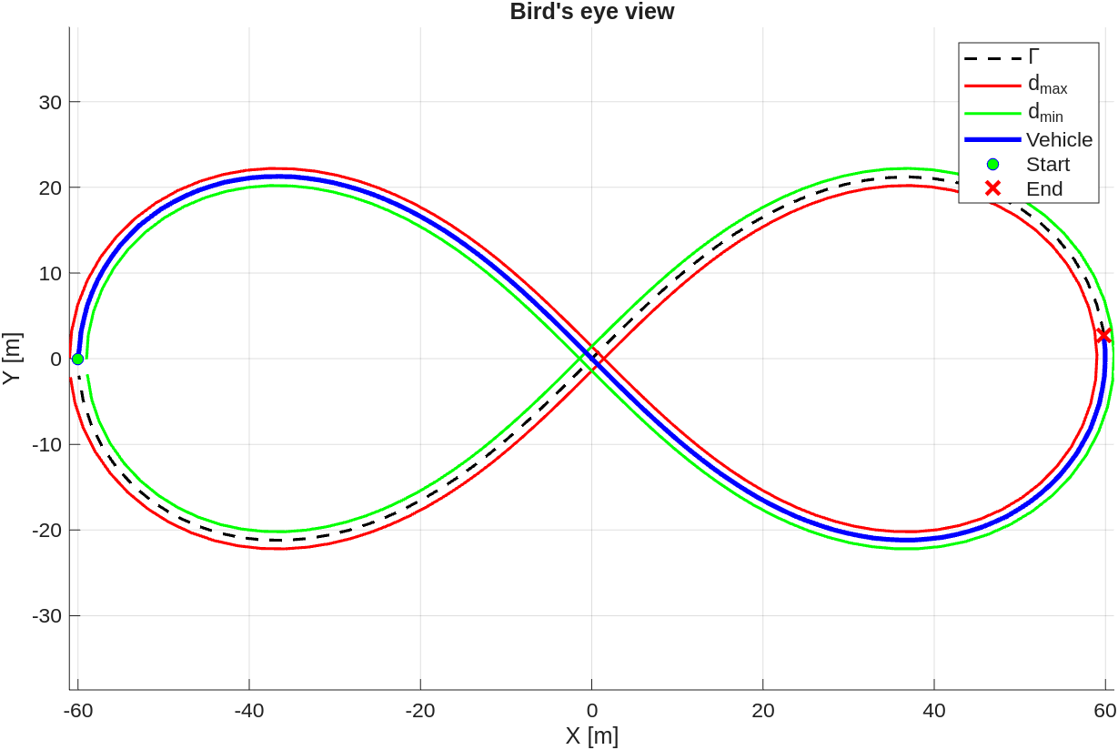
6. RESULTS
LEMNISCATE
...
michelangelo.pozza@studenti.units.it

Slide 46
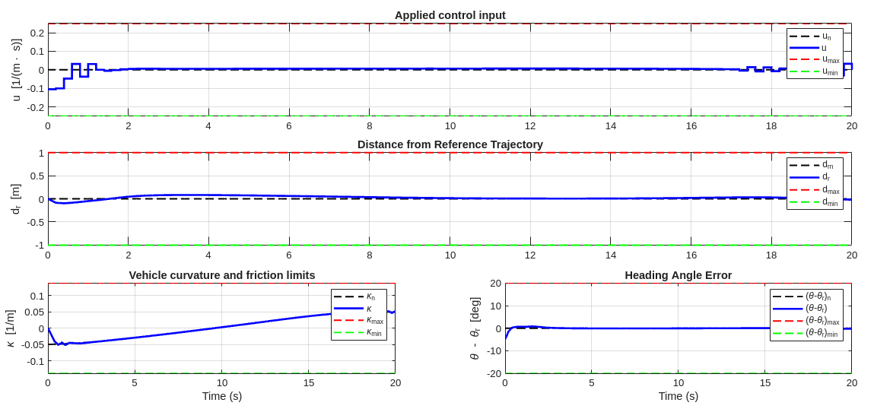
6. RESULTS
LEMNISCATE
...
michelangelo.pozza@studenti.units.it

Slide 47
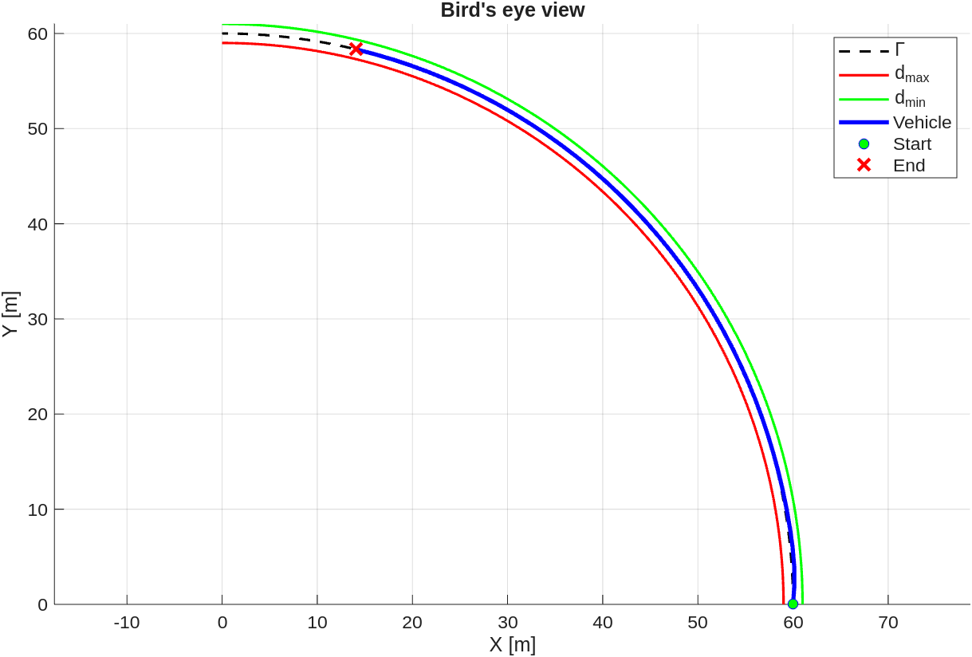
6. RESULTS
SIMPLE CURVE
...
michelangelo.pozza@studenti.units.it

Slide 48
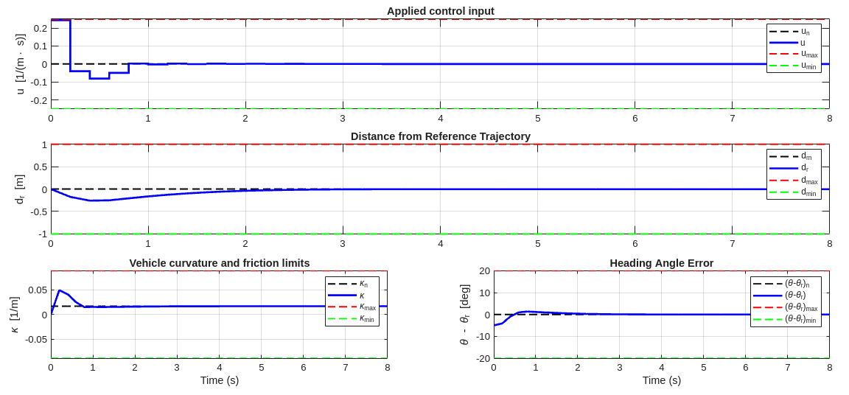
6. RESULTS
SIMPLE CURVE
...
michelangelo.pozza@studenti.units.it

Slide 49
CONCLUSION
Difficulty to generate real world curves with good properties
LMPC worked well on the non-linear system
Slack variables guarantees a good margin of feasibility
Stability assumed to be true using some empirical choices like P and N
Authors implement the code in C over a on-board pc and tested it in real-world environment
The simulation seems to work well, the vehicle was able to avoid obstacles while optimizing the nominal trajectory
michelangelo.pozza@studenti.units.it

Slide 50
THANKS!

