Slide 1

Project 3: Drug Related Crime
By: Kyle Admire, Michel Axel Gnancalo, David Ma, Yonas Michael

Slide 2


objective
We want to see where arrests with drugs involved were happening and by who.
As well as which drugs were most prevalent in drug arrests

Slide 3
Course of Action
Find Data
Filter Data, Clean, and Reduce Data
Establish Connection to SQLite Database
Prepare Python Flask
Begin Web-Design
JavaScript manipulation for plotly graphics and leaflet maps

Slide 4
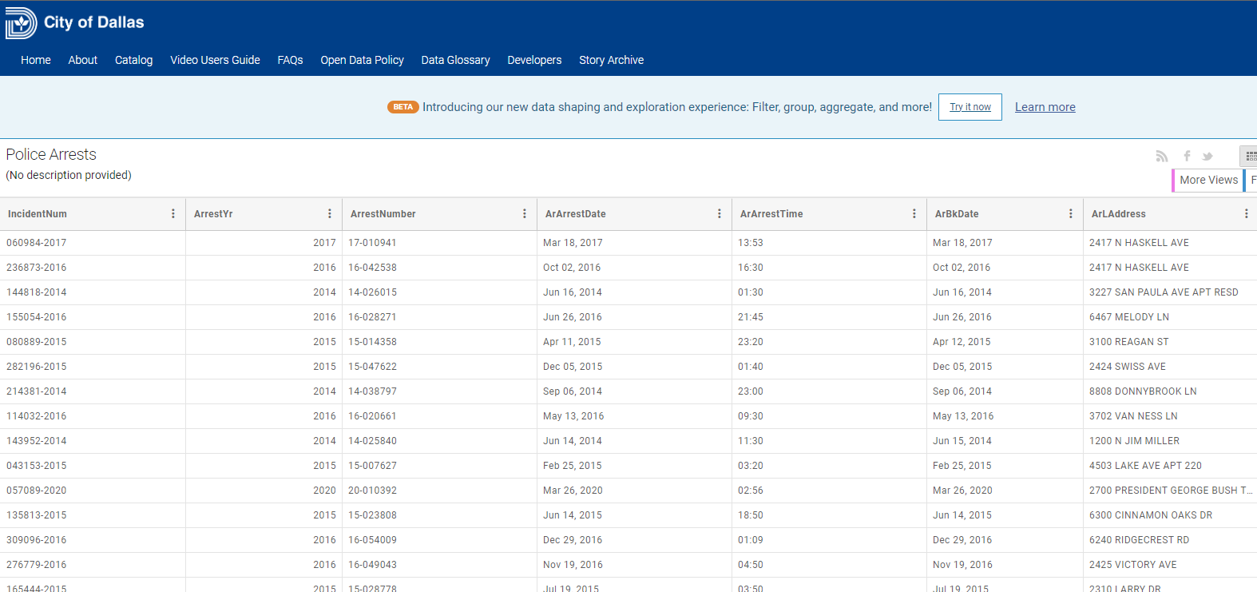
Find Data
Police Arrests | Dallas OpenData

Slide 5
Filter Data, Clean, and Reduce Data
Using Jupyter Notebook
Data filter for only drug arrests
Began with 65 columns reduced to 11
Certain columns formatted for easier manipulation
Retrieved the latitude and longitude with GeoPy library

Slide 6
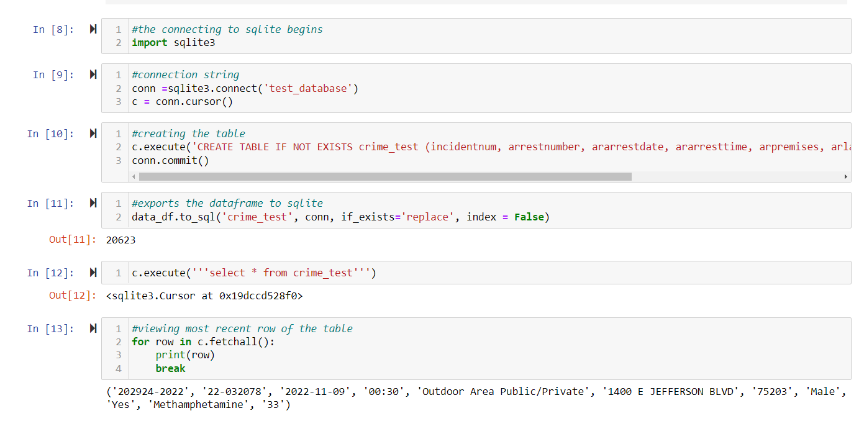
Connecting to SQLite database

Slide 7

Filter SQLite Database
Created a function called json_data to create a JavaScript file from data based on Today, past week, past Month, and past year timeframes

Slide 8
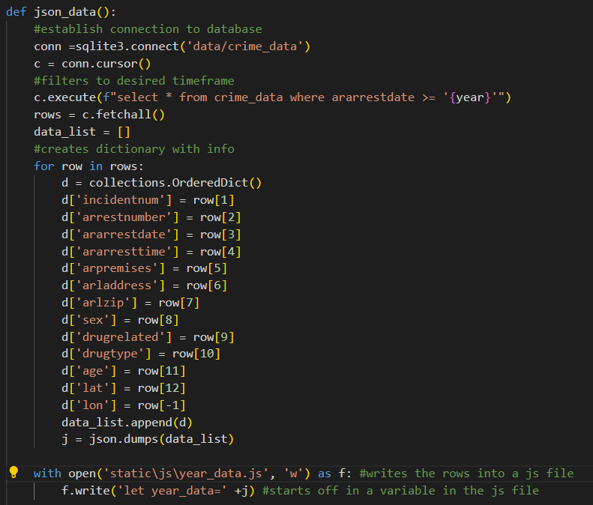
Snippet of json_data function

Slide 9
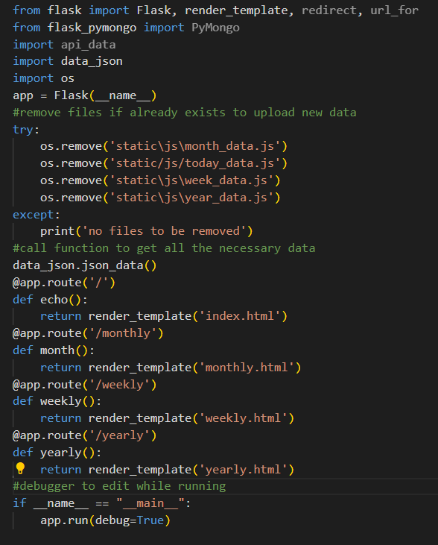
Prepare Python Flask

Slide 10
Web-Design (HTML)
Using Bootstrap:
Created buttons for users to filter between the different timeframes
Created a button to access the raw data

Slide 11
JavaScript
Plotly
Created bar graph based on drugs
Created pie based on gender
Leaflet
heatmap plugin
markercluster plugin

