Slide 1
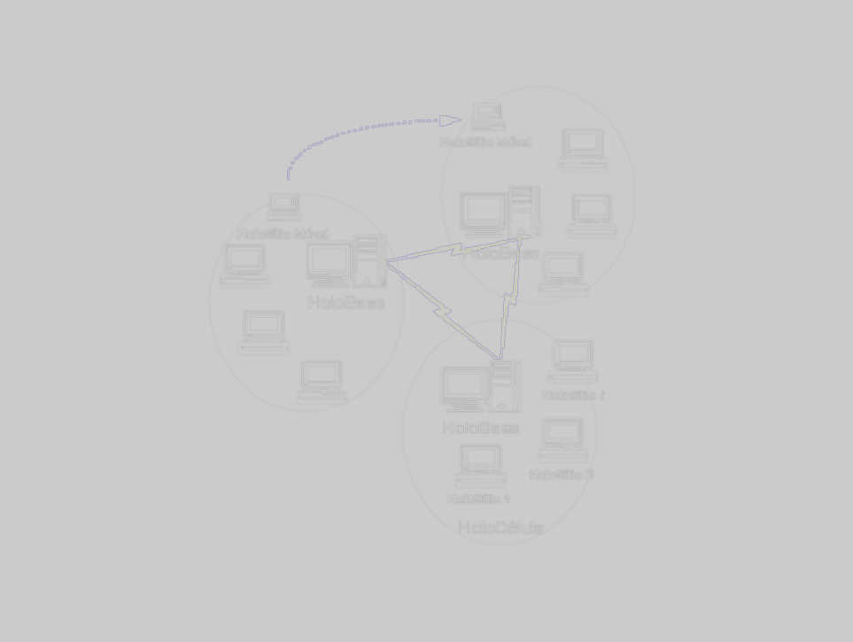
ISAM/EXEHDA Pervasive Computing Infrastructure
Marko Petek
Institute of Informatics - UFRGS
PASI, Mendoza - May, 2005

Slide 2
Summary
Summary
  view of ISAM
  pervasive computation
  adaptation notion
  view of Exehda
  current works

Slide 3
What is ISAM?
ISAM is a proposal
  of an integrated solution
  from development to execution
  for building Pervasive Applications
Pervasive Applications are
  Distributed
  Mobile
  Context aware, i.e. they are able to adapt to the current execution context
    The meaning of “context” is application-specific

Slide 4
CONCEPTS
Pervasive computation
Aspects
  Computation largerly spread on the environment
  Users are mobile
  Computation centered on the user, to serve his tasks.
Project AURA (Carnegie Mellon)
Project OXIGEN (MIT)
Project GAIA(Illinois at Urbana-Champaign)

Slide 5
CONCEPTS
Pervasive computation
User interface
  different modalities of interfaces
Distributed services
  adapted to the user and his tasks
  adapted to the dynamic changes on the environment state
  Automatic discovery of services and resources
  Network based services

Slide 6
CONCEPTS
Pervasive Computation: some current issues
Infra-structures
  Dynamically configured
  Restrictions imposed by the environment: intermittent and unpredictable network connections, low capacity of storage and processing on the devices, high possibility of loss (and robbery) of the devices, high consumption of battery by computational tasks, …
  Anticipate the user action

Slide 7
CONCEPTS
Context aware computation
Aplications with a behaviour determined by the context state (Context-Aware Computing)
Several definitions for the word ‘context’
To our system, a context element is:
  “all relevant information to an application that this one can obtain”.
  “all element which, after a change on its states, triggers an addaptation process on the application”.
  Example: user activity, localization, number of appliances, kind of appliances, computional power needs, resources that can be used...
Particular vision of each application
  Different interests in different momments
  Different interpretation of some given information

Slide 8
CONCEPTS
Grid computing
Main Components
Aplications and portals
Aplications
scientific
engineering
colaboratives
Web
based
...
Tools and development environments
...
Tools
languagens
debugers
ORBs
libraries
Web
Basic services
...
Data access
Middleware
comunication
safet
information
QoS
Local resources managers
OS
libraries
TCP, UDP, IP
...
Factory dispositives
Shared resources among VO
clusters
storage
...

Slide 9
BUILDING THE PERVASIVE GRID
New computational environment
PDAs, desktops, workstations, clusters, supercomputers...
Several operational systems
Network computing
High
heterogeneity

Slide 10
BUILDING THE PERVASIVE GRID
New computational environment
Logical mobility: software
Physical mobility: user and appliances
Computação
de
rede
Elevada
Logical and physical
mobility
heterogeneidade

Slide 11
BUILDING THE PERVASIVE GRID
New computational environment
Follow-me semantic
independent of equipment, place or time
Computação
Services and data
disponibility
de
rede
Elevada
Mobilidade
heterogeneidade
lógica e física

Slide 12
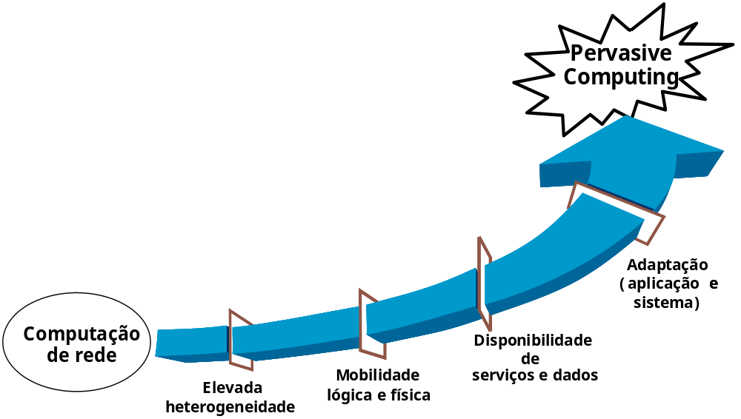
BUILDING THE PERVASIVE GRID
New computational environment
Context adaptation:
execution environment and applications

Slide 13



Towards Pervasive Computing
ISAM* - Support Infrastructure to Mobile Applications
*Infra-estrutura de Suporte às Aplicações Móveis
Pervasive
Distributed
Computing
Context Awareness (Application and System)
Classic Network
Computing
Mobility (Software and Hardware)
Grid
Concepts
High System Heterogeneity

Slide 14
BUILDING THE PERVASIVE GRID
Integrating concepts
Pervasive computation
+
Grid computation
+
Context aware computation
Proposed view
Infra-structure to
Pervasive Grid

Slide 15
BUILDING THE PERVASIVE GRID
Integrating concepts
Wide Area Dist. Computing
Grid Computing
A pervasive view
in Distributed
Computing
Wireless Networks
Global Access
Adaptability
WalkStations
Portable Devices
Context-Aware Applications
Mobile Computing

Slide 16
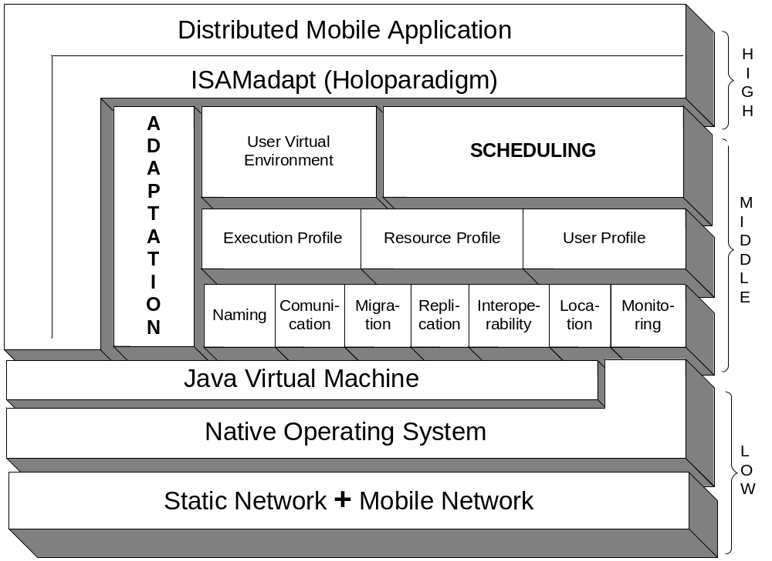
ISAM Software Architecture

Slide 17
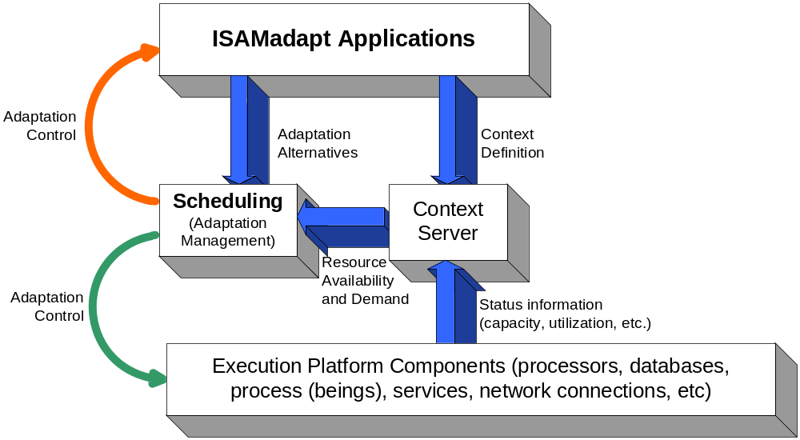
Adaptation Model
Multilevel Collaborative Adaptation
Development decisions

Slide 18
Adaptation Model
Multilevel Collaborative Adaptation
Execution decisions

Slide 19
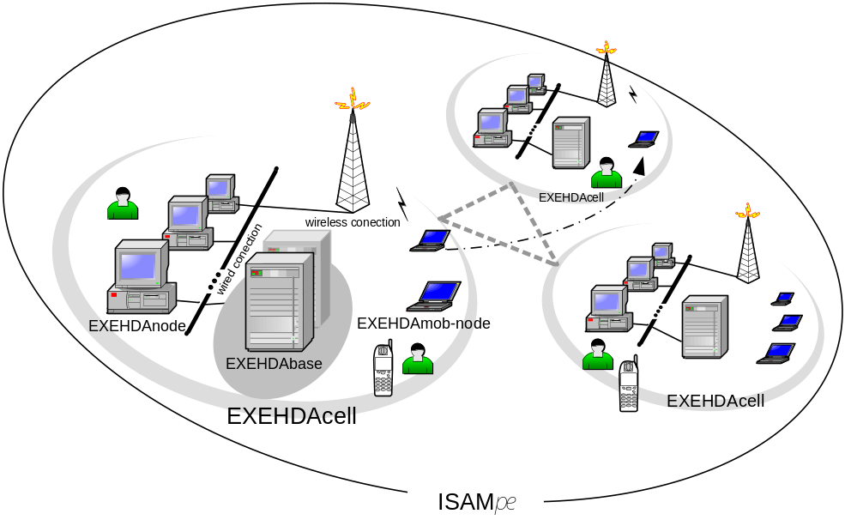
Implementation technologies
ISAMpe Hardware:
Wide Area Networks + Walkstations
System language:
C, C++, Visual C, Java
Applications language:
ISAMAdapt Java

Slide 20





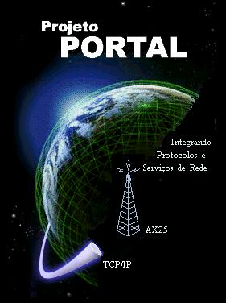
ISAM Framework
Sub-Projects
Logical Mobility
HOLOPARADIGM
Context awareness;
Programming-time adaptation
ABSTRACTION LEVEL
Pervasive aplications management;
Run-time adaptations
Resource Scheduling using
(Baysian Networks)
TiPS
Remote Instantiation of Objects
Resource Monitoring
Wide-area Wireless
Packet-Radio System.

Slide 21
Main Products
ISAMAdapt programming model
  thesis
  2 versions
    Holo extensions
    Java package
      classes, methods
  context specification
    graphical interface
    context server (deamon)
Exehda architecture
  thesis

Slide 22
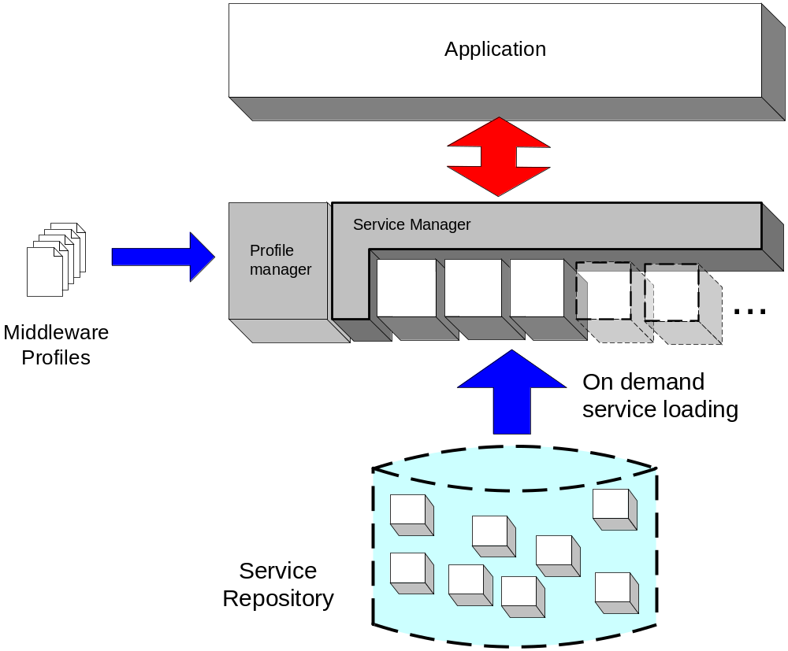
EXEHDA: an adaptive middleware
On demand load of services
  Optimization of resource consumption
Adaptive Services
  middleware profiles define which instance of a service should be used in a specific device (load time adaptation)
  The service may adapt also with respect to dynamic contexts like connectivity state (run time adaptation)
Notes:
EXEHDA é o middleware da plataforma ISAM
baseado em serviços carregados sob demanda e de forma adaptativa

Slide 23
Exehda Current Works
Resource and discovery management
  P2P protocols and algorithms
  master work
  dynamic and heterogeneous platform
Application monitoring
  focus on broadcast (difusion)
  master work
Lazy tasks
  including JL Roch ideas for adaptive task size
  lazy Primos object creation
  methods for getting remote results
  new system level scheduling
    distributed

Slide 24
Exehda Current Works
Fault-tolerant Grid applications
  master work
Execution of Grid application graph (Grand)
  by Exehda application (or high level middleware)
  master work

Slide 25
ISAM Milestones
Development in Grid Computing and/or Mobile Computing:
  made using specific middlewares (ad-hoc applications);
  made by teams of specialists.
Reality
Target
How to build a programming environment that removes the programmer’s tasks of managing the complexity of context-aware applications?
How to design an execution environment that automatically adapts the application to the context's changes?
Whenever possible, improve the efficiency of the execution

Slide 26
Some Lessons Learned
1- Adaptive behavior of the parallelism:
Provided by:
  detection of new processors;
  code installation under demand;
  use of anonymous and asynchronous communications.
ISAM allows that the number of processors involved with the application can be altered during the execution

Slide 27
Some Lessons Learned
2 - Increase of the medium parallelism:
Consequence of the:
  decrease in the waiting time at synchronization barriers;
  decrease in the communications cost for the fastests processors;
  automatic tuning of per processor workload.
Selective delivery of load, considering the computational power of the involved processor.

Slide 28
ISAM Team
PhDs
  Iara Augustin (ISAMadapt)
  Adenauer Yamin (EXEHDA)
PhD Students
  Luciano Cavalheiro da Silva
  Marko Petek
Msc Students
  Alberto Shaeffer Filho (Resource Discovery)
  Maurício Moraes (Monitoring)
  Lucas Santos
  Felipe Weber Fehlberg
  Gustavo Frainer
Collaborator
  Lincoln Moraes (MSc)

Slide 29
Final Considerations
Hardware and Software Mobility
Context awareness Adaptability
Modular concept easy integration of:
  new components or;
  modified components;
      Components = applications codes, schedulers, sensors...
Pluggable infrastructure framework:
  expandable by the system programmer;
  expandable by the user.
Targeted long-lived applications:
  scientific code; information servers, interactive services, etc.

